Slide 1
AUTOMATED STUDENT SCORECARD GENERATOR
Guide Name : Name : Dipak Yadav
Mr. Bibhuti Bhusan University Roll No : 2005080100036 (Assistant Professor) B.Tech(3rd Year ) CS31

Slide 2
Introduction
Python offers multiple options for developing a GUI (Graphical User Interface). Out of all the GUI methods, Tkinter is the most commonly used method. It is a standard Python interface to the Tk GUI toolkit shipped with Python. Python with Tkinter outputs the fastest and easiest way to create GUI applications. Creating a GUI using Tkinter is an easy task.
To create a Tkinter:
Importing the module – Tkinter
Create the main window (container)
Add any number of widgets to the main window
Apply the event Trigger on the widgets.

Slide 3
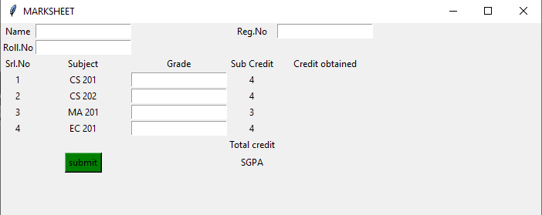
This is how the GUI would look:

Slide 4
Objective
Create a python GUI mark sheet. Where credits of each subject are given, enter the grades obtained in each subject and click on Submit. The credits per subject, the total credits as well as the SGPA are displayed after being calculated automatically. Use Tkinter to create the GUI interface.
Its major purpose of that to create a Mark Sheet by using TKINTER for GUI with Python language.

Slide 5
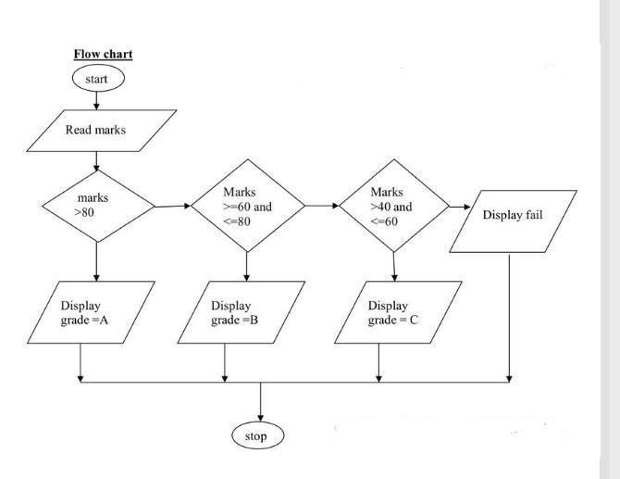
Flow chart

Slide 6
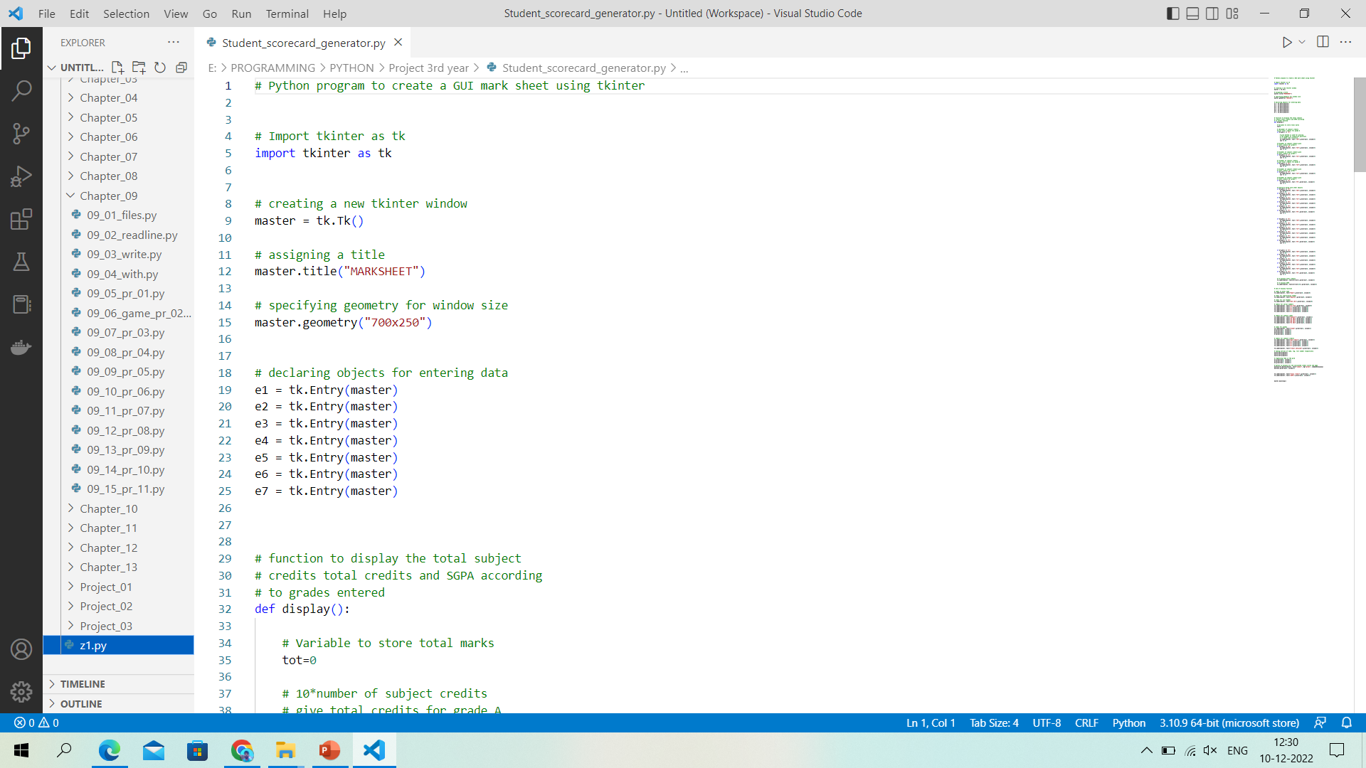
Implementation

Slide 7
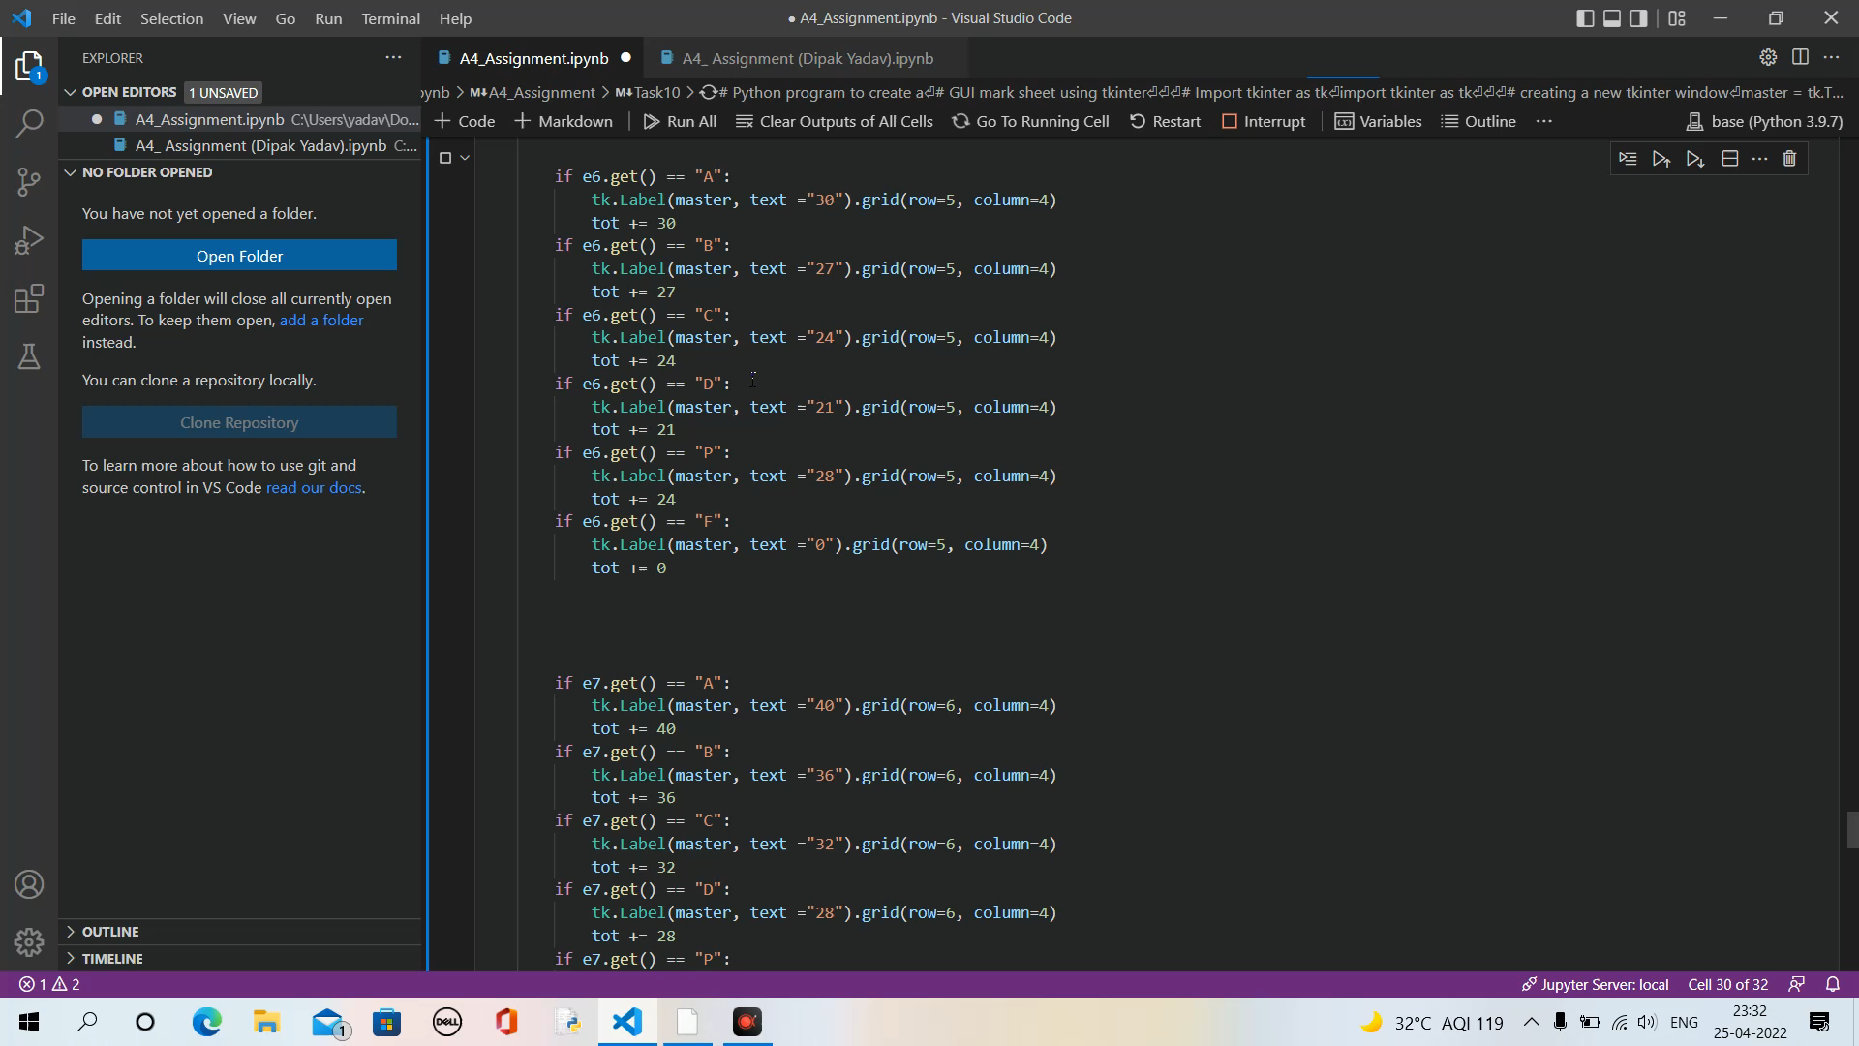
Output

Slide 8
SYSTEM REQUIREMENTS
Hardware Requirement :
i3 processor system minimum
4GB RAM minimum
100GB ROM
Software Requirement :
Python (Programming Language)
VS Code
Jupyter Notebook

Slide 9
REFERENCE
The reference of this project has been taken from several sites. These reference played a vital role in finding key points and gave an important idea that how this project can be further carried out. It is give better by me. There are some sites given below :
https://www.geeksforgeeks.org/python-create-a-gui-marksheet-using- tkinter/https://en.wikipedia.org/wiki/One-time_password
https://www.youtube.com/watch?v=hYZy2cEn378

Slide 10
Thank You

