Slide 1

Department of CSE(Artificial Intelligence)
Optimizing Airline Fare Predictions with Machine Learning Algorithms
PRESENTED BY
Sk.Gousya Famina
Y.Anjali
G.Archana Devi
(21471A4352)
(21471A4364)
(21471A4319)
Under the Guidance of,
Tinnavalli Venkata Manohar _{M.Tech},
Assistant Professor,
Department of Computer Science and Engineering,
Narasaraopeta Engineering College (Autonomous), Narasaraopet- 522 601.
Review No.2
Department of CSE(AI)

Slide 2
OUTLINE
Abstract
Introduction
Literature Survey
Research Gaps
Problem Statement
Objectives
Block Diagram / Flow Diagram
Methodology
Implementation
Result & analysis
References
Review No.2
Department of CSE(AI)

Slide 3
ABSTRACT
We aim to address the dynamic nature of airline ticket pricing within the highly organized airline industry.
Despite the sector's structure, ticket prices remain variable, influenced by diverse factors. This variability leads passengers on the same flight paying different fares causing revenue losses & customer dissatisfaction.
Our objective is to develop a predictive model capable of capturing the intricate relationships among various factors affecting flight ticket costs. Ultimately fostering operational decision-making and customer satisfaction.
Review No.2
Department of CSE(AI)

Slide 4
INTRODUCTION
The study compares the performance of Random Forest and Decision Tree Regressors.
Key performance metrics used include MAE, RMSE, and R².
The dataset includes over 10,000 records with attributes like airline, journey date, route, and stops.
Data preprocessing ensures quality by handling missing values and encoding categorical variables.
The project aids airlines in revenue management and customers in optimizing booking decisions.
Review No.2
Department of CSE(AI)

Slide 5
LITERATURE SURVEY
No | Title | Author | Journal Name & Year | Methodology Adapted | Key Findings | Gaps
1 | A Machine Learning Based Approach to Predicting Flight Fares for Indian Airlines | Dr. R. Srinivasan | International Conference on Innovations in Engineering and Technology (ICIET), 2023. | Data Preprocessing, Regression models such as Random Forest, Extra Trees, Support Vector Regression (SVR), eXtreme Gradient Boosting (XGBoost), and K-Nearest Neighbors. | Identified significant features like total stops, flight duration, and timing for accurate fare prediction. | Expand datasets with more features and consider external macroeconomic factors.
2 | A Novel Approach to Predict Flight Fares in India Using SOM-LSSVM Model Approach | Umanesan R Ajay S Bhongade | International Conference on Electronics, Computing, Communication, and Control Technology (ICECCC), 2024. | Combines Self-Organizing Maps (SOM) for clustering and Least Square Support Vector Machine (LSSVM) for regression, forming the hybrid SOM-LSSVM model. | The hybrid approach provided better stability and convergence for time-series forecasting compared to other models. | Time remaining before departure was identified as the most significant factor affecting airfare predictions.
Review No.2
Department of CSE(AI)

Slide 6
No | Title | Author | Journal Name & Year | Methodology Adapted | Key Findings | Gaps
3 | A Prediction of Flight Fare Using K-Nearest Neighbors | S. Naveen Prasath Dr. Sathish Kumar MMs. Sherin Eliyas | 2022 2nd International Conference on Advance Computing and Innovative Technologies in Engineering (ICACITE) | K-Nearest Neighbors (KNN) Algorithm: Used for predicting flight fare based on historical data, leveraging machine learning regression techniques. | Visualization of data trends helped identify patterns in pricing fluctuations, such as variations on weekends, holidays, and different times of the day. | Future plans include deploying the model in a user-friendly web application to provide real-time predictions.
4 | Prediction of Flight Fares Using Machine Learning | Nimmaraju Naga Srujana | International Conference on Electronics, Computing, Communication, and Control Technology (ICECCC), 2024. | Training models using Random Forest, Decision Tree Regression, and Linear Regression. | Visualization insights reveal travel trends (e.g., popular airlines, source/destination cities, price distribution). | Only one dataset was used (flight_fare.csv from Kaggle), which might limit generalizability.
Review No.2
Department of CSE(AI)

Slide 7
RESEARCH GAPS
Limited Scope to Domestic Market: The study focuses only on the Indian domestic airline market, limiting the generalizability of findings to international markets.
Static Historical Data: The research primarily uses historical flight data and lacks integration with real-time data sources like social media trends, economic indicators, or weather conditions, which could enhance prediction accuracy.
Feature Expansion: Although feature engineering is performed, additional features such as customer behavior, booking window trends, or airline-specific marketing campaigns are not considered.
Real-Time Model Deployment: The paper does not discuss implementing the model in a live, real-time environment, which could present unique challenges and opportunities.
Review No.2
Department of CSE(AI)

Slide 8
PROBLEM STATEMENT
The dynamic and highly variable nature of airline ticket pricing poses a significant challenge for both airlines and consumers. Airlines aim to optimize their revenue through complex pricing strategies, while consumers struggle to identify the best times and options for booking flights.
The unpredictable fluctuations in ticket prices, influenced by multiple factors such as demand, routes, departure timings, and airline-specific policies, make accurate price prediction a complex task.
This study seeks to address the challenge by leveraging machine learning algorithms, specifically Random Forest and Decision Tree Regressors, to predict flight fares based on historical data.
Review No.2
Department of CSE(AI)

Slide 9
OBJECTIVES
Develop a Reliable Prediction Model: To create machine learning models capable of accurately predicting airline ticket prices based on historical data.
Compare Algorithm Performance: To evaluate and compare the performance of Random Forest and Decision Tree Regressors in terms of accuracy, error metrics, and reliability.
Optimize Airline Pricing Strategies: To assist airlines in optimizing their revenue management by understanding pricing trends and customer behavior.
Enhance Customer Decision-Making: To empower consumers with tools to identify the optimal time and conditions for booking flights.
Review No.2
Department of CSE(AI)

Slide 10
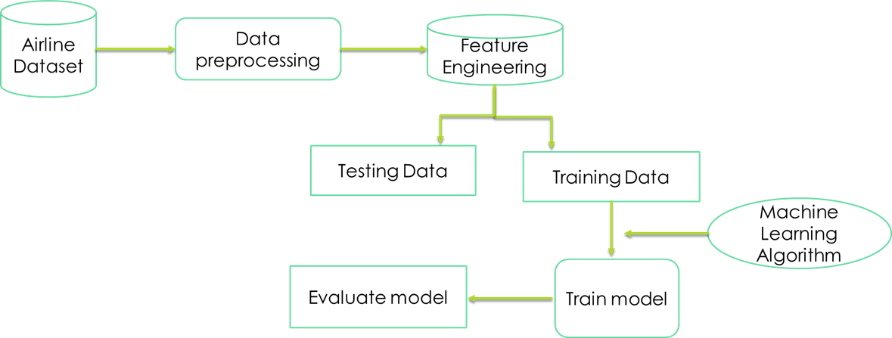
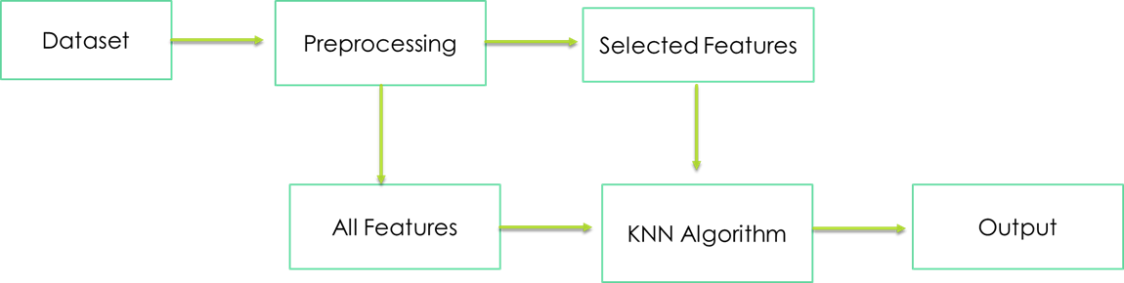
BLOCK DIAGRAM OR FLOW DIAGRAM
EXISTING SYSTEM ARCHITECTURE PROPOSED SYSTEM ARCHITECTURE
Review No.2
Department of CSE(AI)

Slide 11
METHODOLOGY
Dataset Description:Utilize a dataset containing over 10,000 records with features like airline, journey date, source, destination, route, departure and arrival times, total stops, and fare price.These attributes are crucial for analyzing fare patterns and building predictive models.
Data Preprocessing:
Handling Missing Data: Identify and impute missing values using mean or mode for numerical and categorical variables, respectively.
Removing Duplicates: Eliminate duplicate records to ensure dataset integrity.
Standardizing Data: Normalize or standardize numerical features to maintain scale consistency.
Encoding Categorical Variables: Convert categorical features like airline and route into numerical representations using one-hot or label encoding.
Feature Engineering:Extract additional features such as flight duration, day of the week, and whether the flight occurs during peak or off-peak hours.
Exploratory Data Analysis (EDA):Visualize and analyze data distributions to understand the impact of variables like the number of stops or airline type on fare prices.
Review No.2
Department of CSE(AI)

Slide 12
Model Selection:Choose Random Forest Regressor and Decision Tree Regressor for their ability to handle complex relationships and provide feature importance insights.
Model Training:Split the dataset into training and testing sets (e.g., 80% training, 20% testing).Train the models using historical data to capture patterns in fare fluctuations.
Hyperparameter Optimization:Use Randomized Search CV to optimize hyperparameters such as the number of estimators, maximum depth, and minimum samples split for the Random Forest model.
Model Evaluation:Evaluate model performance using the following metrics:
Mean Absolute Error (MAE): Measures the average absolute error of predictions.
Mean Squared Error (MSE) and Root Mean Squared Error (RMSE): Quantify prediction deviations, with RMSE emphasizing larger errors.
R² Score: Determines how well the model explains variance in the target variable.
Review No.2
Department of CSE(AI)

Slide 13
IMPLEMENTATION
Tools and Technologies:
• Programming Language: Python
• Libraries Used: NumPy, Pandas, Scikit-learn, Matplotlib, Seaborn
• Platform: Jupyter Notebook or Google Colab
Environment Setup
• Install required libraries: NumPy, OpenCV, Matplotlib
Dataset Preparation
• Download the dataset from the referenced source.
• Organize the dataset into folders for training, and testing (80% training, 20% testing).
Model Building
Select appropriate machine learning models based on the problem type, Regression models: Random Forest, Decision Tree.
Train the models using the training dataset.
Use cross-validation to ensure the model generalizes well.

Slide 14
Hyperparameter Tuning
Optimize model performance by fine-tuning hyperparameters using methods like: Grid Search or Randomized Search.
Test combinations of parameters (e.g., number of estimators, maximum depth).
Model Evaluation
Evaluate the trained model on the test dataset using metrics such as:
R² (coefficient of determination).
Mean Absolute Error (MAE).
Mean Squared Error (MSE) or Root Mean Squared Error (RMSE).
Mean Absolute Percentage Error (MAPE).
Model Comparison
Train multiple models like Decision Tree, Random Forest and compare their performance.
Select the best-performing model based on evaluation metrics.

Slide 15
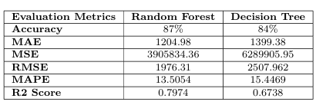
RESULTS & ANALYSIS
The table presents a comparison of evaluation metrics between two machine learning models: Random Forest and Decision Tree.
Random Forest outperforms Decision Tree across most metrics, achieving a higher accuracy (87% vs. 84%) and a better R2 Score (0.7974 vs. 0.6738), indicating better predictive power.

Slide 16
CONCLUSION AND FUTURE SCOPE
Random Forest Outperforms Decision Tree – The study confirms that the Random Forest model (87% accuracy) is more reliable and precise than the Decision Tree model (84% accuracy) due to its ensemble learning capability, which reduces overfitting and improves generalization.
Machine Learning Optimizes Airline Pricing – Predictive models using historical flight data help airlines dynamically adjust ticket prices based on demand patterns, market trends, and seasonal variations, leading to better revenue management and competitive pricing.
Benefits for Consumers – Accurate fare predictions empower travelers to strategically plan their bookings, leading to cost-effective travel decisions and improved financial savings.

Slide 17
Integration of Real-Time Data for Enhanced Accuracy – Future research can incorporate economic indicators, social media trends, weather conditions, and geopolitical events to make fare prediction models more adaptive to market fluctuations.
Advancements in Deep Learning and Hybrid Models – Exploring Artificial Neural Networks (ANNs), LSTMs, Transformer-based models, and hybrid approaches (e.g., combining XGBoost with deep learning) can improve predictive accuracy by capturing complex airfare trends.
Global Expansion and Personalized Fare Recommendations – Extending fare prediction models to international airline markets will improve their applicability, while AI-driven personalized pricing systems can offer customized flight recommendations based on user preferences and behavior.

Slide 18
REFERENCES
J. Daniel, B. Kanisha, P. Meenakshi, U. Agrawal, and S. Ramakrishnan, “Improv ing Accuracy for Flight Fare Prediction using Random Forest Algorithm,” in 2023 11 14th International Conference on Computing Communication and Networking Technologies (ICCCNT), July 2023, pp. 1–9.
M. Mulkalla and A. Joshi, “Predicting the Fare of a Flight Ticket with Machine Learning Algorithms,” in 2022 International Conference on Cyber Resilience (ICCR), October 2022, pp. 1–5.
V. Dixit and R. Srinivasan, “A machine learning based approach to predicting f light fares for Indian airlines,” in 2023 international conference on innovations in engineering and technology (ICIET), July 2023, pp. 1–5.
N. S. S. V. S. Rao and S. J. J. Thangaraj, “Flight Ticket Prediction using Ran dom Forest Regressor Compared with Decision Tree Regressor,” in 2023 Eighth International Conference on Science Technology Engineering and Mathematics (ICONSTEM), April 2023, pp. 1–5.

Slide 19
THANK YOU

