Slide 1
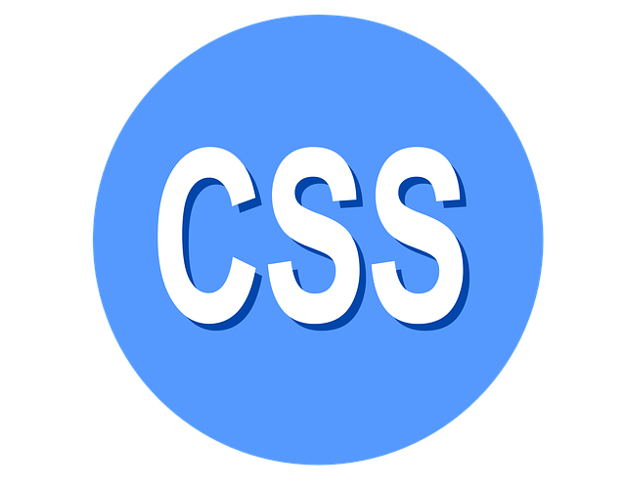
WHAT IS CSS ?
CSS, or Cascading Style Sheets, is a style sheet language used to describe the presentation and layout of HTML (Hypertext Mark up Language) documents.
It enables web developers to separate content from design, allowing for greater control over how elements appear on a webpage.

Slide 2

Key Features of CSS
Styling: CSS defines the visual appearance of HTML elements, including colours, fonts, spacing, and layout.
Selectors: CSS uses selectors to target specific elements in an HTML document, allowing for customized styling (e.g., by element type, class, or ID).
Box Model: Every element in CSS is treated as a box, which includes content, padding, borders, and margins. This model is crucial for layout and spacing.
Responsive Design: CSS supports media queries, enabling styles to adapt based on device characteristics, such as screen size or resolution.
Flexibility: CSS allows for various layout techniques (like Flex box and Grid) and enables transitions and animations for dynamic user experiences.
Reusability: With features like classes and custom properties (variables), CSS promotes code reusability and maintainability.

Slide 3
CSS Syntax
Basic Structure
selector { property: value; }
CSS is made up of selectors and declaration blocks.
Selector: targets HTML elements (e.g., h1, .class, #id).
Declaration Block: contains properties and their values (e.g., color: blue;).

Slide 4
CSS SELECTORS
Types of Selectors
Universal Selector : Targets everything or every element in the document.
Element Selector: Targets HTML elements
(e.g., div, p).
Class Selector: Targets elements with a specific class
(e.g., .classname).
ID Selector: Targets elements with a specific ID
(e.g., #idname).
Attribute Selector: Targets elements with specific attributes
(e.g., [type="text"]).

Slide 5
Responsive Design with CSS
Media Queries: Allow CSS to apply different styles based on device characteristics (screen size, resolution).
Enhances user experience on mobile devices and tablets.
Example:- @media (max-width: 600px) {
body {
background-color: lightblue; }}

Slide 6

WELCOME TO

Slide 7
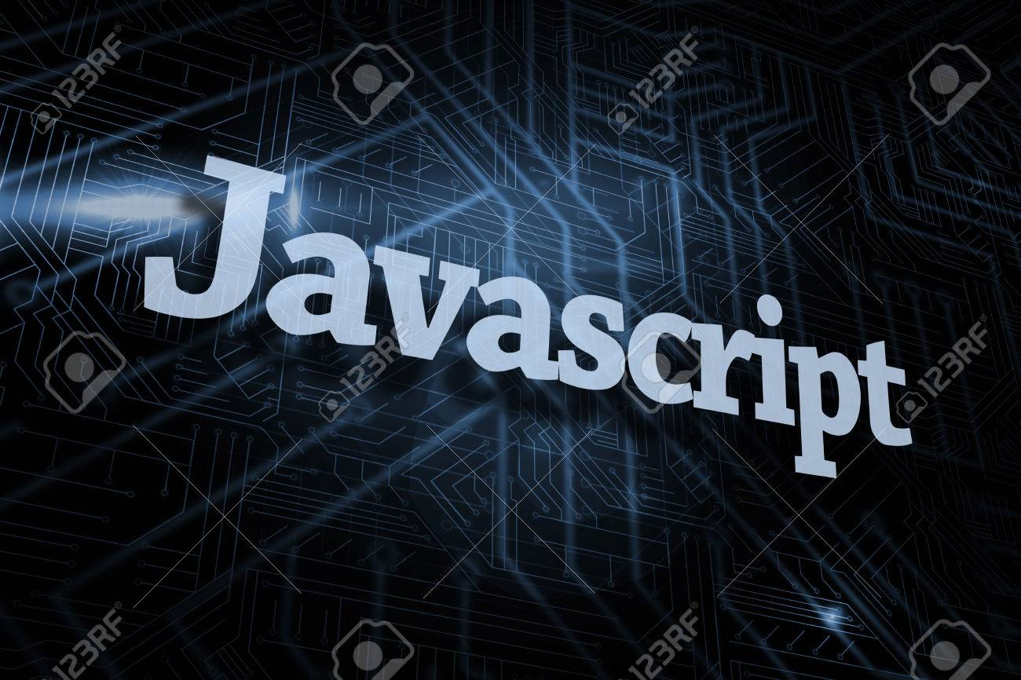
What is JavaScript?
Definition: JavaScript is a high-level, dynamic, untyped, and interpreted programming language.
Use Cases: Primarily used for client-side web development, but also on the server side (e.g., Node.js).
Creation: Developed by Brendan Eich in 1995.
Evolution: Originally named Mocha, then Live Script, and finally JavaScript.
ECMAScript standardization started in 1997.

Slide 8
How JavaScript Works ?
Client-side vs Server-side
Client-side: Runs in the browser; manipulates the DOM.
Server-side: Runs on the server; handles database operations, etc.
Execution: Interpreted by JavaScript engines (e.g., V8 in Chrome).

Slide 9
ADDING JAVASCRIPT
Inline
Internal
External
COMMENTS
Single Line Comment :- //……//
Multiple line Comments :- /*……*/
VARIABLES
Var:- Function-scoped or globally-scoped. If declared outside a function, it is available globally; if declared inside a function, it is only available within that function.
let:-Block-scoped, meaning it is only available within the block (e.g., within { } ) where it is defined.
Const:-Cannot be re-declared or updated. Must be initialized at the time of declaration.

Slide 10
DATA TYPES
Strings :- (e.g : a= “Hello World”;)
Number:- (e.g : a= 5; )
Boolean:- (e.g : Num= True/False ;)
Undefined:- (e.g : let a; console.log(a);)
Null:- Null Values
OPERATORS
Arithmetic Operators :- + , - , / , % , ++ , --
Assignment Operators :- = , +=, -=, *=, /=, %=, **=
Comparison Operators :- ==, ===, !=, !==, < ,>, <=, >=
Logical Operators :- && , || , !
Conditional (Ternary) Operator :- condition ? expr1 : expr2
PRIMITIVE DATATYPE
NON PRIMITIVE DATATYPE
Array
Object

Slide 11
If-Else Ladder
if ( Condition1 ){ };
else if ( Condition2 ){ };
else { Statement } ;
SWITCH-CASE
Switch( Condition ){
case 1 : code to be executed ;
case 2 : code to be executed ;
break;
default: code to be executed if above value are not matched; }
LOOPS
For
While
Do-While
For in
For of

Slide 12
FUNCTION
Predefined Function
User defined Function
Syntax of function :- function function name ([arg 1, arg2 ,....argn])
{ // code to be executed }
ARRAY
By Array Literals :- arr = [ a, b, c,......,n];
By New Keyword :- var arr = new Array( );
arr [0] = 1;
arr [1] = 2;
By Constructors :- var arr = new Array(‘1’, ‘2’, ‘3’);

Slide 13

DOCUMENT OBJECT MODEL
DOM represents the HTML structure of a web pages as a tree of objects. JavaScript is use to manipulate these objects called Nodes.
EVENT :- It’s a specific action that occurs within a web pages (e.g :- onclick , mouse holder, etc )

Slide 14
Example of DOM
<!DOCTYPE html>
<html lang="en">
<head>
<meta charset="UTF-8">
<meta name="viewport" content="width=device-width, initial-scale=1.0">
<title>DOM Example</title>
</head>
<body>
<h1 id="myHeader">Hello, World!</h1>
<button id="changeTextButton">Change Text</button>
<script>
// Select the header element and button
const header = document.getElementById('myHeader');
const button = document.getElementById('changeTextButton');
// Add an event listener to the button
button.addEventListener('click', function() {
// Change the text of the header
header.textContent = ‘Hello Everyone!';
});
</script>
</body>
</html>

Slide 15
ARRAY
An array in JavaScript is a special type of object used to store multiple values in a single variable. Arrays can hold items of any type, including numbers, strings, objects, or even other arrays. They are ordered, meaning the elements are indexed, allowing for easy access and manipulation.
E.g :- let fruits = ['apple', 'banana', 'cherry’];
METHODS OF ARRAY
Push(): Adds one or more elements to the end.
pop() : Removes the last element.
Shift () :Removes the first element.
Unshift(): Adds one or more elements to the beginning.
METHODS OF STRING
charAt(index) : Returns the character at the specified index.
charCodeAt(index) : Returns the Unicode of the character at the specified index.
replace(searchValue, newValue) :Replaces the first occurrence of a specified value with a new value. And so on ..

Slide 16
OBJECTS IN JAVASCRIPT
An object is a data structure that allows you to store collections of data and more complex entities. Objects are essential for organizing and managing data in a meaningful way.
Objects can be created by 3 ways :
Object Literal :-> e.g: let person = { name: 'Alice', age: 30
Using “new Object” :-> e.g: let car = new Object();
car.make = 'Toyota’;
car.model = 'Camry'; car.year = 2021;
3. Using Constructor Functions :-> e.g: function Person(name, age) {
this.name = name;
this.age = age;
this.greet = function() {
console.log(`Hello, my name is ${this.name}.`); }; }
let person1 = new Person('Alice', 30);
Object Literal
Using “new Object”
Using Constructor Functions

Slide 17
THANK YOU
By Yadav ji

