Slide 1
AI Resume Analyzer
To Improve Employability Among Graduates
Y. Neha (24091D0504)
Guided by: Dr. R. Kaviarasan
Dept. of CSE, RGMCET

Slide 2
ABSTRACT
The AI Resume Analyzer is an advanced tool designed to automate and optimize the resume screening process using state-of-the-art Natural Language Processing (NLP) techniques and similarity algorithms.
In the current recruitment landscape, hiring managers are often overwhelmed by the volume of resumes they receive for job openings, which leads to time consuming manual screenings and the potential for overlooked candidates.
The AI Resume Analyzer addresses these challenges by automating the initial review process, reducing manual screening time by up to 80%.
This innovative tool not only saves significant time and resources for employers but also enhances the overall efficiency and accuracy of candidate selection.

Slide 3
EXISTING METHOD
Existing systems for AI-based resume analysis primarily utilize machine learning and NLP techniques to automate resume screening and evaluation.
Traditional methods focus on keyword-based filtering and rule-based criteria to shortlist candidates.
These systems rely heavily on predefined templates and keyword matching, which often miss out on context and relevance in candidate profiles.
Moreover, existing systems often lack real-time feedback mechanisms to help candidates optimize their resumes for ATS compatibility.

Slide 4
PROPOSED METHOD
This system focuses on providing real-time feedback to candidates, ensuring their resumes are optimized for ATS compatibility.
It incorporates machine learning models trained on diverse datasets, enhancing adaptability across industries and job roles.
The system will offer actionable insights, such as keyword optimization suggestions and formatting guidelines, helping candidates improve their resumes in real time.
The focus is on creating an adaptable, scalable, and user friendly solution that bridges the gap between candidates and recruiters.

Slide 5
Tools & Technologies
Python, Streamlit
• MySQL, Scikit-learn
• NLP (TF-IDF, BERT)
• Text extraction: PyPDF2, docx2txt

Slide 6
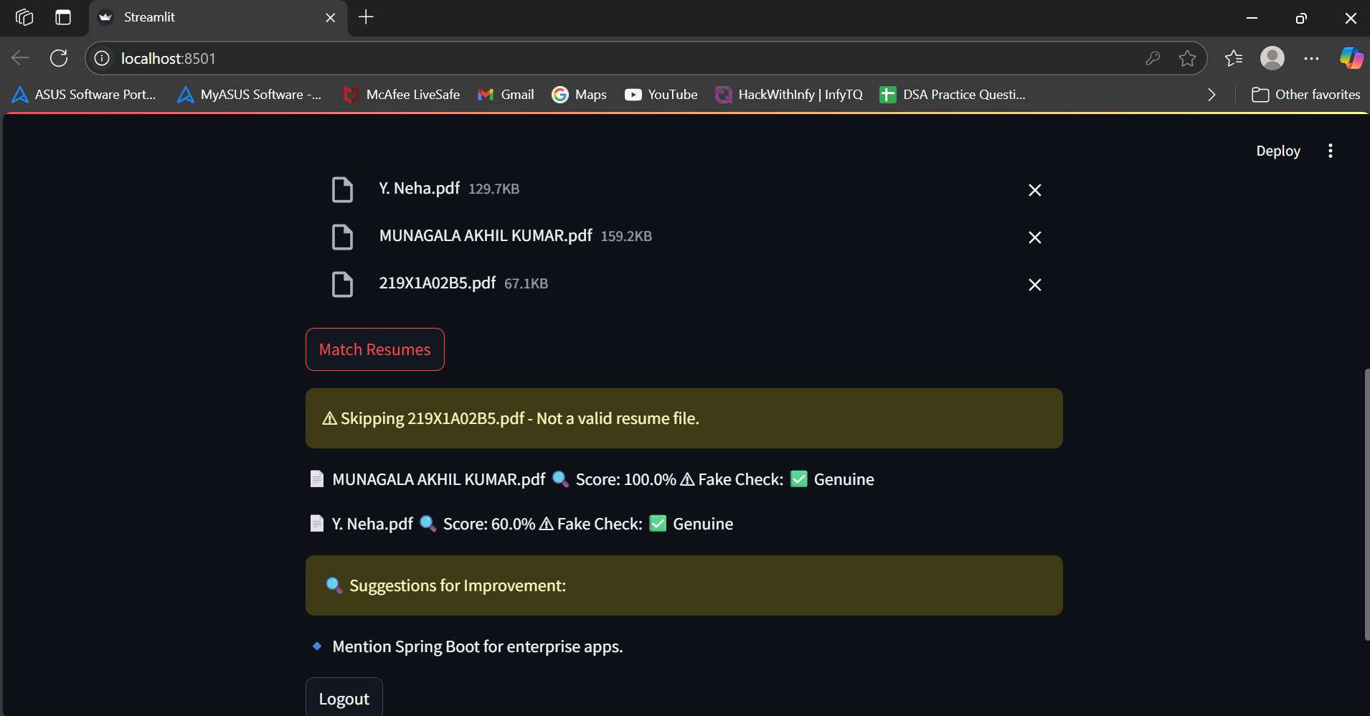
rESULTS

Slide 7
Conclusion
• Automated Resume Matching: Utilizes advanced NLP techniques like TF-IDF vectorization and cosine similarity to accurately compare resumes with job descriptions and generate prediction scores.
• User-Friendly and Secure: Includes a secure login system and supports multiple resume formats (PDF, DOCX), ensuring ease of use and data protection.
• Smart Insights and Suggestions: Offers personalized improvement suggestions and fake check analysis to enhance resume quality and credibility.
• Efficient and Scalable Solution: Streamlines the recruitment process by providing valuable insights for both candidates and recruiters, making it suitable for large-scale applications

Slide 8
FUTURE SCOPE
Mobile Application: Create a mobile version of the application for enhanced accessibility and convenience.
Advanced Fake Check Mechanism: Enhance the fake check system to perform deeper analysis, such as verifying credentials and detecting inconsistencies in provided data.
Expanded File Format Support: Extend support to additional file formats like HTML and JSON for broader compatibility.
Cloud Integration: Enable cloud storage for uploaded resumes and job descriptions, ensuring better scalability and access.

Slide 9
REFERENCES
Sharma, S., Sethi, A., & Shirbhate, A. (2022). Resume Builder & Analyzer. International Journal of Emerging Technologies and Innovative Research.
Mirajkar, R. R., Shinde, G. R., Shelke, P. M., Yadav, S., Shinde, B., & Shinde, G. (2024, December). Skill Recommendation System and Resume Analysis using AI. In 2024 IEEE Pune Section International Conference (PuneCon) (pp. 1-3). IEEE.
Prashanth, V. J., Gopinath, S., Udith, S., & Kavitha, C. R. (2024, July). Resume Analyzer and Skill Enhancement Recommender System. In 2024 Asia Pacific Conference on Innovation in Technology (APCIT) (pp. 1-6). IEEE.
Revillod, G. (2024). Implementation of AI Recruitment Systems in Swiss HRM: The Importance of Technological and Organizational Factors. Journal of Human Resource Management, 27(2), 95-122.

Slide 10
THANK YOU

