Slide 1
PROJECT PRESENTATION
Vehicle Repair Management System
A simple portal for repair requests, progress and bills.
Three roles: Customer, Admin and Mechanic.
Built with Python, Django, SQLite and HTML/CSS/JavaScript.
Presented by
Abhay 123B1D057
Yadnesh 123B1D034
Anushka 123B1D027
Vehicle Repair Management System |
01 / 10
Notes:
Introduce the workshop problem: keep requests, assignments, progress and repair costs in one application. Suggested delivery: 7–9 minutes. Current functionality and future design proposals are distinguished throughout.

Slide 2
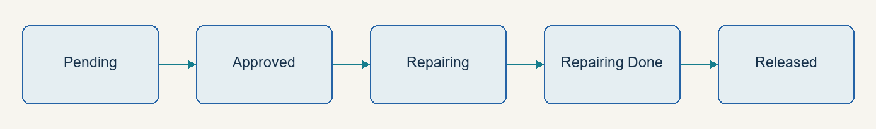
REQUIREMENTS & WORKFLOW
One repair workflow, three roles
Customer requests service; admin approves, assigns and sets cost.
Mechanic updates progress; customer tracks status and views the bill.
Vehicle Repair Management System
02 / 10
Notes:
Customer: request, track and view bills. Admin: approve, assign, set costs and manage staff. Mechanic: view assignments and update progress. Diagram shows intended progression; the application has status choices but no strict transition state machine. Source: vehicle/models.py, forms.py and views.py.

Slide 3
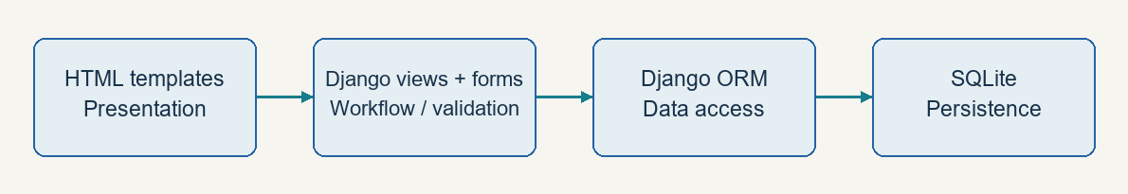
LAYERED ARCHITECTURE | CLIENT–SERVER | MVC/MTV
Current design: one Django application
Browser sends requests; Django returns rendered HTML.
Templates display; views/forms handle requests; ORM accesses SQLite.
Vehicle Repair Management System
03 / 10
Notes:
Logical layers belong to one deployable monolith. Django uses Model–Template–View: models store data, templates present it, and views plus URL routing handle controller responsibilities. No separate workflow service layer exists. Sources: vehicleservicemanagement/urls.py; vehicle/views.py, forms.py and models.py.

Slide 4
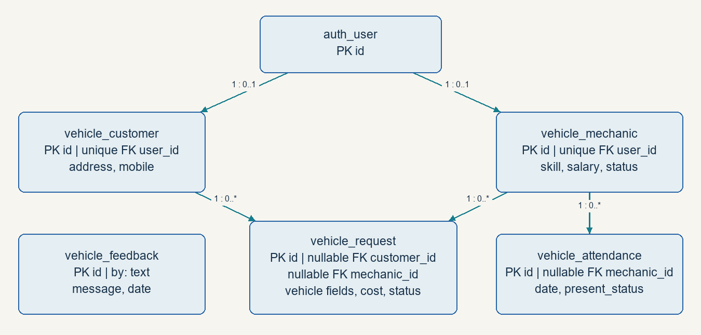
OBJECT MODEL → ORM TABLES
Data model and database relationships
Customer and Mechanic each link to Django User.
Request stores vehicle details, status and cost; bills use Request.cost.
Vehicle Repair Management System
04 / 10
Notes:
Customer and Mechanic have one-to-one links to User. Request has nullable customer and mechanic foreign keys; Attendance references Mechanic. Feedback.by is plain text. There is no separate Vehicle or Invoice entity. Source: vehicle/models.py. Future improvements: text registration numbers, decimal currency and safer history retention.

Slide 5
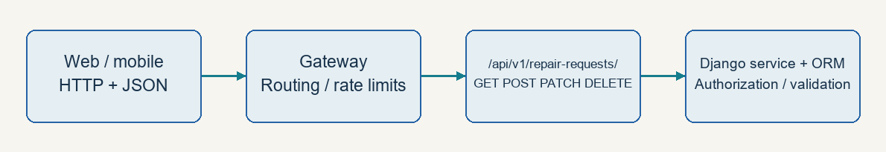
CURRENT HTML | PROPOSED REST, REACT AND HTMX
API and UI choices
Current: Django HTML forms. Proposed: /api/v1/repair-requests/.
GET reads · POST creates · PATCH updates · DELETE cancels eligible requests.
Vehicle Repair Management System
05 / 10
Notes:
A versioned JSON API and gateway are proposals. Validate ownership, role permissions and repair transitions. React is an option for richer interfaces; HTMx can refresh HTML fragments within the existing templates. Stripe illustrates resource APIs and idempotency; GitHub illustrates explicit API versioning. References: https://react.dev/learn ; https://htmx.org/docs/ ; https://docs.stripe.com/api ; https://docs.github.com/en/rest/about-the-rest-api/api-versions .

Slide 6
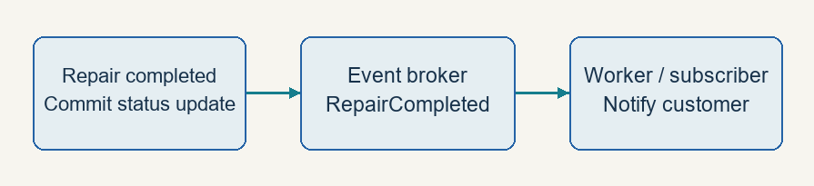
PROPOSED EVENT-DRIVEN DESIGN | SOA | MICROSERVICES
Service integration and events
After a committed repair update, an event can trigger a notification.
SOA uses clear service contracts; extract services only when justified.
Vehicle Repair Management System
06 / 10
Notes:
The current app is synchronous and monolithic. Proposed RepairCompleted events support background notifications. Consumers need idempotency, retries and failure handling. SOA separates capabilities through contracts; microservices add independent deployment and owned data. Keep the monolith for the prototype.

Slide 7
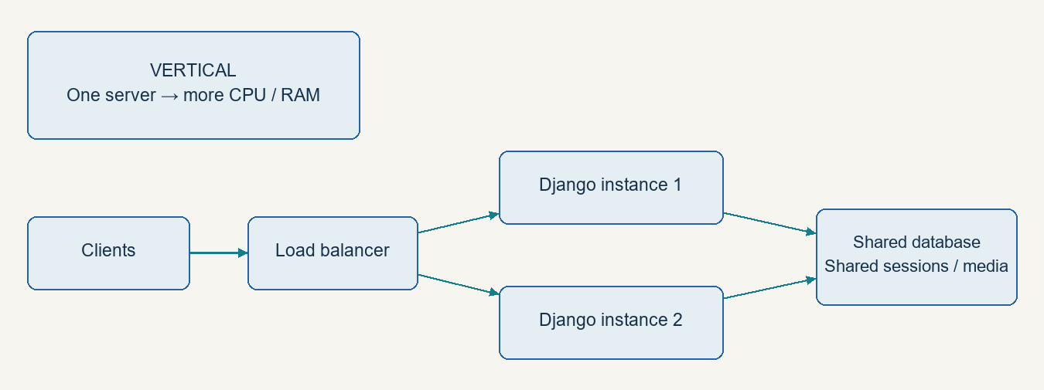
PERFORMANCE | CACHING | DATABASE | CDN | QUALITY
Scale gradually and protect repair data
First: reduce ORM queries, paginate lists and add suitable indexes.
Then: shared DB/cache, more app instances and CDN for public assets.
Vehicle Repair Management System
07 / 10
Notes:
Vertical scaling adds CPU/RAM; horizontal scaling adds instances behind a load balancer. Shared sessions/media are needed. Cache user-scoped summaries and invalidate after writes; do not publicly cache invoices. Quality priorities: role/object authorization, workflow functions and tests, DEBUG=False, explicit hosts, external secrets and HTTPS. These are proposed improvements, not completed fixes. No benchmark claims.

Slide 8
MVC/MTV TODAY | FIVE PROPOSED REFACTORINGS
Design patterns: simple repair examples
MVC / MTV — separate data, presentation and request handling.
Factory — create the estimator for a vehicle category.
Singleton — hold configuration once per process.
Adapter — wrap an external SMS or payment provider.
Observer — notify listeners when repair status changes.
Strategy — swap pricing rules for different vehicle types.
Vehicle Repair Management System
08 / 10
Notes:
Only Django MTV is represented in the current structure. The other five patterns are conceptual refactorings. Singleton is per process, not a shared database connection or a global instance across servers. Factory creates an object; Strategy selects interchangeable behavior. Individual editable pattern diagrams are included in the draw.io set.

Slide 9
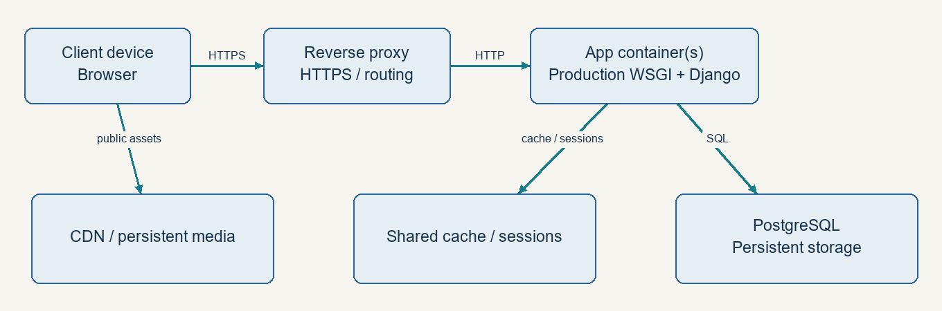
PROPOSED DEPLOYMENT & CONTAINERIZATION
From local demo to production
Today: Django runserver + SQLite. Proposed: proxy + app + shared services.
Build image → configure secrets → migrate → collect static → health check.
Vehicle Repair Management System | Abhay
09 / 10
Notes:
Production deployment is a proposal. HTTPS reverse proxy routes to Django served by a production WSGI server. Database and media persist outside disposable containers. Shared cache/sessions support multiple instances. Back up persistent data. End-to-end trace: requirements → objects → tables → workflow → UI/API → deployment. Reference: https://docs.docker.com/get-started/docker-concepts/the-basics/what-is-a-container/ .

Slide 10
AI REVIEW | ADR-001 | CONCLUSION
Design decision and demonstration
Decision: retain the Django monolith and HTML templates.
Reason: simple development and deployment for a small workshop.
Tradeoff: coupled scaling; revisit for mobile clients or growing load.
AI assists diagrams and reviews; verify claims against source code.
Demo: submit → approve & assign → repair update → view bill.
Vehicle Repair Management System | Abhay
10 / 10
Notes:
ADR-001 is a presentation draft, not an implemented architecture change. AI can check topic coverage, suggest design reviews and draft documentation; human verification is required. All 29 chapter diagrams are supplied as editable draw.io files. Credits: upstream project Sumit Kumar / LazyCoder; dashboard UI Tran Anh Tuat, as listed in README.md. Source evidence is the local repository; framework links in notes are further reading.

