Slide 1
HLD Assistant
SWC_Speed
SWC_Arb
Ask AUTOSAR design documents. Get answers with sources.
SWC_Key
TechPulse FY-26 | Applied AI/ML Capstone | Case Study CS1
SWC_Lock
Student: Yadnesh Patil | PRN: 123B1D034 | PCCOE, Pune
Notes:
Hello, I am [your name], PRN [your PRN]. My project is the HLD Assistant for case study CS1. It helps AUTOSAR architects ask questions about long design documents and get answers with the exact document, section and page as proof.

Slide 2



The problem
Hundreds of pages.
Read by hand.
Slow reviews
Finding one signal across many pages takes hours.
Hidden mismatches
High-Level Design documents describe components, ports, interfaces and signals. They live in PDFs, so every review is manual.
Missing producers and conflicting types go unnoticed.
Knowledge in few heads
New engineers depend on a handful of experts.
Notes:
Architects read hundreds of pages of design PDFs by hand. That is slow, mismatches between documents are easy to miss, and knowledge stays with a few experts. This is the problem the project solves.

Slide 3




What it does
Ask with sources
Architecture inventory
Natural language questions. Every answer shows document, section and page.
Components, ports, interfaces, signals and a dependency map with impact analysis.
Consistency checks
Compare revisions
11 rules find missing producers, type conflicts, timing and safety-level gaps.
See what changed between two versions of the same document.
Notes:
Four things. One: ask questions and get cited answers. Two: an automatic inventory of components, ports, interfaces and signals with a dependency map. Three: eleven checks that find inconsistencies. Four: comparison of two document revisions.

Slide 4
The knowledge base
4
23
101
12
PDF documents
pages
text chunks
seeded defects
HLD-BCM-001 v1.1
Door and Access Control
approved
HLD-BCM-001 v1.0
Door and Access Control
superseded
HLD-DCM-003 v1.0
Diagnostic Communication and Gateway
approved
HLD-BMS-002 v1.0
Battery Management System
approved
Notes:
The knowledge base is four synthetic AUTOSAR design PDFs in two projects. No real company data is used. Twelve defects are planted on purpose so I can measure whether the checks find them. Only approved versions are searched; older versions are marked superseded but kept for comparison.

Slide 5
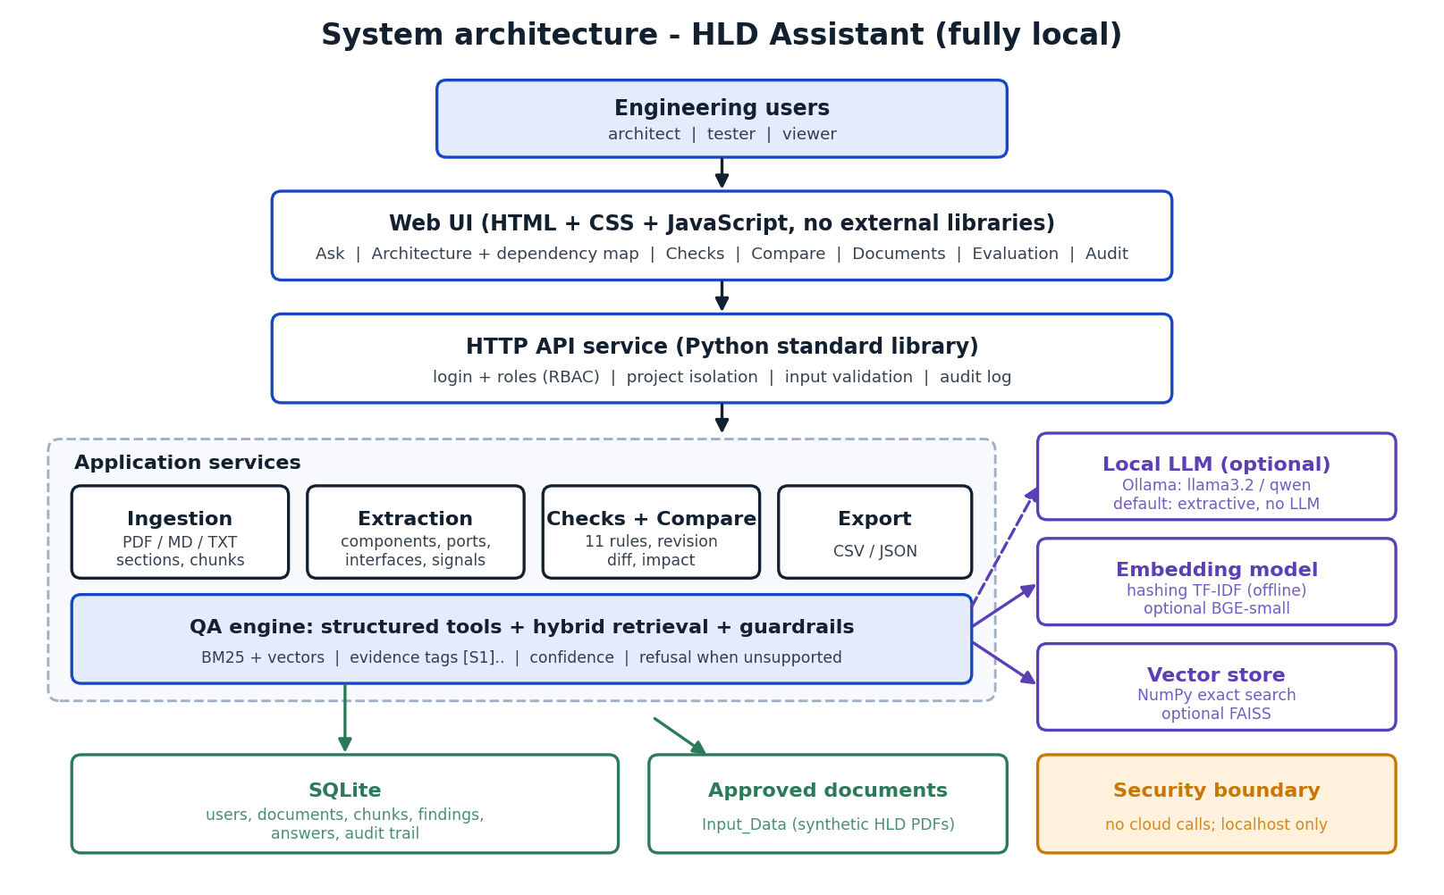



System architecture
Fully local
No cloud, no external API
SQLite + vector search
Per-project collections
Optional local LLM
Ollama, off by default
Notes:
Users sign in through a web page. A Python API handles login, roles and the audit log. Behind it are ingestion, extraction, the question answering engine, SQLite and a local vector store. Everything runs on one laptop with no cloud and no external API. A local language model through Ollama is optional and off by default.

Slide 6
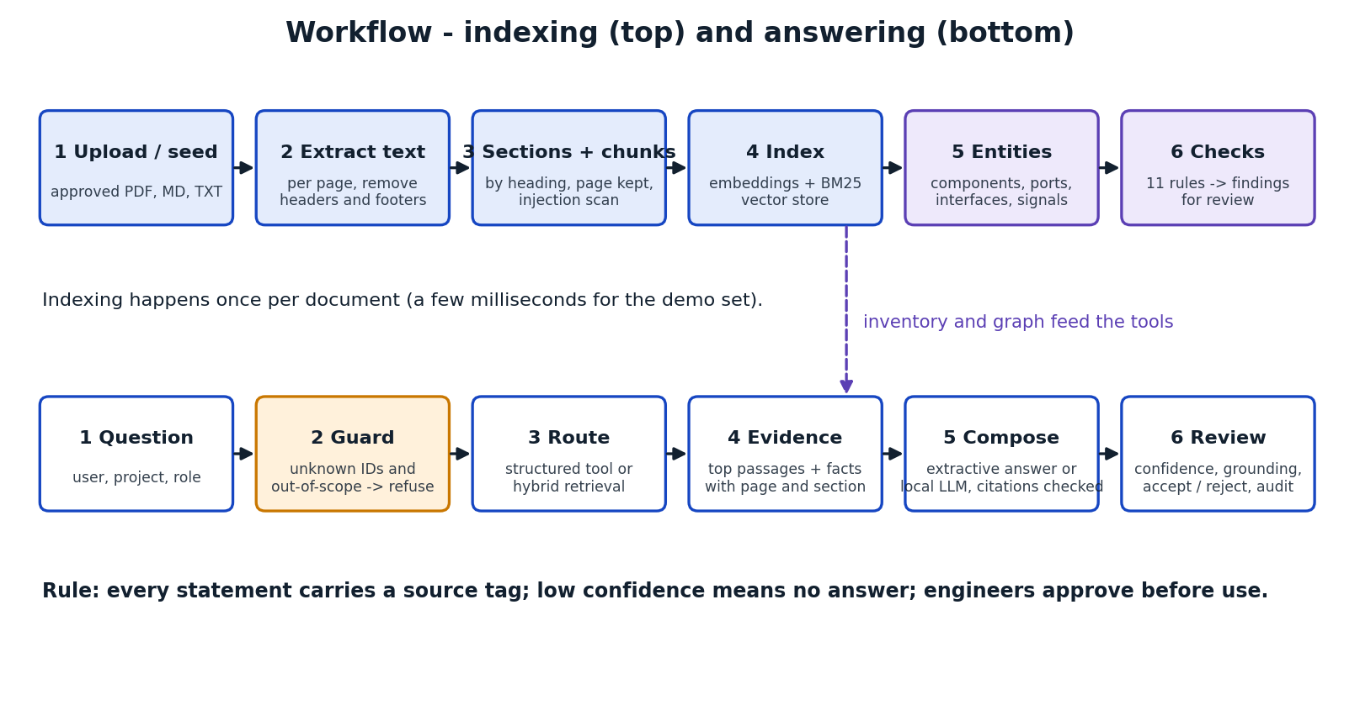
Indexing and answering
Notes:
Top row is indexing, done once per document: extract text, remove headers and footers, split by section, build the search index, extract entities and run the checks. Bottom row is answering: guard, route, collect evidence, compose, and finally human review.

Slide 7



How an answer is made
Guard
Route
Compose
Unknown identifiers and out-of-scope questions are refused.
Structured question: look it up in the parsed inventory. Otherwise: hybrid search (BM25 + vectors).
Build the answer from evidence only. Tag every statement [S1], [S2] ...
Default: no generative model. The answer cannot contain text that is not in the approved documents. An optional local LLM is accepted only if it cites real evidence.
Notes:
Every question goes through three stages. The guard refuses unknown identifiers and out-of-scope questions. The router uses a structured lookup for questions about producers, consumers, ports and impact, and hybrid search for everything else. The composer builds the answer only from evidence and tags every statement with a source. By default there is no language model, so the system cannot hallucinate.

Slide 8
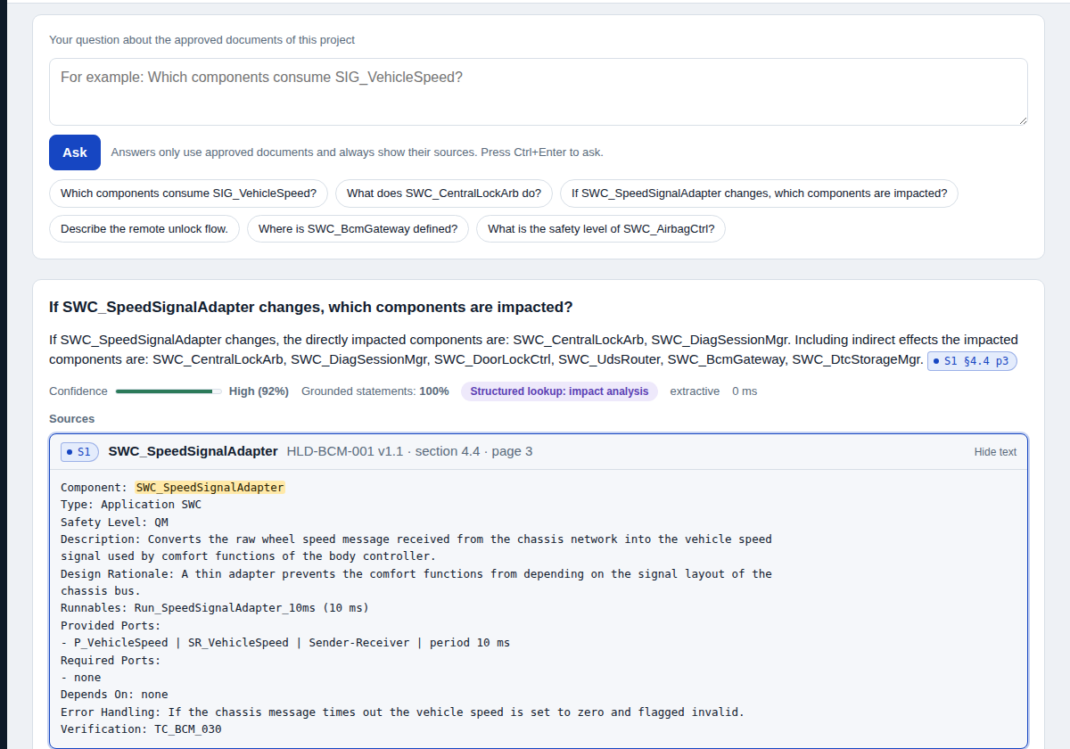
Answers with proof
Source tags
Click S1 to open the exact passage.
Confidence and grounding
Shown with every answer.
Refusals
Unsupported questions get no answer.
Notes:
Live demo here. Ask which components consume SIG_VehicleSpeed. Show the source tag, click it, and show the highlighted passage, the confidence meter and the grounding score. Then ask about SWC_AirbagCtrl and the capital of France to show that the system refuses instead of guessing.

Slide 9
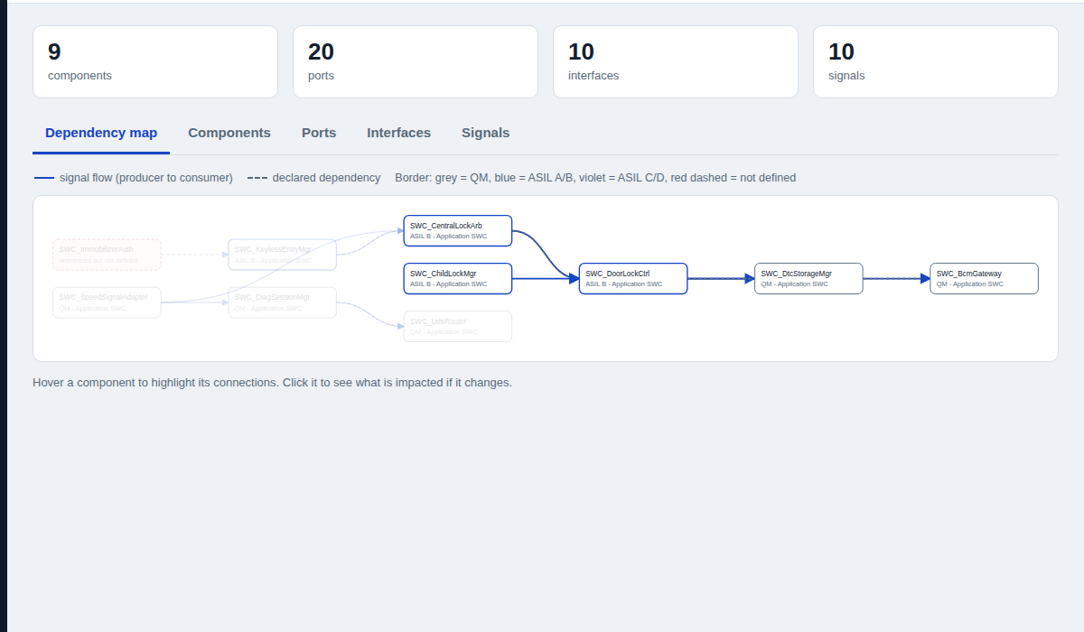
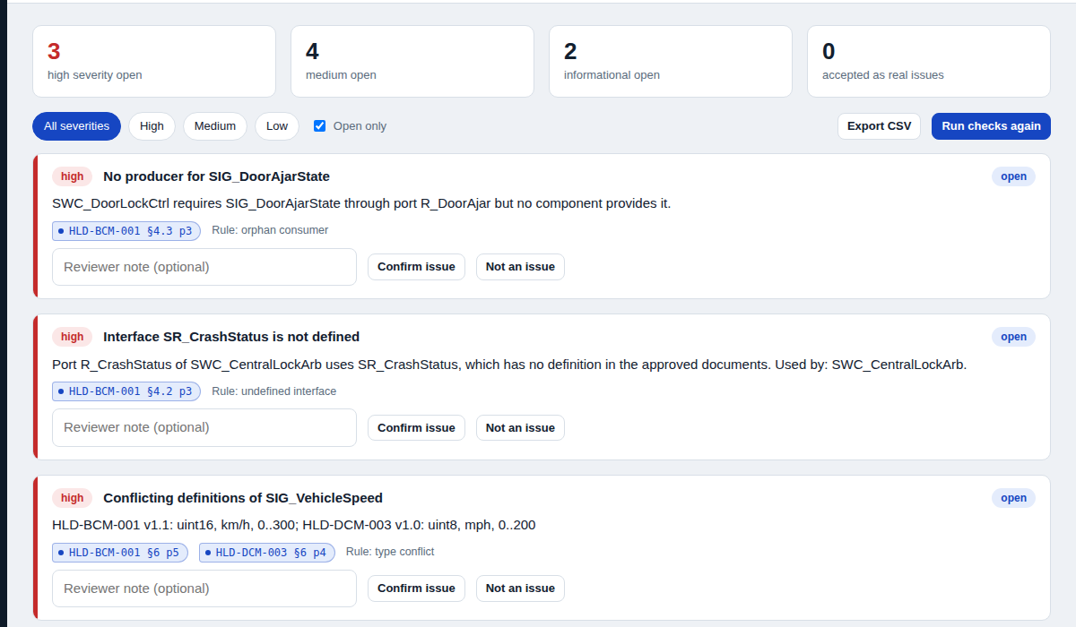
Explore and check
Dependency map
Consistency checks
Producer to consumer links and impact of a change. Red dashed = referenced but not defined.
Findings with severity and evidence. Architects confirm or reject each one.
Notes:
The architecture page shows the dependency map. Hover a component to highlight its links. The checks page lists findings with severity and evidence. For example SIG_VehicleSpeed is defined as uint16 kilometres per hour in one document and uint8 miles per hour in another. An architect confirms or rejects every finding, and the decision is saved.

Slide 10
Evaluation results
43
test questions, incl. 10 paraphrased
17
automated tests, all passing
One miss kept on purpose. A paraphrase the word-matching search cannot see. Synthetic data: scores are optimistic.
Notes:
I tested with 43 questions: 27 direct, 10 paraphrased without identifiers, and 6 out of scope. 97.3 percent of answers were correct and cited, all out-of-scope questions were refused, and all 12 planted defects were found. Plain text search alone finds the right section first only 67.6 percent of the time, which is why the structured lookups matter. One question failed and I kept it: it is a paraphrase that word matching cannot understand. BGE embeddings are the planned fix. The data is synthetic and I wrote the questions, so the scores are optimistic. Seventeen automated tests pass.

Slide 11



Responsible by design
Grounded
Private
Approved documents only, with a source on every statement.
Runs on localhost. No cloud calls, no telemetry.
Access control
Human in charge
Roles, project isolation, upload validation, injection guard.
Architects approve. Every action is in the audit trail.
Notes:
Responsible AI. Answers are grounded in approved documents. Everything is local. Users have roles, each user sees only assigned projects, uploads are validated, and instruction-like text hidden in documents is blocked. Engineers approve every finding and answer, and all actions are logged.

Slide 12


Limits and next steps
Limitations
Next steps
Synthetic, templated documents
No OCR; diagrams in PDFs are not read
Word-matching embeddings miss paraphrases
Demo-grade login; Docker and LLM mode not fully tested
BGE embeddings with FAISS and a re-ranker
Real HLDs and an independent question set
OCR and diagram understanding
Link to safety and cybersecurity artifacts
Notes:
Being honest about limits: the documents are synthetic and follow one template, there is no OCR, my default embeddings match words rather than meaning, login is demo-grade, and Docker and the optional language model path were not fully tested. Next steps are BGE embeddings with FAISS and a re-ranker, real documents with an independent question set, OCR and diagram reading, and linking to safety and cybersecurity artifacts.

Slide 13
Thank you
Questions?
Cited answers from approved documents only
Architecture inventory, checks and revision compare
Measured honestly: 97.3% pass, 12 of 12 defects, one failure kept
Fallback evidence: demo video in the Video folder
Notes:
To close: the system gives cited answers from approved documents only, it builds an architecture inventory with checks and revision comparison, and I measured it honestly, including the failure. Thank you, I am happy to take questions.

