Slide 1
Computational Alloy Design and Discovery using Machine Learning
Yadu Krishna Choyi
Comp4560
Supervisor: Nick Birbilis

Slide 2

Motivation
“Worldwide there are millions of materials available commercially that are characterised by hundreds of different properties. Using traditional techniques to explore the information we know about these materials, to come up with new substances, substrates and systems, is a painstaking process that can take months if not years,” Gareth Conduit, the Chief Technology Officer at Intellegens
Notes:
<number>

Slide 3
What is alloy designing and why do we need it?
Knowledge-guided approach
In the field of engineering we are typically using only up to 1000 different types of metallic alloys on a regular basis.
This is a very tiny fraction of potentially interesting alloys

Slide 4
Current Methodology
Semi-empirical chemical rules.
Other approaches are to reflect which type of property we actually aim to design.
Using already existing data to learn machine learning models that can accurately predict alloy compositions.

Slide 5
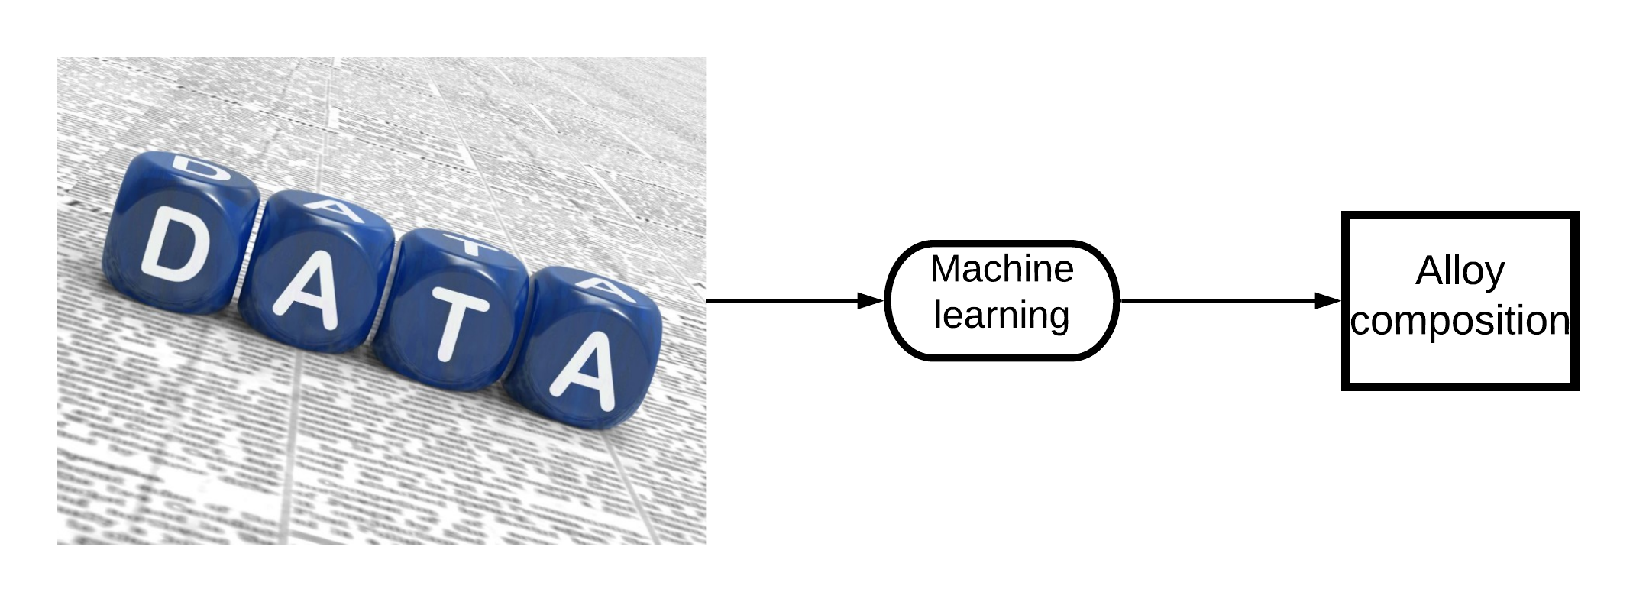
Objective

Slide 6
Objective
Generate aluminium alloy composition using machine learning.
Aim to generate aluminium alloy composition such that certain criteria are met.

Slide 7
Criteria
Percentage of Mg ≈ 3.5% - 6.0%, Mn ≈ 0.1% - 0.6%, Fe ≈ 0.1% - 0.4%, Cr ≈ 0.0% - 0.3%, Ti ≈ 0.0 % - 0.3%, Sr ≈ 0.0% - 0.5%,Zn ≈ 0.05% - 0.75%,Zr ≈ 0.0% - 0.5%,Cu ≈ 0.0% - 0.7%, Ag ≈ 0.0% - 0.2%, Si ≈ 0.0% - 0.5%, Ni ≈ 0.0% - 0.2%, Ca ≈ 0.0% - 0.2%, Ge ≈ 0.0% - 0.4%, Nd ≈ 0.0% - 0.4%, Ce ≈ 0.0% - 0.4%
Aim to minimize DoS value

Slide 8
Degree of sensitization(DoS)
Sensitization in 5XXX aluminum alloys is a problem characterized by the gradual formation and growth of beta phase (Mg2Al3) at grain boundaries, which increases the susceptibility of alloys to inter granular corrosion (IGC) and intergranular stress-corrosion cracking (IGSCC).
5XXX series aluminium is commonly used in hull construction for ships.
The DoS value gives a measurement of the extent of sensitization in such alloys.
High DoS value implies less corrosion resistance, and vice-versa.

Slide 9
Methodology Overview

Slide 10
Data
Extracted from ‘A Survey of Sensitization in 5xxx Series Aluminum Alloys’ by R. Zhang,* S.P. Knight,* R.L. Holtz,** R. Goswami,** C.H.J. Davies,*** and N. Birbilis‡.
Consists of 458 records

Slide 11
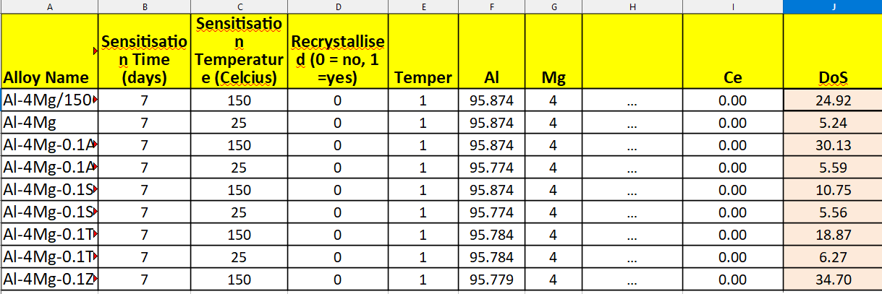
Data
Number of data points = 458
Number of input features = 21
Number of output features = 1

Slide 12
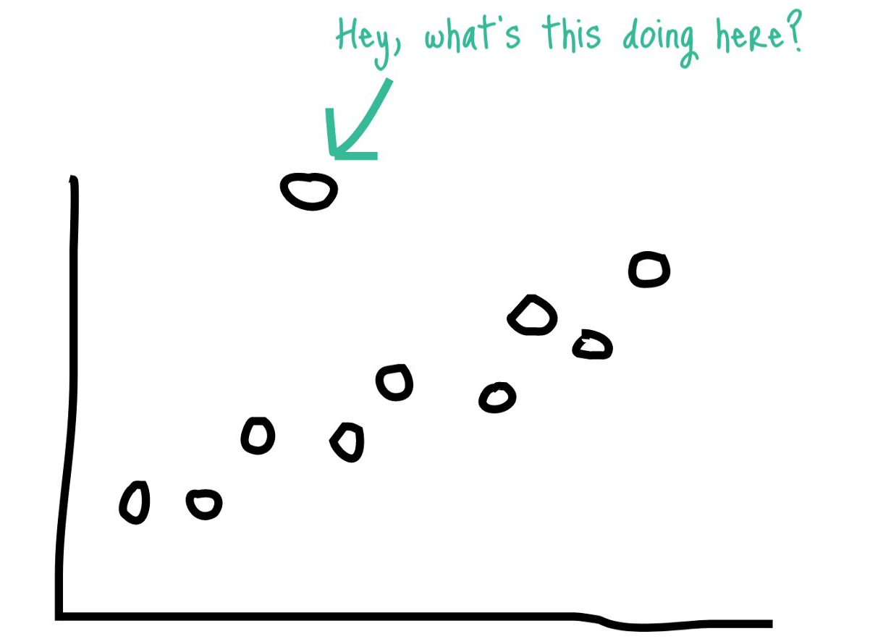
Data pre-processing / removing outliers
Machine learning algorithms suffer in terms of their performance when outliers are not taken care of
How to get rid of outliers?
Solution = Isolation forest

Slide 13
Isolation Forest
Isolation Forest is built on the basis of decision trees.
Identifies anomalies instead of profiling normal data points.
Anomalies are more susceptible to isolation and hence have short path lengths.

Slide 14
Approach
Step 1 : Select a machine learning model that can predict the value of DoS.
Step 2 : Tune the model.
Step 3 : Generate alloy composition data to be fed to the model based on criteria.
Step 4 : Feed generated data to the model and obtain DoS value to evaluate the alloy composition.
Step 5 : Extract optimum alloy composition based on the value of DoS.

Slide 15
Model creation technique
Supervised Machine Learning
Neural Network

Slide 16
Which technique?
Is supervised machine learning more suitable than a neural network model for the task in hand?
Answer : Yes

Slide 17
Why supervised machine learning?
Small size of dataset
Faster execution time
Higher accuracy

Slide 18
Machine learning model vs Neural network model
Machine learning
Model = xgboost
Average r2 score = 0.94
Average training time = 0.58 seconds
Neural network
Model = Simple feed forward neural network with 2 hidden layers
Average r2 score = 0.52
Average training time = 12.98 seconds

Slide 19
Xgboost vs other supervised learning algorithms
Linear | Nearest Neighbor | Decision Tree | SVR | Xgboost
R2 = 0.125 | R2 = 0.657 | R2 = 0.707 | R2 = 0.820 | R2 = 0.943

Slide 20
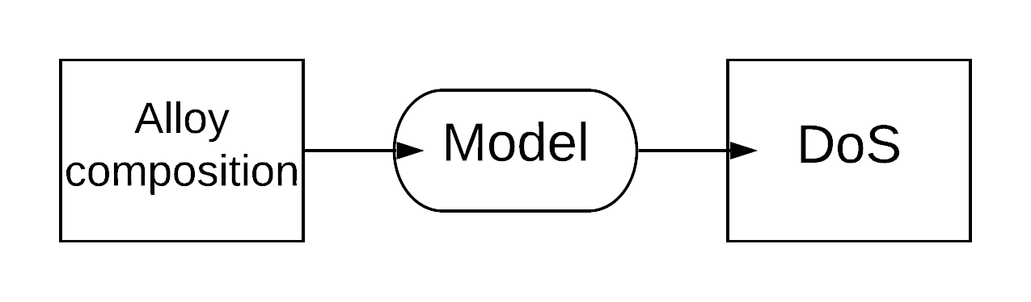
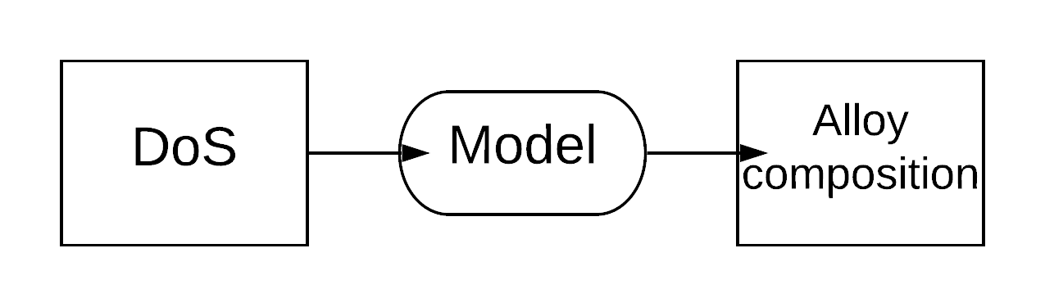
Recap
What we have
A good supervised machine learning model
What we want
Alloy composition

Slide 21
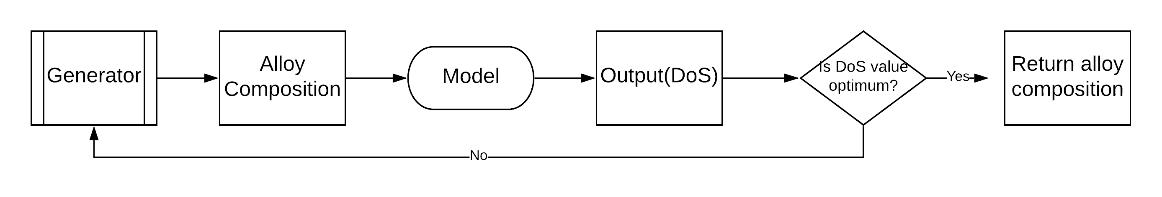
Technique to generate composition
Main idea is screening.
Generate random composition satisfying all criteria.
Use trained model to screen all generated composition and find best result.

Slide 22
How to generate random data?
Two methods
1: Randomly select a the composition with range equal to criteria.
2: Randomly sample a point from the same feature space as that of the training data.

Slide 23
Result
An average of around 10^5 random compositions are screened to select the one with the most optimum DoS value.
DoS value of resulting composition is in the range (0.1 – 1.1).
Comparing with average DoS value of original dataset which is 26.9, the generated composition seems to outperform existing alloy composition by a large margin.
Example composition generated: Dos = 1.04
Al=94.7, Mg=4.01, Mn=0.49, Fe=0.35, Cr=0.11, Si=0.2

Slide 24

Conclusion
Marine engineers and naval architects recognise 5XXX series aluminium as an advantageous material in shipbuilding and the fabrication of components in offshore platforms. The lightweight, superior mechanical properties, and corrosion resistance of aluminium alloys has dictated their use in many of these applications.
Using existing data to generate new alloy composition using machine learning can drastically decrease designing time.
These new alloys can also find use in other fields such as the automotive industry.

Slide 25
Thank You!

