Slide 1

Research Methodology and Technical Communication
Presentation On
Zero Trust Architecture for Military UAV Security Systems
Presented By
YADUNANDAN N- 251091010013
Under the Guidance of
Dr. Deepak Parashar
Associate Professor,
School of Computer Engineering,
Manipal Institute of Technology.

Slide 2


Zero Trust Architecture for Military UAV Security Systems

Slide 3


Introduction
UAVs are widely used in defense and military for surveillance, reconnaissance, and intelligence.
As UAVs become more interconnected, cybersecurity threats grow.
Traditional security models are ineffective against modern cyber threats.
Zero Trust Architecture (ZTA) provides a more robust security framework.

Slide 4
Objectives of the Study
To assess the applicability of ZTA in securing military UAV systems.
To investigate the role of Machine Learning (ML) in supporting ZTA.
To conduct a systematic literature review on ZTA and UAV integration.

Slide 5
What is Zero Trust Architecture (ZTA)?
Security model based on the principle: "Never Trust, Always Verify."
Assumes no user or device is trustworthy by default.
Enforces continuous authentication, authorization, and validation.

Slide 6
Why ZTA for Military UAVs?
UAVs carry sensitive data and perform critical missions.
A breach could compromise national security.
ZTA limits lateral movement and unauthorized access.
Enhances situational awareness through real-time monitoring.

Slide 7
Limitations of Traditional Security Models
Perimeter-based (castle-and-moat) model assumes internal trust.
Vulnerable to insider threats and external breaches once perimeter is broken.
Ineffective in decentralized, mobile UAV systems.

Slide 8
Core Principles of ZTA
Eliminate implicit trust.
Apply least privilege access.
Enforce continuous monitoring.
Use micro-segmentation.
Rely on strict Identity and Access Management (IAM).

Slide 9
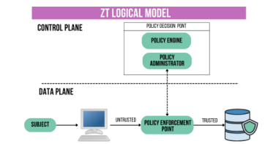
ZTA Components (Based on NIST)
Policy Engine (PE): Makes access decisions using trust algorithms.
Policy Administrator (PA): Enforces PE decisions.
Policy Enforcement Point (PEP): Controls access between users and resources.

Slide 10
Logical ZTA Components
Continuous diagnostics and mitigation systems.
IAM with multi-factor authentication (MFA).
Security Information and Event Management (SIEM) tools.
Encryption mechanisms.

Slide 11
Machine Learning in ZTA
Detects anomalies in behavior and access patterns.
Triggers automated responses to potential threats.
Enhances threat detection and situational awareness.

Slide 12
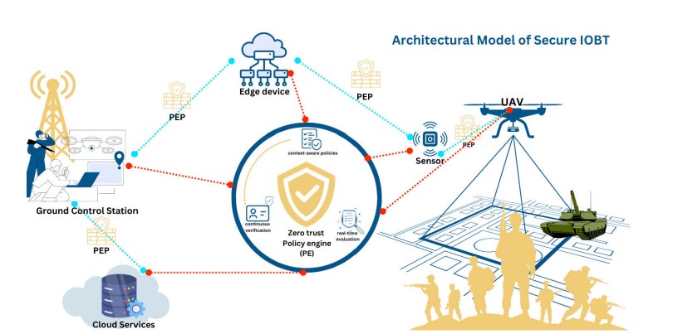
UAV Security Layers
Hardware Level
Software Level
Communication/Network Level
Sensor Level
Each level presents unique vulnerabilities

Slide 13
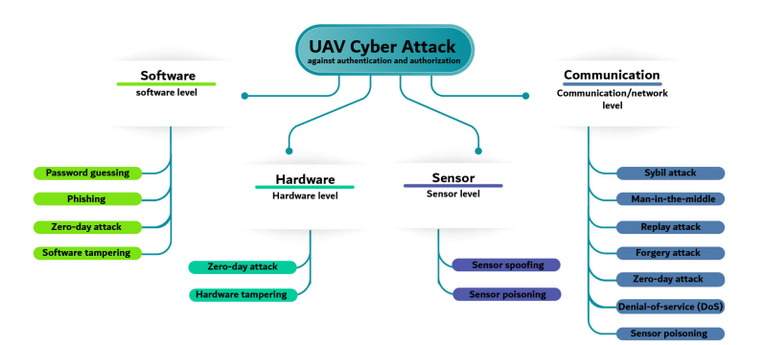
Common Cyber Threats to UAVs
GPS Spoofing
Denial of Service (DoS)
Data interception
Unauthorized command injection
Insider threats

Slide 14
Applications of UAVs in Military
Reconnaissance and surveillance
Target acquisition and designation
Communication relays
Logistics and battlefield support
Electronic warfare and cyber payloads

Slide 15
IoBT and UAV Integration
Internet of Battlefield Things (IoBT) links multiple devices.
ZTA ensures secure communication and coordination.
Real-time access control through PE, PA, and PEP.

Slide 16
Access Control Mechanisms
RBAC: Access based on roles (e.g., pilot, analyst).
ABAC: Access based on attributes (e.g., location, time, device).
ACPBS-IoT: Protocol for battlefield surveillance access control.

Slide 17
Benefits of Implementing ZTA in UAVs
Strong access control
Better threat detection
Reduced risk of data breaches
Improved trust and accountability
Scalability and flexibility in dynamic environments

Slide 18
Risks and Challenges of ZTA Implementation
Complexity in deployment
Performance degradation (due to continuous checks)
Higher resource consumption
Requires trained personnel

Slide 19
Accuracy of ZTA Systems
Studies report detection accuracy up to 99.99%
Machine Learning helps identify both known and unknown threats
Supports dynamic access and real-time threat response

Slide 20
Literature Review Summary
Over 27,000 papers analyzed
Final selection: 26 key papers (2014–2023)
Topics: ZTA, UAVs, Machine Learning, IoBT

Slide 21
Future Directions
Refined and standardized trust algorithms
Integration with 5G/6G networks for better latency and speed
Advanced ML and AI for proactive threat mitigation
Establishing global standards for military UAV security

Slide 22
Conclusion
ZTA is critical for securing military UAV systems.
Machine Learning augments detection and response.
Future work should focus on real-time adaptation and global standardization.
Zero Trust is a strategic necessity, not just a cybersecurity trend.

