Slide 1
Embedded 3D Scanner with ESP32-S3 and the Sharp GP2Y0A51SK0F Infrared Sensor
Final course project · Embedded System Design (ESDS437064E)
Lecturer: M.Sc. Huỳnh Hoàng Hà
No. | Full name | Student ID
1 | Huỳnh Anh Tuấn | 24119096
2 | Lê Thành Tài | 24119080
3 | Phan Anh Khoa | 24119048
GitHub: https://github.com/YaePak/DESIGN-AND-IMPLEMENTATION-OF-AN-ESP32-S3-BASED-3D-SCANNING-SYSTEM
Notes:
Introduce the team and the project: a low-cost turntable 3D scanner controlled by an ESP32-S3, using an infrared triangulation sensor.

Slide 2
Goal: digitise small objects with one low-cost sensor
≈120 mm
150 mm
100
±1–2 mm
max object diameter
max height, 1 mm layers
points per turn (3.6°)
target on a 60 mm cube
Requirements
Why it is embedded
Starts at power-on, no buttons
Streams each layer over Wi-Fi
Data kept in RAM only
Closed STL model on the PC
Real-time stepper timing
Analog sampling on ADC2
Two FreeRTOS tasks, two cores
Framed TCP with ACK/NACK

Slide 3
TF-Luna cannot see the object; the Sharp sensor can
Criterion | TF-Luna | Sharp (final)
Principle | time of flight | triangulation
Range | 0.2–8 m | 2–15 cm
Accuracy | ±6 cm | ≈0.2–1 mm
Interface | UART / I²C | 1 analog pin
Calibration | not needed | voltage table
At 30–90 mm | no | yes
Decision
Object is 30–90 mm away
That is inside the TF-Luna 20 cm blind zone
Sharp is built for 2–15 cm

Slide 4
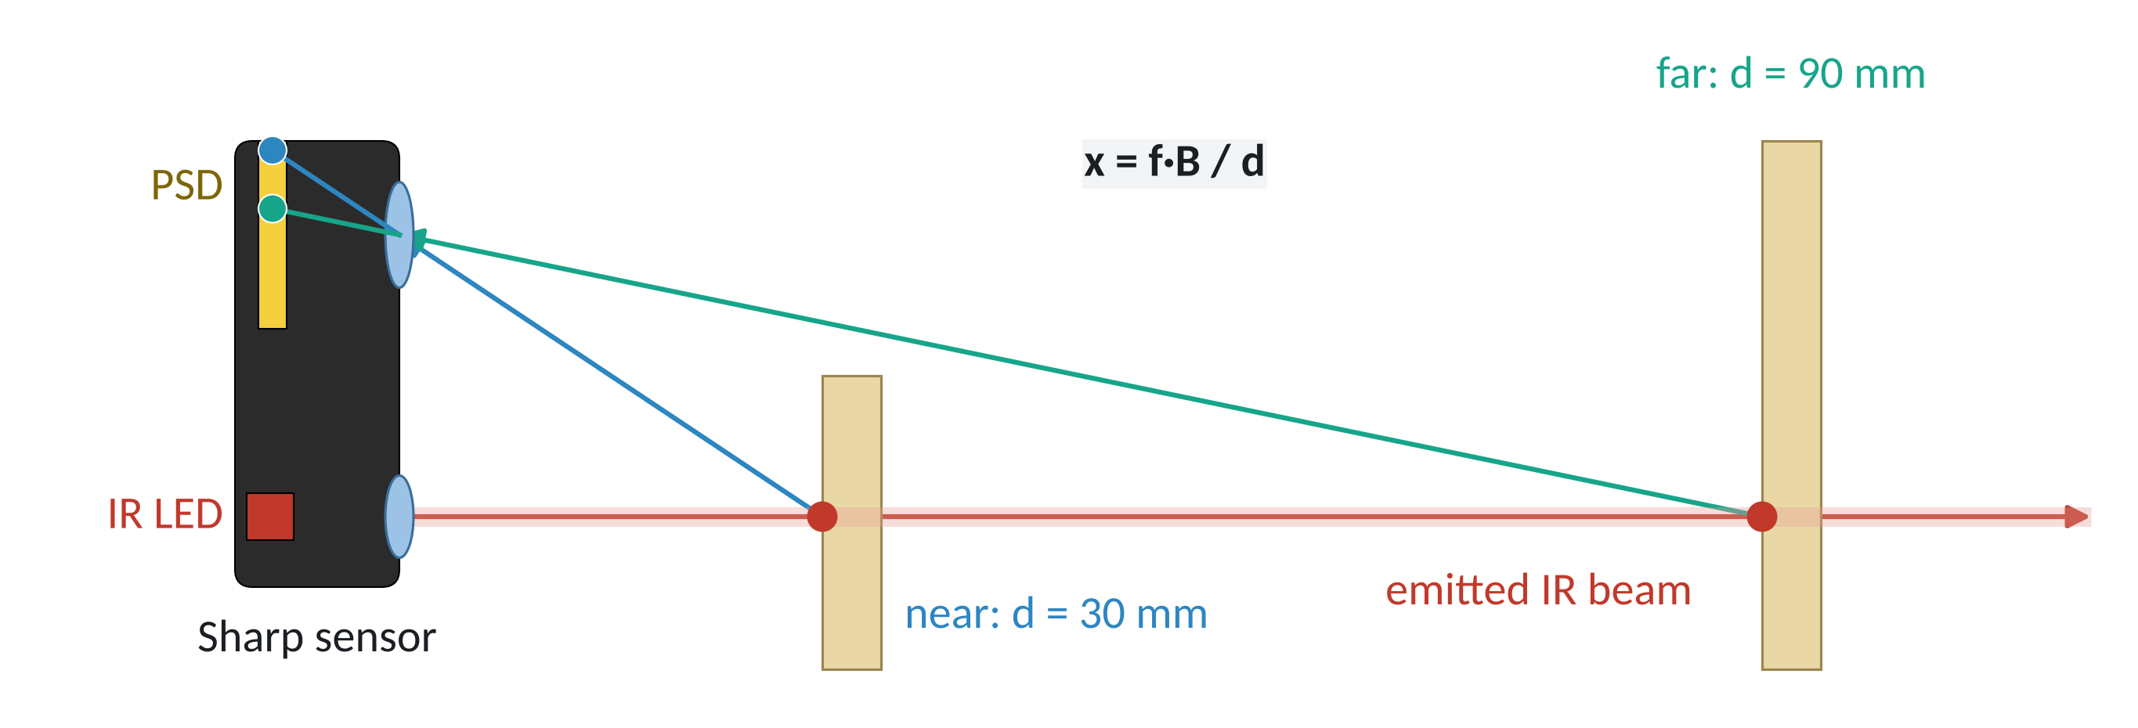
Triangulation: distance moves the light spot on the PSD
Nearer object → spot moves further on the PSD → higher Vo
Vo is turned into millimetres with a calibration table

Slide 5
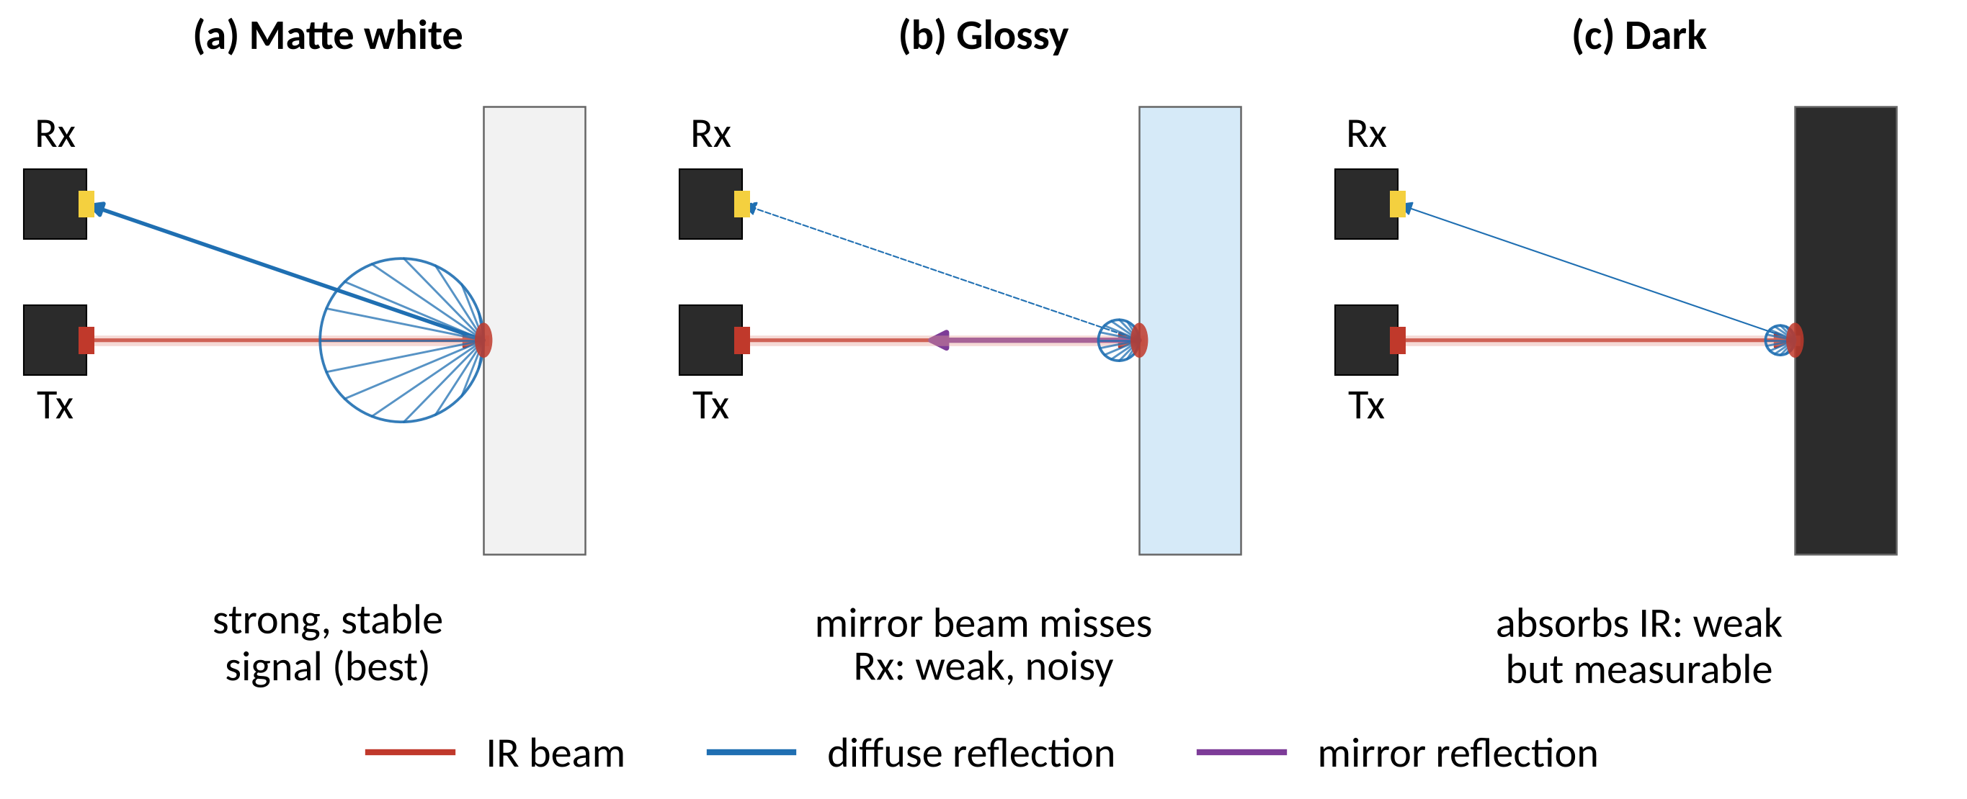
The reading depends on the surface (1/2)
Notes:
Matte white paper gives the cleanest spot; that is why the test cube was wrapped in A4 paper.

Slide 6
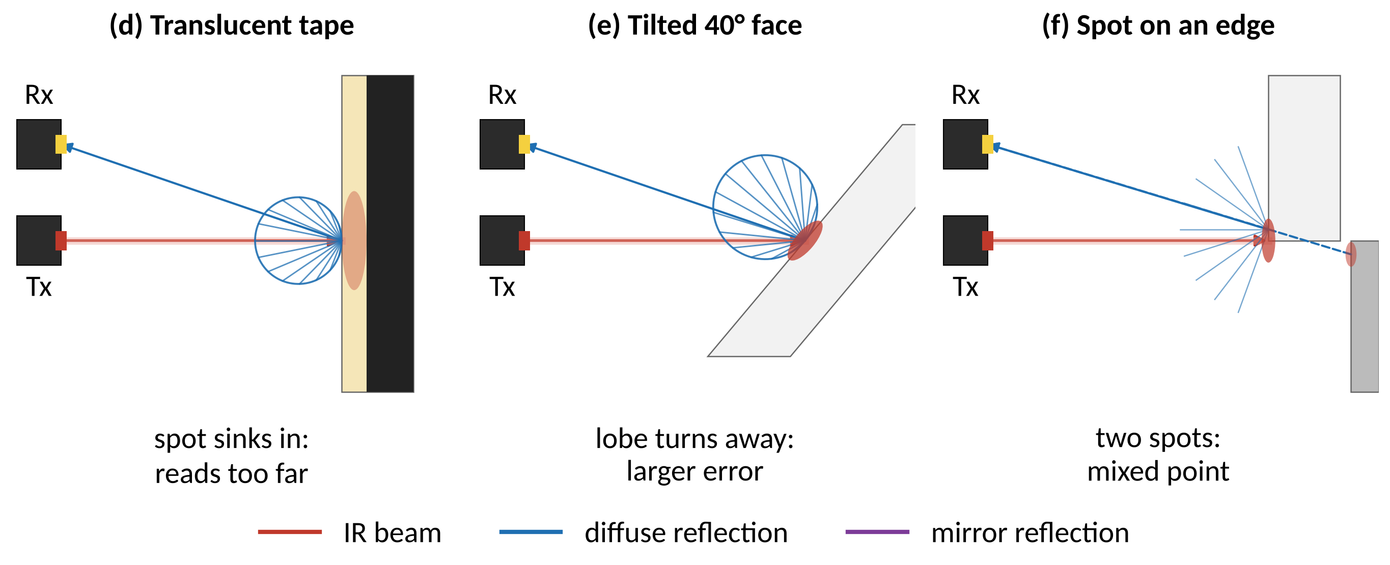
The reading depends on the surface (2/2)
Notes:
Translucent tape pulled faces in by 11–15 mm. Grazing angles and edges are filtered on the ESP32 and on the PC.

Slide 7
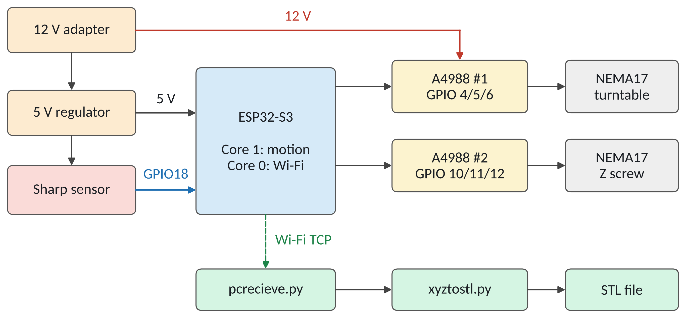
System overview

Slide 8
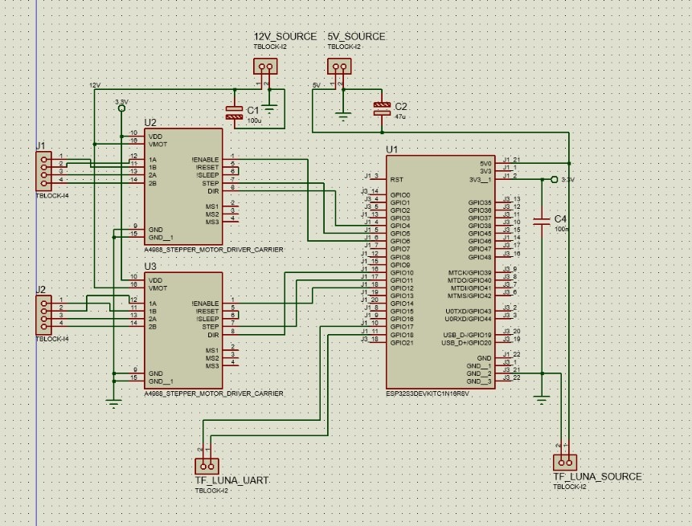
Pin allocation and control board
Pin | Function
4 / 5 / 6 | table DIR/STEP/EN
10 / 11 / 12 | Z DIR/STEP/EN
18 | Sharp Vo (ADC2)
17 | unused input
5V · 3V3 | 5 V regulator, logic
No push button: the scan starts at power-on, RST starts a new scan
Control board schematic

Slide 9
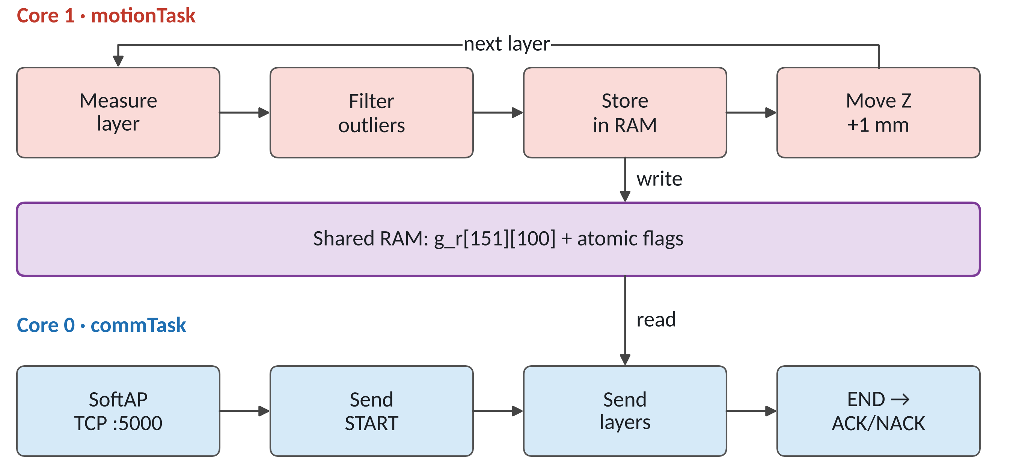
Firmware: two tasks that only meet in RAM

Slide 10
Measuring one point next to Wi-Fi
The problem
irMeasure()
ADC2 shares the radio with Wi-Fi
While Wi-Fi sends, a read can return ≈0 mV
The PCB cannot be changed
Wait 30 ms to settle
Read 24 samples, 1 ms apart
Drop ≈0 mV reads
Mean of the middle 50 %
CAL table → d, r = 90 − d

Slide 11
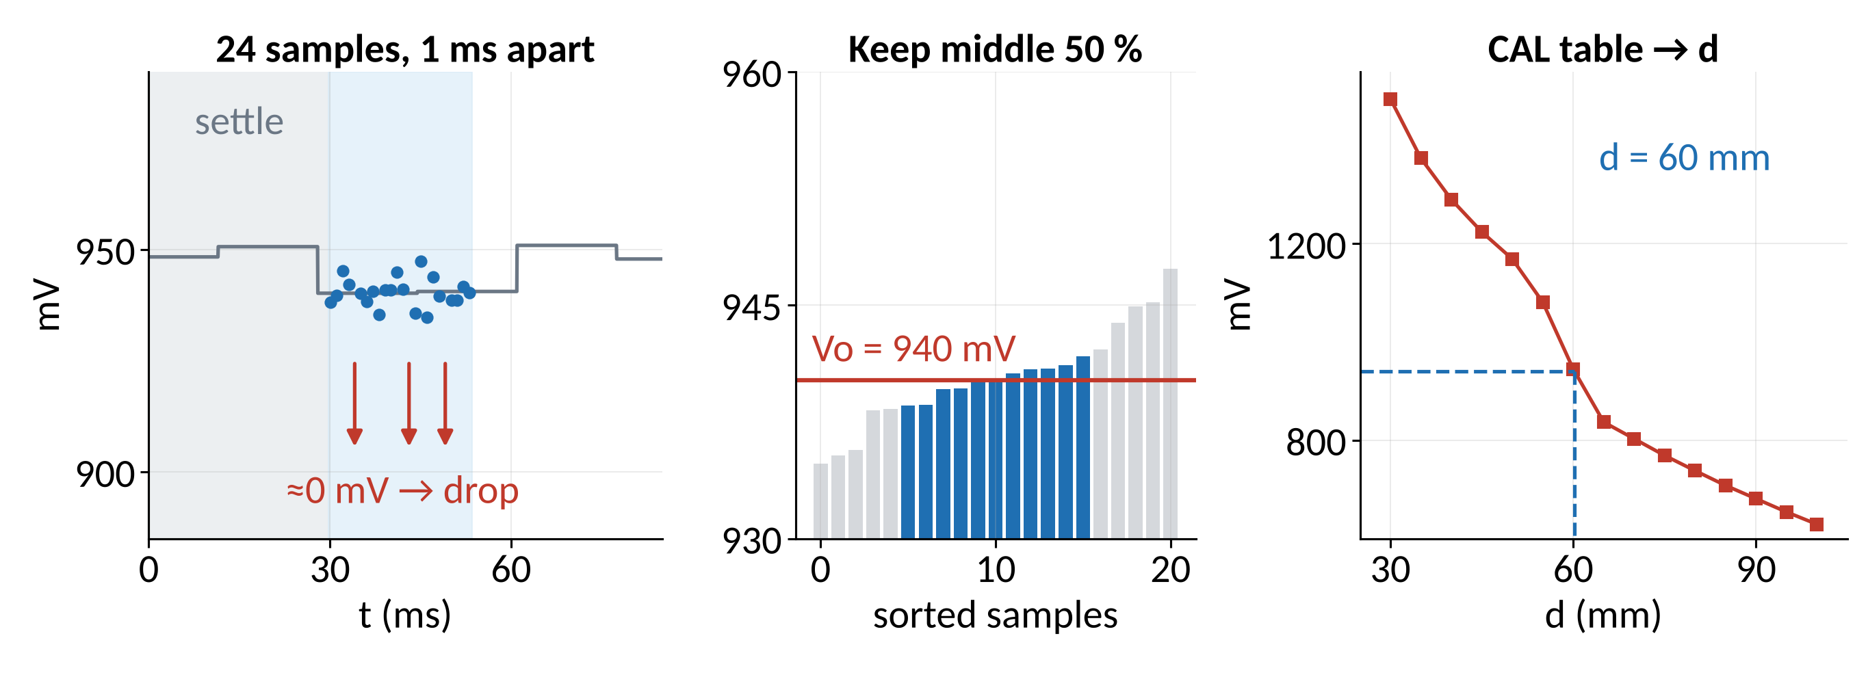
From 24 raw samples to one radius
Example point: Vo = 940 mV → d = 60 mm → r = 30 mm

Slide 12
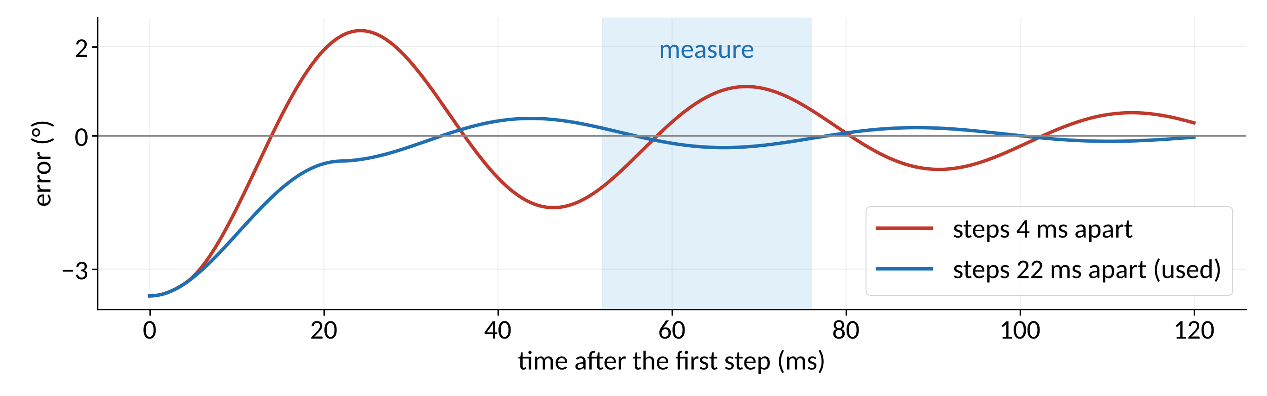
Motion timed to cancel table vibration
22 ms
25 steps
0–150 mm
between the 2 steps of a move
per 1 mm layer
Z range, returns home

Slide 13
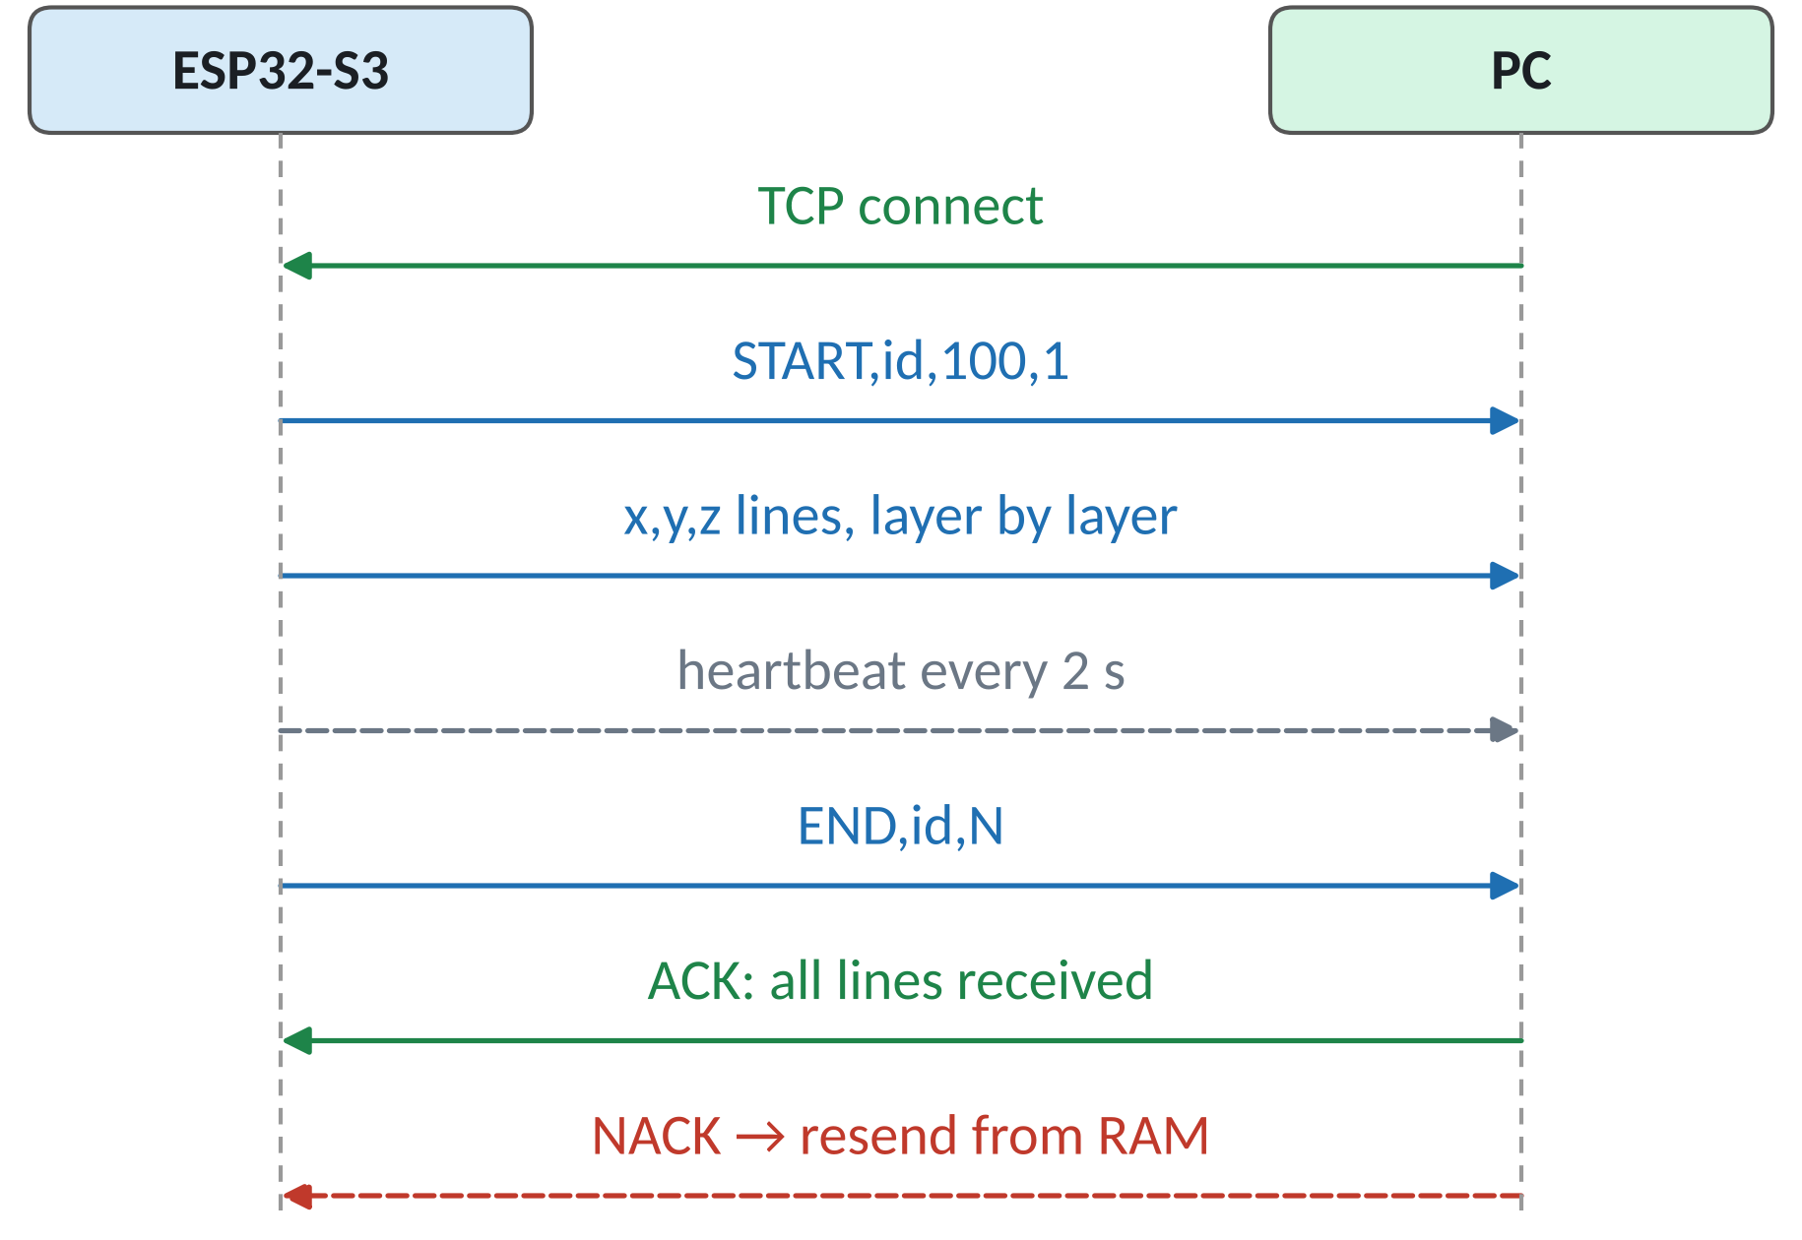
A transfer the PC can verify
Why it is safe
PC counts the lines
A late PC still gets the whole scan
Lost link: resend from RAM

Slide 14
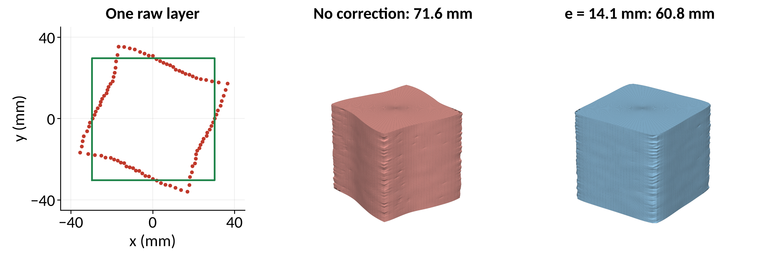
PC side: correcting the 14.1 mm beam offset
Red: raw points, green: true 60 mm square
xyztostl.py: offset fix, grazing filter, gap fill, binary STL

Slide 15
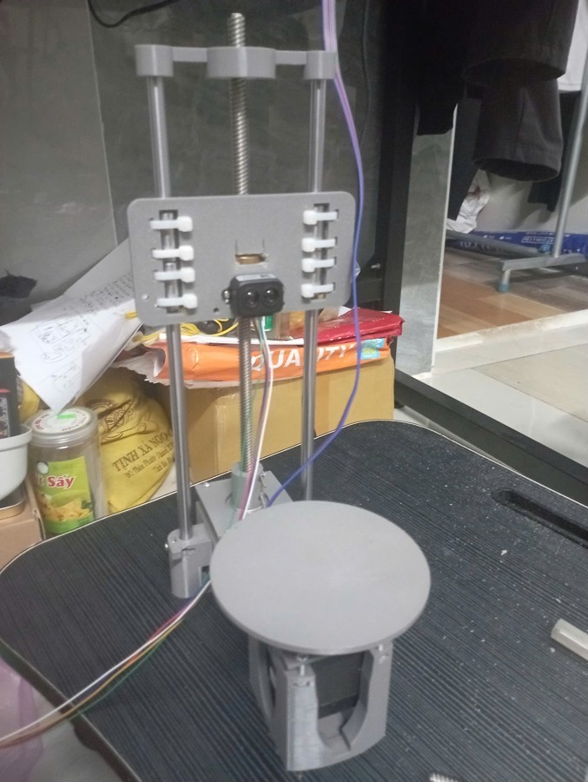
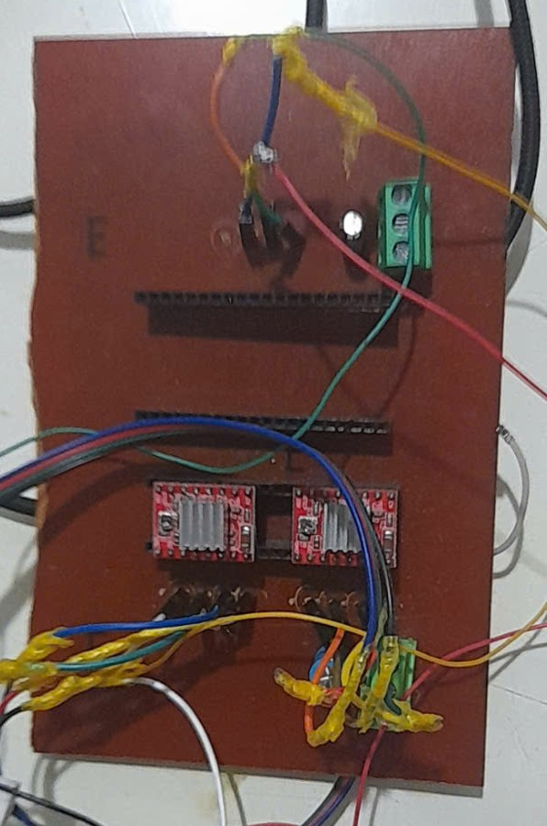
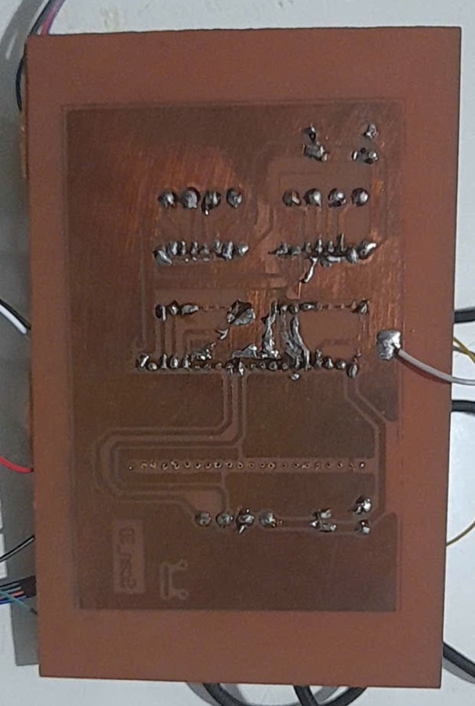
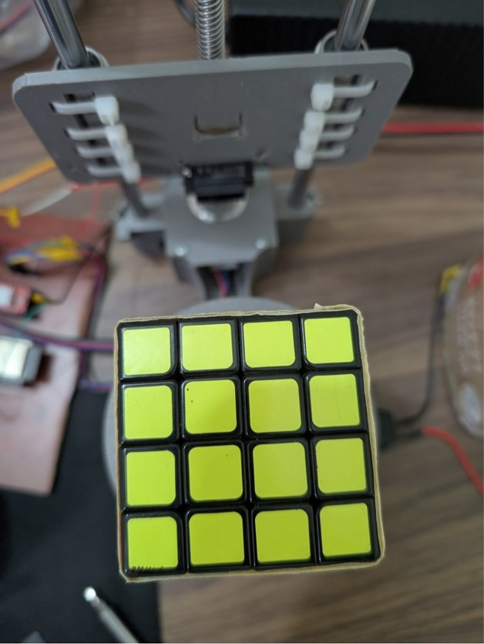
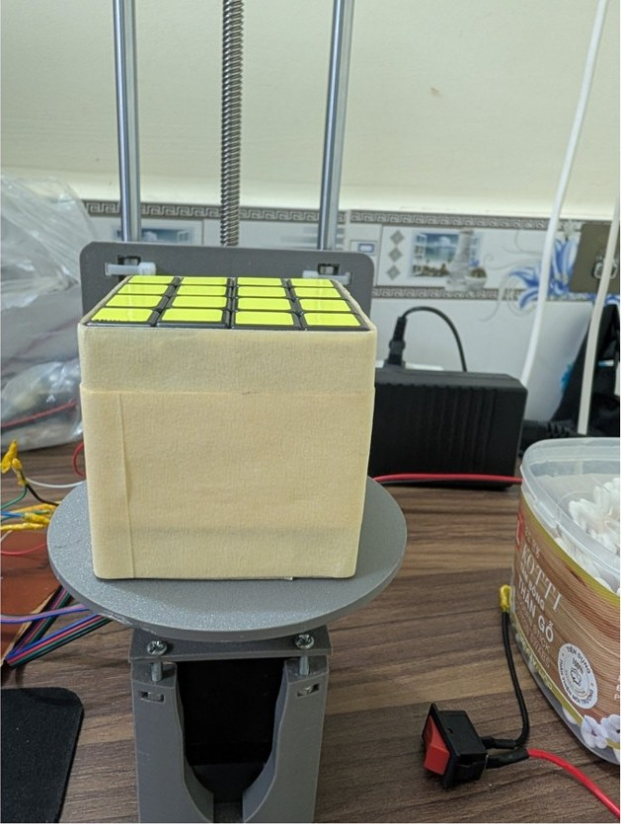
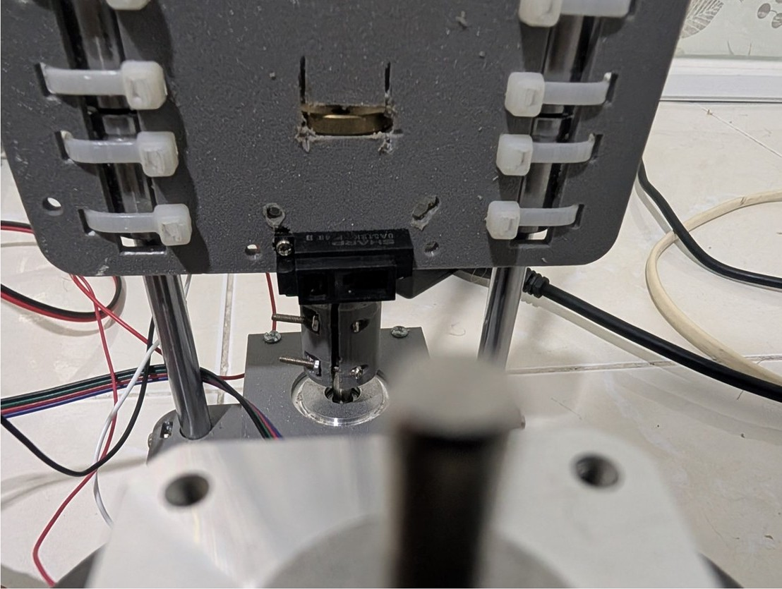
Hardware built
Printed frame
Board, component side
Board, copper side
4×4 test cube
Cube in A4 paper
Sensor on the Z axis

Slide 16
60 test runs, no functional error
22
18
28
36 %
firmware runs
receiver runs
mesh builder runs
ADC errors still OK
Unmodified firmware against a simulated machine and real TCP sockets
Covered: no object, late PC, Wi-Fi loss, NACK, tall object, bad input
Simulated 60 mm cube → 60.7–60.9 mm, 0.35 mm RMS
22 + 18 + 28 = 68 program runs: 8 tests run firmware and receiver together

Slide 17
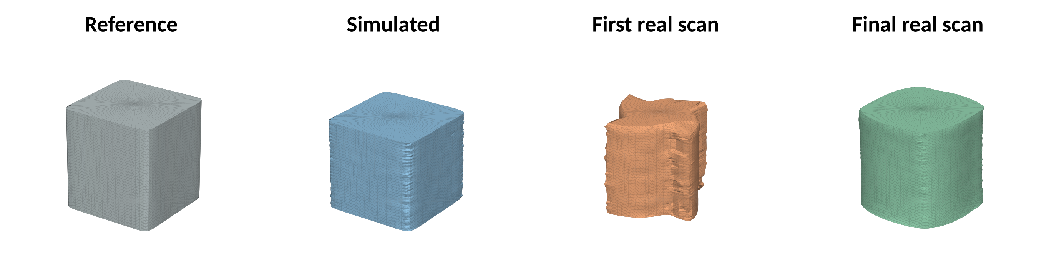
Results on the 60 mm cube: ±1–2 mm met
Case | Result | Remark
Sim, no correction | 71.6 × 71.1 mm | pinwheel
Sim, e = 14.1 mm | 60.8 × 60.9 mm | 0.35 mm RMS
Real, tape, old table | 65.8 × 66.7 mm | translucent
Real, A4 paper | 62.3 × 62.5 mm | side 61.3 mm (+1.3)

Slide 18
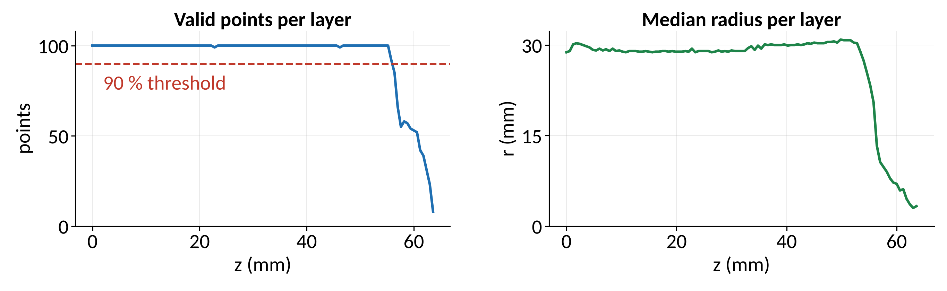
Real scan: stable from bottom to top
100/100
0.0 %
7.9 s
points per layer
ADC errors
per 1 mm layer
Notes:
Points drop at z ≈ 55 mm: the beam is 10 mm above the table, so the top is at 65 mm, the real cube height.

Slide 19
Limitations and future work
Limitations
Embedded
AI and features
Surface-dependent sensor
No Z home switch
No top surface
No colour
CAL set on the test cube
Z limit switch
ADC1 or ADS1115
STEP pulses from RMT / timer
AI auto-calibration
Top-surface scan
Colour output
Point-cloud completion

Slide 20
A working low-cost scanner, built around the sensor's real behaviour
Automatic scan · robust ADC next to Wi-Fi · verified transfer · closed STL
Demo video: https://www.youtube.com/watch?v=GfAV5bEJ8As
Thank you for listening
Notes:
Fill in the GitHub link before submitting.

