Slide 1




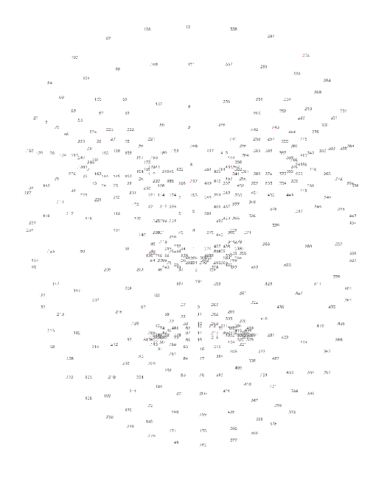
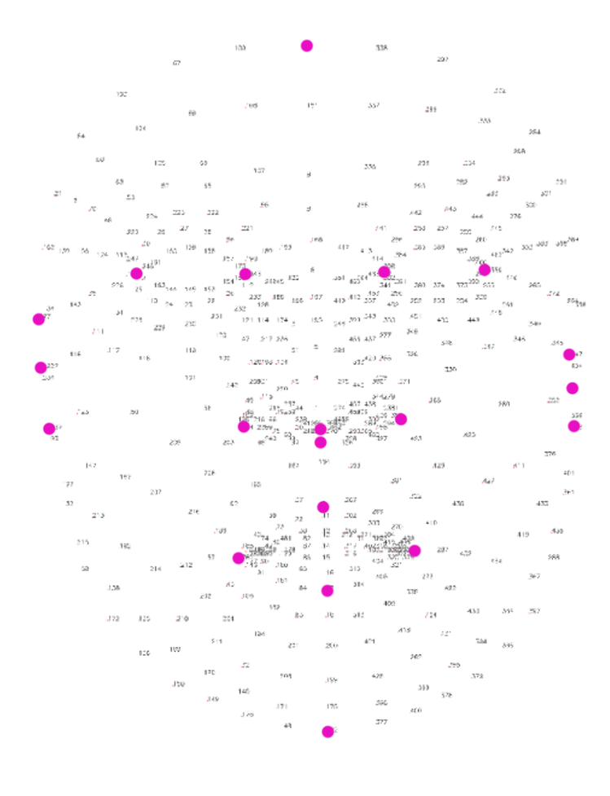
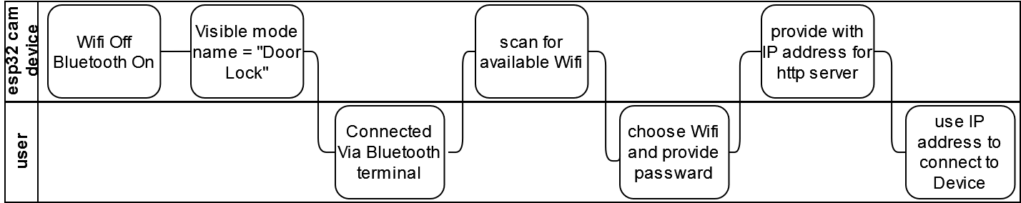
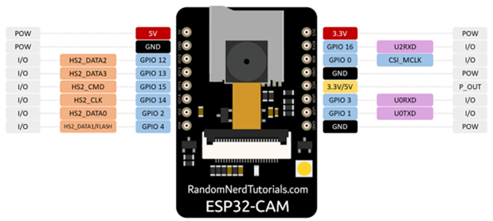
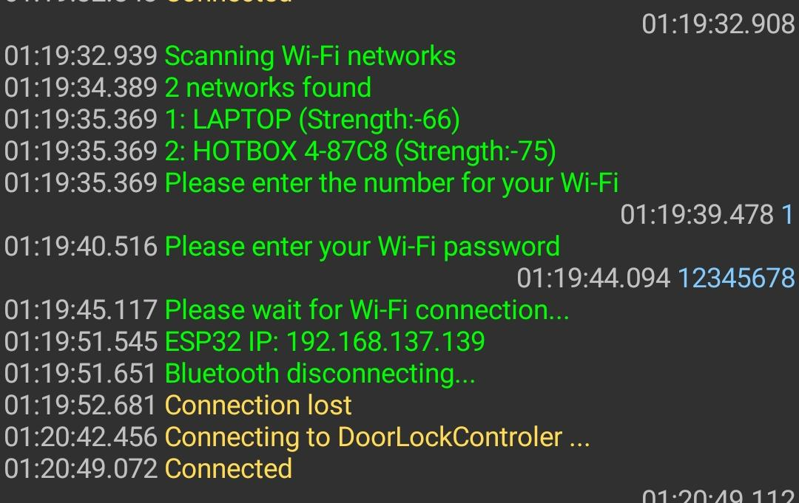
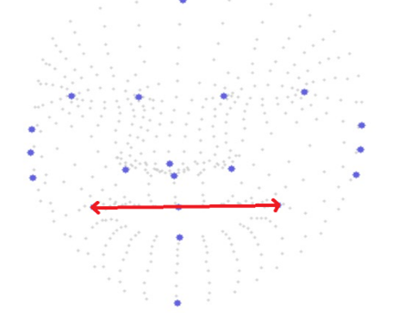
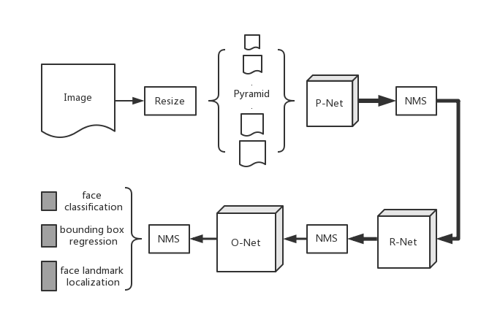
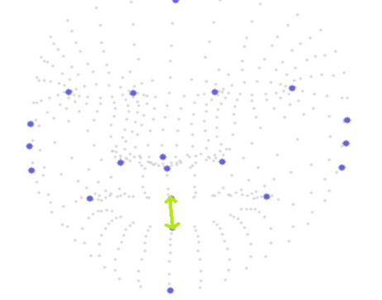
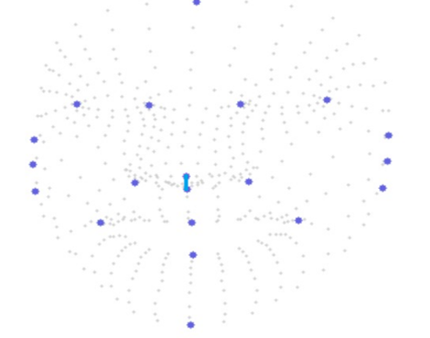
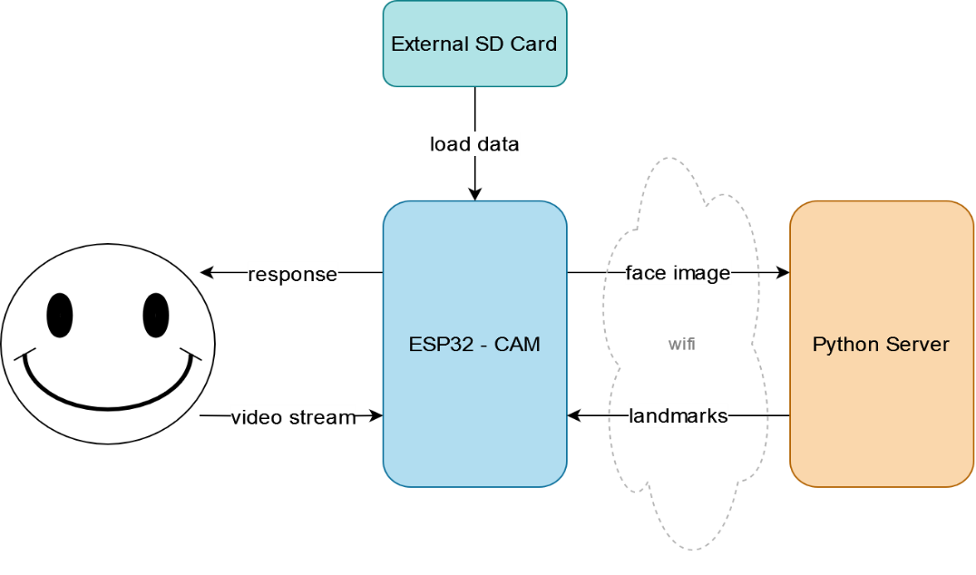
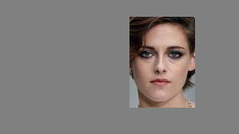
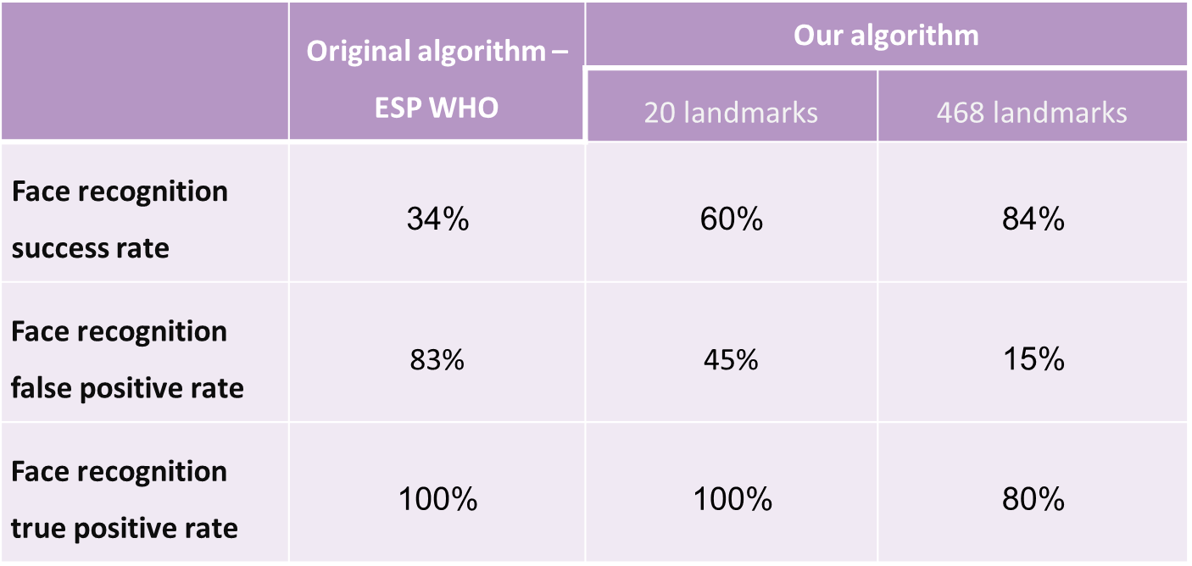
ESP32-cam door control system
Yael Tzadik & Eden Ishay, supervised by Johanan Erez
Introduction
Bluetooth connection
Our project introduces a cutting-edge Face Recognition System utilizing the ESP32 Camera, designed to offer a seamless, efficient, and cost-effective solution for various applications, ranging from smart homes to secure workplaces.
The ESP32 is a low-cost, low-power system on a chip (SoC) with integrated Wi-Fi and Bluetooth capabilities, thus the project considers its hardware limitations.
The project also respond to the danger of spoofing, where unauthorized individuals may deceive the system using fake images or videos.
When starting the system or restarting it, a Bluetooth connection named “Door Lock” is available. It makes the system user friendly and mobile.
The ESP32-CAM can be communicated through Bluetooth terminal by the following the stages below:
Full FaceMesh
20 landmarks
The facial recognition algorithm, based on facial landmarks, measures the distances between each landmark and a reference point.
These measurements are then compared to a database of distances from other images.
Set-Up Using Bluetooth connection
$$distance of point \#i= \sqrt{{\left(x_{0}−x_{i}\right)}^{2}+{\left(y_{0}−y_{i}\right)}^{2}}$$
Smile Detector
ESP32-CAMERA component
Bluetooth terminal using mobile app
Normalize the distances of the points using fixed nose points as reference (blue),
Detect:
20% increase in horizontal distance (red)
100% increase in vertical distance (green)
Main Goal
Develop a facial recognition system for door access utilizing ESP32-CAM module.
Create an anti-spoofing algorithm, all implemented on the ESP32-CAM.
Design a portable system that is not restricted to a specific network or a predefined list of authorized personal
Face Detection
MTMN model for face and landmarks detection
Challenges
Horizontal change
A small component with low computational capabilities.
Severe memory constraints.
MTMN architecture
vertical change
Main Solution
The image is sent to the server via HTTP protocol I JPEG format.
To expedite the image transmission process, all areas except the face are painted gray (0x808080) before sending.
Normalization reference
Results
The example code in the Arduino IDE crashes after recognizing more than 3 out of 5 people. Our system significantly improves this limitation.
Our system offers a more reliable solution with significantly fewer false positives.
Solution structure
Face detected
The system integrates three components:
ESP32-camera
External server using the HTTP protocol
External repository on an SD card
Communication between the device and the server is done via Wi-Fi.
Connection to WI-FI is done Via Bluetooth.
Authorized personal are loaded from SD card and can be changed by switching cards.
Communication time is reduced by 65%.
Face Recognition
Media Pipe FaceMesh provides 468 landmark points.
We selected 20 anatomically optimal points to differentiate between individuals
Results – comparison with existing solution
https://visl.technion.ac.il/projects/2024s08/ Technion, Haifa, July. 2024

