Slide 1




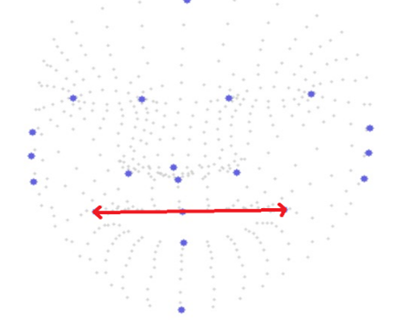
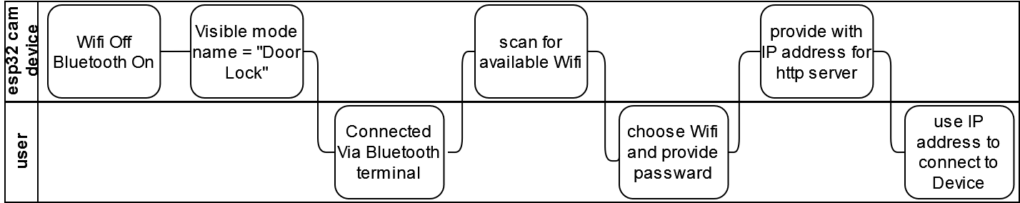
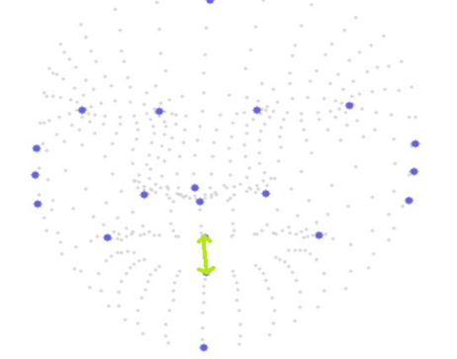
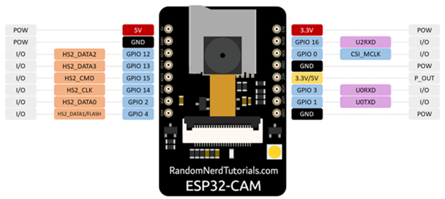
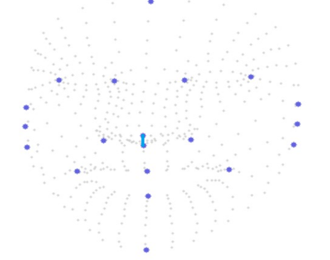
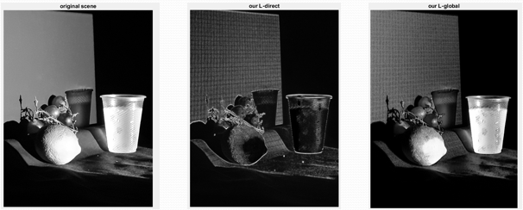
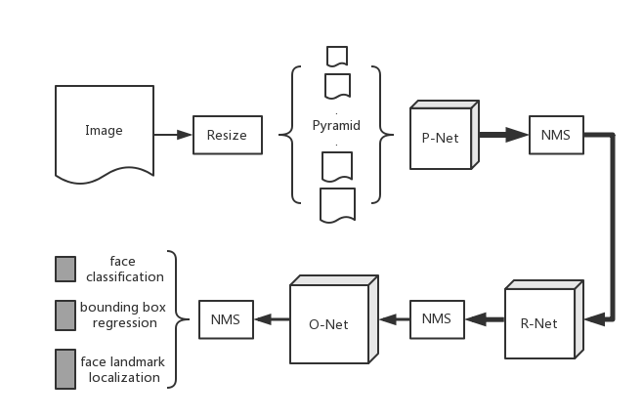
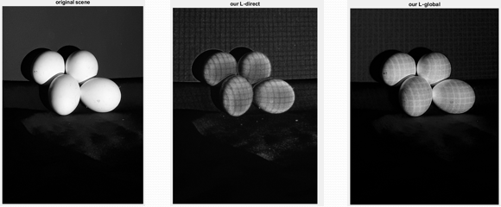
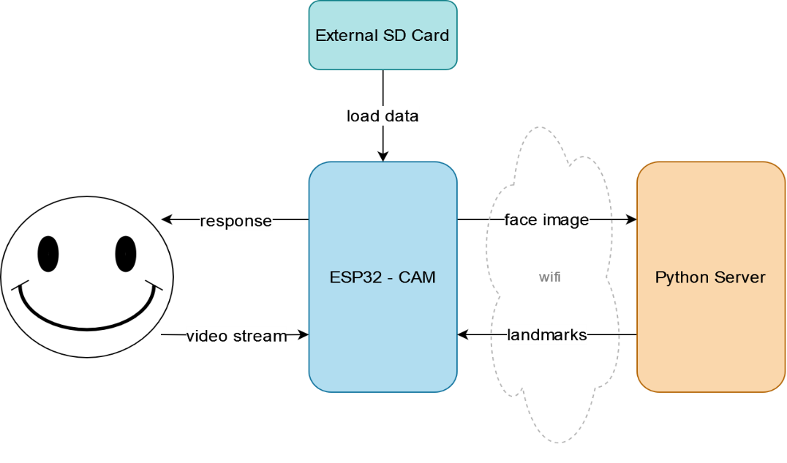
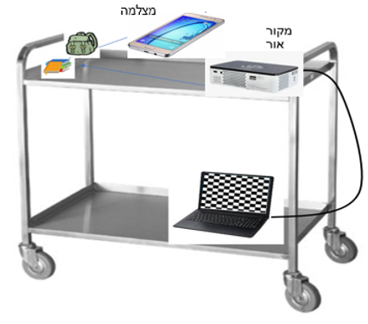
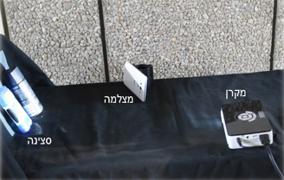
ESP32-cam door control system
Yael Tzadik & Eden Ishay, supervised by Johanan Erez
Introduction
Smile Detector
Bluetooth connection
Our project introduces a cutting-edge Face Recognition System utilizing the ESP32 Camera, designed to offer a seamless, efficient, and cost-effective solution for various applications, ranging from smart homes to secure workplaces.
the ESP32 is a low-cost, low-power system on a chip (SoC) with integrated Wi-Fi and Bluetooth capabilities, thus the project considers its hardware limitations.
The project also respond to the danger of spoofing, where unauthorized individuals may deceive the system using fake images or videos.
Normalize the distances of the points using fixed nose points as reference (blue),
Detect:
20% increase in horizontal distance (red)
100% increase in vertical distance (green)
When starting the system or restarting it, a Bluetooth connection named “Door Lock” is available. It makes the system user friendly and mobile.
The ESP32-CAM can be communicated through Bluetooth terminal by the following the stages below:
Set-Up Using Bluetooth connection
Horizontal change
vertical change
Main Goal
Develop a facial recognition system for door access utilizing ESP32-CAM module.
Create an anti-spoofing algorithm, all implemented on the ESP32-CAM.
Design a portable system that is not restricted to a specific network or a predefined list of authorized personal
Normalization reference
Results
Face Detection
MTMN model for face and landmarks detection
Challenges
A small component with low computational capabilities.
Severe memory constraints.
Full Direct Global
Main Solution
Face Recognition
Full Direct Global
Outside Experiment
We executed the same experiment outside the dark room, with the agenda of making it a mobile experiment.
The system integrates three components:
ESP32-camera
External server using the HTTP protocol
External repository on an SD card
Communication between the device and the server is done via Wi-Fi.
Mobile Set-Up
https://visl.technion.ac.il/projects/2024s08/ Technion, Haifa, July. 2024

