Slide 1
What is streaming?
client
A method of transmitting or receiving data (especially video and audio material) over a computer network as a steady, continuous flow, allowing playback to start while the rest of the data is still being received.
The client plays the video without actually copying and saving it.
The video loads a little bit at a time instead of the entire file loading at once.
The client can start playing from the middle of the video, jump, and doesn’t need to get to the end.
It allowed playing live video (no start or end needed).
server
client

Slide 2
Buffering
To play a video or audio the data need to be ready in advance.
In order to overcome some limitations in the network, the streaming media players load a few seconds of the stream ahead of time so that the video or audio can continue playing if the connection is briefly interrupted. This is known as buffering.
Buffering ensures that videos can play smoothly and continuously.
However, over slow connections, or if a network has a great deal of latency, a video can take a long time to buffer.
With the use of buffering of the content for just a few seconds in advance of playback, the quality can be much improved.
Playing now
Not yet receive
Buffer, already received.

Slide 3
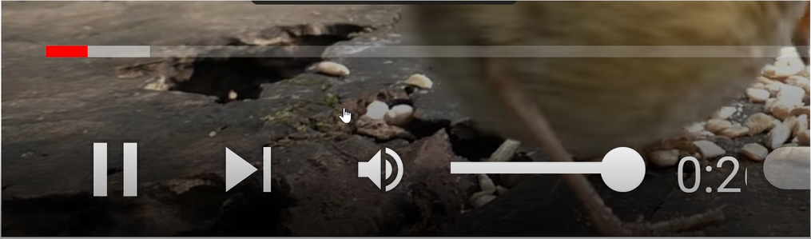
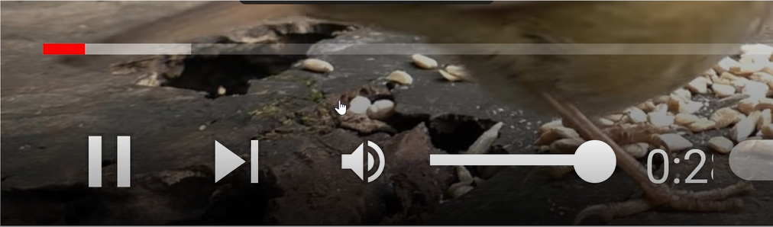
What is transaction?
Transaction is one jump int the buffer.
Transaction don’t have a fix size (in Bytes)
The duration between transaction is variable.
Also, the number of packets is not fix.
Transaction

Slide 4
YouTube traffic (packets).
While playing video, there are a lot of other connections besides the video connection that are passing traffic:
The HTTP browser.
Advertisements (can be a video as well).
Other applications that are running on the PC.
We will focus on the Video connection.
The video connection contains:
The video control (handshake).
The video traffic.
We will focus on the video traffic.
The YouTube video connection is encrypted.
What can we get from these encrypted packets:
IP header
UDP header
Packet size.
Arriving time.

Slide 5
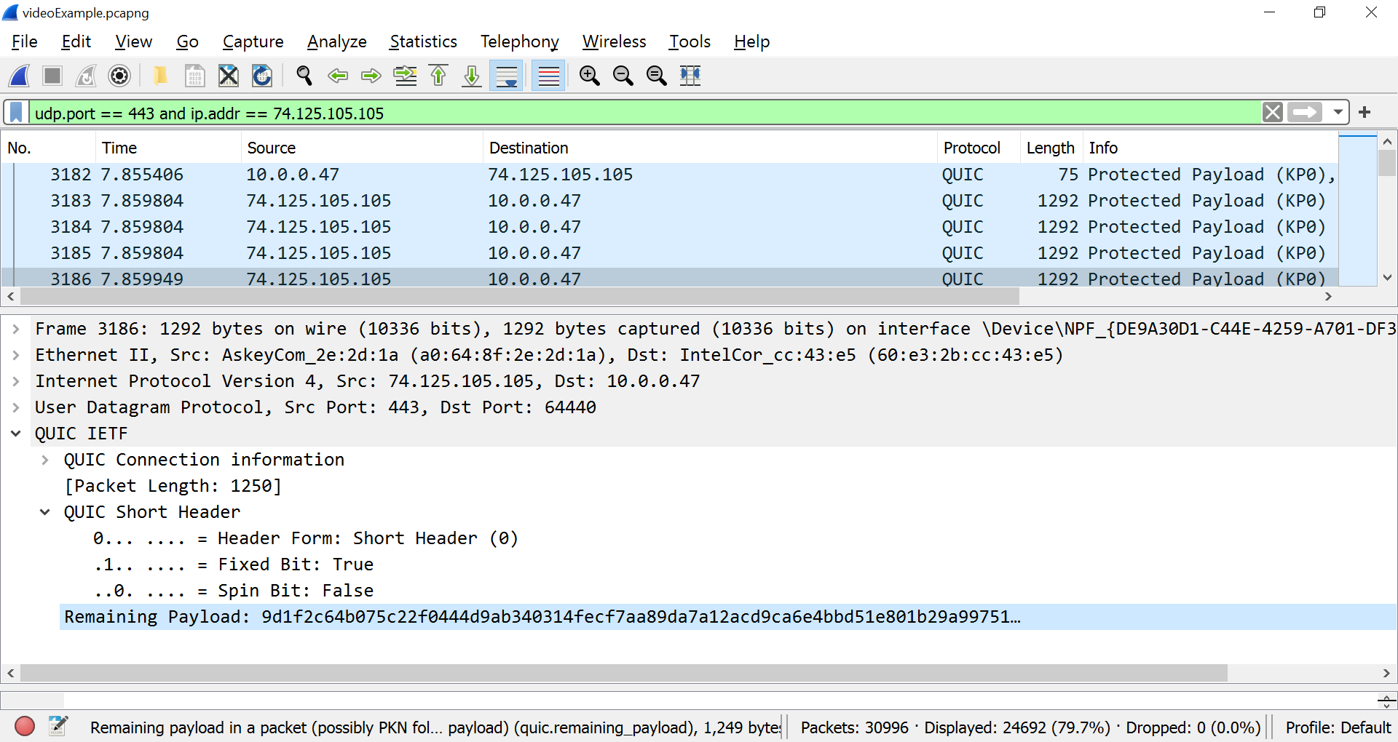
YouTube encrypted packet

Slide 6

UDP IP packets
In this project we will use:
Ethernet packet.
Only IPv4 packets (no IPv6).
No VLAN or other encapsulation.

Slide 7
UDP IP packet
14 Bytes | 20 Bytes | 8 B | 22 – 1500 Bytes | 4 B
MAC Header | IP Header | UDP Hdr | Data + Pad | CRC
A typical UDP packet will be look that:
The IP header in the packet:
The UDP header in the packet:
Bit | 0-7 |  | 8-15 |  | 16-23 |  | 24-31
0 | Ver | H Length | DSCP | ECN | Total Length
32 | Packet ID |  |  |  | Flags | Fragment Offset
64 | TTL |  | Protocol |  | Header Checksum
96 | Source IP Address
128 | Destination IP Address
Bit | 0-7 | 8-15 | 16-23 | 24-31
0 | Source port |  | Destination port
32 | Length |  | Header and Data Checksum

Slide 8
5 Tuple
We will use the 5 tuple to distinguish between different connections.
What are the 5 tuple:
Source IP Address.
From the IP header.
Size of 4 Bytes.
Destination IP Address.
From the IP header.
Size of 4 Bytes.
IP protocol.
From the IP header.
Size of 2 Bytes.
UDP source port.
From the UDP header.
Size of 2 Bytes.
UDP destination port.
From the UDP header.
Size of 2 Bytes.

Slide 9

The Project
Project Overview
Distinguish video packets of a Transaction from other packets.
Start/End video connection and transaction.
INI file.
Transaction Data Records (TDR) fields

Slide 10
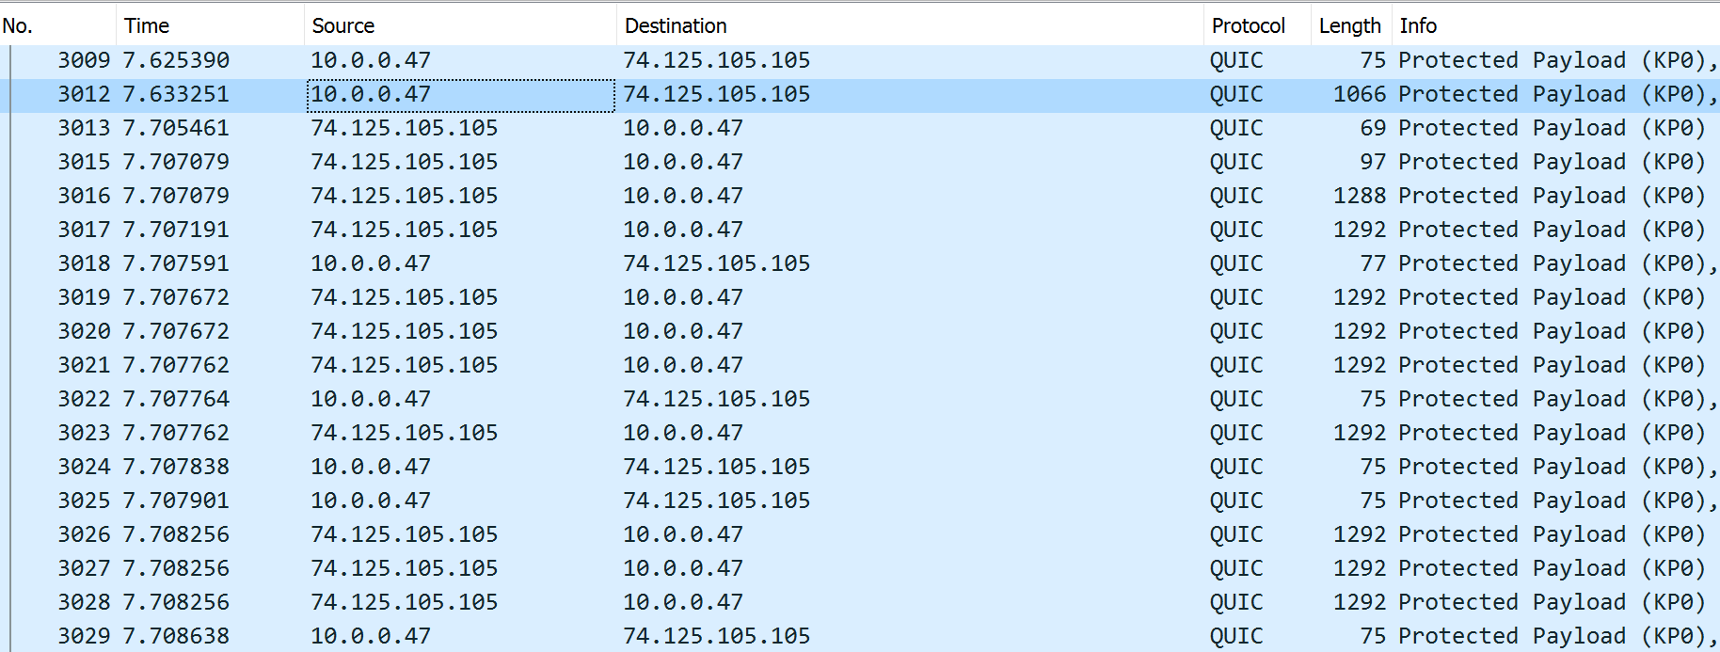
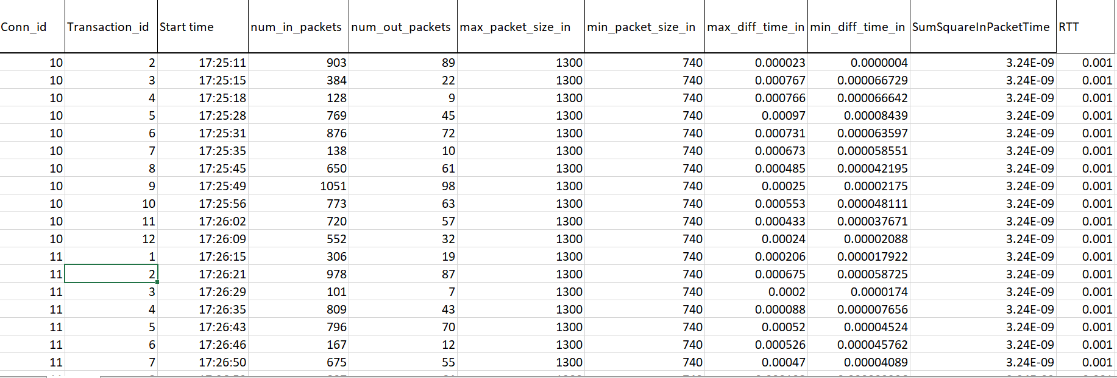
Project overview
The project will run on PCAP files that contain traffic from a real YouTube video session.
the project will analyze the traffic and will collect statistics per Video connection and per each transaction in the video connection.
In the end, after running on all the packets from the PCAP file, the project will convert the statistics that were collected into an SCV file.
Transaction Data record Project

Slide 11
Distinguish video packets of a Transaction from other packets.
A YouTube video connection uses the UDP port 443 (as a source or destination port).
The video connection is contained control and video (Data) packets.
In the client-to-server direction, outbound, We will treat packets that are bigger than "Request_packet_threshold" as Data packets.
In the server-to-client direction, inbound, We will treat packets that are bigger than "inbound_packets_in_range_min" as Data packets.
In this project, only Data packets will consider as part of a Transaction.

Slide 12
Start/End video connection and transaction
A video connection starts when a new 5 tuple with UDP source or destination port is equal to 443.
A transaction starts when the client sends a packet on the video connection that is bigger than “request_packet_threshold”.
A transaction ended when a new transaction start or the video connection ends.
A video connection will consider as valid if the connection contains more than “minimum_video_connection_size” bytes in all his transactions.
A video connection that didn’t pass the above will be discarded from the list.
A video connection end when no packet arrives on this connection for “video_connection_timeout” seconds.
The program ends when it reaches the end of file.

Slide 13
INI file.
The project should support an INI file that contains at least the following parameters:
request_packet_threshold – 700B
minimum_video_connection_size – 1MB
inbound_packets_in_range_min – 500B
inbound_packets_in_range_max – 2000B
outbound_packets_in_range_min – 0
outbound_packets_in_range_max – request_packet_threshold-1
max_diff_time_inbound_threshold – 500
min_diff_time_inbound_threshold - 500
number_of_videos_to_output_statistics_per_video – 3
max_number_of_connections – 1000
max_number_of_transaction_per_video - – 1000
video_connection_timeout – 20 seconds

Slide 14
Transaction Data Records (TDR) fields
Field name | Description
Conn_id | Connection id of the transaction
5_tuple | The 5 Tuple of this connection ID.
Transaction_id | The ID of the transaction in the connection
Start time | The time of the request of the transaction
num_inbound_packets_in_range | Number of packets from the server to the client with size in each range.
num_outbound_packets_in_range | Number of packets from the client to the server with size less than request size.
max_packet_size_inbound | Max packet size in inbound direction.
min_packet_size_inbound | Min packet size in inbound direction.
max_diff_time_inbound | Max diff time between two consecutive packets (size more than predefine size) in the inbound direction.
min_diff_time_inbound | Min diff time between two consecutive packets (size more than predefined size) in the inbound direction.
SumSquareInboundPacketTimeDiff | Sum of squared diff time between two consecutive inbound packets (for variance calculation)
RTT | Time between the request until the first packet from the server.

