Slide 1
HOTEL RESERVATIONS
FINAL PROJECT
October 2023

Slide 2
DATA SET AND STEPS
Reservation cancellation prediction
Kaggle data set from a hotel with booking variables and labels for a show a no-show in order to predict the future status of the reservations.
Followed steps
Graphs in Python
Cleaning
Modeling
Dashboard in Tableau
Conclusions

Slide 3
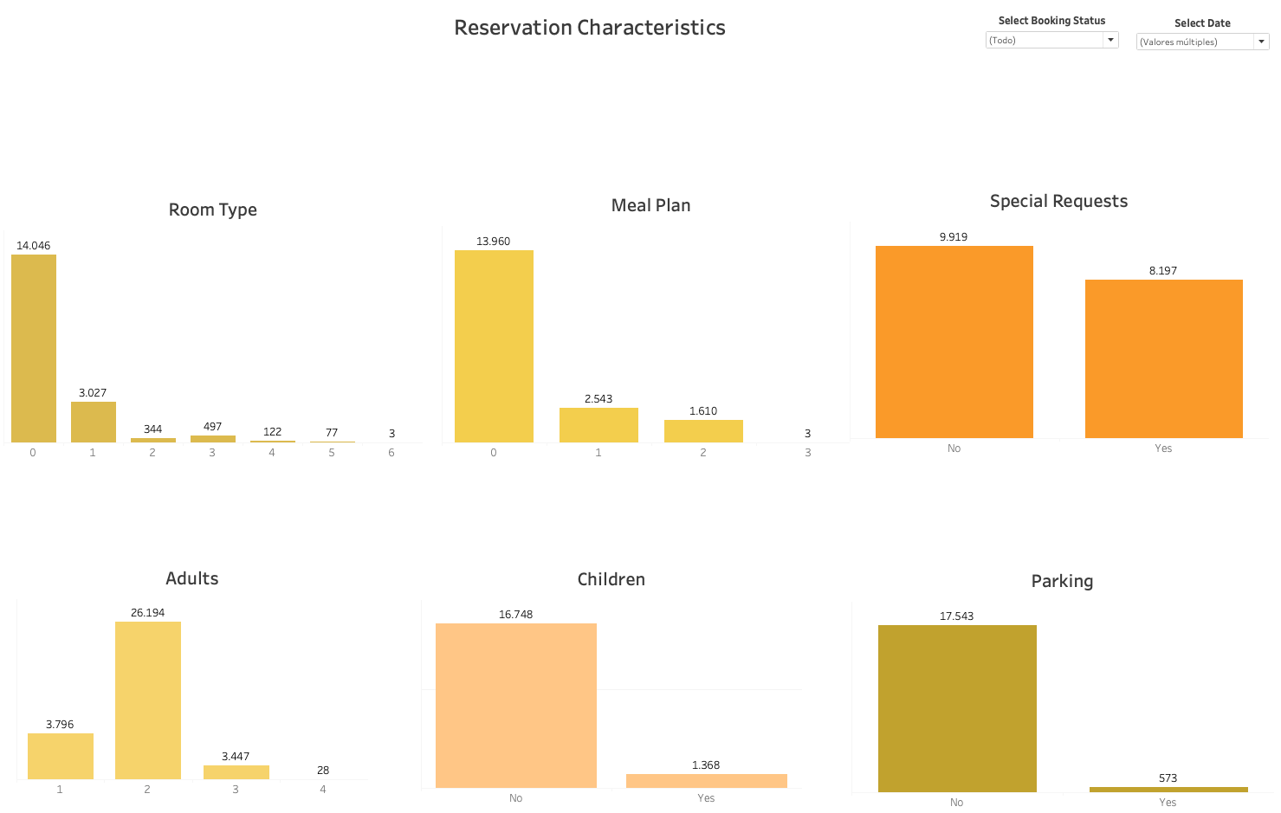
RESERVATION CHARACTERISTICS

Slide 4
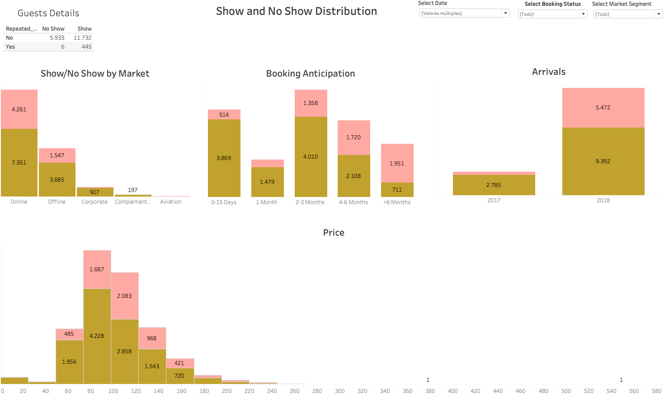
DASHBOARD FOR NO SHOW DISTRIBUTION

Slide 5
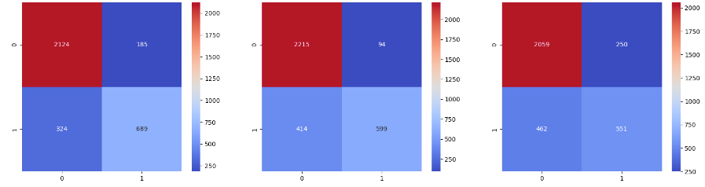
CLASSIFICATION MODELS
Decision Tree
Random Forest
Logistic Regression
Accuracy: 0.8535190063981934
Accuracy: 0.8448626270229582
Accuracy: 0.7870530673692134

Slide 6
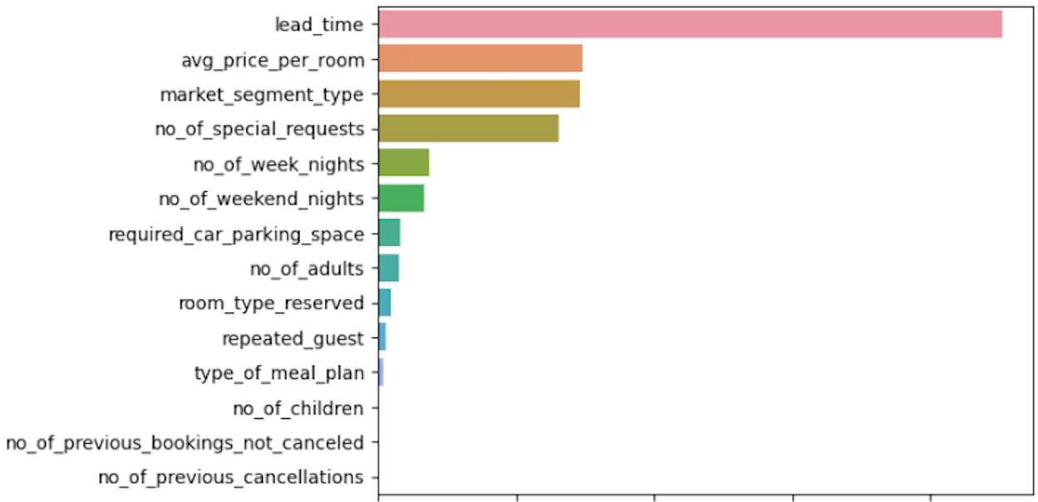
cONCLUSIONS
While lead time appears to have the highest feature importance, suggesting a significant role in predicting cancellations, further exploration of other variables paints a more nuanced picture. Notably, it seems that this hotel may be positioned as an affordable option, possibly catering to stopover stays or those booked for business purposes. This characteristic could explain why reservations are often made with relatively short lead times.
Considering the unique conditions of this hotel, it might be beneficial to tailor the predictive model specifically to similar establishments within the same category. This focused approach could enhance the model's accuracy by capturing patterns that are specific to hotels with comparable features and target audiences.
FEATURE IMPORTANCE

Slide 7
THANKS

