Slide 1
Ticket System
Done By:
Bulgan Galbadrakh
Guamaral Vasili
Yafei Geng

Slide 2
Agenda
About Ticket System
Problem Statement
Team Members
Used Technology
Main Classes & Web Presentation
Demo

Slide 3
About Ticket System
Ticket system is a system to search a movie you want to see in the cinema and buy the ticket for the movie.
There are 2 users: Admin & Customer

Slide 4
Problem Statement
You can buy movie ticket online. Don’t need to stand for a long line waiting to buy it.
Save a lot of time. You can buy the movie ticket for anytime and anywhere you want.

Slide 5
Team Members
Team Member Name | Use case
Bulgan Galbadrakh | Payment Module Reservation Module
Guamaral Vasil | Login Module Movie Module
Yafei Geng | Choose Seats Module

Slide 6
Used Technology
Spring Tool Suits:
Java
Spring MVC
Validation
Annotation
Java Script
Ajax
CSS
HTML 5
Jquery
DataBase - Mysql

Slide 7
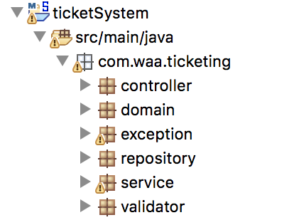
Main Classes & Web Presentation
Controller
Service
Repository
Domain
Jsp
Css
Java Script

Slide 8
Demo
Ticket System
http://localhost:8080/TicketSystem

