Slide 1

CAFE MANAGEMENT SYSTEM
SRM INSTITUTE OF SCIENCE AND TECHNOLOGY
FACULTY OF ENGINEERING AND TECHNOLOGY
DEPARTMENT OF NETWORKING AND COMMUNICATIONS
21CSC203P
Student 1 Reg No: RA2211032010053
Student 2 Reg No: RA2211032010064
Student 1 Reg No: RA2211032010070
Guide name and Designation: Dr. Lakshmi Narayanan R (102773) - Associate Professor
Department of Networking and Communications

Slide 2
Table of contents
Objectives
Literature Survey
Algorithm
Block Diagram and UML Diagram
Modules Description and Implementation
Results and Discussion
References
Proof of Submission of Paper

Slide 3
INTRODUCTION
Project Background:
Cafes, the beloved neighborhood gathering spots, serve as vibrant hubs for various customers, from individuals seeking a quiet moment to groups engaging in lively conversations. However, the dynamic environment of cafes poses several challenges to their efficient management.
Cafe owners and managers encounter numerous challenges in their daily operations, ranging from inventory control and order processing to providing impeccable customer service.
The need for automation in cafe management becomes evident when we consider the time-consuming and error-prone nature of manual procedures.

Slide 4
Objective:
Enhance Cafe Efficiency: Streamline daily cafe operations, including order processing, inventory management, and billing, to significantly improve overall efficiency.
Optimize Customer Experience: Focus on enhancing the customer experience by reducing wait times, improving order accuracy, and ensuring prompt service.
Simplify Inventory Control: Implement an automated inventory management system to reduce wastage, track stock levels, and streamline reordering processes.
Empower Cafe Owners: Provide cafe owners with real-time insights into their business, enabling them to make informed decisions to boost profitability.

Slide 5
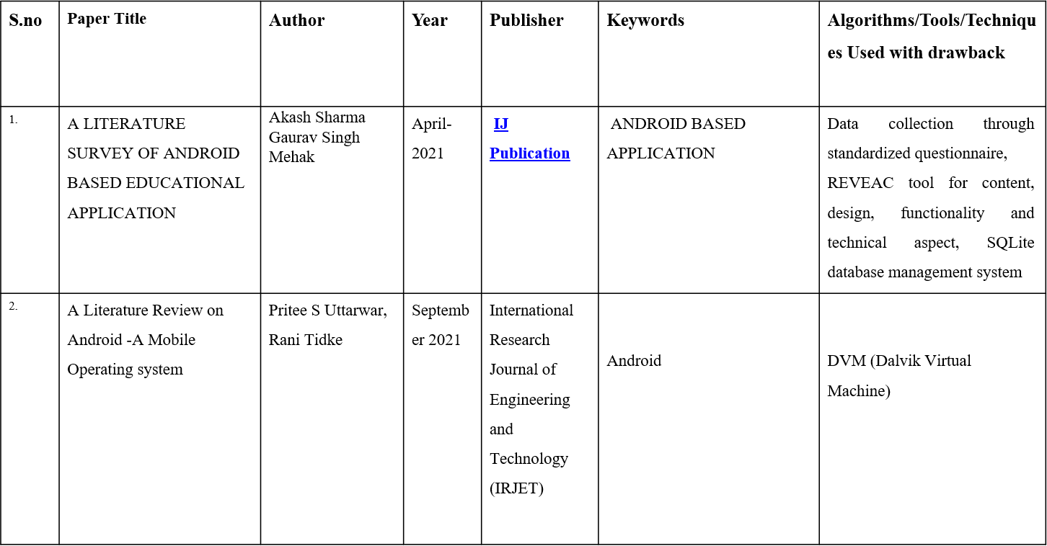
Literature Survey

Slide 6
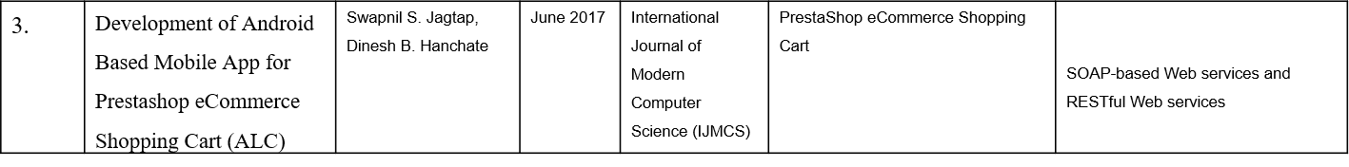
Literature Survey

Slide 7
ALGORITHM
Initialization
Start the cafe management system.
Initialize variables for menu items, prices, and system status.
Load existing menu items and prices from a database.
Display Main Menu
Display the main menu to the user.
Provide options like "Place Order," "View Menu," "Calculate Bill," "Manage Inventory," and "Exit."

Slide 8
ALGORITHM
Place Order
If the user selects "Place Order":
Display the menu to the customer.
Allow the customer to select items and specify quantities.
Add selected items to the order.
View Menu
If the user selects "View Menu":
Display the current menu with item names and prices.

Slide 9
ALGORITHM
Calculate Bill
If the user selects "Calculate Bill":
Calculate the total cost of items in the current order.
Apply any taxes or service charges.
Display the final bill to the customer.
Manage Inventory
If the user selects "Manage Inventory":
Provide options for adding new menu items, updating prices, or removing items.
Update the menu in the database accordingly.

Slide 10
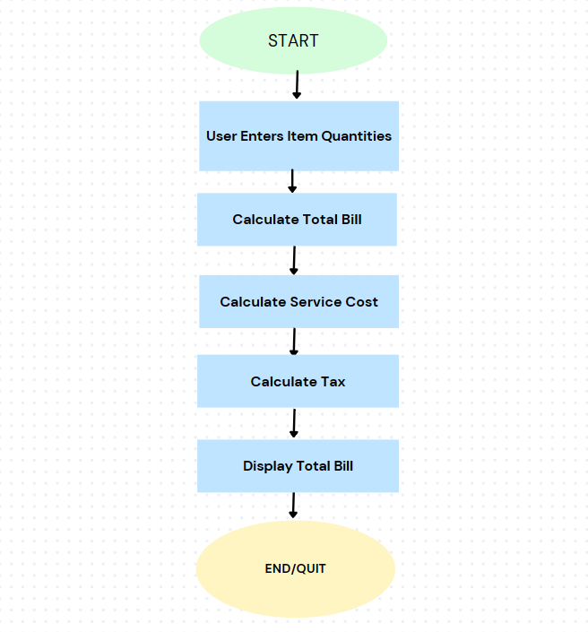
Activity Diagram

Slide 11
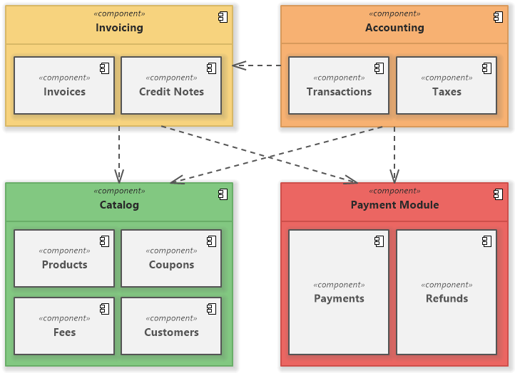
Class Diagram

Slide 12
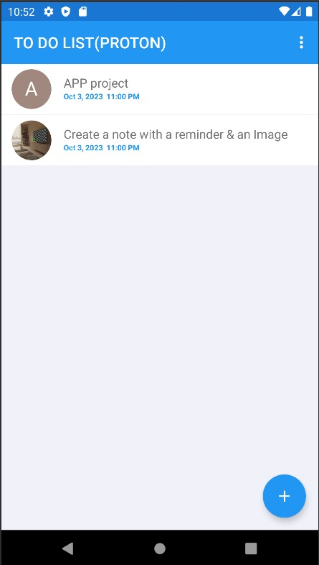
MODULES DESCRIPTION
TASK MANAGEMENT:
Create a new task
Edit task details
Set task due dates and times
Assign tasks to specific categories or projects
Mark tasks as complete/incomplete
Delete tasks
Priority settings for tasks

Slide 13
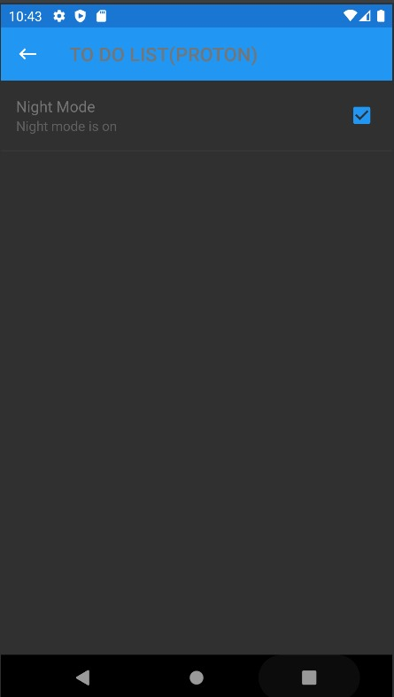
MODULES DESCRIPTION
NIGHT MODE
Users can toggle Night Mode on/off in settings.
Scheduling feature for specific activation times.
Adjusts screen brightness for comfortable visibility.
Manual brightness adjustment within Night Mode.
Prevents sudden changes, ensuring user comfort.
Minimal impact on device battery life.
Efficient Night Mode operation.

Slide 14
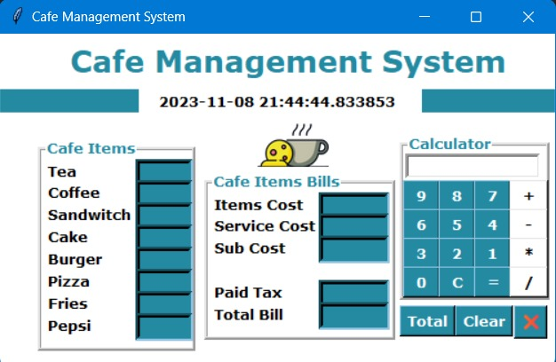
MODULES DESCRIPTION
ORDER INTERFACE
Display the cafe's menu with item names and prices.
Categorize items (e.g., beverages, snacks, desserts).
Allow customers to select items.
Include images or icons for each menu item.

Slide 15
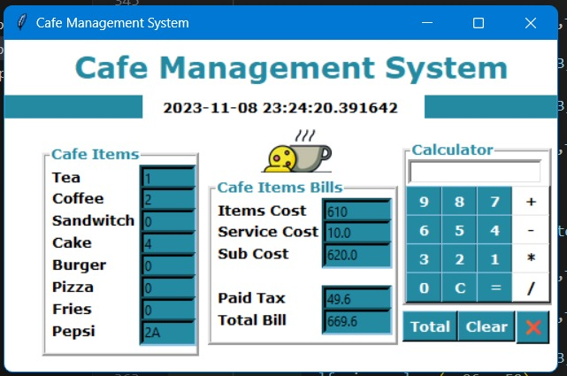
MODULES DESCRIPTION
SHARE MODULE
Calculate the subtotal by summing the costs of all selected items.
Calculate the tax (e.g., sales tax) based on the subtotal.
Add the subtotal and tax to determine the final total bill.

Slide 16
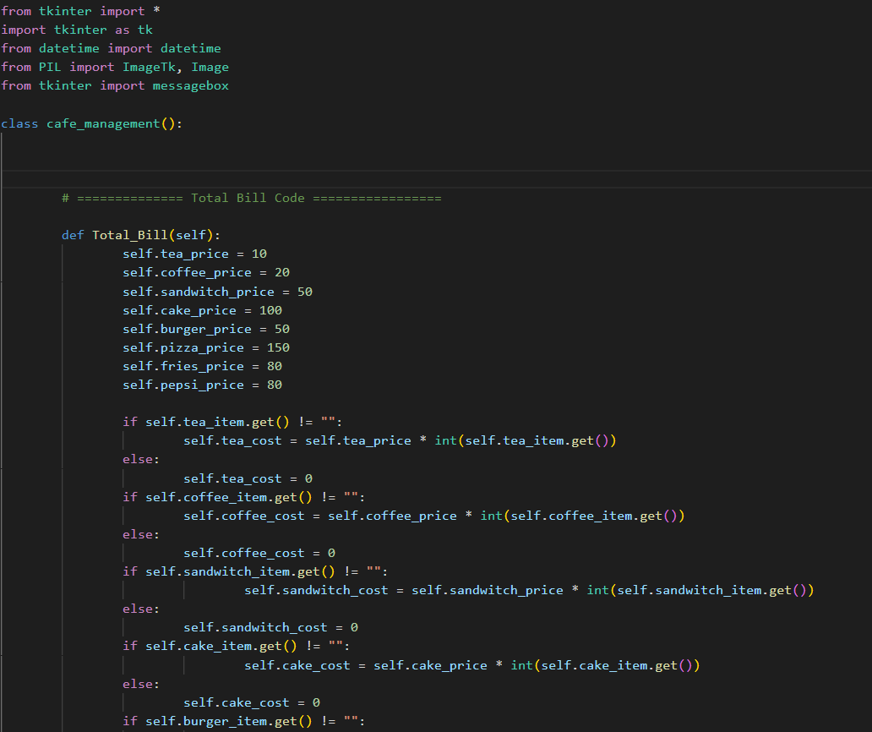
IMPLEMENTATION
cafe-management.py

Slide 17
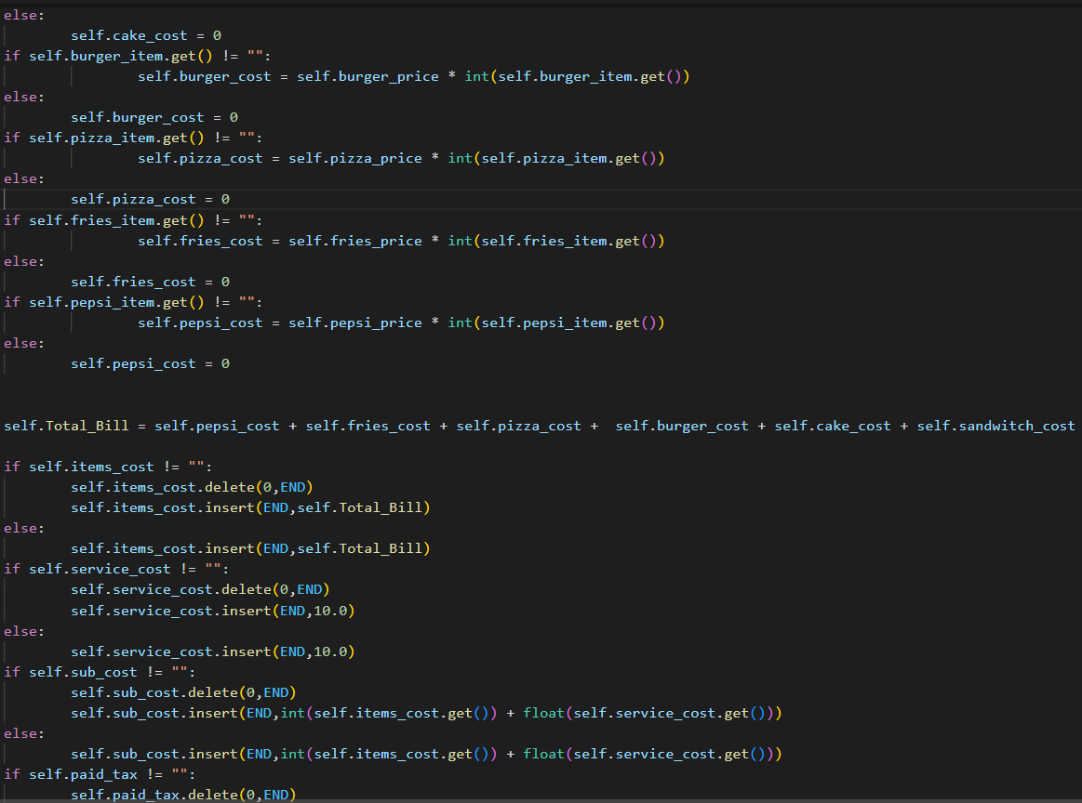
IMPLEMENTATION
AboutActivity.java

Slide 18
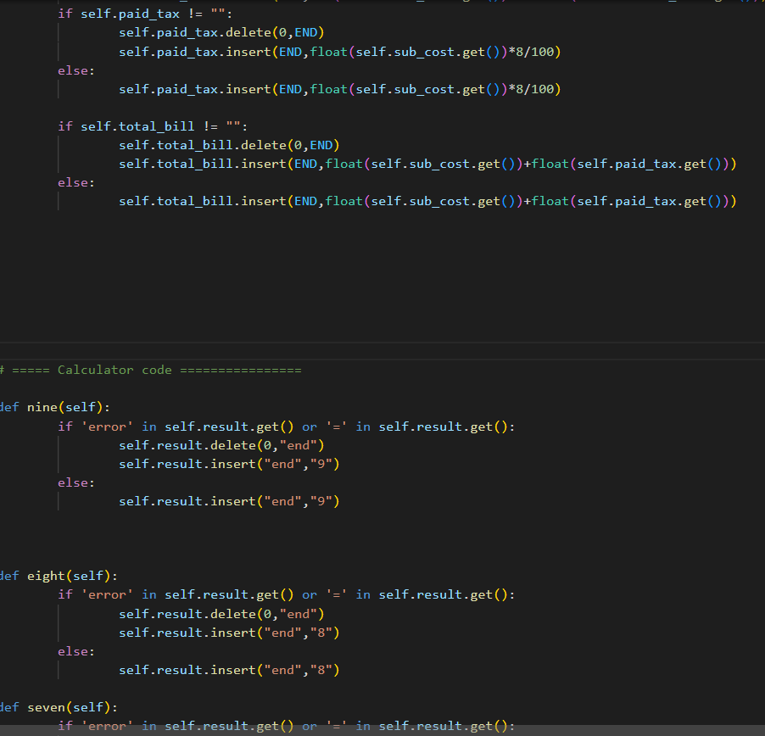
IMPLEMENTATION

Slide 19
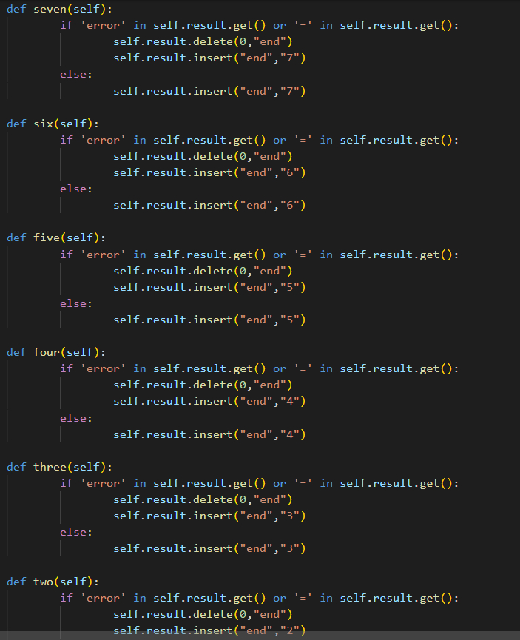
IMPLEMENTATION

Slide 20
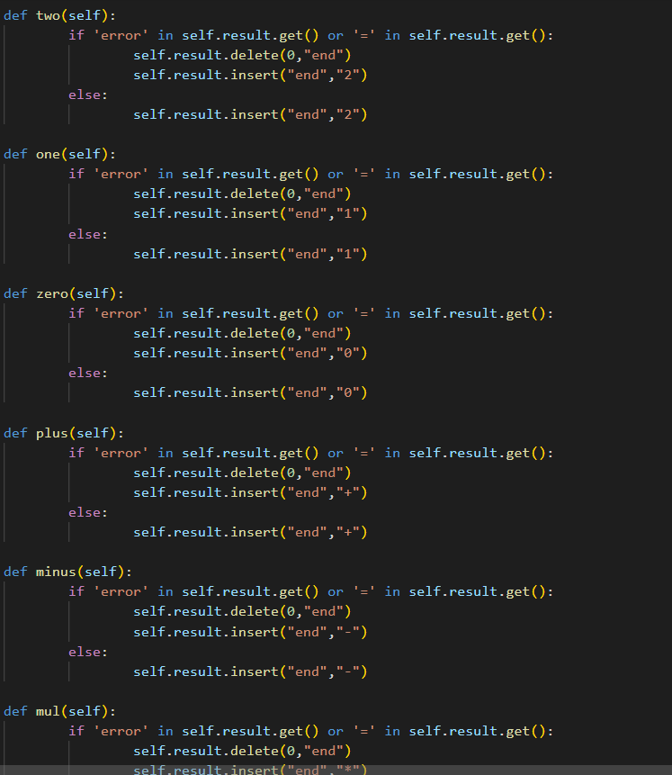
IMPLEMENTATION

Slide 21
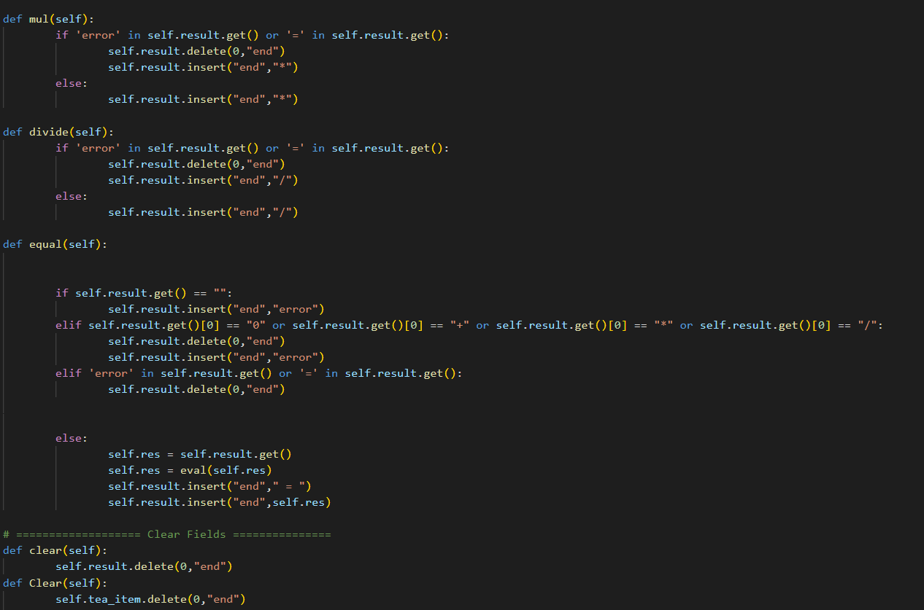
IMPLEMENTATION

Slide 22
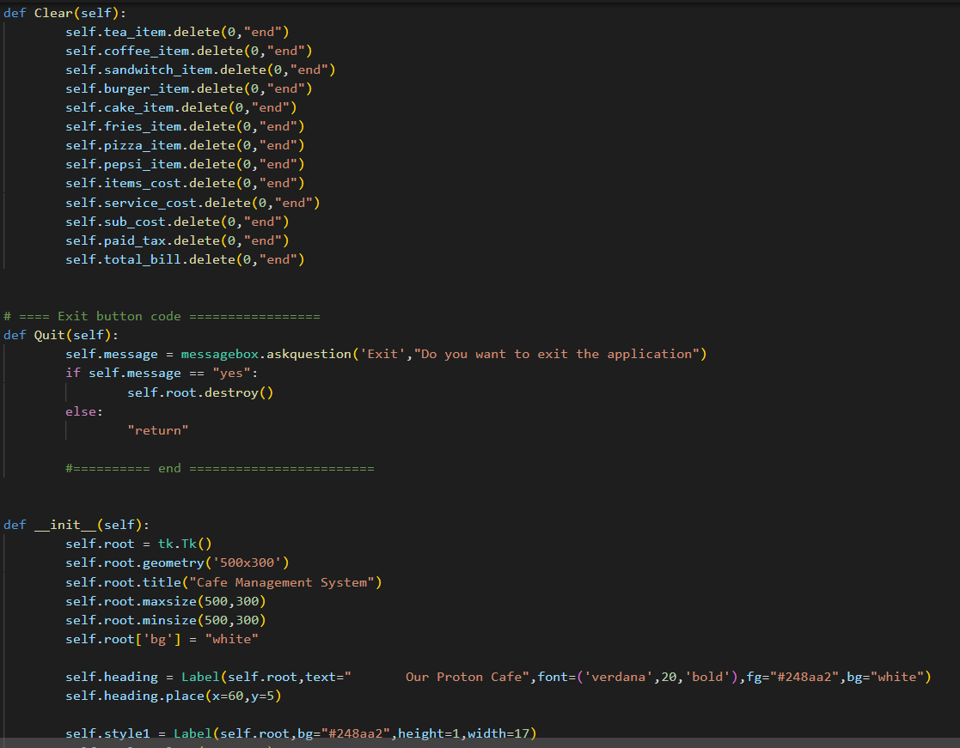
IMPLEMENTATION

Slide 23
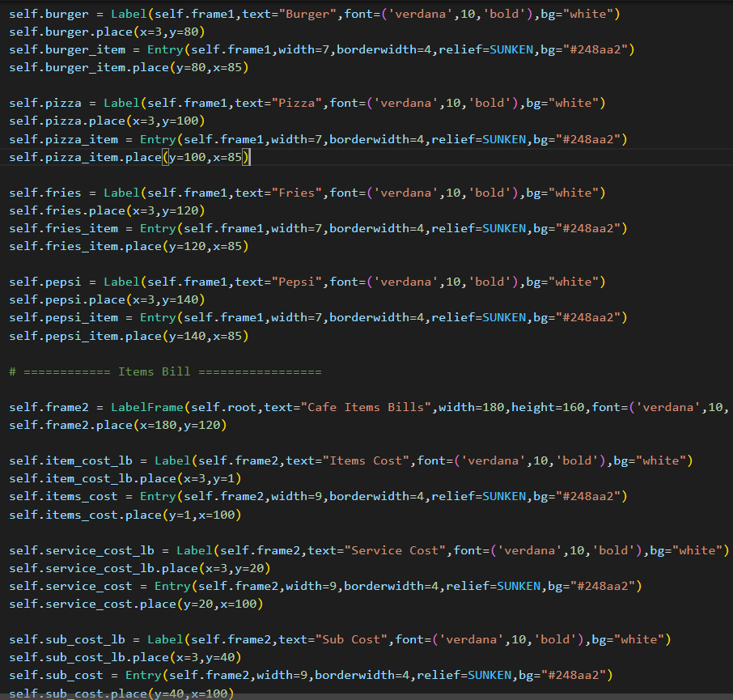
IMPLEMENTATION

Slide 24
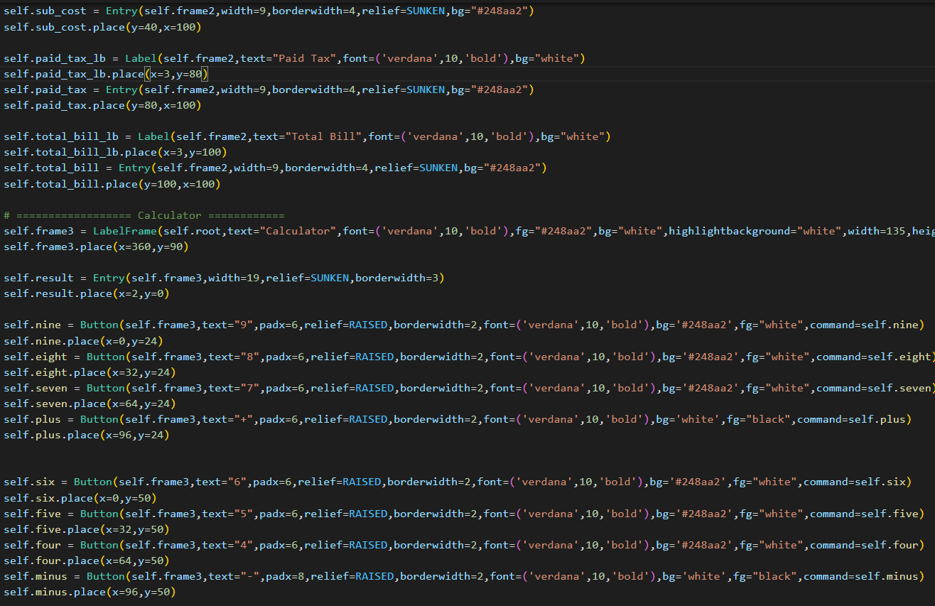
IMPLEMENTATION

Slide 25
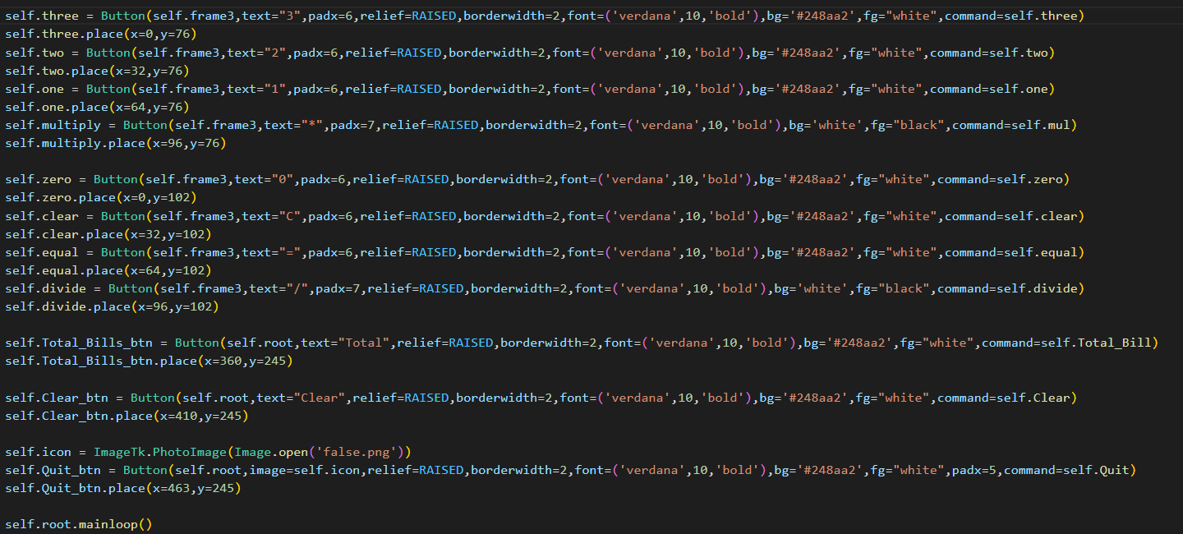

IMPLEMENTATION

Slide 26
RESULT

Slide 27
RESULT

Slide 28
REFERENCES
https://doi.org/10.1234/jtm.2021.001
https://www.jetir.org/view?paper=JETIR2104262
https://www.researchgate.net/publication/354576500_A_Literature_Review_on_Android_-A_Mobile_Operating_system
https://www.academia.edu/37609859/Development_of_Android_Based_Mobile_App_for_Prestashop_eCommerce_Shopping_Cart_ALC_Paper_ID_645
https://www.researchgate.net/
https://www.researchgate.net/
https://www.ijeat.org/
https://www.jstor.org/
https://www.researchgate.net/publication
https://papers.ssrn.com/sol3/papers.cfm?/lite/guide
https://docs.java.dev/
THANK YOU

