Slide 1
Diabetes analysis and risk calculation – Auto rebuild model by using Flask API
Team Name : Eswar_hyderabad
Team members: Yaganteeswarudu Akkem
Email : yaganteeswaritexpert@gmail.com

Slide 2
Abstract :
Diabetes analysis in many existing systems considered few parameters like age, sex, bmi, insulin, glucose, blood pressure, diabetes pedigree function, pregnancies. But in this paper we considered in addition to age, sex, bmi, insulin, glucose, blood pressure, diabetes pedigree function, pregnancies we included serum creatinine, potassium, GlasgowComaScale, heart rate/pulse Rate,respiration rate,body temparature,low density lipoprotein(LDL),high density lipoprotein (HDL),TG (Triglycerides). Our paper includes analysis of Pima Indian diabetes datasets which is available in UCI machine learning repository, the data set which was acquired from a hospital in Frankfurt, Germany and also visited some local hospitals to get Data sets for diabetes analysis. Due to analysis includes all parameters which causes diabetes, which may be helpful in detecting diseases like heart disease, neuropath, retinopathy, hearing loss, and dementia. This paper main aim is to analyse the datasets by using different machine learning algorithms along with parameter tuning. One more important feature of this article is to analyse diabetes risk factor and based on risk factor providing suggestions to the patients.
The importance of this paper is continuously monitoring the model, if model accuracy reduces rebuilds the model and suggest the best model. We prepared Flask API to consume this model and integrated in frontend. So that if user calls this API it will produce diabetes status of the patients. We have collected live samples of datasets from apple phone readings and reached many hospitals for live data sets and in each time if any accuracy reduces in current model it will automatically rebuilt and considers the model which will produce better accuracy.

Slide 3
Pre-processing ( Trainset and test set preparation)
Initially used pima Indian diabetes data set
Second data set used was data set collected from hospital in Frankfurt, Germany
Used Python library for train set and test set preparation

Slide 4
Parameters included in analysis:
Many Existing systems used only few parameters to analyze diabetes
But in current implementation considered all parameters which cause diabetes like to age, sex, bmi, insulin, glucose, blood pressure, diabetes pedigree function, pregnancies we included serum creatinine, potassium, GlasgowComaScale, heart rate/pulse Rate,respiration rate,body temparature,low density lipoprotein(LDL),high density lipoprotein (HDL),TG (Triglycerides)
Due to including lot of parameters it is useful to identify diseases caused due to diabetes like heart disease, neuropath, retinopathy, hearing loss, and dementia.

Slide 5
Data flow :
Below diagram represents data flow in the application
Data set preparations , model design and model evaluation
Risk calculation
Auto rebuilding model when performance level decreases
Flask API Design

Slide 6
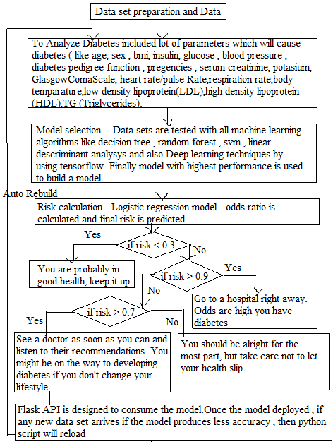

Slide 7
Data cleaning sample code :
Ideally a living person BP can not be zero or glucose can not be zero
Sample code :
diabetes_mod = df[(df.BloodPressure != 0) & (df.BMI != 0) & (df.Glucose != 0)]

Slide 8
Sample code for machine learning algorithms
Random forest:
rmfr = RandomForestClassifier(n_estimators=50)
rmfr.fit(x_train, y_train)
y_pred = rmfr.predict(x_test)

Slide 9
Parameters Tuning
Each algorithm is parameter tuned to achieve better accuracy
Ex : max_depth tuning in random forest
max_depth represents the depth of each tree in the forest. The deeper the tree, the more splits it has and it captures more information about the data. We fit each decision tree with depths ranging from 1 to 32 and plot the training and test errors.
Sample code:
rmfr = RandomForestClassifier(max_depth=15,n_jobs=-1)
rmfr.fit(x_train, y_train)
y_pred = rmfr.predict(x_test)

Slide 10
Deep learning implementation by using tensorflow
Sample code :
import numpy
model = Sequential()
model.add(Dense(12, input_dim=8, activation='relu'))
model.compile(loss='binary_crossentropy', optimizer='adam', metrics=['accuracy'])
model.fit(x_train, y_train, epochs=150, batch_size=10)
scores = model.evaluate(x_test,y_test)
print("\n%s: %.2f%%" % (model.metrics_names[1], scores[1]*100))

Slide 11
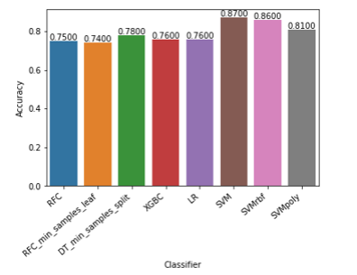
Sample Chart generated for different algorithms and their accuracy

Slide 12
Final model Development :
Model which giving highest performance is developed.
Algorithms tested by using train set and test set. And also used cross fold validation

Slide 13
Flask API:
Flask API is a drop-in replacement for Flask that provides an implementation of browsable APIs similar to what Djano Rest Framework provides. It gives you properly content negotiated-responses and smart request parsing:

Slide 14
Creating a pickle file:
To store model status pickle file in python is used
Sample code :
sv = svm.SVC(kernel='linear')
sv.fit(x_train,y_train)
pred = sv.predict(x_test)
p.dump(sv, open('final_diabetes.pickle', 'wb'))

Slide 15
Load the pickle file:
Sample code :
if __name__=='__main__':
modelfile='final_diabetes.pickle'
model=p.load(open(modelfile,'rb'))

Slide 16
Flask API :
Sample code:
def diabetescondition():
url="http://localhost:5000/diabetesprediction"
Pregnancies = request.form['Pregnancies']
Glucose = request.form['Glucose']
BP = request.form['BP'] ST = request.form['ST']
Insulin = request.form['Insulin'] BMI = request.form['BMI']
DPF = request.form['DPF'] Age = request.form['Age']
data=[[Pregnancies,Glucose,BP,ST,Insulin,BMI,DPF,Age]]
j_data=json.dumps(data)
headers={'content-type':'application/json','Accept-Charset':'UTF-8'}
r=requests.post(url,data=j_data,headers=headers)

Slide 17
Risk calculation:
Sample code:
def diabetes_risk_prediction(glucose, bp, skinthickness, insulin, bmi, age):
indicator_list = [int(glucose), int(bp), int(skinthickness), int(insulin), int(bmi), int(age)]
predictions = model1.predict_proba(np.array(indicator_list).reshape(1, -1))
risk = predictions[0,1]
print("-"*len("Health Indicator Analysis"))
print("Health Indicator Analysis")
print("-"*len("Health Indicator Analysis"))
riskdata=""
if risk < 0.3:
riskdata="You are probably in good health, keep it up. \n"
#print("-"*len("You are probably in good health, keep it up"))
elif risk > 0.9:
riskdata="Go to a hospital right away. Odds are high you have diabetes."

Slide 18
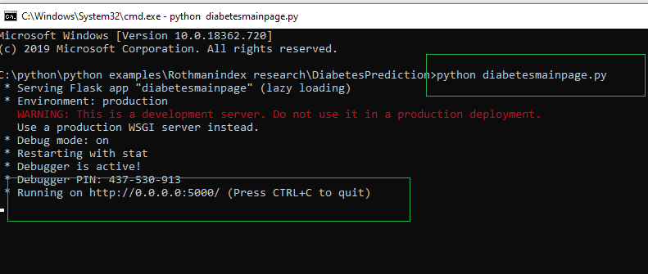
Running the application:
Step1 : Run Diabetes main page, it will start flask server

Slide 19
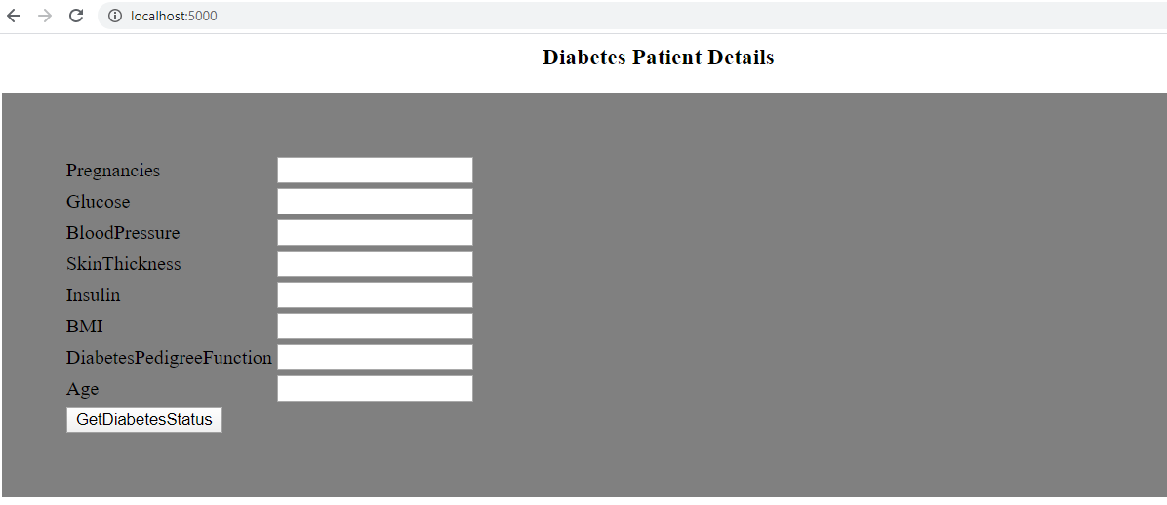
Run the server in any browser and I have designed a sample html page to access the diabetes patients input values

Slide 20
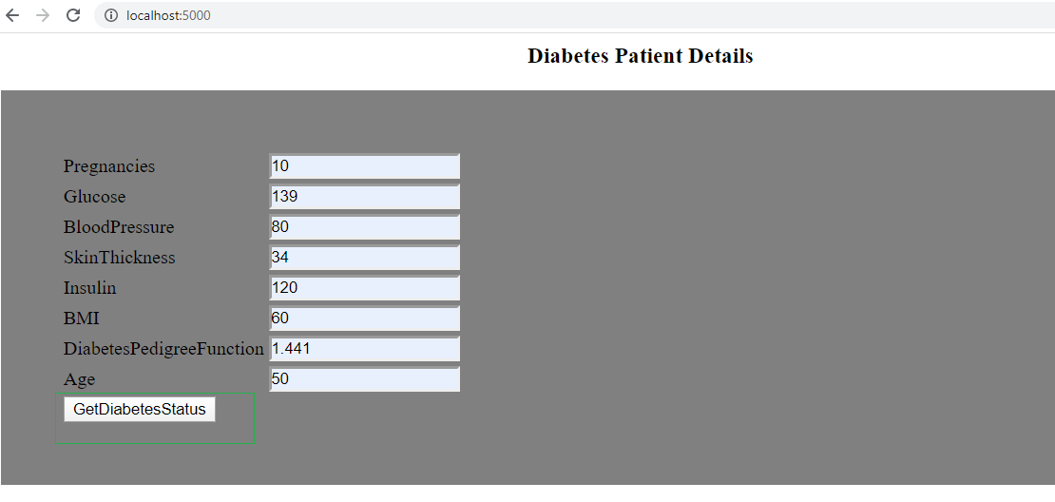
Enter input values and click on get diabetes status

Slide 21
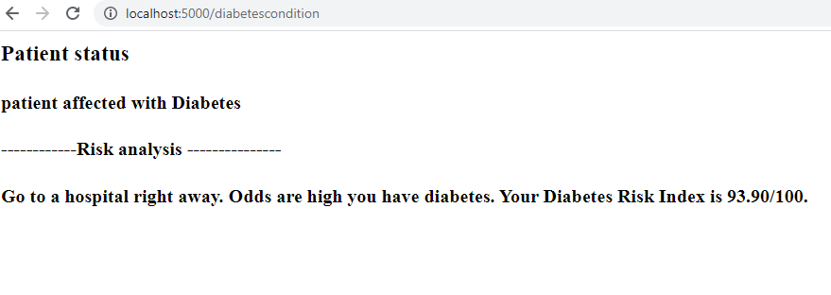
Output:

