Slide 1



Shri Vishnu Engineering College For Women
(Autonomous)
AN INNOVATIVE YOUTH OBESTIY FRAMEWORK WITH MULTILEVEL CLASSIFICATION BY HARNESSING ML TECHNIQUES
Guided by: Dr. V V R Maheswara Rao
Presented by:
22B01A0573
22B01A0586
22B01A05B3
23B05A0511

Slide 2


PRESENTATION INCLUDES
Introduction
Literature Survey
Proposed work
Implementation
Results
Conclusion
References

Slide 3
INTRODUCTION
In modern times, obesity has become a significant threat all over the world. Obesity means an unnatural or excessive amount of fat that is present in our bodies.
People are constantly moving towards an unhealthy lifestyle, eating excessive junk food, late-night sleep, spend a long time sitting down. Especially, adolescents are being affected because of their unconscious attitudes.
Obesity is considered a principal public health concern and ranked as the fifth foremost reason for death globally . Overweight and obesity are one of the main lifestyle illnesses that leads to further health concerns and contributes to numerous chronic diseases, including cancers, diabetes, metabolic syndrome, and cardiovascular diseases. The World Health Organization also predicted that 30% of death in the world will be initiated with the lifestyles disesses in 2030.

Slide 4

INTRODUCTION
This project is regarding to move towards machine learning pathways for predicting the risk of obesity using machine-learning algorithms.In this project we apply five prominent machine learning algorithms.Those are
1.Optimized tree
2.Logistic Regression
3.Optimized SVM
4.Boosted trees
5.Neural network
we evaluated the performance of each classification model using some key performance metrics.
From the experimental results, we determine that optimized SVM receives highest accuracy compared to all classifiers

Slide 5
LITERATURE SURVEY
we read some researcher's work. This section of the paper deals with all of the past and present work that predicted the risk of obesity. We followed their work and tried to understand their demonstrated method, which was applying by them. Some of them are:
Dugan et al predict obesity in children after age two. They used six models to test for their study. They got the best performance from the model ID3, with accurate 85% and sensitive at nearly 90%.
Jindal et al works on predicting obesity using ensemble machine learning approaches. Their predicted value of obesity was 89.68% accurate to propose an ensemble machine learning approach to the prediction of obesity
Hammond et al(2019) used electronic health records and public data to predict childhood obesity by age five using various machine learning algorithms. They applied logistic regression achieving reasonable accuracy by analyzing data from the first two years.

Slide 6
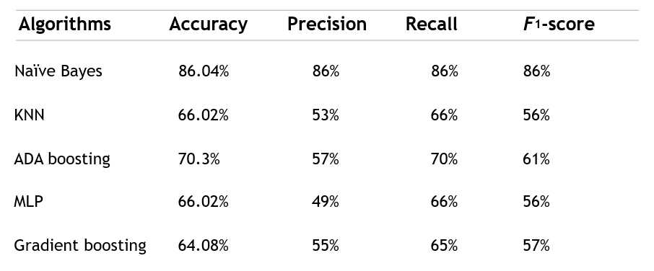
LITERATURE SURVEY

Slide 7
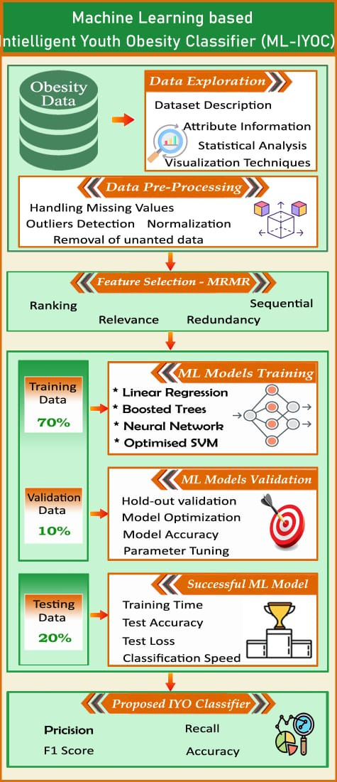
Proposed Machine learning based Intelligent Youth Obesity Classifer (ML-IYOC)
The research introduces the Machine learning based intelligent Youth Obesity Classifer (ML-IYOC) as presented.
In this by using multi level classification we classify the obesity levels.We categorize them into
1.Insufficient weight
2.Normal weight
3.Obesity type 1
4.Obesity type 2
5.Obesity type 3
6.Overweight type 1
7.Overweight type 2

Slide 8
Proposed Machine learning based Intelligent Youth Obesity Classifer (ML-IYOC)
The working of the system starts with the collection of data and selecting the important attributes. Then the required data is processed into the required format. The data is then divided into two parts training and testing data. The algorithms are applied and the model is trained using the training data. The accuracy of the system is obtained by testing the system using the testing data. This system is implemented using the following modules.
1. Collection of Dataset.
2. Data Processing
3. Splitting of dataset
4. Applying different algorithms
5. checking accuracy scores of algorithms
6. Applying different model evaluation techniques
7.Making decision

Slide 9
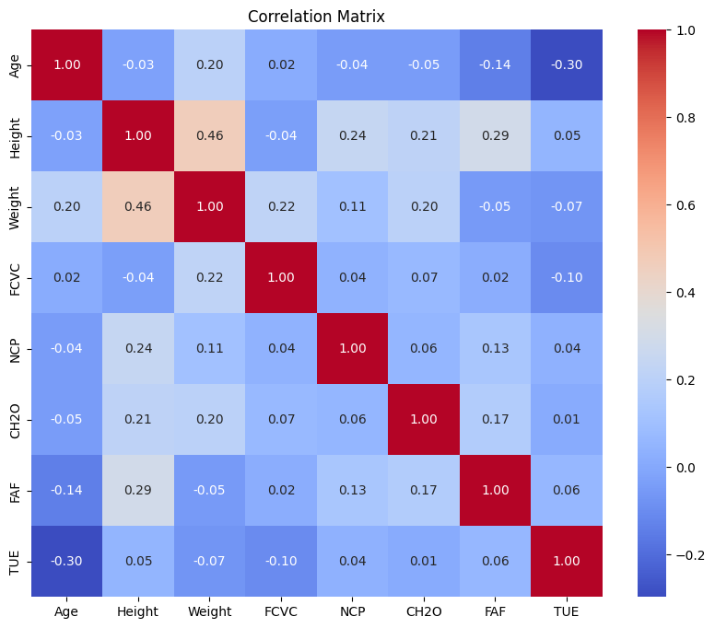
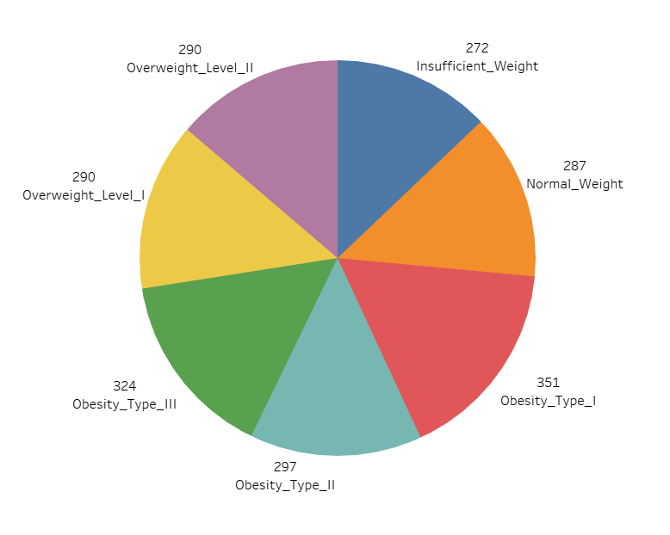
Proposed Machine learning based Intelligent Youth Obesity Classifer (ML-IYOC)

Slide 10

Proposed Machine learning based Intelligent Youth Obesity Classifer (ML-IYOC)
In this project we used MRMR (Minimum Redundancy Maximum Relevance) technique for feature selection.
By using MRMR Pick features that have high relevance to the target and low redundancy with other features.
Hold-out validation in machine learning is a simple technique for evaluating model performance.
Divide the dataset into two parts: a training set and a test set (commonly 70-80% for training and 20-30% for testing).
Train Model: Use the training set to train the model.
Test Model: Evaluate the model's performance on the test set.

Slide 11
ALGORITHMS USED
Optimized trees in machine learning, often referred to as decision trees, are models used for classification and regression tasks. These trees are built by splitting the data based on feature values to create branches, ultimately leading to a decision or prediction at the leaves.
Optimizations involve: Pruning, Boosting, Bagging.
These techniques make decision trees more accurate and robust.
Logistic Regression is a statistical model used in machine learning
for binary classification tasks, where the outcome is either 0 or 1.
It uses a logistic function (sigmoid) to map predicted values to probabilities between 0 and 1.

Slide 12
Optimized SVM Vector Machines (SVMs) are enhanced versions of the standard SVMs used for classification tasks. They aim to find the best boundary (hyperplane) that separates different classes in the data.
Optimizations involve: Kernel trick, Regularization,Hyperparameter.These optimizations make SVMs more flexible and accurate in handling complex datasets.
Boosted trees in machine learning are an ensemble technique that combines multiple weak decision trees to create a stronger predictive model.
It works based on sequential training, Weighted Voting, Gradient Boosting improve accuracy and robustness by focusing on the mistakes of earlier models.

Slide 13
Neural network in machine learning is a model inspired by the human brain, designed to recognize patterns and make predictions.
The key components includes in this are Neurons, layers, Weights and Biases,Activation Functions.
Neural networks learn by adjusting weights through training (backpropagation) to minimize prediction errors, making them powerful for tasks like image and speech recognition.

Slide 14
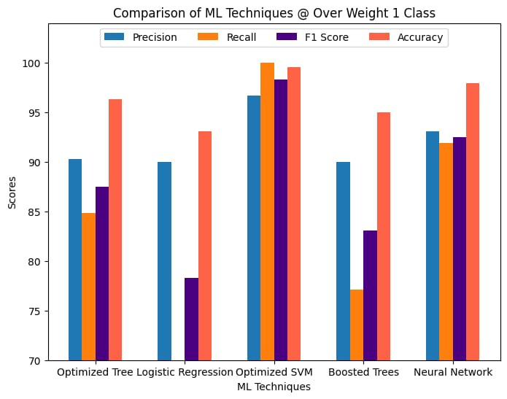
Experimental Result and analysis
Performance Comparison Of Over Weight 1
Optimized SVM and Neural Network show the highest accuracy overall, with all metrics close to or at 100% in optimized SVM.
Boosted Trees and Logistic Regression have good precision , but slightly lower recall.
Optimized Tree has better accuracy,precision, recall compared to other techniques except optimized SVM and neural network.
Overall, the Optimized SVM is the best-performing technique for detecting.

Slide 15
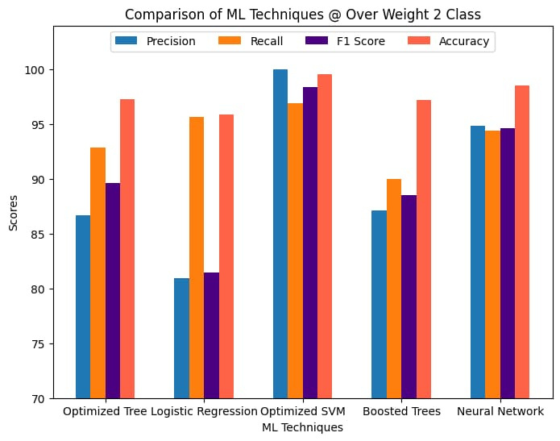
Performance Comparison Of Over Weight 2
Optimized SVM out performs all other techniques across all metrics, achieving perfect scores in precision, recall, F1 score, and accuracy.
Boosted Trees and Neural Network also show better performance, with high scores in all metrics
Logistic Regression shows relatively lower scores in F1 score and accuracy compared to other techniques.
Optimized Tree has balanced performance but slightly lower precision compared to recall.
Overall, the Optimized SVM is the best-performing technique for detecting.

Slide 16
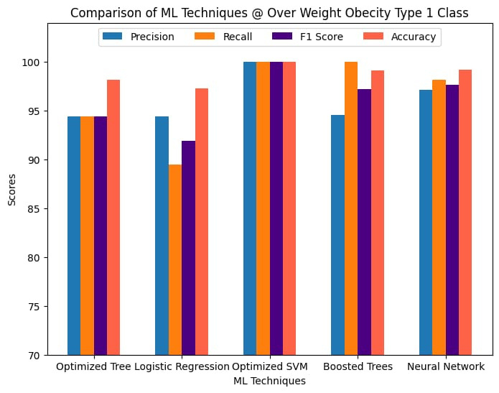
Performance Comparison Of Obesity Type 1
Optimized SVM out performs all other techniques across all metrics, achieving perfect scores (100) in precision, recall, F1 score, and accuracy.
Boosted Trees and Neural Network also show strong performance, with high scores in all metrics,but slightly low compare to optimized SVM.
Logistic Regression shows relatively lower scores in all compared to other techniques.
Optimized Tree has maintained equal performance (precision, recall and F1 score) .
Overall, the Optimized SVM is the best-performing technique for detecting and maintaining a balanced performance.

Slide 17
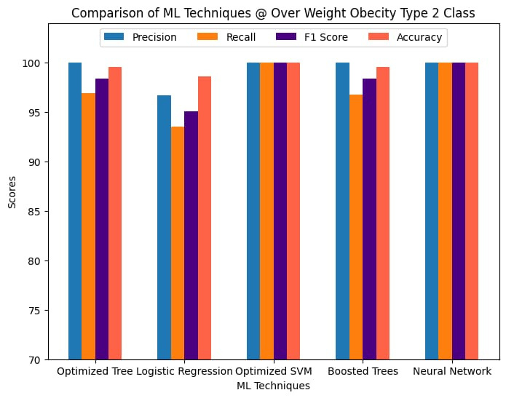
Performance Comparison Of Obesity Type 2
Optimized SVM and Neural Network outperforms all other techniques across all metrics, achieving excellent recall and F1 score, highlighting its ability to capture true positives effectively.
Logistic Regression shows relatively lower scores in F1 score and accuracy compared to other techniques.
Boosted Trees and Optimized Tree has balanced performance but slightly lower recall and F1 score compared to precision.
Overall, the Optimized SVM is the best-performing technique for detecting.

Slide 18
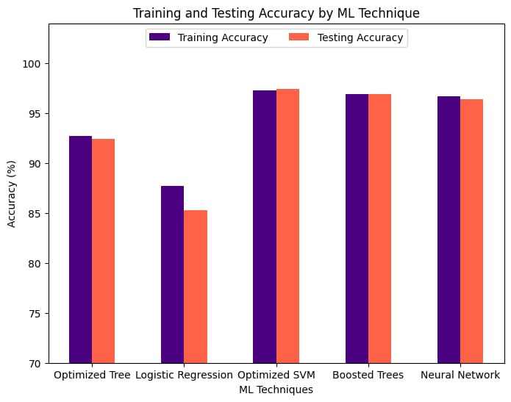
CONCLUSION
Comparison Of Training and Testing Accuracy over Different ML Techniques
In this project, we evaluated multiple machine learning models for obesity prediction, including an optimized decision tree, logistic regression, boosted tree, optimized SVM, and neural network.
The optimized SVM model emerged as the best performer, achieving the highest accuracy (97%) in both training and testing phases.
This highlights the SVM's effectiveness and reliability in handling the complexities of obesity prediction, making it a strong candidate for future predictive healthcare applications.

Slide 19
REFERENCES
Dataset- Kaggle
https://www.sciencedirect.com/science/article/pii/S2666518221000401
Referred paper from NIH(National Institute of Health)
https://www.sciencedirect.com/science/article/pii/S1386505621000800

Slide 20
THANK YOU!

