Slide 1
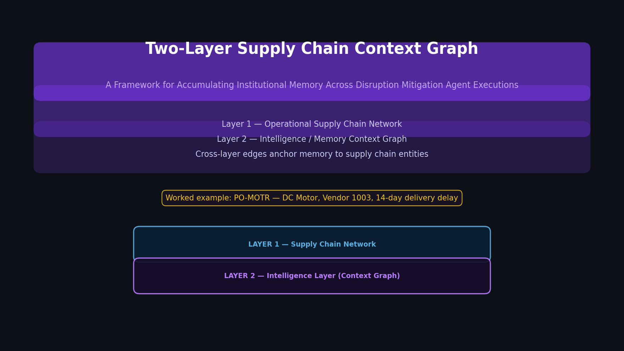
Overview Two-Layer Supply Chain Context Graph
Notes:
Two-Layer Supply Chain Context Graph
Every time the Disruption Mitigation Agent handles a supply chain problem, it doesn't just fix it and forget.
It writes a trace into a memory layer — and the next agent facing a similar disruption starts smarter.
Layer 1 — Operational Supply Chain Network: The physical and commercial entities you'd find in any ERP —
Suppliers, Items, Purchase Orders, Production Orders, Inventory, Distribution Centers, Sales Orders, and Customers.
Layer 2 — Intelligence Layer (Context Graph): Accumulated institutional memory — Episodes, MitigationDecisions,
Facts, Reflections, Concepts, Policies, Goals, and Recommendations — distilled from every past DMA execution.
Cross-layer edges anchor memory to specific supply chain entities so context retrieval is automatic.
Worked example: PO-MOTR — DC Motor, Vendor 1003, 14-day delivery delay

Slide 2
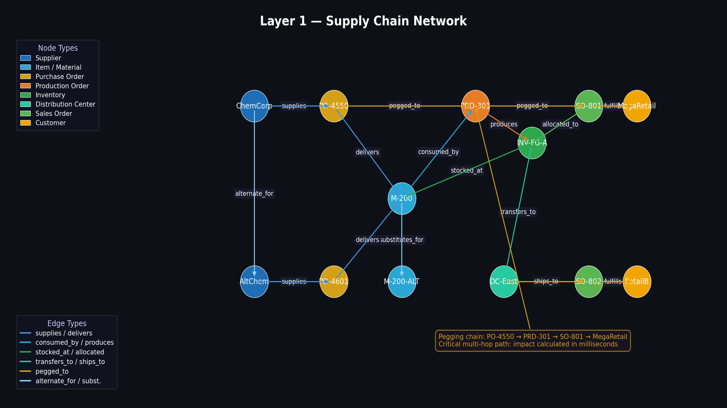
Layer 1 Layer 1 — Supply Chain Network
Notes:
Layer 1 is the operational supply chain — nodes and edges the agent acts on via MCP calls to D365.
Node types:
■ Supplier
■ Item / Material
■ Purchase Order
■ Production Order
■ Inventory
■ Distribution Center
■ Sales Order
■ Customer
Edge types:
supplies · delivers · consumed_by · produces ·
stocked_at · allocated_to · transfers_to · ships_to ·
pegged_to · alternate_for · substitutes_for
The pegging chain links a Purchase Order directly to the Production Order that needs it,
to the Sales Order at risk, all the way to the customer. This multi-hop traversal happens in milliseconds
as a graph query. In a relational ERP model it would require sequential joins across multiple tables.
Layer 1 is also where the agent acts — it issues new POs, triggers inventory transfers,
and modifies delivery dates via MCP calls back to D365.

Slide 3
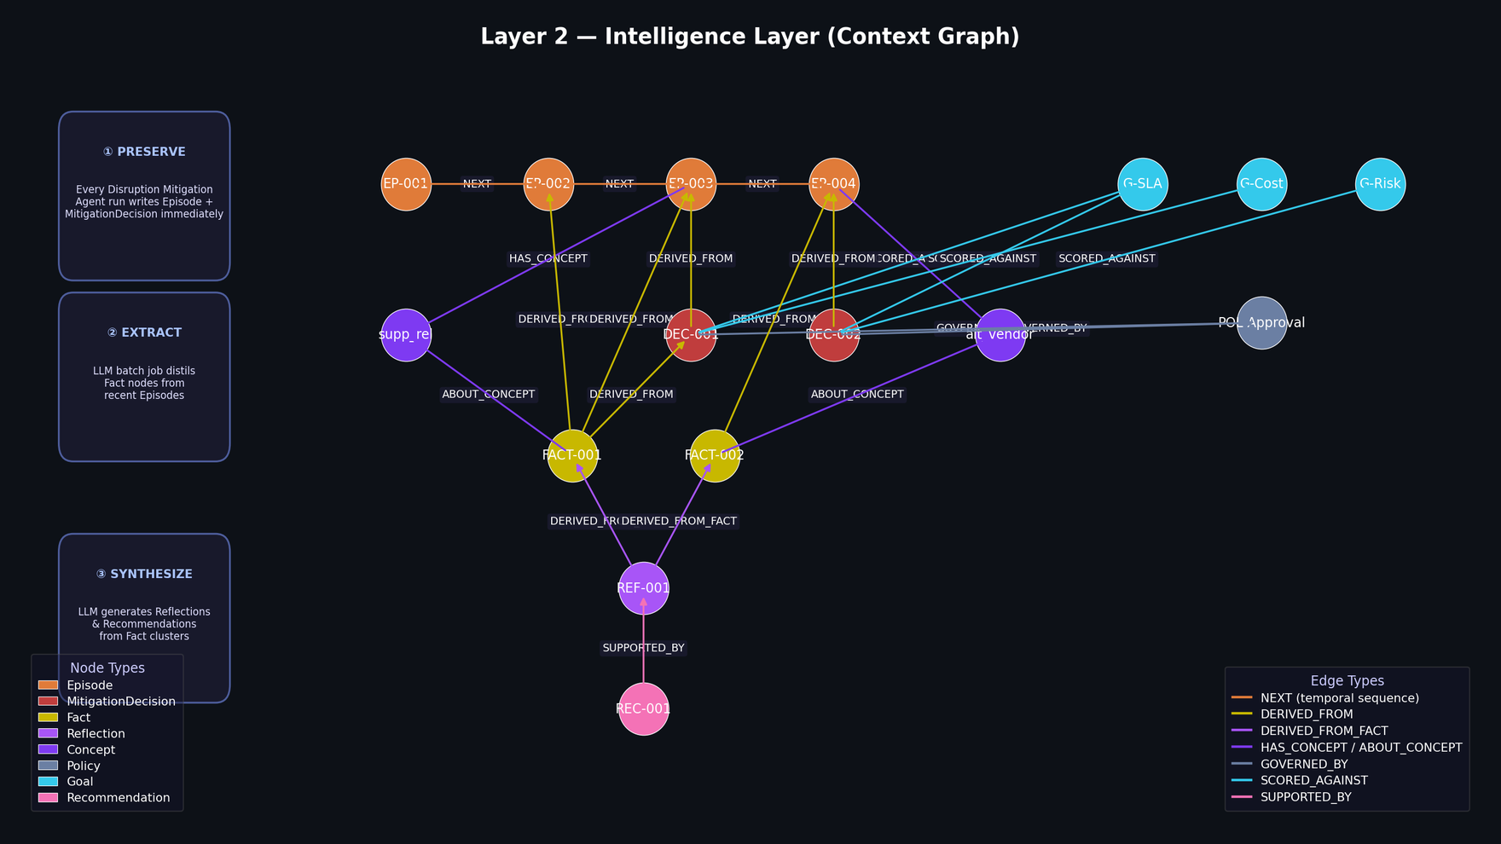
Layer 2 Layer 2 — Intelligence Layer
Notes:
Layer 2 is the intelligence layer — the context graph that makes the agent accumulate institutional
memory over time. The nodes here are not supply chain entities — they are memory constructs.
Node types:
■ Episode — timestamped, immutable record of one DMA execution
■ MitigationDecision — option chosen and why
■ Fact — LLM-distilled atomic insight (e.g. “Vendor 1003 is disruption source in all 6 episodes”)
■ Reflection — higher-order pattern synthesized from multiple Facts
■ Concept — thematic anchor enabling cross-disruption retrieval (e.g. safety_stock_erosion)
■ Policy
■ Goal
■ Recommendation
Edge types:
NEXT (temporal chain) · DERIVED_FROM · DERIVED_FROM_FACT ·
HAS_CONCEPT · ABOUT_CONCEPT · GOVERNED_BY ·
SCORED_AGAINST · SUPPORTED_BY
Layer 2 is built in three phases: ① Preserve — every DMA run writes Episode + MitigationDecision
immediately. ② Extract — a batch LLM job distils Fact nodes from recent Episodes.
③ Synthesize — a periodic LLM job generates Reflections and Recommendations from Fact clusters.

Slide 4
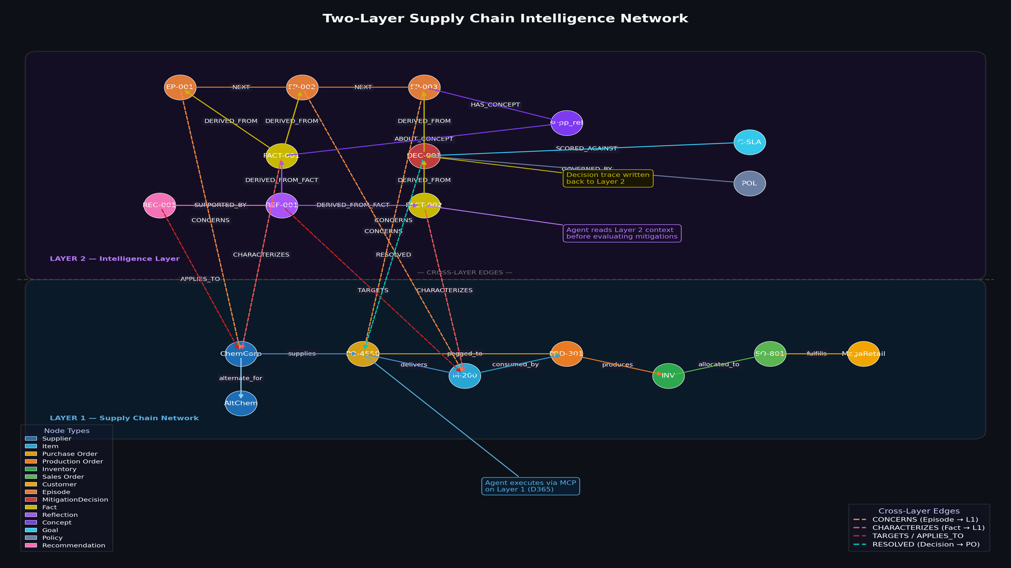
Architecture Two-Layer Combined Architecture
Notes:
The two layers are coupled through typed cross-layer edges (dashed lines in the diagram).
Layer 1 nodes:
■ Supplier
■ Item
■ Purchase Order
■ Production Order
■ Inventory
■ Sales Order
■ Customer
Layer 1 edges: supplies · delivers · consumed_by ·
stocked_at · allocated_to · pegged_to · alternate_for
Layer 2 nodes:
■ Episode
■ MitigationDecision
■ Fact
■ Reflection
■ Concept
■ Policy
■ Goal
■ Recommendation
Layer 2 edges: NEXT · DERIVED_FROM · DERIVED_FROM_FACT ·
HAS_CONCEPT · GOVERNED_BY · SCORED_AGAINST · SUPPORTED_BY
Cross-layer edges:
CONCERNS (Episode → L1 entity) ·
CHARACTERIZES (Fact → Supplier/Item) ·
TARGETS (Reflection → Item) ·
APPLIES_TO (Recommendation → Item) ·
RESOLVED (Decision → Purchase Order)
The agent reads Layer 2 before reasoning, acts on Layer 1 via MCP, and
writes the trace back to Layer 2 when done. Cross-layer edges ensure that when the agent
queries a vendor or item, all related memory surfaces automatically.

Slide 5
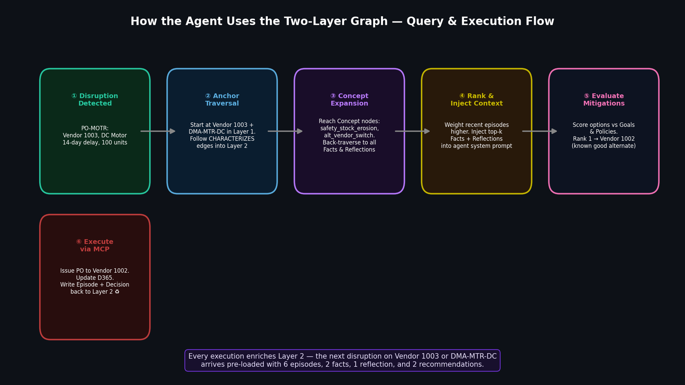
Agent Loop Agent Retrieval & Execution Flow
Notes:
The full retrieval and execution loop in six steps:
① Disruption Detected — PO-MOTR flagged: Vendor 1003, DC Motor, 14-day delay, 100 units at risk.
② Anchor Traversal — Agent follows CHARACTERIZES edges from Vendor 1003 and DMA-MTR-DC
(Layer 1 entities) up into Layer 2. Six prior episodes surface immediately — the agent is not starting cold.
③ Concept Expansion — Hops through Concept nodes (safety_stock_erosion,
alt_vendor_switch) to pull in all related Facts and Reflections, including those from disruptions
with completely different PO numbers.
④ Rank & Inject Context — Recent episodes weighted higher. Top-k Facts + Reflections injected
into the agent system prompt before evaluating a single mitigation option.
⑤ Evaluate Mitigations — Score options against Goals and Policies. Rank 1 → Vendor 1002
(known good alternate, confirmed by prior episode history in Layer 2).
⑥ Execute via MCP — Issue new PO to Vendor 1002. Update D365. Write new Episode and
MitigationDecision back to Layer 2. ♻
Every execution enriches Layer 2. The next disruption on Vendor 1003 or DC Motor arrives pre-loaded
with 6 episodes, 2 facts, 1 reflection, and 2 recommendations — none had to be re-derived.

Slide 6
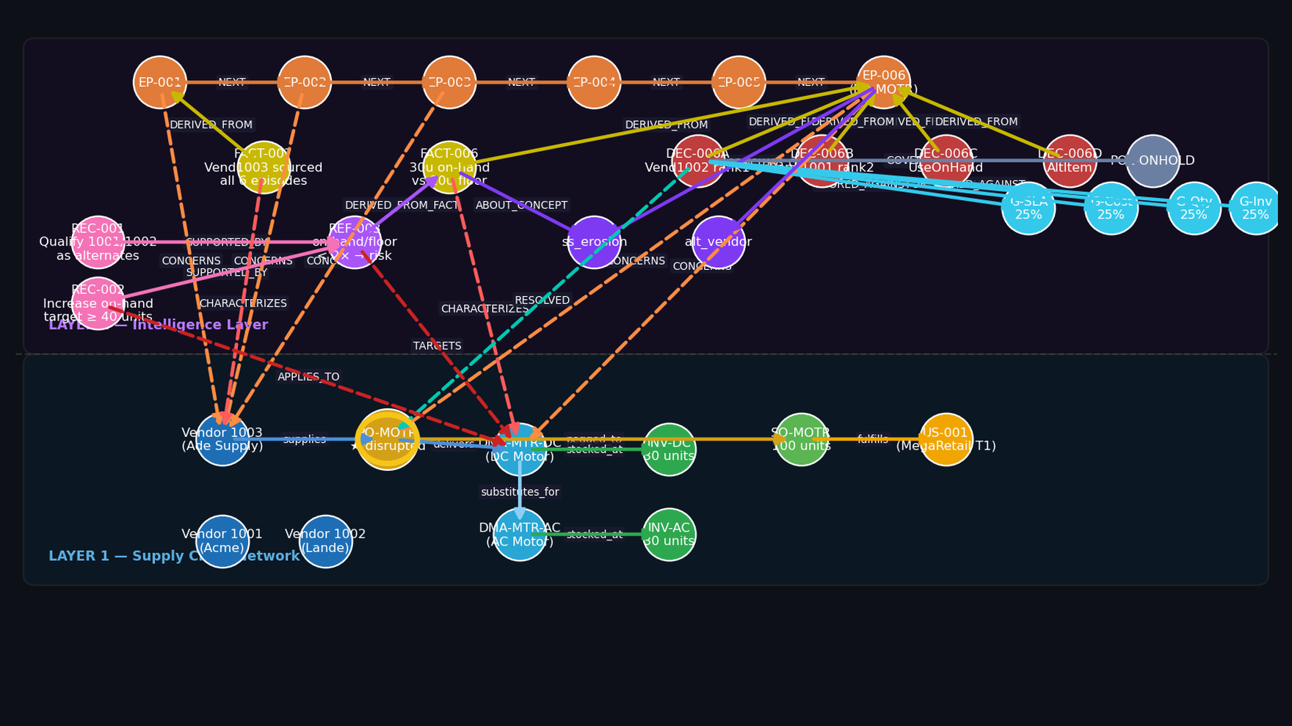
① Disruption Detected
Notes:
PO-MOTR has just been flagged. Vendor 1003 — Ade Supply — is reporting a
14-day delay on 100 DC Motors at $50/unit.
Every node visible here belongs to one of two layers separated by the dashed line.
Below: Layer 1, the live operational supply chain — suppliers, purchase orders,
items, inventory, sales orders, customers.
Above: Layer 2, the accumulated intelligence layer — episodes, facts, reflections,
and decisions written by every prior Disruption Mitigation Agent execution.
The agent's job: use both layers to arrive at the right mitigation decision.

Slide 7
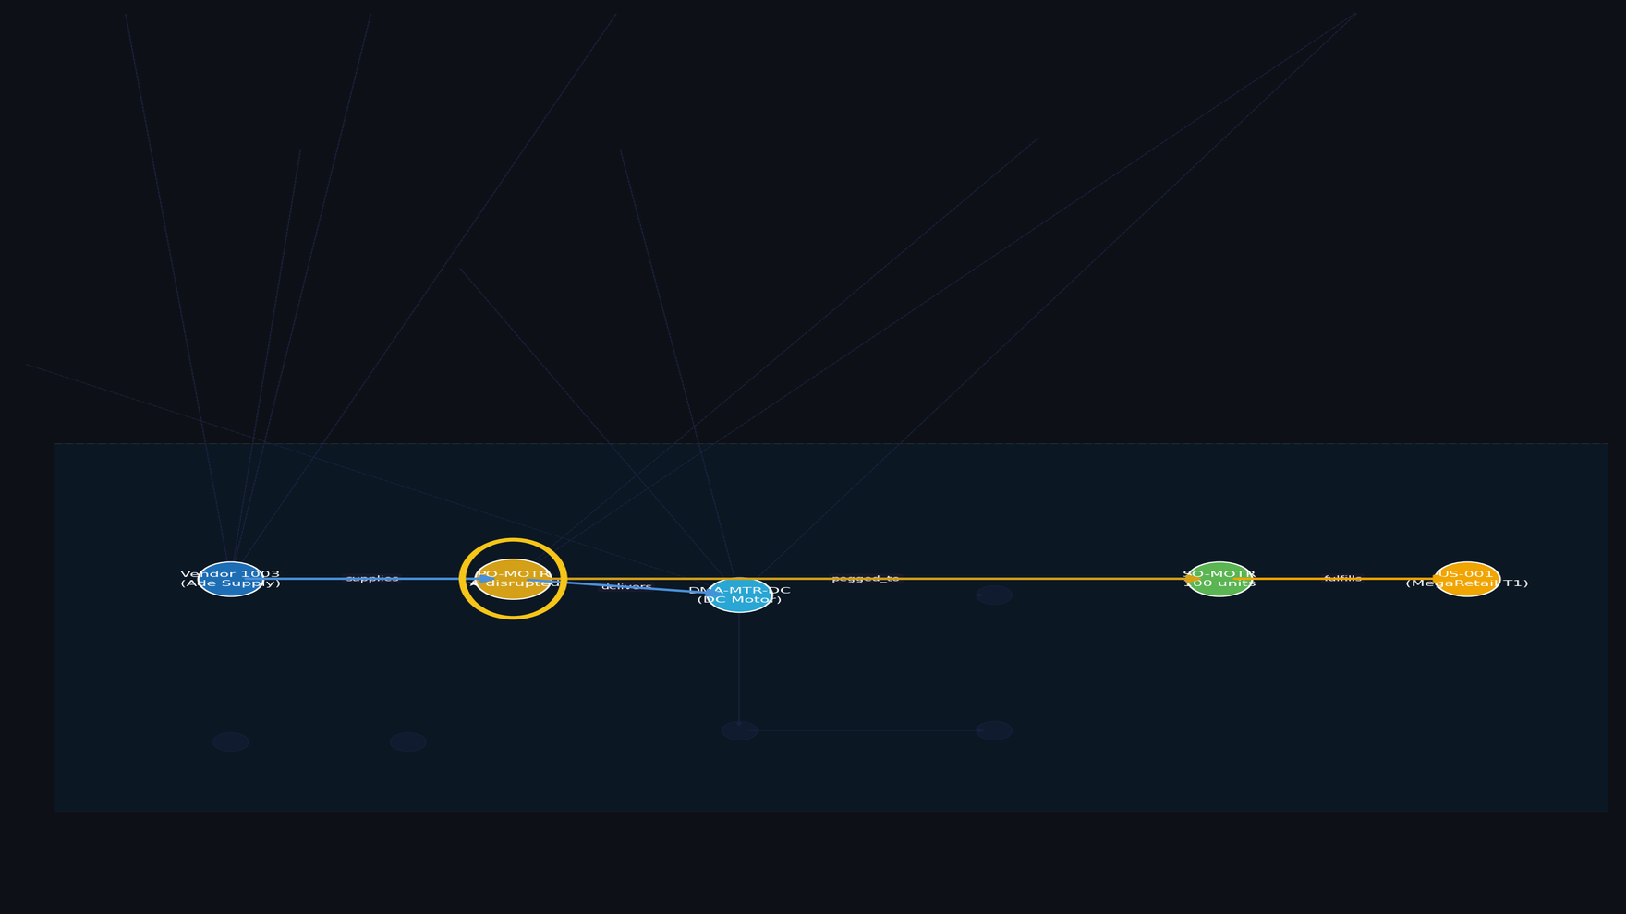
② Layer 1 — Trace the Pegging Chain
Notes:
The agent's first move is to traverse Layer 1 — the live supply chain.
Following the pegging chain from PO-MOTR exposes the full blast radius:
the DC Motor is delivered by PO-MOTR, and that PO is pegged to
Sales Order SO-MOTR, which belongs to MegaRetail — a Tier 1 customer
with a hard SLA commitment.
This multi-hop traversal — from a delayed purchase order all the way to an at-risk
customer — happens as a single graph query in milliseconds. In a relational
ERP model this would require sequential form navigation and joins across multiple tables.

Slide 8
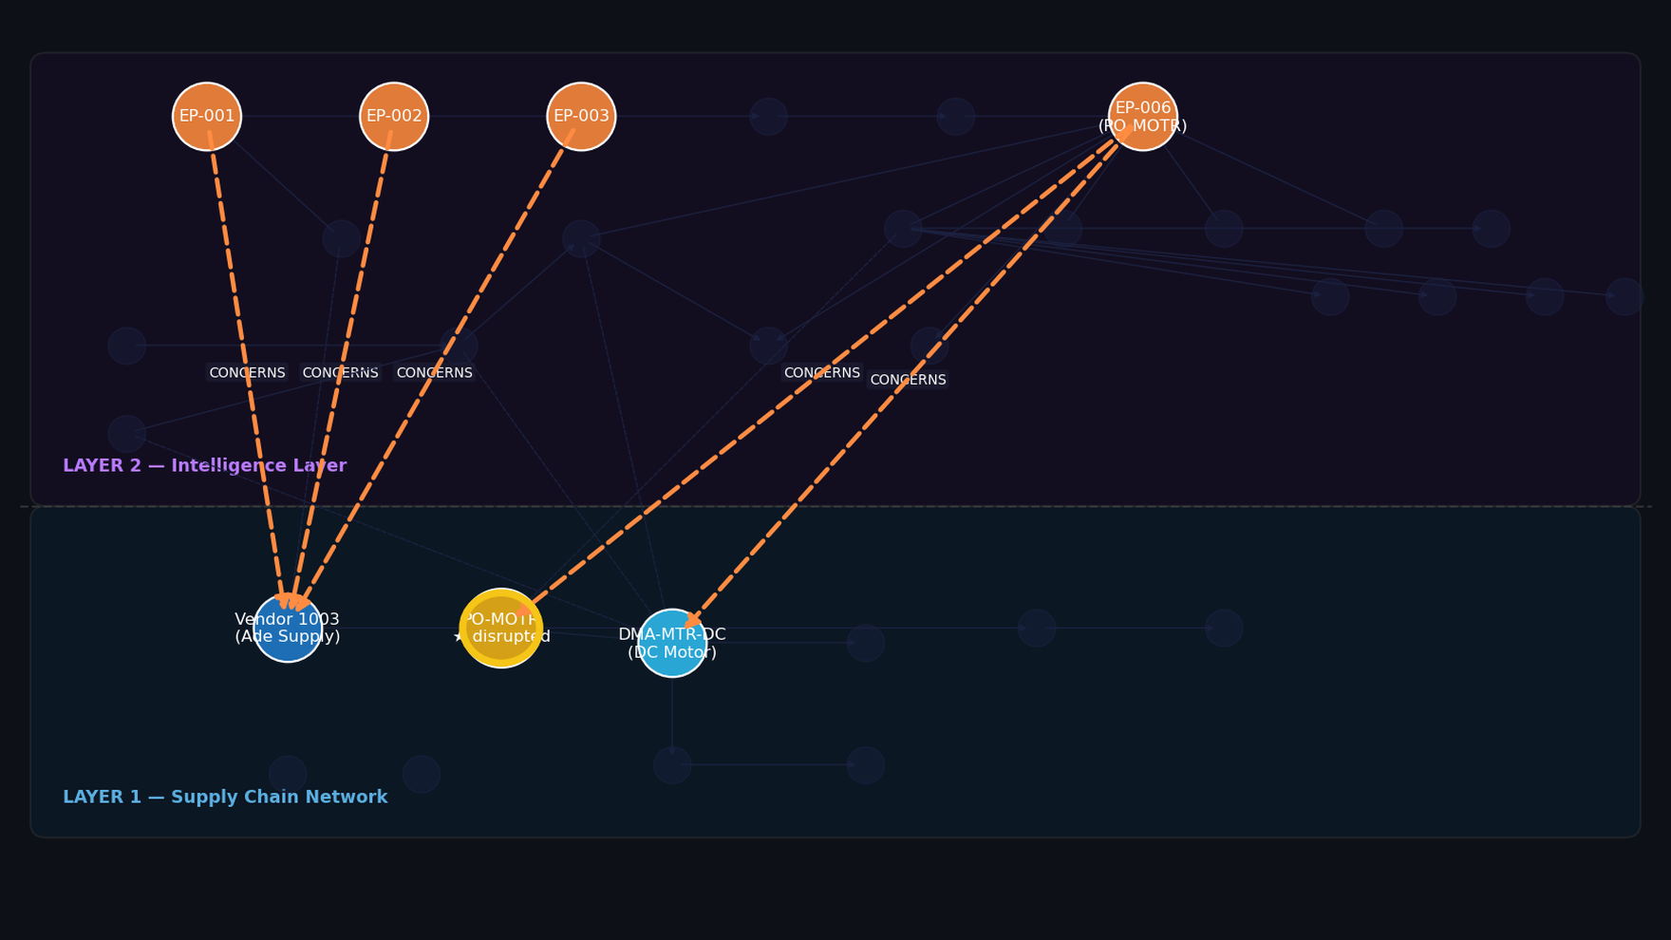
③ Anchor Traversal — CONCERNS Edges Into Layer 2
Notes:
With the blast radius mapped, the agent crosses into Layer 2 via
CONCERNS edges — the dashed orange lines that span both layers.
These edges were written by past DMA executions and anchor memory nodes
to the specific operational entities they concern. Starting from
Vendor 1003 and DMA-MTR-DC in Layer 1, the agent follows
CONCERNS edges upward into the intelligence layer.
Six prior episodes surface immediately. All six involve Vendor 1003.
The agent is not starting cold.

Slide 9
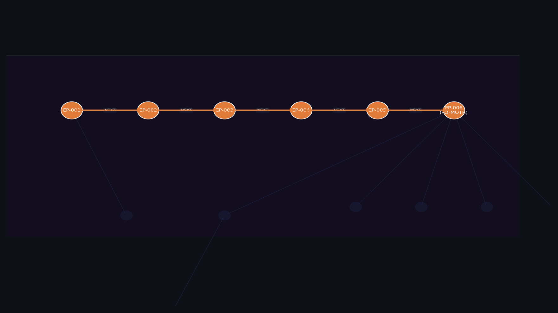
④ 6 Prior Episodes — All Involving Vendor 1003
Notes:
The six episodes form a temporal chain connected by NEXT edges.
EP-001 through EP-005 are disruptions the agent has already handled and
recorded memory for. EP-006 is the current disruption — it was
written to Layer 2 at the start of this execution, before the agent
evaluated a single mitigation option.
This is the first compounding effect: the agent doesn't just react to
today's disruption — it inherits the full recorded history of every
prior disruption involving this vendor. Six data points instead of zero.

Slide 10
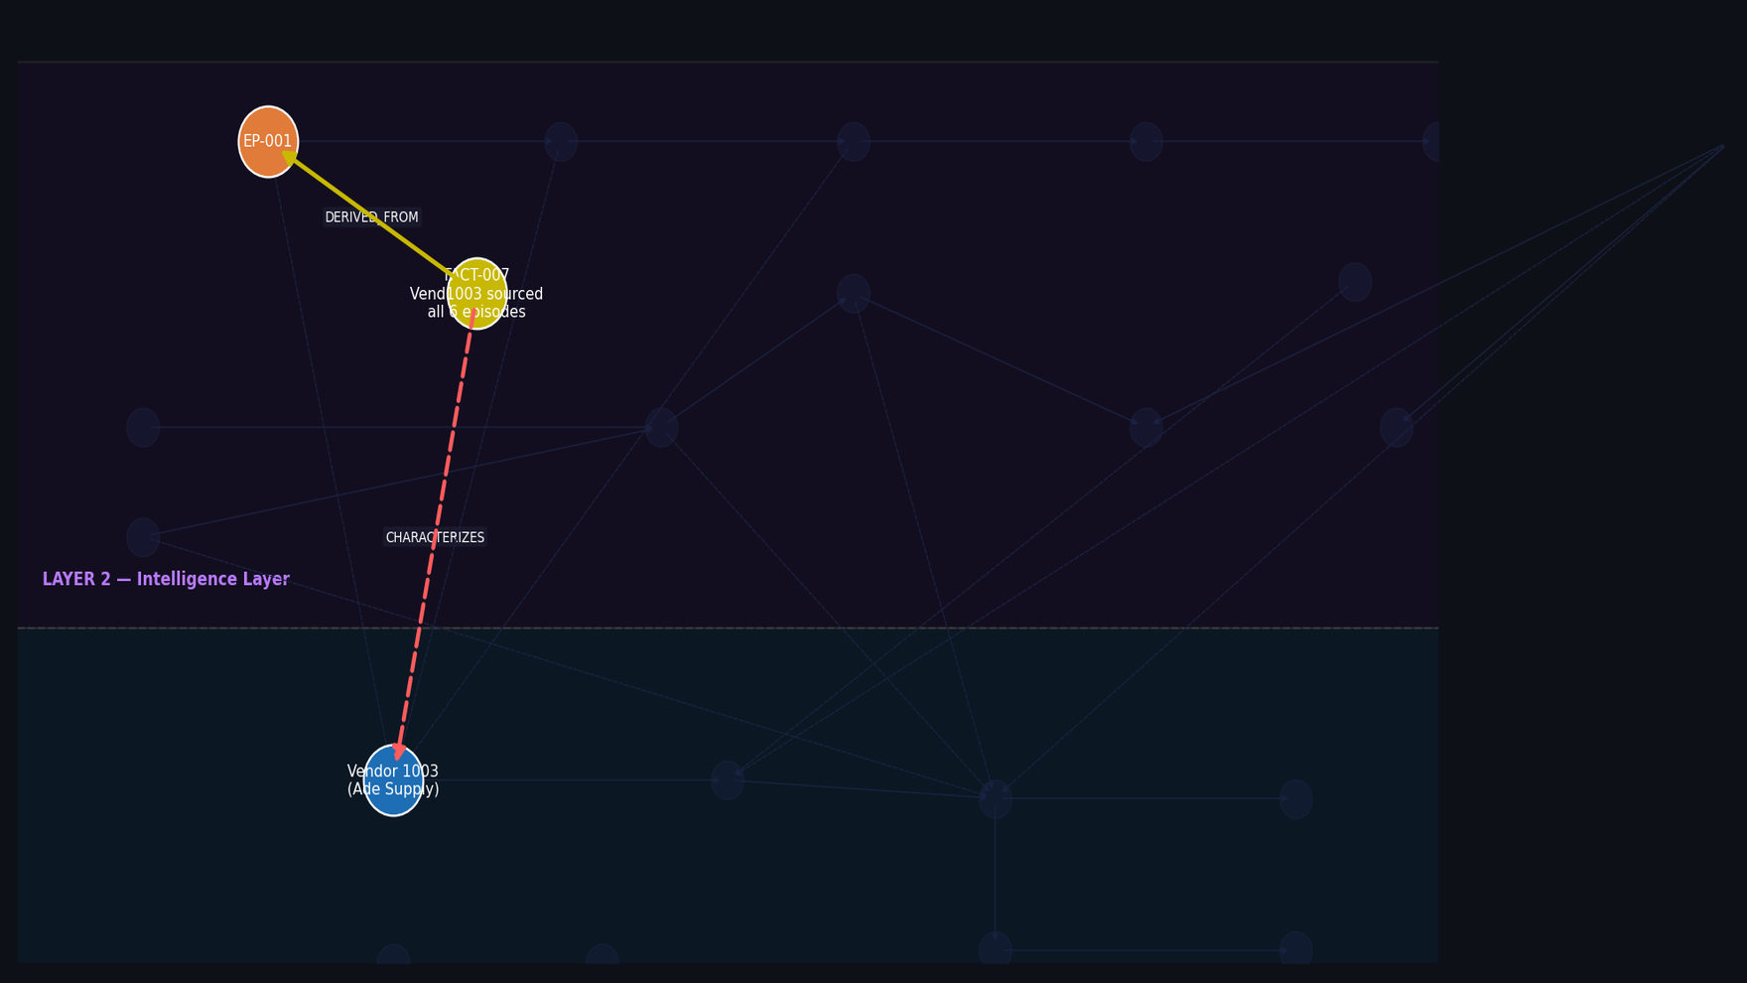
⑤ FACT-007 Surfaces — Vendor 1003 Pattern Identified
Notes:
FACT-007 is the key insight distilled from the episode history:
"Vendor 1003 is the disruption source across all 6 recorded episodes."
This fact was produced by an LLM Extract job that read the episode
chain and extracted the pattern — it was not hardcoded by any rule engine.
The DERIVED_FROM edge traces it back to EP-001.
The CHARACTERIZES edge (dashed red) anchors FACT-007 to the
Vendor 1003 node in Layer 1. Any future DMA query on this vendor surfaces
this fact automatically — no re-derivation required.

Slide 11
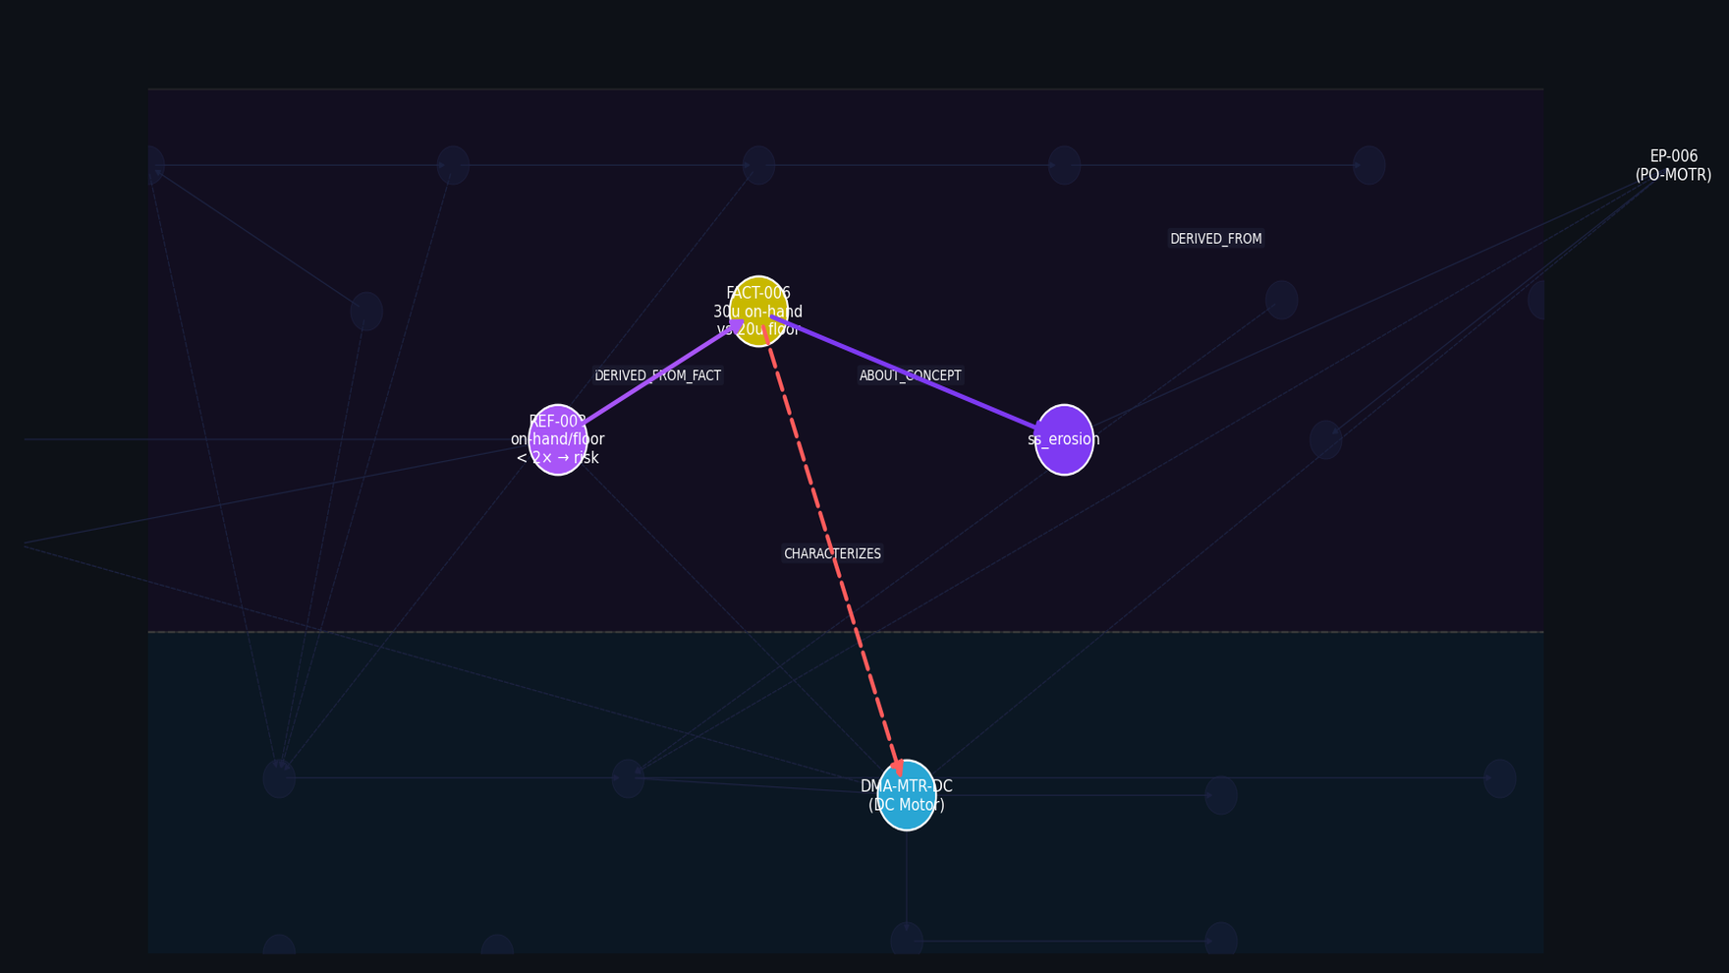
⑥ Safety Stock Risk — FACT-006 + REF-003
Notes:
FACT-006 flags a second risk: 30 units on-hand against a
20-unit safety stock floor. Drawing all 30 units to cover the DC Motor
shortfall would breach the floor — leaving zero buffer.
REF-003 generalizes this to a structural pattern via
DERIVED_FROM_FACT: "Items where on-hand inventory is less than
twice the safety floor are inherently fragile."
This Reflection was synthesized by an LLM across multiple fact clusters.
The CHARACTERIZES edge anchors FACT-006 to DMA-MTR-DC (the DC Motor)
in Layer 1. The ss_erosion Concept node enables cross-disruption
retrieval — any future disruption tagged with this concept will find
FACT-006 and REF-003 in its context window.

Slide 12
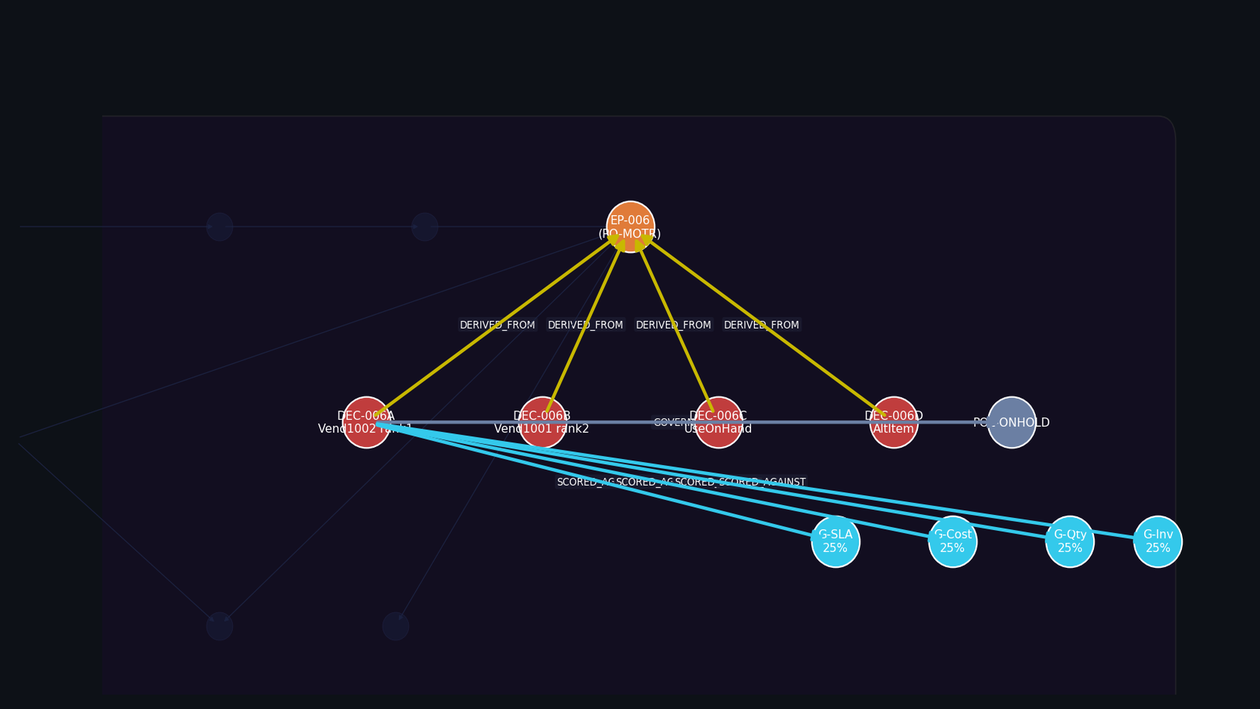
⑦ Evaluate 4 Mitigation Options Against Goals
Notes:
Context loaded, the agent evaluates four mitigation options:
• DEC-006A — Switch to Vendor 1002 (Lande), $52/unit, 8-day lead. Full coverage.
• DEC-006B — Switch to Vendor 1001 (Acme), $55/unit, 5-day lead. Full coverage.
• DEC-006C — Draw from on-hand inventory (30 units). Breaches safety floor.
• DEC-006D — Substitute AC Motor (alternate item). Also a floor breach.
Each decision is scored against four Goals — SLA protection (25%),
cost minimisation (25%), quantity coverage (25%), inventory health (25%) —
and validated against POL-ONHOLD, the business policy governing
purchase order changes. The scoring is transparent: the graph records exactly
which goal drove which ranking.

Slide 13
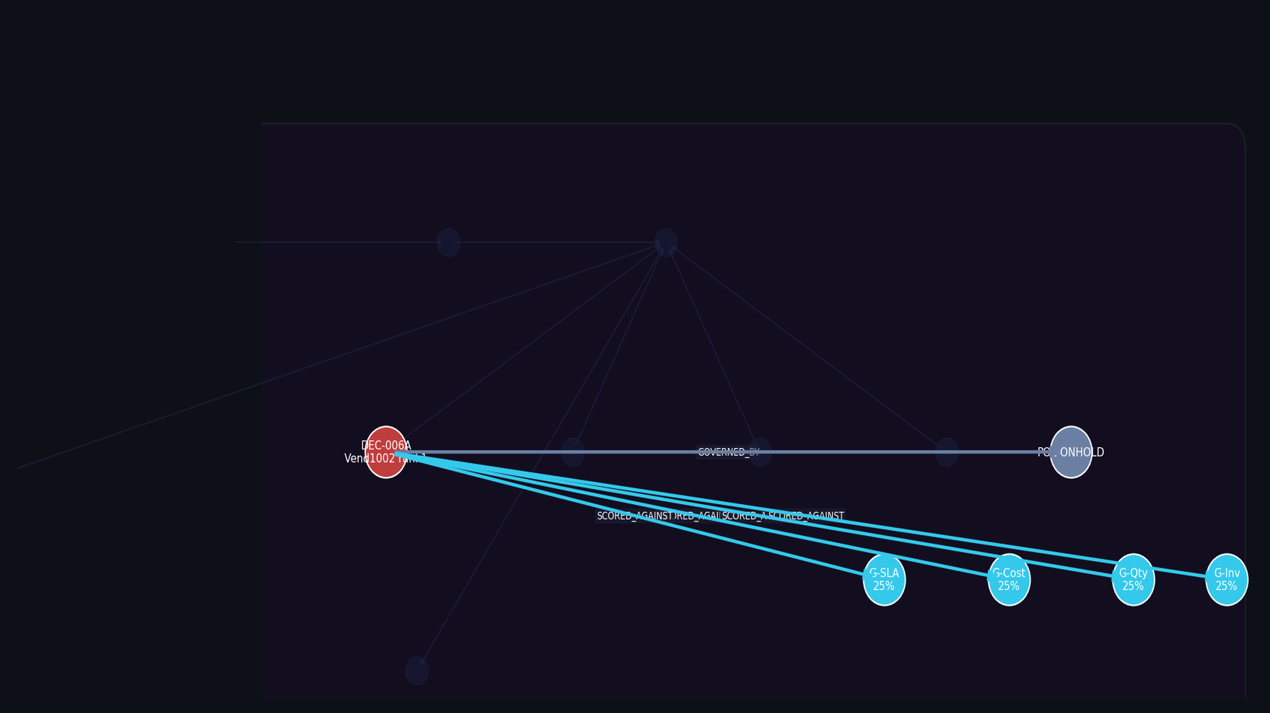
⑧ Rank-1 Selected — Vendor 1002, $52/unit, 8-day Lead
Notes:
DEC-006A wins. Switch to Vendor 1002 — Lande — at $52/unit,
8-day lead time.
The ranking was not arbitrary. FACT-007's six-episode failure record
on Vendor 1003 made the alternate vendor switch the only viable full-coverage
option. DEC-006C and DEC-006D are partial mitigations that both breach the
safety floor — FACT-006 and REF-003 penalised them heavily in the Goal scoring.
This is the second compounding effect: the agent did not reason from
scratch. The conclusion — "switch to a known alternate" — was implicit
in the Layer 2 context before the evaluation even started.
DEC-006B through DEC-006D are dimmed; they were considered and rejected.

Slide 14
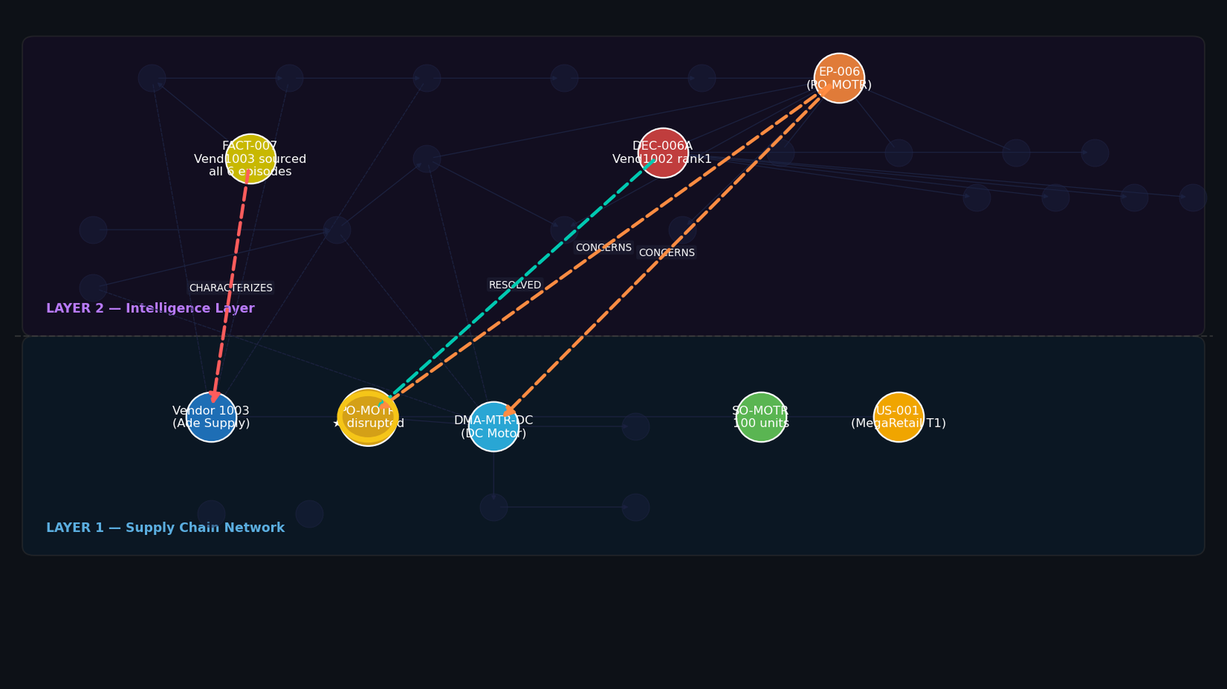
⑨ RESOLVED — Decision Anchored · Loop Complete
Notes:
The decision is recorded. A RESOLVED edge (teal dashed) is written
from DEC-006A back to PO-MOTR in Layer 1 — the specific purchase order
that triggered this run. The loop is closed.
CONCERNS edges from EP-006 anchor the new episode to Vendor 1003
and DMA-MTR-DC. CHARACTERIZES from FACT-007 stays live in Layer 1.
The next disruption involving Vendor 1003 or DC Motors will arrive
pre-loaded with:
• 6 episodes in the temporal chain
• 2 facts (unreliable vendor, safety floor risk)
• 1 reflection (on-hand/floor structural fragility)
• 2 recommendations (qualify alternates, increase on-hand target)
None of this had to be re-derived. The graph doesn't forget.
Every execution makes it smarter.

