Slide 1
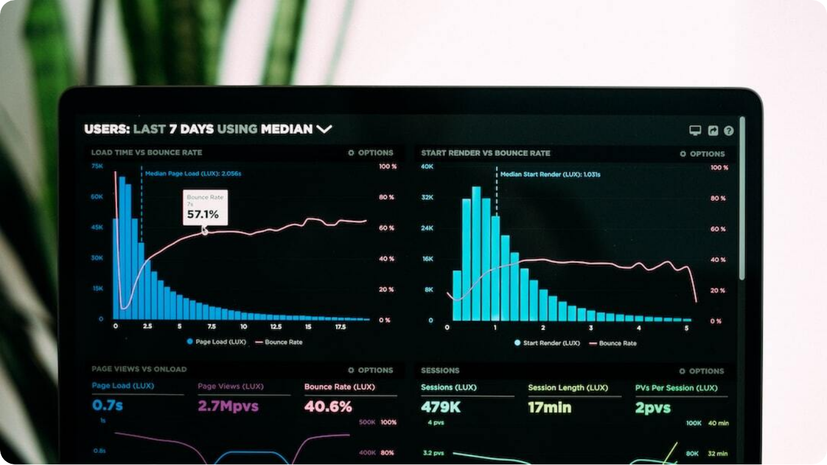
Superstore Sales & Profit Analysis (USA Focus)
Executive Summary & Key Metrics
Total Sales: $3.63M: Represents the total revenue generated from US-based orders, emphasizing the importance of this market.
Deal Size Breakdown: Medium deals account for 60.87%, with large and small deals at 24.58% and 14.55%, indicating bulk-order tendencies.
Top Product Segments: Classic Cars, Vintage Cars, and Motorcycles contribute over 65% of sales, forming the core product focus.
Sales Seasonality: Peak activity observed in Q4, particularly November and December, driven by holiday season demand surges.
Photo by Luke Chesser on Unsplash

Slide 2




Customer Insights & Dashboard Features
Driving Targeted Strategy Through Data Interactivity
Top 10 Customers
High-value clients like Valarie and Julie lead sales. Top 5 customers are US-based corporates such as Mini Gifts Distributors.
Filters & Interactivity
Dynamic filters allow real-time segmentation by country, customer name, product line, and deal size.
Visualization Types
Dashboard includes KPI cards, pie charts, bar charts, line graphs, and annotations for contextual clarity.
Strategic Takeaways
Enables targeted retention, promotion timing, inventory planning, and customer-focused selling.

