Slide 1
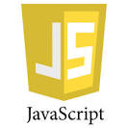
Introduction to Java Script
The Language of Web Development
Gudivada Yagna Sree

Slide 2

Introduction
How to Include Java Script
Variables
Operators
Conditional Statements
Loops
Functions

Slide 3
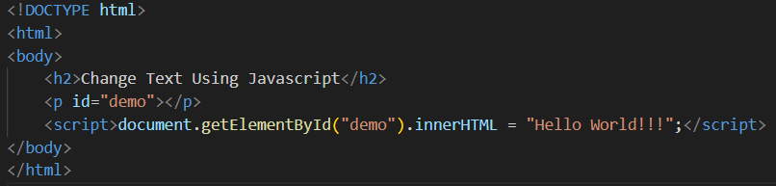
Introduction to Java Script
What is JavaScript?
JavaScript is the Programming Language for the Web.
JavaScript can update and change both HTML and CSS - getElementById()
JavaScript can calculate, manipulate and validate data.

Slide 4
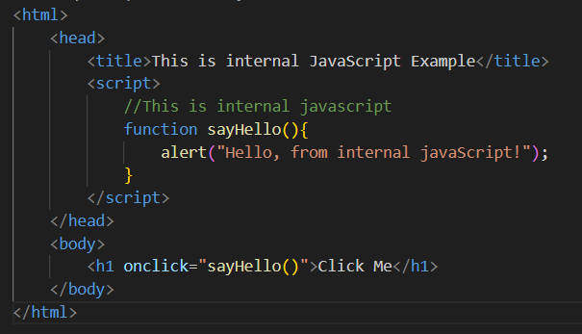
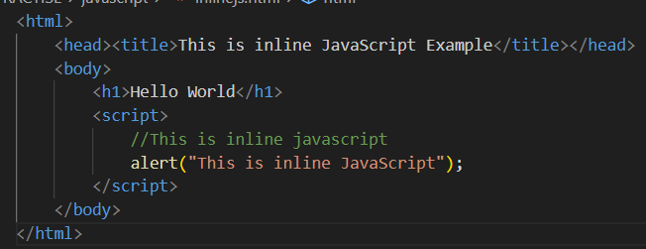
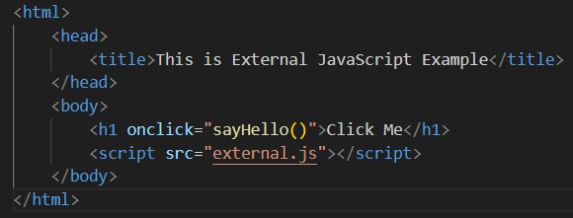
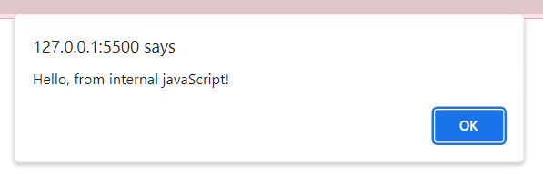
How to Include JavaScript?

Slide 5
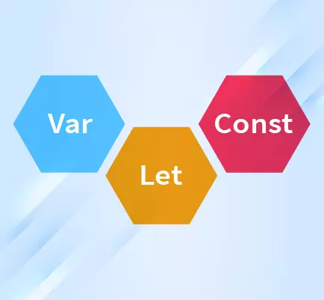
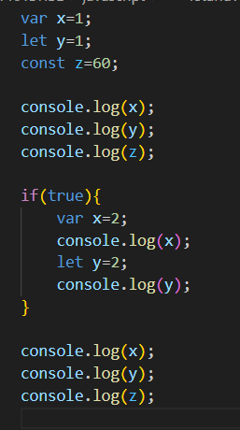
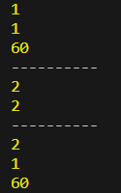
Variables

Slide 6
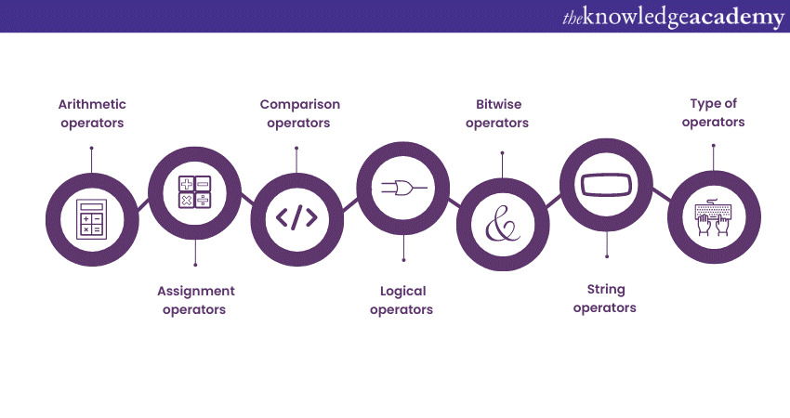
JavaScript Operators

Slide 7
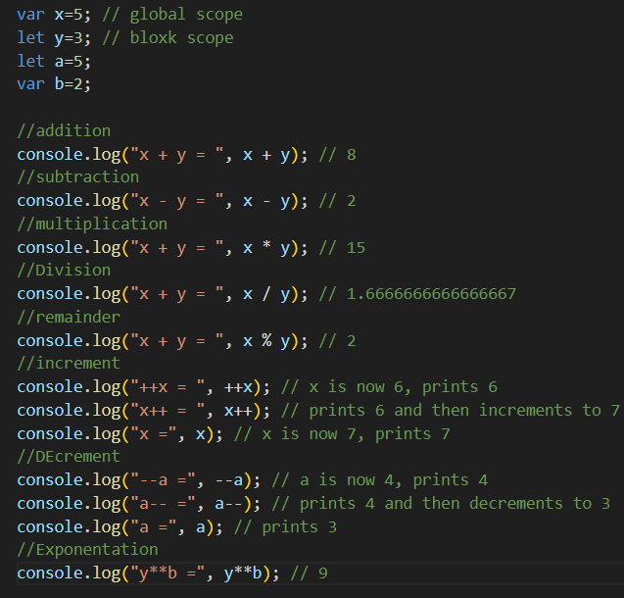
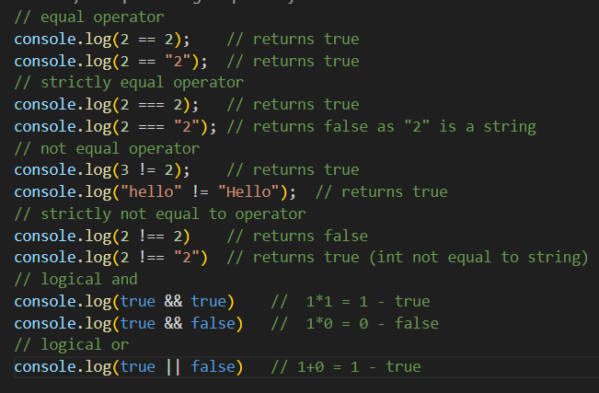

Slide 8
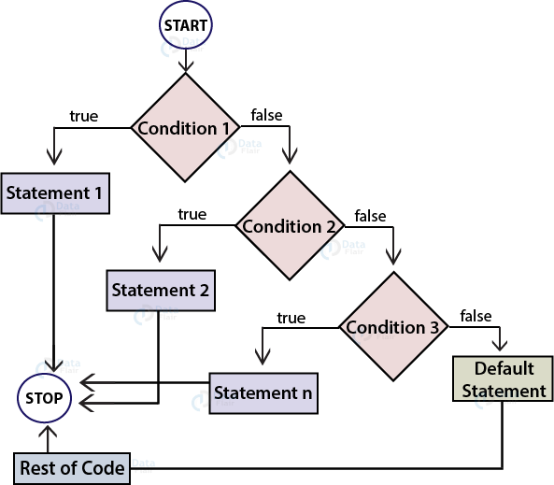
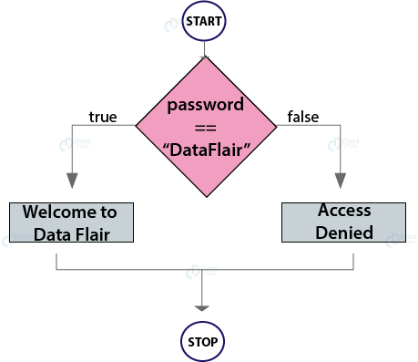
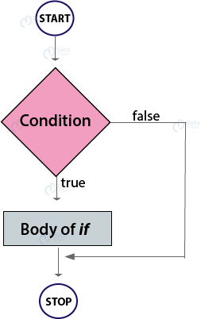
Conditional Statements
if…else if… else Statements
if Statements
if… else Statements
if (condition1){
//code if condition1 is true
}
else if (condition2){
//code if condition2 is true
}
else{
//code if all above conditions are false
}
if (condition)
{
//statements to be executed if true
}
if (condition)
{
//code if condition is true
}else{
//code if condition is false
}

Slide 9
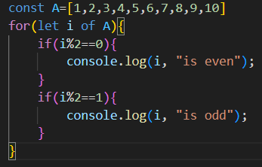
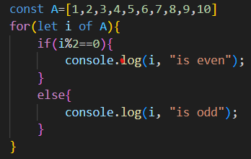
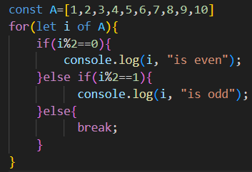


Slide 10
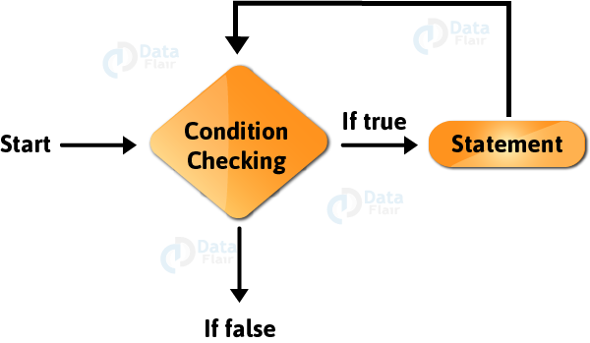

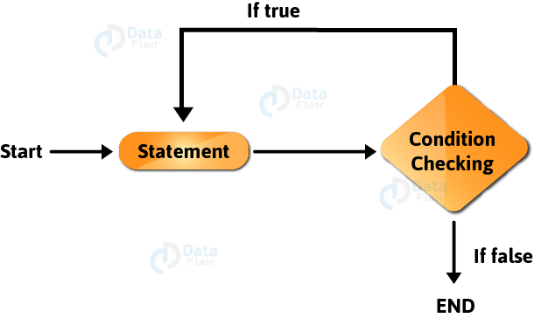
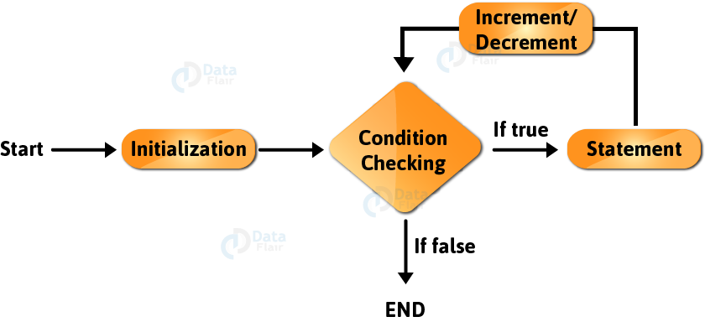
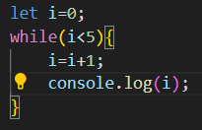
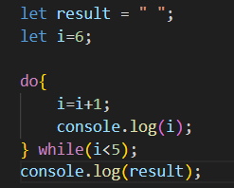
Loops
While Loop
Do-While Loop
For Loop

Slide 11
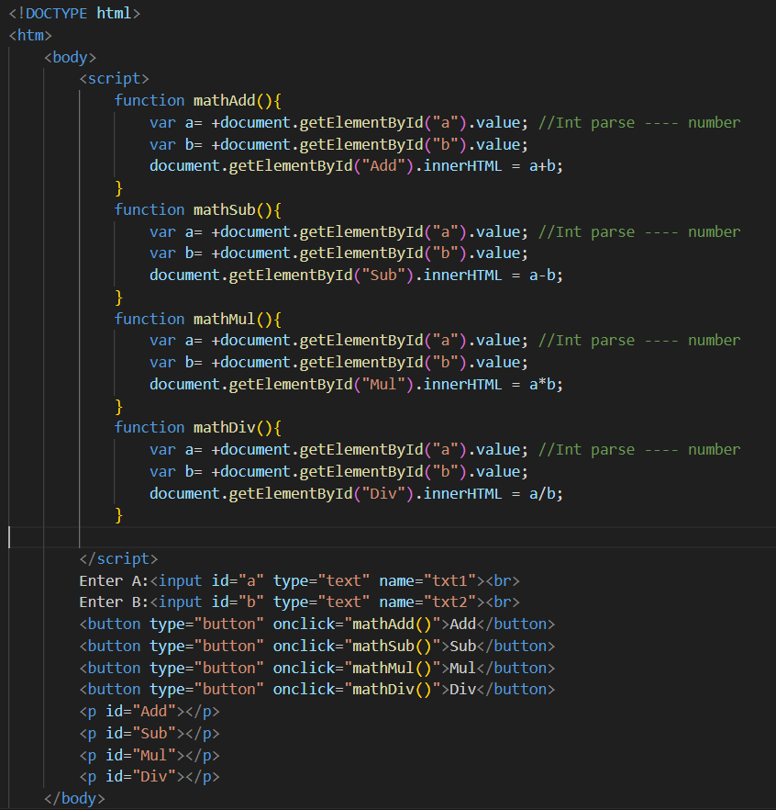
Functions
A JavaScript function is a block of code designed to perform a particular task.
A JavaScript function is executed when "something" invokes it (calls it).

Slide 12


