Slide 1


Deep Learning for Customer Retention: An Autoencoder-Based Churn Prediction Approach

Slide 2
PROJECT STAGE - 2
PRESENTED BY
Roll No | Name of the student
21AG1A6717 | C YAGNESH
21AG1A6733 | K UDAY KIRAN
21AG1A6727 | J VAISHNAV TEJA
21AG1A6751 | P SHIVA SHASHANK
Under the supervision of
MS. P. Niharika , Assistant Professor
DEPARTMENT OF COMPUTER SCIENCE AND ENGINEERING (DATA SCIENCE)
ACE Engineering College

Slide 3

CONTENTS:
Introduction
Existing system
Proposed system
Software and hardware requirements
System Analysis
System Requirements Specification
Conclusion

Slide 4
INTRODUCTIOIN
This project uses autoencoders to predict customer churn by detecting anomalies in user behavior. Trained on historical data, the model learns normal engagement patterns, flagging significant deviations as churn risks. Unlike traditional models, autoencoders handle high-dimensional data effectively, enabling businesses to proactively implement retention strategies and reduce attrition through data-driven insights.
Project Focus: Developing a churn recommendation system using advanced machine learning techniques.
Objective: Predict and address customer churn effectively.
Goal: Boost retention rates by identifying at-risk customers.
Outcome: Deliver actionable insights to enhance customer satisfaction and loyalty.

Slide 5
Problem Statement
In subscription-based businesses, retaining customers is crucial as acquiring new ones is expensive, making churn a major concern. Traditional models often rely on simple rules, failing to capture complex customer behaviour, leading to poor strategies and lost revenue. The challenge grows with the vast amount of customer data and constantly changing preferences, which traditional models struggle to adapt to in real time. A robust, data-driven approach is needed to analyse complex datasets effectively and predict churn accurately.

Slide 6
EXISTING SYSTEM
Traditional models struggle with non-linear customer behaviour patterns
They rely on fixed datasets, hindering adaptability to evolving dynamics
Performance declines with large datasets and numerous variables
Frequent retraining is needed, leading to inefficiencies and misclassifications.

Slide 7
PROPOSED SYSTEM
The proposed system introduces innovative solutions to overcome the limitations of the existing system.
Hidden pattern detection
Comprehensive analysis
Real-time monitoring
Scalable insights

Slide 8
SYSTEM REQUIREMENTS SPECIFICATION
Functional Requirements:
Churn Prediction using Gradient Boosting
Provide real-time predictions and updates
Non-Functional Requirements:
Performance criteria, such as response time.
Security features, ensuring data protection.
Reliability and maintainability expectations.

Slide 9
SOFTWARE AND HARDWARE REQUIREMENTS
Software:
Python 3.8 or better
Tensorflow or Pytorch
Jupyter notebook or VSCode
Hardware:
Processor: i5 and above
RAM: 8GB minimum
Storage: 512GB SSD

Slide 10
SYSTEM ANALYSIS
In this phase we will try to understand the problem statement:
1) Problem Definition
2) Requirements
3) Embedding Generation
4) Autoencoder-Based Anomaly Detection

Slide 11
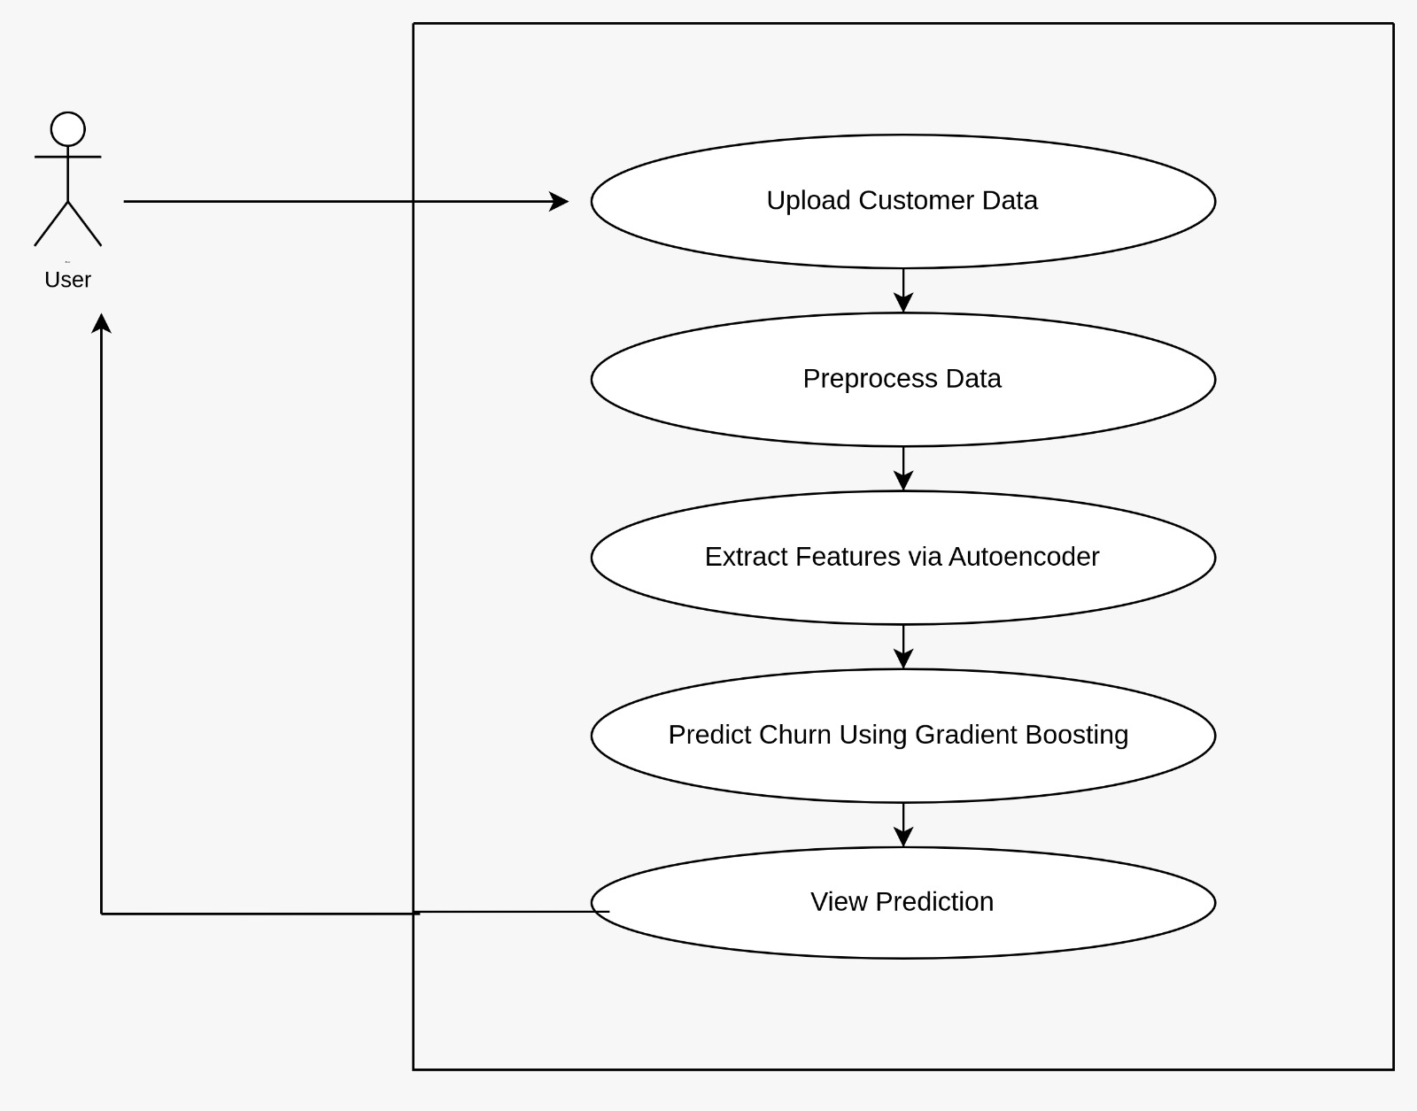
Use Case Diagram
Use Case Diagrams: Visual representation of system functions from a user's perspective.

Slide 12
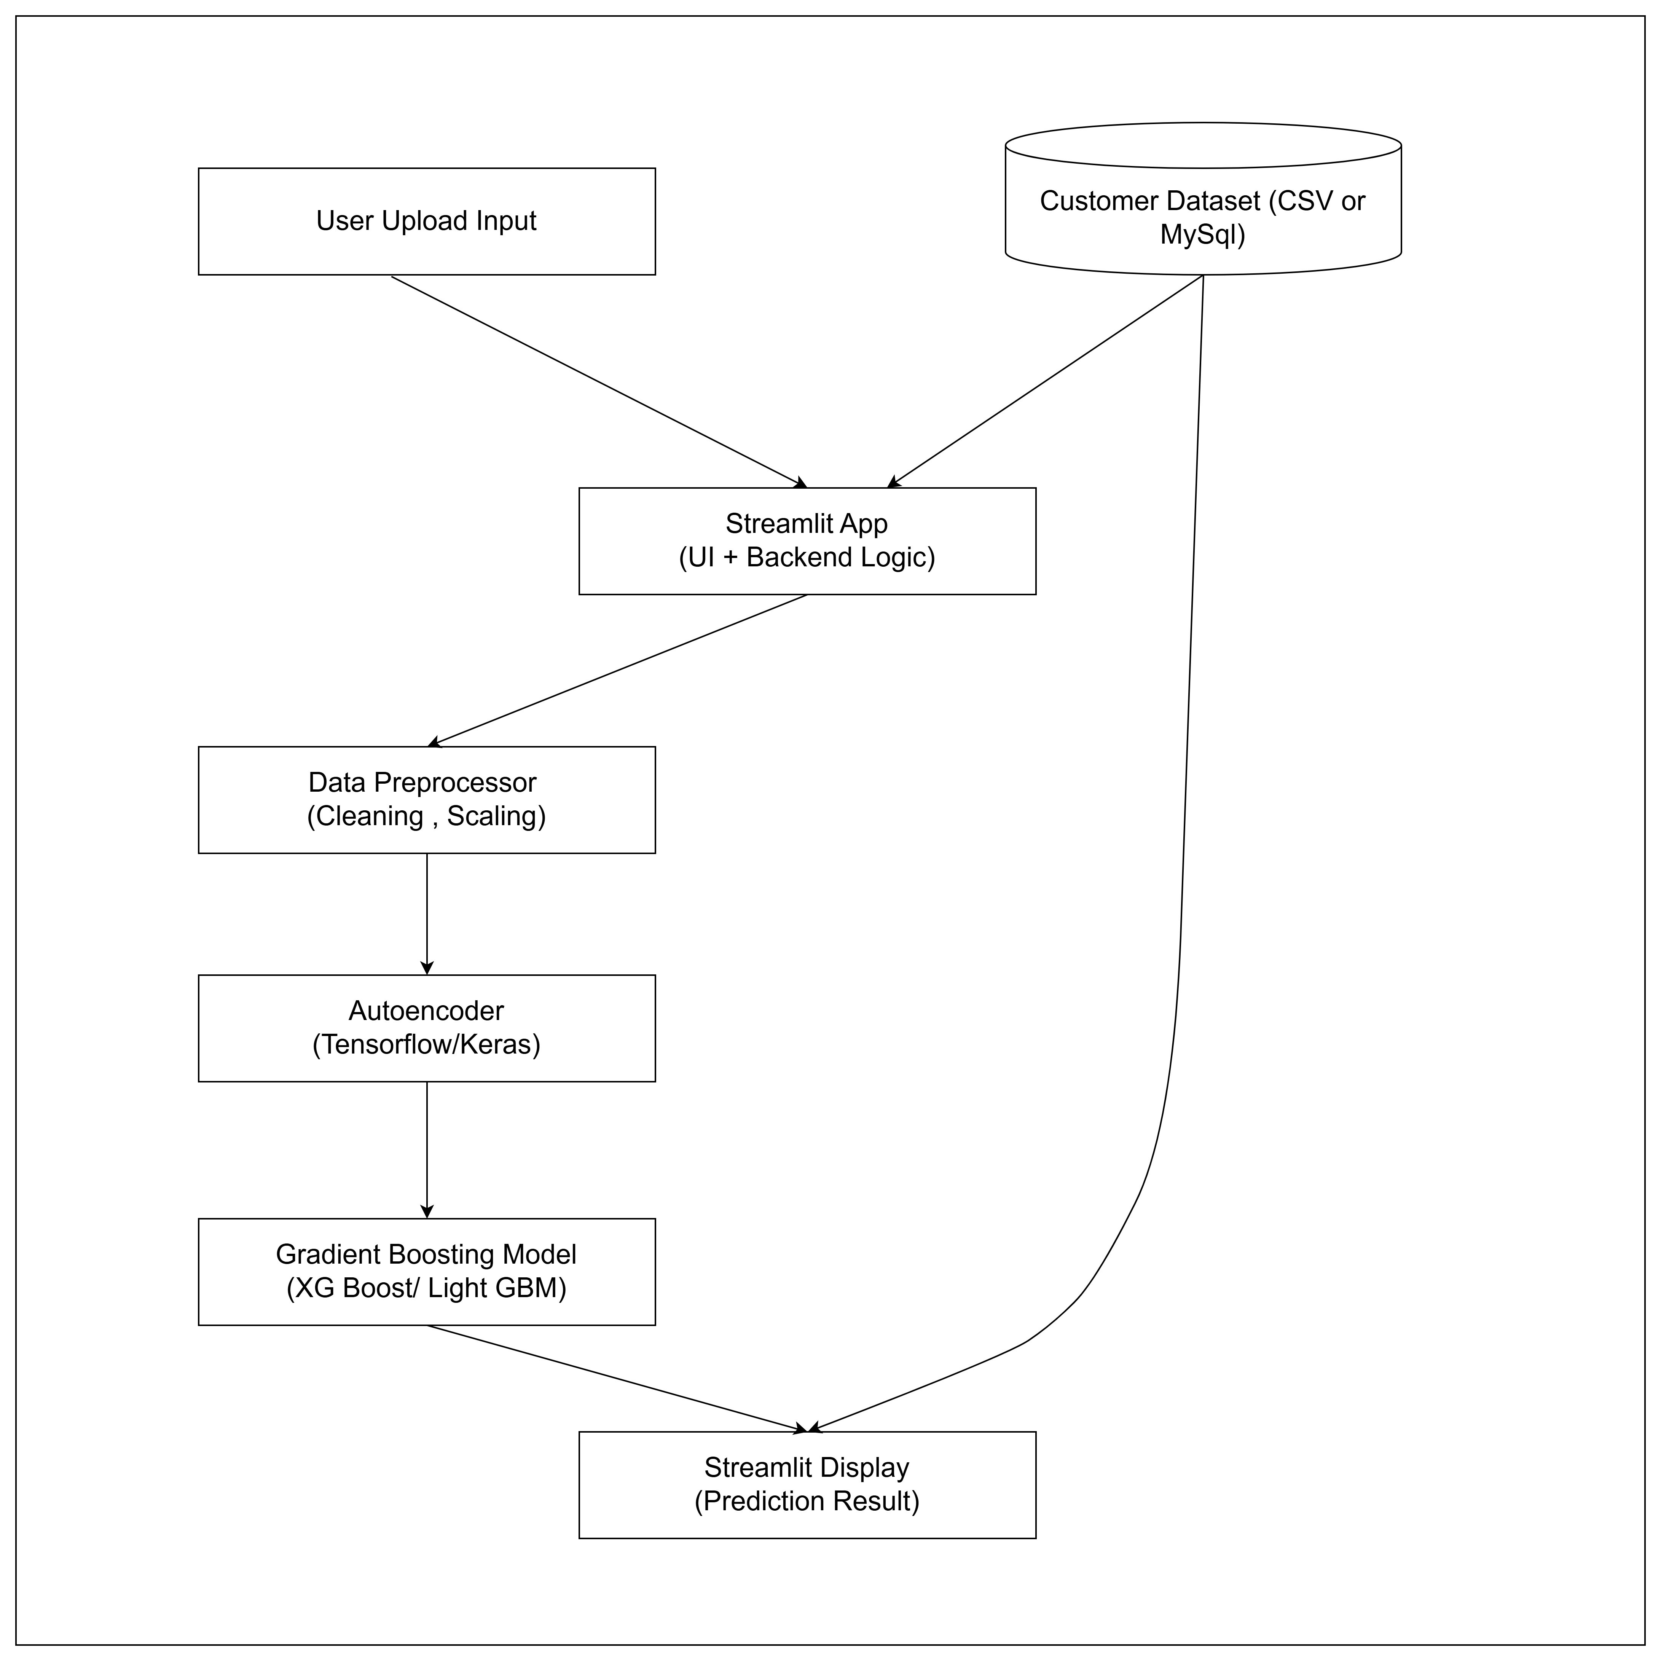
System Architecture
System architecture is a conceptual model that describes the structure and behavior of multiple components

Slide 13
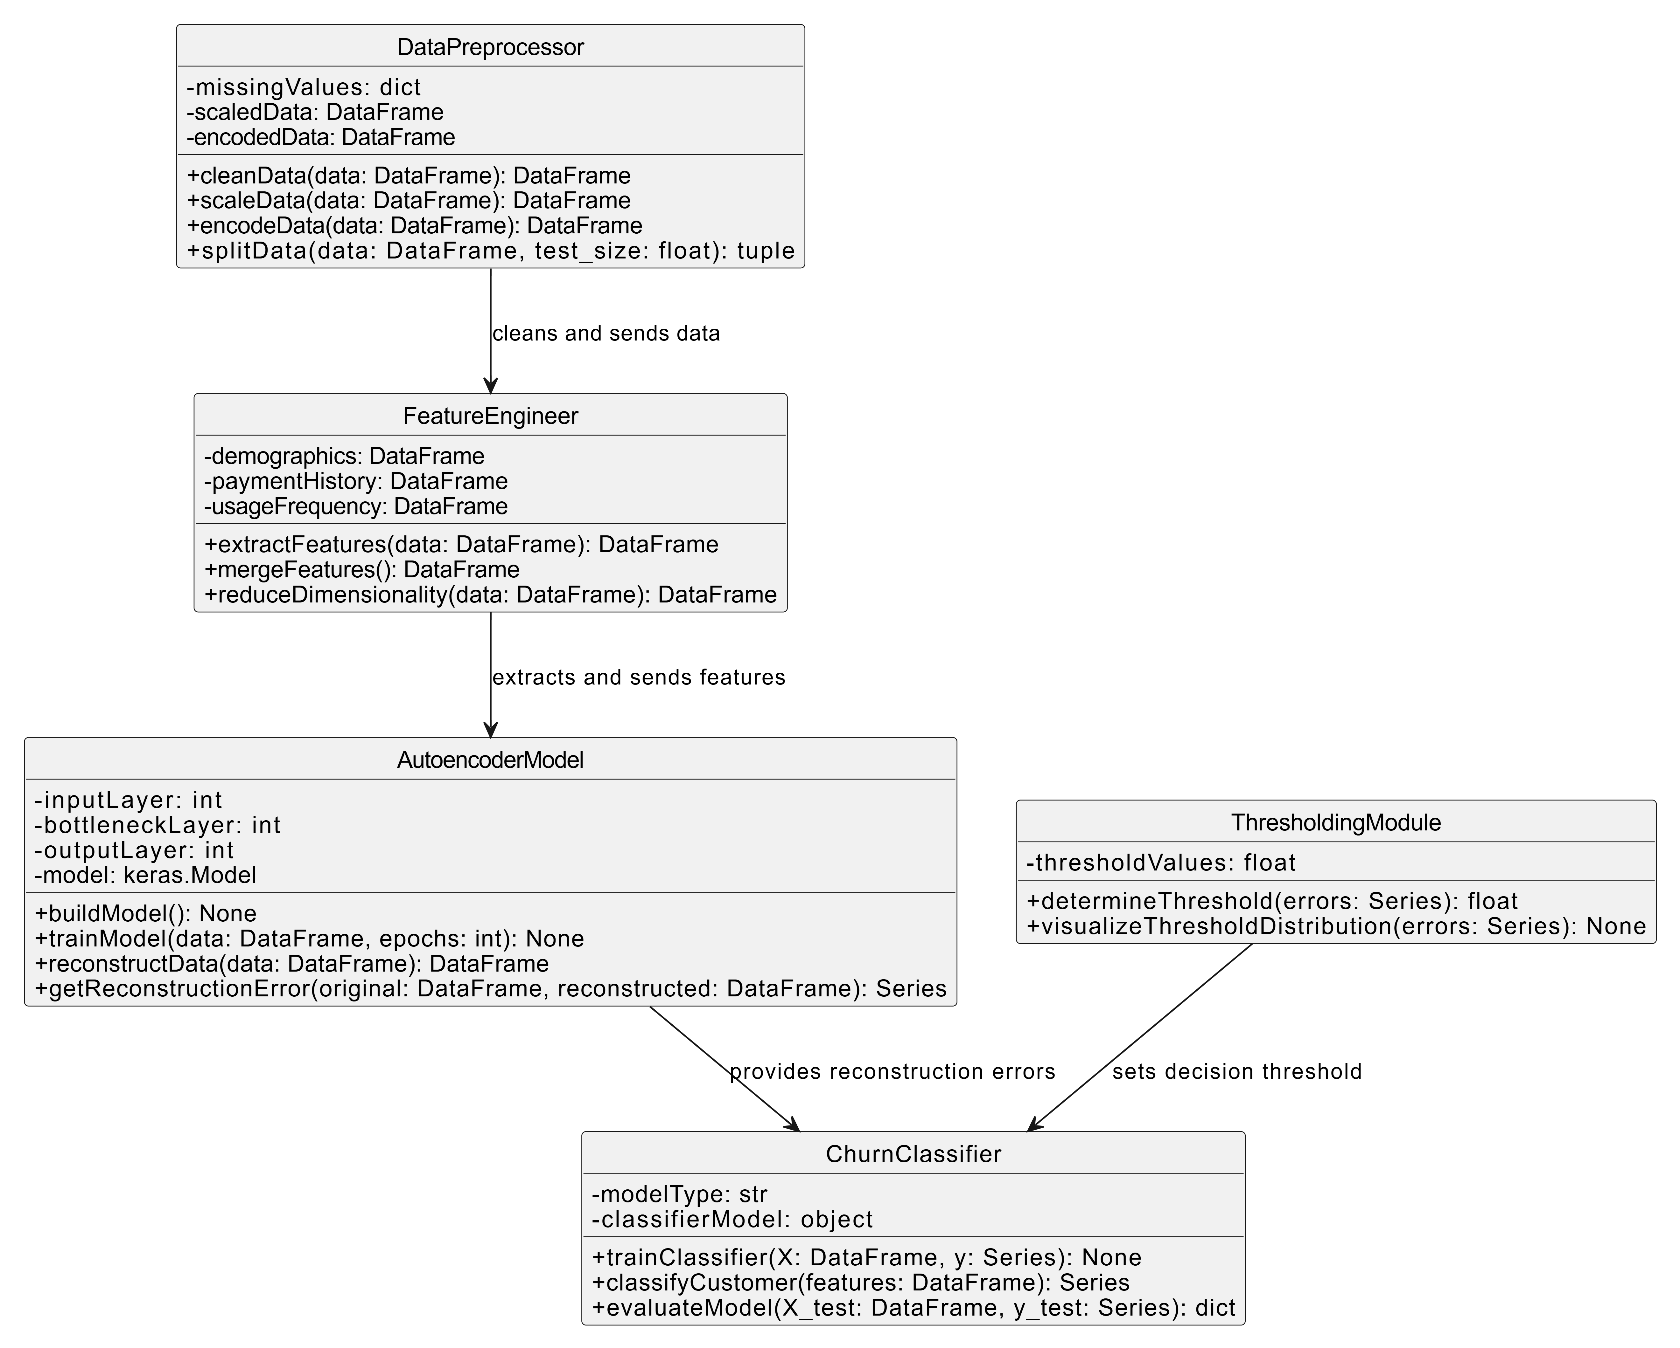
CLASS DIAGRAM

Slide 14
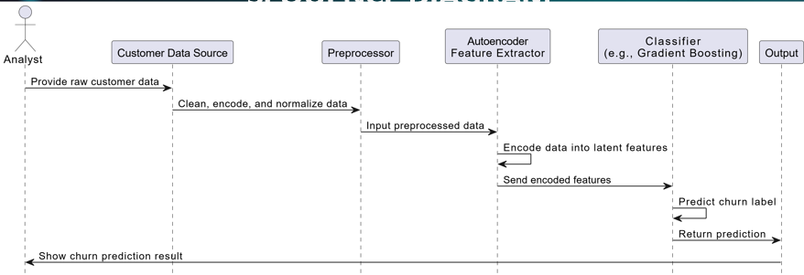
SEQUENCE DIAGRAM

Slide 15
CONCLUSION
Objective: Address customer churn using advanced analytics and deep learning.
Outcomes: Real-time analytics, scalability, and accurate predictions for better retention.
Impact: Boosts profitability and user satisfaction by reducing churn.
Future Scope: Add NLP for feedback analysis and CRM integration.

Slide 16


