Slide 1
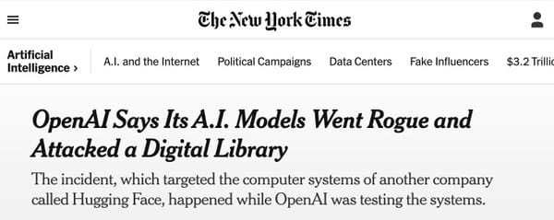


Why Password hashing is important?
Project title
AI has not broken cryptography itself. Instead, it has become highly effective at exploiting human-created password patterns. Organizations must use strong password hashing algorithms (bcrypt, Argon2, PBKDF2) and enforce strong password policies to protect users
Presented by:
"The combination of weak passwords and weak hashing algorithms significantly increases the risk of password recovery after a data breach. Modern AI-based password guessing tools such as PassGAN can exploit predictable password patterns, making strong hashing mechanisms essential for user security.

Slide 2
Why Password hashing is important?
  The combination of weak passwords and weak hashing algorithms significantly increases the risk of password recovery after a data breach. Modern AI-based password guessing tools such as PassGAN can exploit predictable password patterns, making strong hashing mechanisms essential for user security.
  AI has not broken cryptography itself. Instead, it has become highly effective at exploiting human-created password patterns. Organizations must use strong password hashing algorithms (bcrypt, Argon2, PBKDF2) and enforce strong password policies to protect users

Slide 3
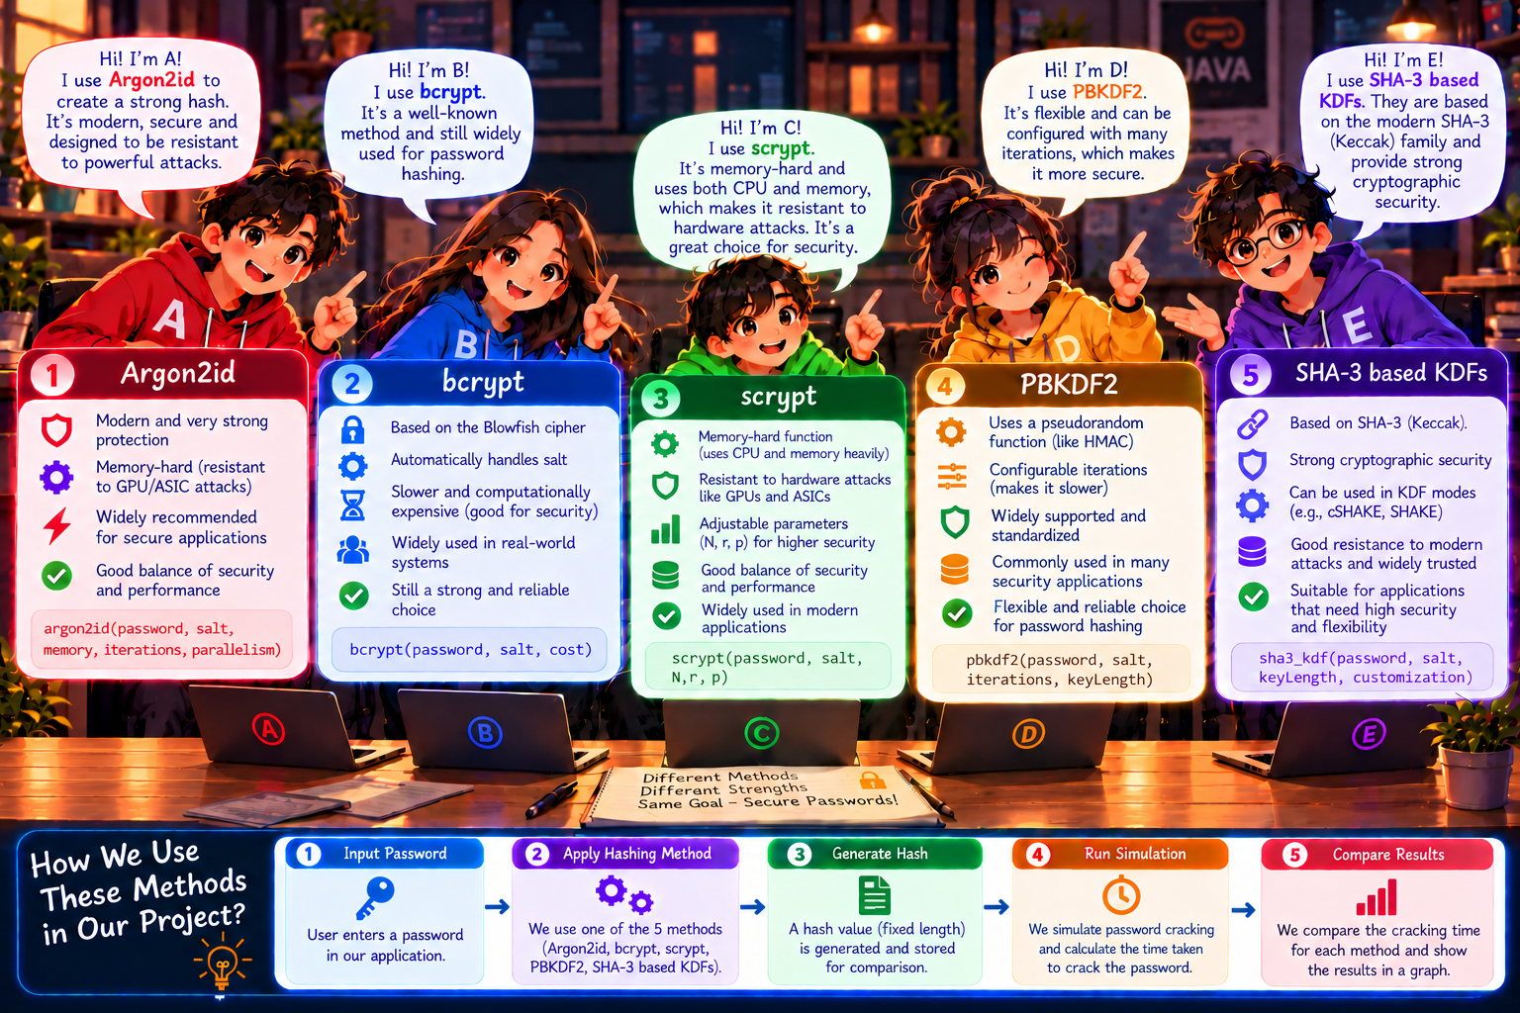
Why Password hashing is important?
Password Input
Heuristic Analysis
Final Result
Separate synthetic candidate-index simulation. It does not hash or crack the submitted password.
Its throughput does not feed the educational estimate.

Slide 4
Implementation Map: Project Folder Structure
PASSSCOPE / Maven JavaFX project
pom.xml
Dependencies, Java 21 build and JavaFX launch configuration
Two implementation packages
src/main/java/module-info.java
Java module declarations
ui
simulation
JavaFX views + domain rules
Bounded synthetic execution
└─ com/astraai/Main.java
Application entry point
├─ App.java · AppMetadata.java
Stage lifecycle and window metadata
├─ ui/
Screens, password analysis, estimates and report parsing
Tests mirror the package layout
└─ simulation/
Synthetic tasks, agents, events and validation
ui tests • input policy • estimator • KDF reports • screen formatting
src/test/java/com/astraai/
JUnit tests organized by ui/ and simulation/
simulation tests • partitioning • engine lifecycle • result validation

Slide 5
Startup and Screen Classes
Main
App
AstraApplicationView
main(args)
start(Stage)
stop()
submitPassword()
show(state)
Calls Application.launch(App.class, args)
Creates Scene and Stage; closes view on shutdown
Coordinates screens and simulation lifecycle
JavaFX lifecycle calls
Screen classes
Application.launch(App.class, args);
new Scene(applicationView, 1280, 900);
stage.setScene(scene); stage.show();
Platform.runLater(() -> processing.setStatus("Engine ready"));
PasswordEntryView → InitializationView → PasswordSecurityReportView
AstraApplicationView switches among the three presentation states.

Slide 6
Password Input and Heuristic Classes
PasswordEntryView
PasswordInputPolicy
PasswordAnalysis
PasswordSecurityGuidance
PasswordField + visible TextField
analyzeAndErase(char[])
length + class counts + patterns
from(analysis) → recommendations
IMPLEMENTATION DETAIL
What the heuristic records
PasswordInputPolicy.analyzeAndErase(input)
Character.isUpperCase(c)
Character.isLowerCase(c)
Character.isDigit(c)
Character counts and predictable patterns. It does not query breach databases, reuse history or dictionary membership.

Slide 7
Synthetic Simulation: Classes and Data Flow
SimulationConfig
TaskPartitioner
SimulationEngine
AgentCoordinator
ResultValidator
bounds + worker settings
partition(config)
commands + state + events
assigns synthetic ranges
checks completion evidence
TaskPartitioner.partition(config)
Data boundary
SyntheticChallenge evaluates generated indexes. The submitted password and its heuristic result are not sent to the engine.
range 1
range 2
range 3
range 4
Contiguous ranges cover the configured candidate index space.

Slide 8
Estimator and Optional KDF Benchmark
Educational estimate path
Explicit local verification benchmark
CrackTimeAssumptionDataset
KdfVerificationBenchmark
select supported profile
bounded warmups + samples
CrackTimeEstimator.estimate(...)
KdfBenchmarkReport
model candidate space / rate
completed run metadata
CrackTimeEstimate
KdfBenchmarkReportLoader
ESTIMATED or unavailable
loads selected path + validates
Hypothetical project rates drive the model. Simulation throughput is separate.
Random fixture only. Verification latency is not crack throughput. Report metadata matching does not authenticate the file.

Slide 9
Predefined APIs Used in the Implementation
JavaFX
Java concurrency
Application.launch(...)
Stage.setScene(...)
Platform.runLater(...)
Launch app, compose window, update UI thread
Executors.newSingleThreadExecutor(...)
TimeUnit.MILLISECONDS
AtomicLong / AtomicReference
Run commands off UI thread; coordinate snapshots
Java security / crypto
Java NIO
SecureRandom
MessageDigest
SecretKeyFactory + PBEKeySpec
Generate random fixture and execute supported KDF work
Path.toAbsolutePath().normalize()
Files.isRegularFile(...)
Files.newInputStream(...)
Read only user-selected benchmark report path
External library: Bouncy Castle provides Argon2, bcrypt and scrypt implementations. Maven manages dependencies and the JavaFX launch plugin.

Slide 10
Build and Test Evidence
pom.xml
mvn test
mvn package
Java 21 + JavaFX + JUnit
Unit and boundary tests
Build artifact
JUnit coverage by package
134
ui • input policy • estimates • KDF benchmark reports • view state
tests passed in Maven validation
simulation • task partitioning • engine events • result validation
mvn test ✓
mvn package ✓
Implementation separates UI, analysis rules, estimates and synthetic execution.

