Slide 1
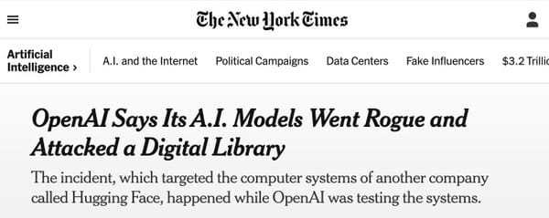


Why Password hashing is important?
Project title
AI has not broken cryptography itself. Instead, it has become highly effective at exploiting human-created password patterns. Organizations must use strong password hashing algorithms (bcrypt, Argon2, PBKDF2) and enforce strong password policies to protect users
Presented by:
"The combination of weak passwords and weak hashing algorithms significantly increases the risk of password recovery after a data breach. Modern AI-based password guessing tools such as PassGAN can exploit predictable password patterns, making strong hashing mechanisms essential for user security.

Slide 2
Why Password hashing is important?
  The combination of weak passwords and weak hashing algorithms significantly increases the risk of password recovery after a data breach. Modern AI-based password guessing tools such as PassGAN can exploit predictable password patterns, making strong hashing mechanisms essential for user security.
  AI has not broken cryptography itself. Instead, it has become highly effective at exploiting human-created password patterns. Organizations must use strong password hashing algorithms (bcrypt, Argon2, PBKDF2) and enforce strong password policies to protect users

Slide 3
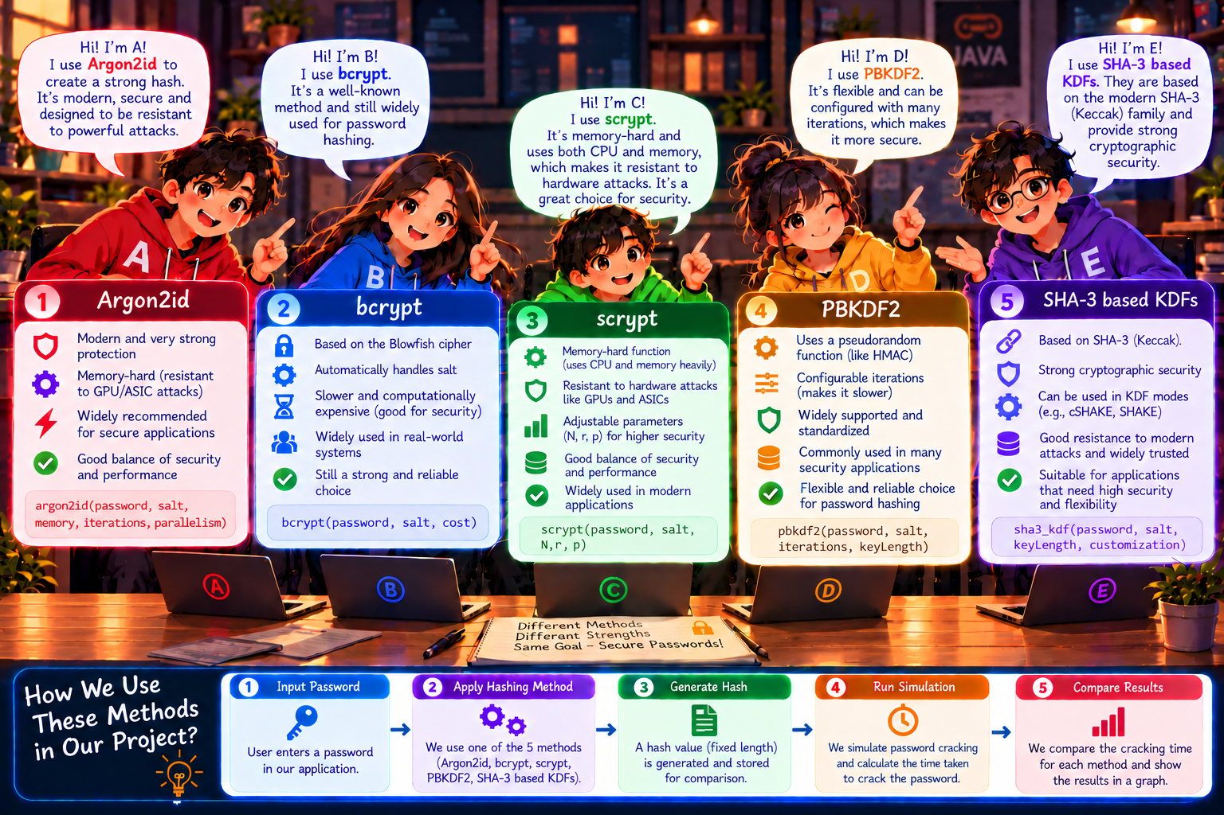
Why Password hashing is important?
Password Input
Heuristic Analysis
Final Result
Separate synthetic candidate-index simulation. It does not hash or crack the submitted password.
Its throughput does not feed the educational estimate.

Slide 4
PassScope: Educational Password Analysis
Users need a clear way to explore password characteristics and compare password-hashing approaches. PassScope brings local heuristic analysis and algorithm guidance into one desktop interface.
Password Input
Heuristic Analysis
Hashing Guidance
Entered for local analysis
Character patterns are assessed
Five algorithm entries are explained
The result is educational feedback. It does not prove that a password is secure.

Slide 5
Project Objectives
01
Analyze password characteristics locally with heuristics.
02
Explain Argon2id, bcrypt, scrypt, PBKDF2 and SHA-3.
03
Show educational crack-time estimates when model inputs are supported.
04
Demonstrate a separate synthetic candidate-index simulation.
05
Explain estimate assumptions and benchmark limits.
Scope: education, transparent assumptions and clear separation between application components.

Slide 6
Technology Stack and System Architecture
Java 21, JavaFX 21.0.6, Maven 3.10.0 and JUnit 5.11.4
PASSWORD_ENTRY
Local PasswordAnalysis
PROCESSING
FINAL_RESULT
JavaFX input
Character heuristic
Synthetic index simulation
Analysis and guidance
FINAL_RESULT contains
Password Strength Analysis
Hashing Algorithm Analysis
The educational crack-time estimator uses heuristic inputs and project-defined rates. Simulation throughput does not feed the estimator.

Slide 7
Three-State Workflow
1
2
3
PASSWORD_ENTRY
PROCESSING
FINAL_RESULT
The user submits a password for local heuristic analysis.
A separate synthetic candidate-index simulation runs with logical simulation agents.
Heuristic analysis and five algorithm cards show estimates or clear statuses.
The simulation uses synthetic indexes. It does not hash or crack the submitted password.

Slide 8
Password Strength Analysis
The local heuristic considers length and character classes to produce a strength assessment and recommendations.
01
Length
02
Lowercase and uppercase
Number of characters
Presence of letter classes
03
Digits
04
Symbols
Presence of numeric characters
Presence of non-alphanumeric characters
LIMITS
Heuristic feedback is not true entropy. It does not check breached-password databases, password reuse or dictionary membership, and it cannot prove a password is secure.

Slide 9
Five Algorithm Entries and Educational Estimates
A simplified candidate-space model uses project-authored illustrative offline rates.
ALGORITHM
ROLE IN THE GUIDANCE
EDUCATIONAL MODEL INPUT
Argon2id
Memory-hard password hashing; a recommended educational starting point.
v1.3 · 65,536 KiB · t=3 · p=1
10 guesses/second
bcrypt
Adaptive password hashing.
2b · cost 12
10 guesses/second
scrypt
Memory-hard password-based key derivation.
N=131,072 · r=8 · p=1
5 guesses/second
PBKDF2
Password-based key derivation.
HMAC-SHA-256 · 600,000 iterations
50 guesses/second
SHA-3
No concrete password KDF is specified in this entry.
Not estimable
The rates are hypothetical internal assumptions, not measured facts. Estimates are not real-world predictions or attacker ordering.

Slide 10
Implementation, Limitations and Conclusion
Java 21 desktop application built with JavaFX and Maven. The Results page presents local heuristic feedback and five algorithm entries. JUnit tests cover analysis, estimation, simulation boundaries and report validation.
Validation evidence: mvn test and mvn package succeeded; 134 tests passed.
LIMITATIONS
1
Estimates are educational and depend on simplified assumptions.
PassScope provides an educational way to explore password characteristics, hashing approaches, and the assumptions behind crack-time estimates.
2
Synthetic simulation does not crack the submitted password.
3
Optional benchmark uses a random fixture; verification latency is not cracking throughput.
4
Benchmark JSON is unsigned. Matching metadata does not prove authenticity or tamper resistance.
Understand the assumptions. Interpret estimates responsibly.

