Slide 1

Food Nutrition Analysis
Manage your diet properly

Slide 2
Problem Statement
In the modern era of health-conscious living, understanding the nutritional content of food has become paramount.
The primary goal of this analysis is to unravel insights that can aid individuals, researchers, and health practitioners in making informed dietary choices.
The project employs Python's data manipulation and visualization libraries, such as Pandas, NumPy, and Matplotlib, to clean, preprocess, and visualize the nutrition data.
Exploratory data analysis techniques are employed to identify trends, correlations, and patterns within the dataset.

Slide 3

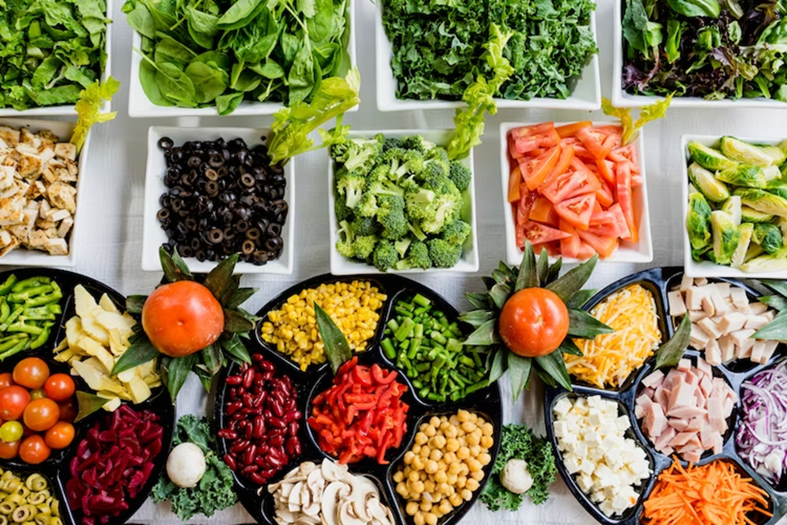

Our Objective is to Analyze the Food data and to find the Nutrient values

Slide 4
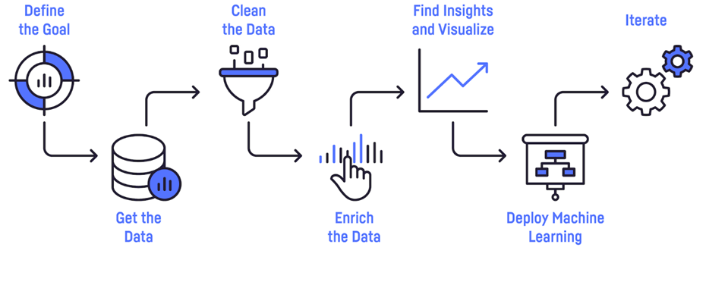
Architecture Diagram

Slide 5
Steps involved

Slide 6
Steps Involved in Data Analysis
Identify the Problem
Get the dataset
Data Cleaning
Data Analysis
Data Visualization

Slide 7
Advantages
Automation and Efficiency
Data Cleaning and Preprocessing
Visualization
Personalized Nutrition
Portion Control and Calorie Counting
Nutritional Labeling
Cost-Effectiveness
Customization and Flexibility
Collaboration and Sharing

Slide 8
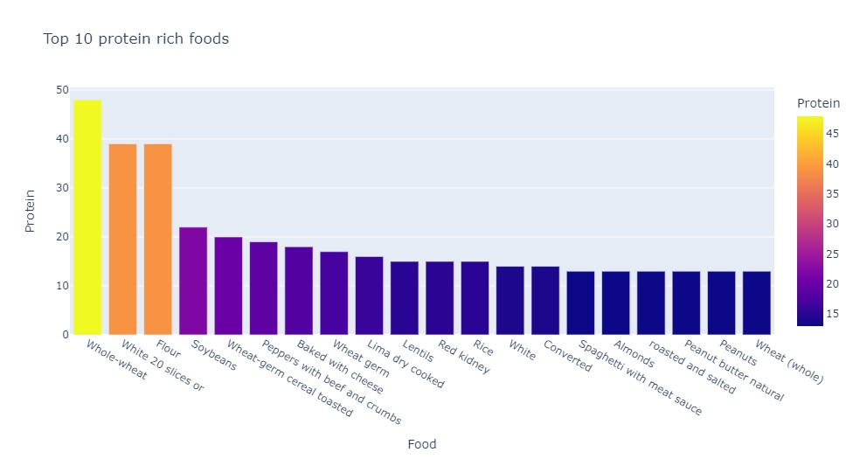
Some of the Results
From the category of Grains, Vegetables and Seeds, whole wheat has the most protein content followed by white bread. Soybeans are also in the top 20s. Also, Almonds rank no. 1 in the Seeds category.

Slide 9
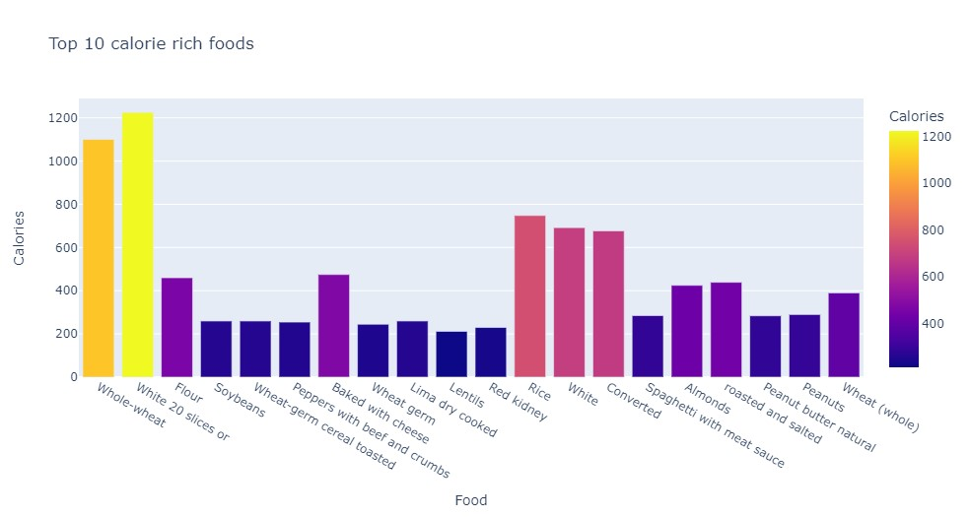
Calorie Rich Foods
Fortified milk has the most calories, followed by white bread. Also, notice how whole wheat has the most proteins but has almost equal number of calories. Lard is fat source with most calories and 1/2 cup of ice-creams tops the charts in the dessert category.

Slide 10
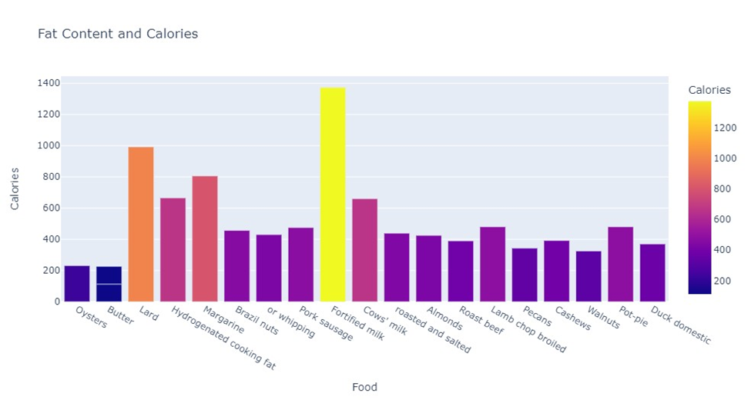
Fatty Foods
Oysters and Butter have the largest combination of calories and fats, followed by lard.

Slide 11
Conclusion
In conclusion, this food nutrition data analysis project utilizing Python has provided valuable insights into the dietary habits and nutritional composition of various food items.
Through careful data collection, preprocessing, and analysis, we have been able to uncover important patterns and trends that contribute to a better understanding of the nutritional landscape.

Slide 12


