Slide 1
Insurance Claim Risk Analysis
PySpark decision-tree workflow
Actual dataset run • model evaluation • dashboard
Notes:
Introduce the project and explain the key limitation: risk labels are rule-derived. Actual cleaned rows: 1000.

Slide 2
Problem and dataset
• Source: authentic insurance claims CSV
• 1,000 source rows; 1,000 cleaned rows
• Target: Low / Medium / High risk
• Mappings: claim_type ← incident_type; customer_region ← policy_state; policy_type ← policy_csl proxy
Notes:
Describe source fields and state that policy_type is not native to the source dataset.

Slide 3
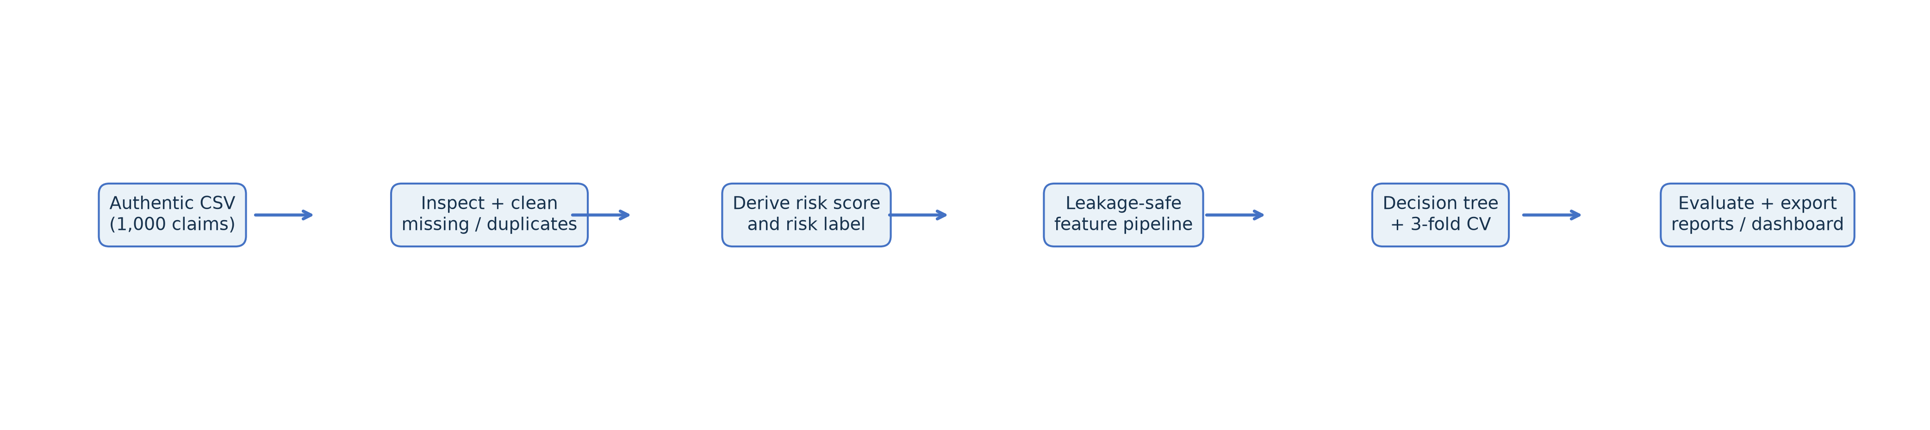
Methodology and processing pipeline
Spark CSV ingestion → inspection → missing-value normalization → deduplication / IQR cap → risk-label derivation → feature pipeline → decision tree / CV → evaluation and exports
Notes:
Walk through the diagram from raw CSV to deliverables. Spark performs processing and modeling; pandas writes small CSV exports.

Slide 4
Risk rule and leakage controls
Risk score = 0.5 × normalized claim amount + 0.3 × normalized severity + 0.2 × fraud indicator
Cutoffs: p40=0.3656; p75=0.5430
Excluded model fields: fraud_reported, incident_location, incident_severity, injury_claim, insured_zip, policy_number, property_claim, risk_level, risk_score, total_claim_amount, vehicle_claim
Notes:
Explain that target ingredients and identifiers are excluded from feature inputs. This rule-derived label is not ground truth.

Slide 5
Training and cross-validation
Decision tree • three-fold CV • weighted F1 selection
Best parameters: {"maxBins": 32, "maxDepth": 5, "minInstancesPerNode": 5}
Code: results = train_evaluate(spark, cleaned, cleaning_metadata, outputs_dir)
Feature columns: 32
Class weighting used: True
Notes:
Explain train-only class weight estimation and the selected tree hyperparameters.

Slide 6
Model comparison and generalization
Majority baseline: accuracy 0.407, weighted F1 0.236
Untuned tree: accuracy 0.574, weighted F1 0.562
Tuned tree: accuracy 0.556, weighted F1 0.537
Tuned train/test F1: 0.548 / 0.537
Train-test gap: 0.011. The train score is higher by 0.0111; this is a modest train/test gap.
Notes:
Compare model performance and use the train-test F1 gap as a basic overfitting check. These are estimates on the fixed random holdout.

Slide 7
Per-class evaluation and confusion matrix
class precision recall f1 support
Low 0.912 0.470 0.620 66
Medium 0.451 0.879 0.596 58
High 0.533 0.211 0.302 38
Confusion matrix (rows actual, columns predicted):
Low Medium High
actual
Low 31 34 1
Medium 1 51 6
High 2 28 8
Baseline weighted precision=0.7087 exceeds weighted recall=0.5741. Precision is the share of predictions that are correct; recall is the share of actual cases found. The per-class results where precision exceeds recall are: Low: precision=1.000, recall=0.470; High: precision=0.588, recall=0.263; this indicates missed actual cases (false negatives) are lowering recall more than false positives lower precision. The weighted scores are support-weighted, so interpret them with the per-class metrics and confusion matrix.
Notes:
Discuss the class-level results and the confusion matrix. Weighted precision averages class precision by support; false negatives reduce recall.

Slide 8
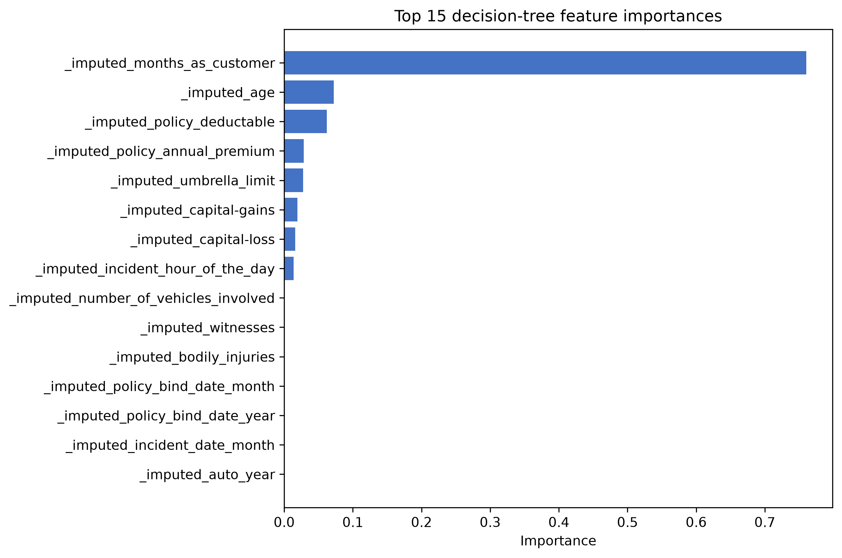
Feature importance
feature importance
_imputed_months_as_customer 0.7605
_imputed_age 0.0723
_imputed_policy_deductable 0.0618
_imputed_policy_annual_premium 0.0284
_imputed_umbrella_limit 0.0276
_imputed_capital-gains 0.0191
_imputed_capital-loss 0.0163
_imputed_incident_hour_of_the_day 0.0140
_imputed_number_of_vehicles_involved 0.0000
_imputed_bodily_injuries 0.0000
Notes:
Read feature names from Spark VectorAssembler metadata. Explain that tree importance is model-specific and not causal.

Slide 9
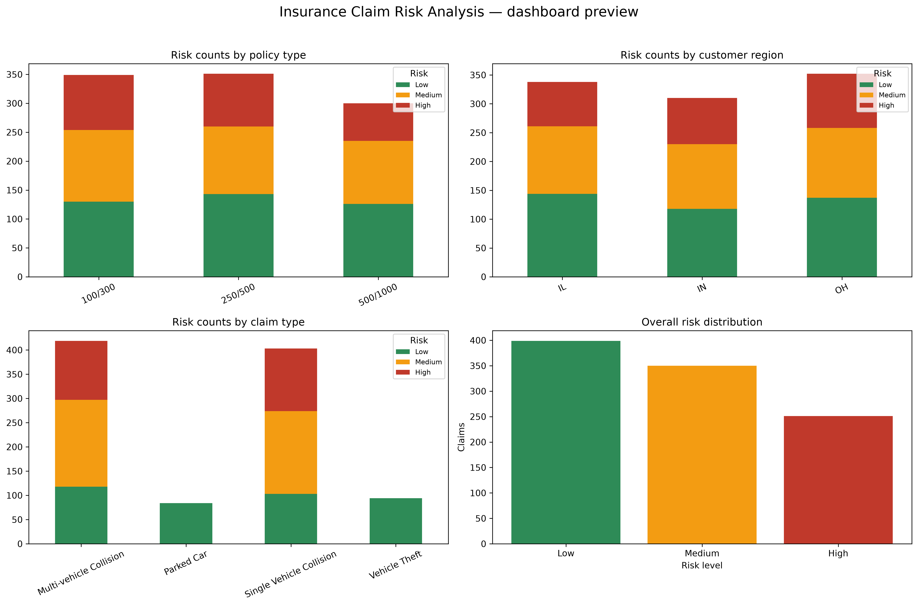
Dashboard and risk distributions
Actual run dashboard preview
Grouped counts • 100% stacked risk composition • policy / region / claim-type heatmaps • overall distribution
Notes:
Use the preview to orient the audience, then point to the Excel workbook and Power BI CSV exports.

Slide 10
Conclusions, limitations, references
Tuned test accuracy 0.556; weighted F1 0.537.
Limitations: rule-derived labels, 1,000 claims, random holdout, proxy policy_type, no external validation.
Next steps: validate target independently; temporal/external testing; compare calibrated models.
References: supplied CSV; Apache Spark 3.5 docs; PySpark ML guide; pandas / XlsxWriter docs.
Notes:
Summarize actual results, emphasize the target's heuristic nature, and propose independent validation.

Slide 11
Viva questions and answers (1–5)
Q1. What is predicted?
A. A three-level rule-derived risk label.
Q2. How is the score built?
A. Normalized claim amount, severity, and fraud indicator with weights 0.5/0.3/0.2.
Q3. Why exclude target ingredients?
A. To prevent direct target leakage.
Q4. What does policy_type represent?
A. A coverage-limit proxy mapped from policy_csl.
Q5. How was the tree selected?
A. Three-fold CV optimizing weighted F1.
Notes:
Use the questions as a viva preparation appendix; answers are concise and based on the implemented project.

Slide 12
Viva questions and answers (6–10)
Q6. What does weighted precision mean?
A. Support-weighted average of class precision.
Q7. How is overfitting checked?
A. Training versus held-out test weighted F1 gap.
Q8. What does confusion matrix show?
A. Actual-versus-predicted class counts.
Q9. Why might saving fail on Windows?
A. Hadoop local permissions may require winutils.exe.
Q10. What is the primary limitation?
A. The heuristic label is not independently validated ground truth.
Notes:
Use the questions as a viva preparation appendix; answers are concise and based on the implemented project.

