Slide 1
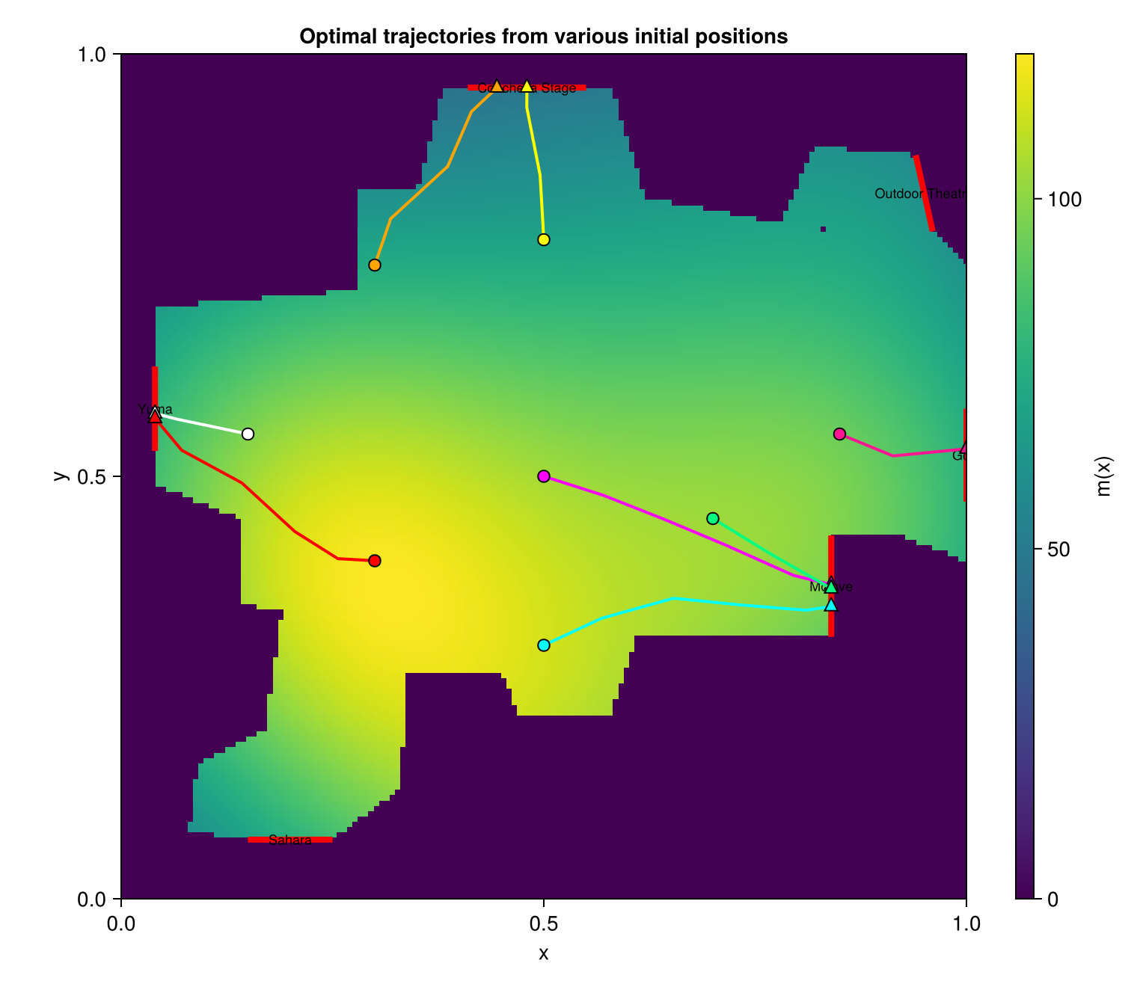
Single-Agent Optimal
Feedback Control
for concert-venue egress
Nick Gilligan · Kene Nnolim · Ben Volokh
18.337 Final Project — May 2026
HJB optimal control
Crowd-aware routing
Medics / tracers
Output: optimal feedback routes through a fixed crowd-density field

Slide 2
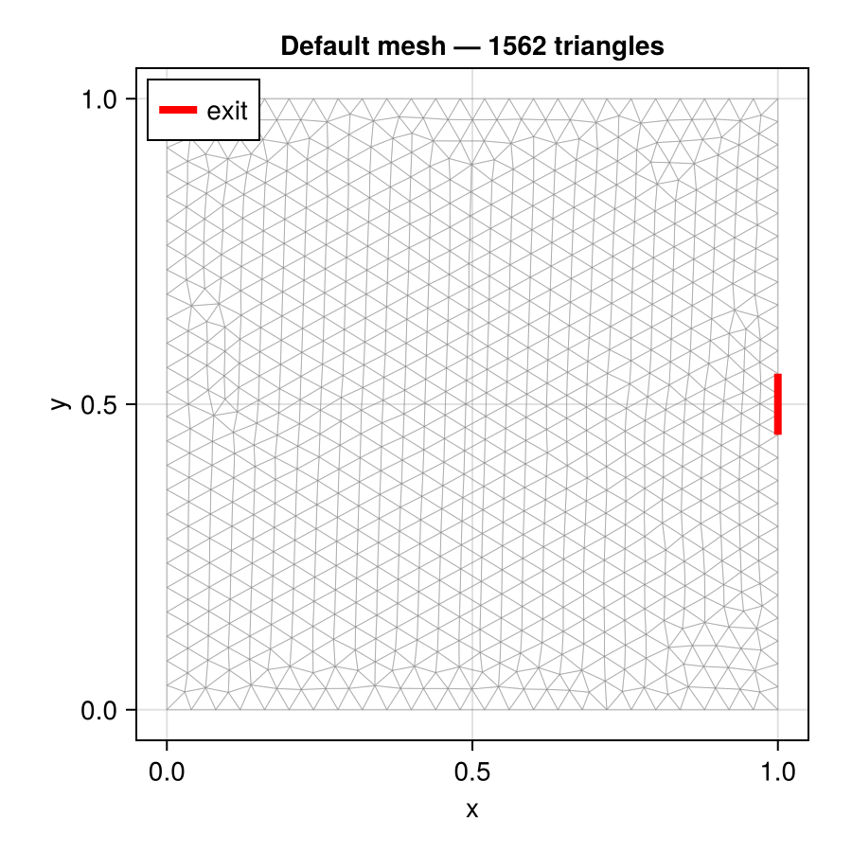
From MFG proposal to single-agent HJB
Key modeling choice: freeze the crowd density over a tracer crossing time.
Final model
Density m(x) is prescribed, exogenous, and time-independent
Solve one regularized HJB PDE for cost-to-go v(t,x)
Recover optimal feedback field: α*(t,x) = -∇v(t,x)
Operational question: fastest route for one identified attendee or medic
deliberate
scope shift
Original proposal
Mean Field Game: HJB + Fokker-Planck for a whole crowd.
18.337 Final Project | scope

Slide 3
Problem formulation
A deterministic controlled tracer moves until it hits an exit segment.
State and stopping time
Physical interpretation
ẋₜ = αₜ, τ = inf { t ≥ 0 : xₜ ∈ Γₑ }
Kinetic term discourages unrealistic speed
Density term penalizes pushing through crowds
Gradient of v points toward best exit in cost, not just distance
Artificial viscosity stabilizes the numerics, not the physics
Cost functional
J(α;x₀) = ∫₀ᵗᵃᵘ [ ½|αₜ|² + κ log(m(xₜ)+ε) ] dt
Regularized HJB
-∂ₜv - (σ²art/2) Δv + ½|∇v|² = κ log(m(x)+ε)
Boundary: v = 0 on exits; no-flux Neumann on walls.
18.337 Final Project | formulation

Slide 4
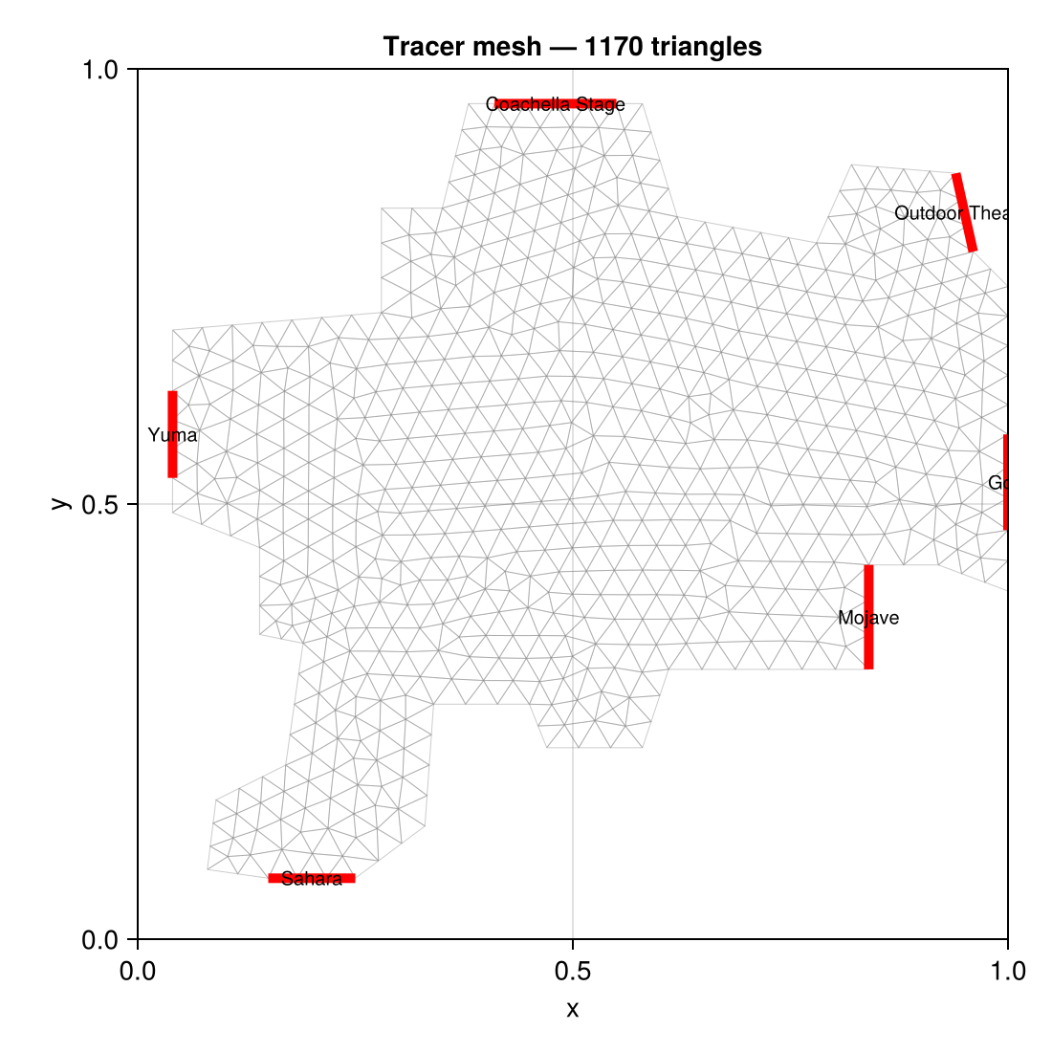
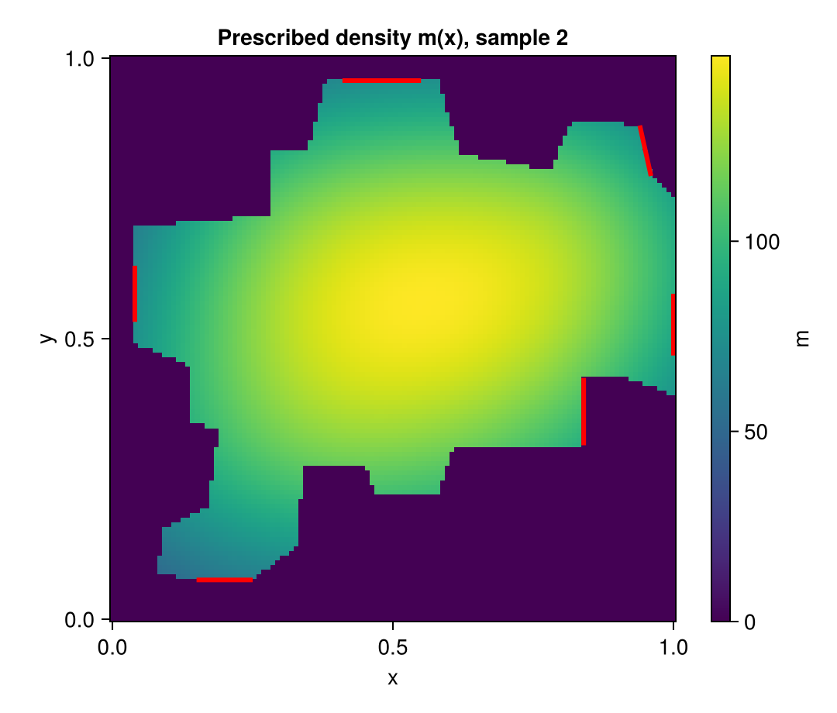
Venue, mesh, and density field
Coachella-like polygon with five tagged exit segments.
Unstructured mesh
Prescribed density m(x)
18.337 Final Project | geometry

Slide 5
Numerical pipeline
One backward HJB solve produces a reusable feedback field.
1. Build mesh
2. Prescribe m(x)
3. Solve HJB
4. Integrate tracer
5. Detect exit
tag exits + walls
baseline + Gaussian bumps
implicit Euler + Newton
xₖ₊₁ = xₖ - ∇v Δt
segment intersection
Discretized weak form actually solved at each Newton step
∫ vⁿw + Δt(σ²art/2)∇vⁿ·∇w + Δt(∇vᵏ·∇vⁿ)w
= ∫ vⁿ⁺¹w + ΔtFw + (Δt/2)|∇vᵏ|²w
Backward in time for v(t,x); then forward in time for the closed-loop path.
18.337 Final Project | solver

Slide 6
Implementation packages
Julia-based FEM and meshing stack for PDE control on an irregular venue.
Core PDE stack
Mesh + numerics
Visualization
Gridap: finite-element spaces, weak forms, assembly, boundary conditions
GridapGmsh: imports the Gmsh mesh and physical tags
Gridap.CellData / Geometry / FESpaces: gradients, cell fields, FE function handling
Gmsh: builds the Coachella-like polygonal venue mesh
LinearAlgebra + SparseArrays: sparse FEM systems and Newton solves
Statistics / Printf / Random: diagnostics, reproducibility, and formatted logging
CairoMakie: plots mesh, density heatmaps, value fields, and trajectories
Notebook workflow: Pkg.activate(@__DIR__) keeps the project environment local
Same infrastructure supports future MFG extension with time-dependent density
Why these packages mattered: Gmsh gave the geometry; Gridap solved the weak-form HJB; CairoMakie made the results interpretable.
18.337 Final Project | implementation

Slide 7
Results: one solve, many routes
Eight starting points follow the same optimal feedback field.
Key qualitative behavior
Tracers avoid the yellow high-density core
Sparse-region starts take near-straight exits
“Nearest exit” means nearest-in-cost, not Euclidean distance
The cyan tracer rounds the plateau before exiting at Mojave
Deliverable for operations: route + estimated travel time τ from any reported location.
18.337 Final Project | results

Slide 8
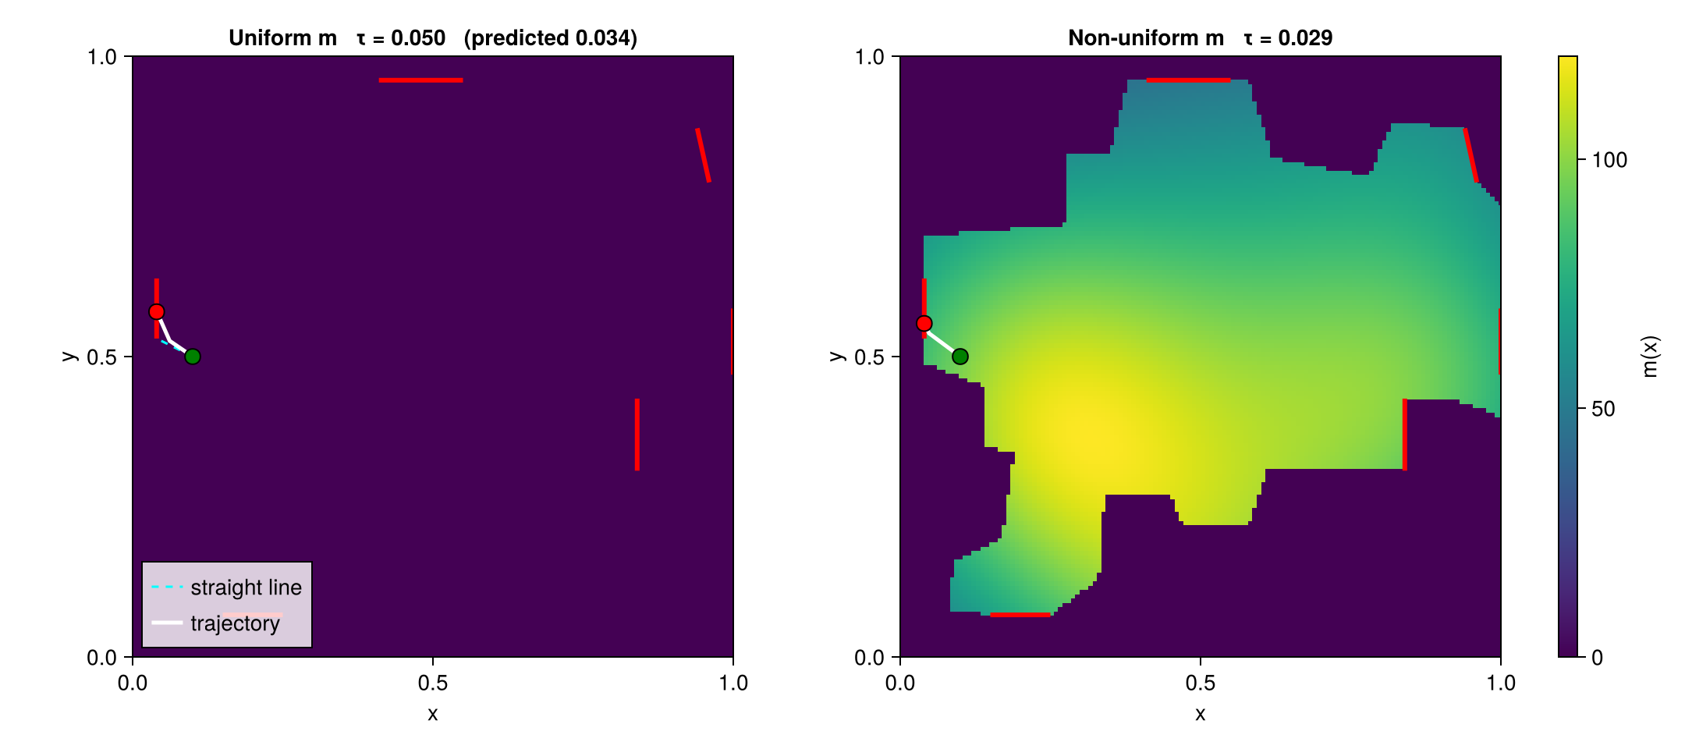
Validation and numerical sensitivity
Uniform-density limit gives an analytic benchmark.
Uniform-density check
If F ≡ c₀, the optimal path is a straight line at speed √(2c₀).
τpred = L / √(2c₀); for c₀ = 2, τpred = L/2.
Sensitivity to σart
Too small: Galerkin convection oscillates
Too large: v is over-smoothed and trajectories straighten
Used σart = 0.3 for robustness on irregular mesh
18.337 Final Project | validation

Slide 9
Takeaways and next steps
A tractable single-PDE model that is directly useful for extraction routing.
What we kept
What we gave up
Where it is useful
HJB structure of the original proposal
Finite-element solve on realistic venue geometry
Density-aware optimal feedback control
No self-consistent crowd response
No exit congestion fixed point
Density is fixed snapshot data
Vector medics to an attendee
Estimate travel time through crowd
Recompute when density snapshot updates
Future extension: replace fixed m(x) with time-dependent m(x,t), then restore the Fokker-Planck equation to recover a true mean-field-game evacuation model.
Bottom line: one HJB solve turns a crowd-density snapshot into a full venue-wide routing policy.
18.337 Final Project | takeaways

