Slide 1
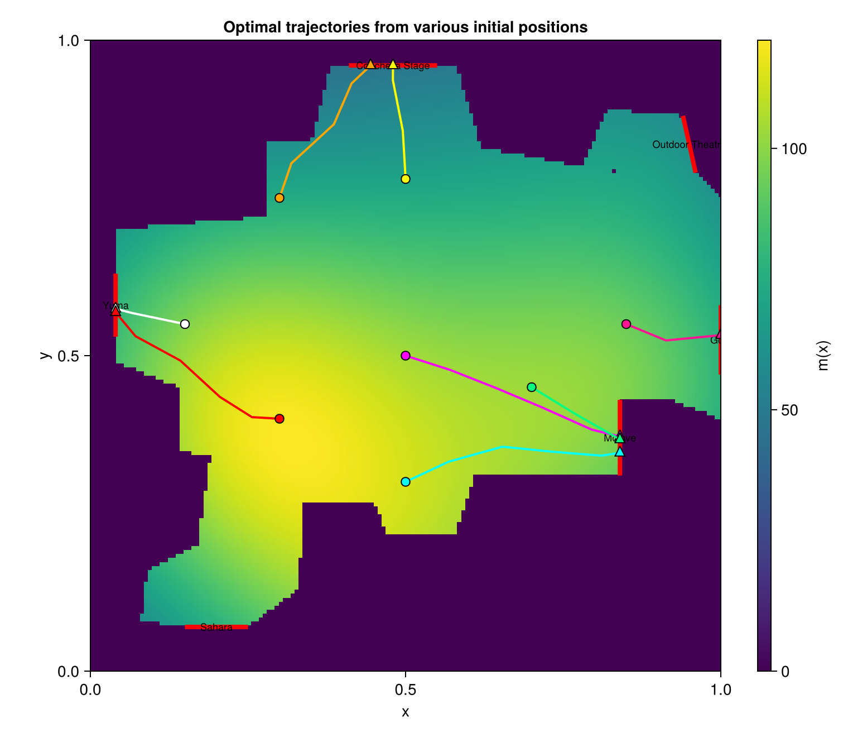
Concert Venue Egress using Optimal Feedback
Nick Gilligan - I love bagels
Kene Nnolim - I speak 5 languages
Ben Volokh – I like seltzer-water
18.337 Final Project — May 2026
Output: optimal feedback routes through a fixed crowd-density field

Slide 2
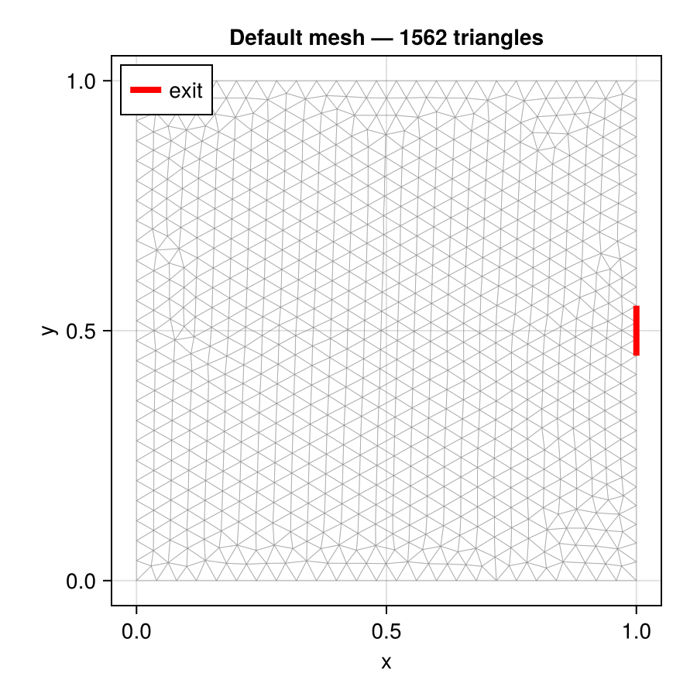
From MFG proposal to single-agent HJB
Final model
Density m(x) is prescribed, exogenous, and time-independent
Solve one regularized HJB PDE for cost-to-go v(t,x)
Recover optimal feedback field: α*(t,x) = -∇v(t,x)
Operational question: fastest route for one identified attendee or medic
deliberate
scope shift
Original proposal
Mean Field Game: HJB + Fokker-Planck for a whole crowd.
18.337 Final Project | scope

Slide 3

Problem formulation
State and stopping time
Physical interpretation
ẋₜ = αₜ, τ = inf { t ≥ 0 : xₜ ∈ Γₑ }
Kinetic term discourages unrealistic speed
Density term penalizes pushing through crowds
Gradient of v points toward best exit in cost, not just distance
Artificial viscosity stabilizes the numerics, not the physics
Cost functional
Regularized HJB
Boundary: v = 0 on exits; no-flux Neumann boundary constraints on walls.
18.337 Final Project | formulation

Slide 4
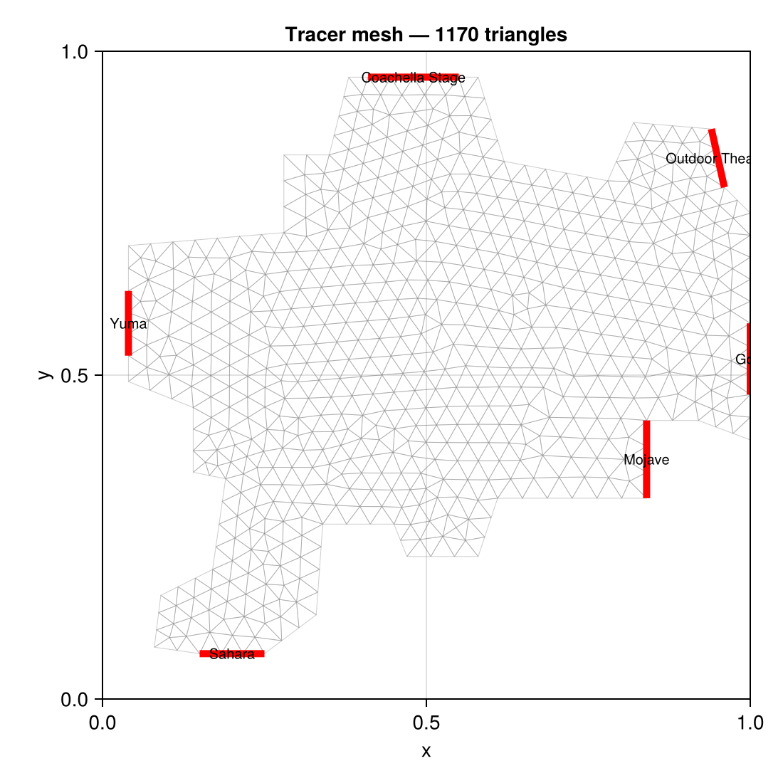
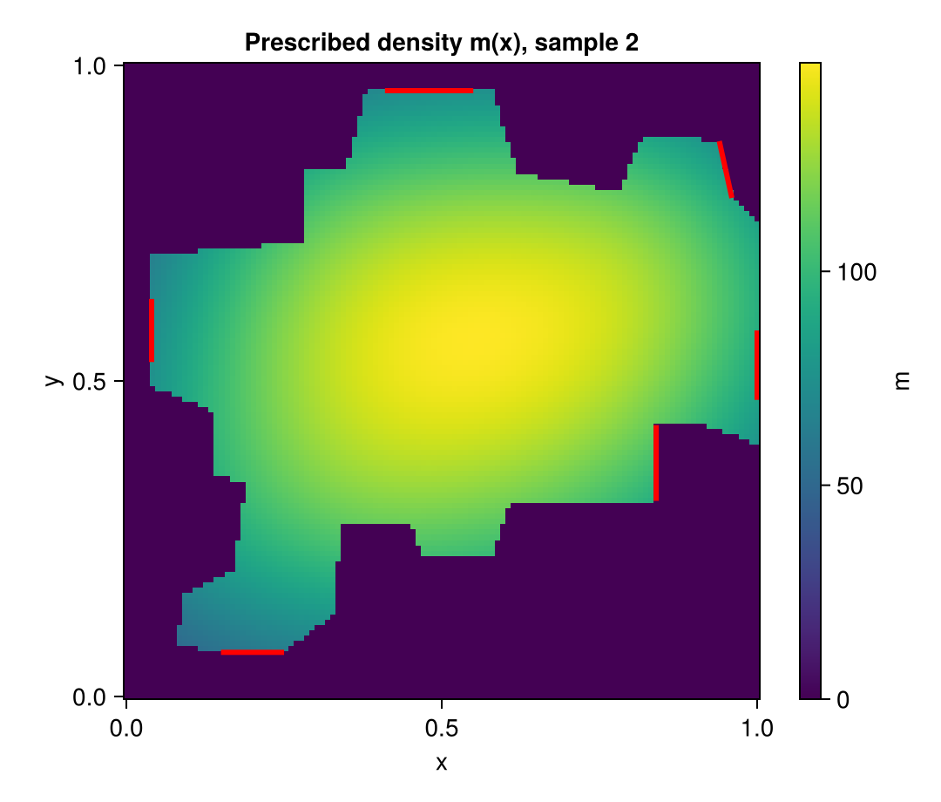
Venue, mesh, and density field
Unstructured mesh
Prescribed density m(x)
18.337 Final Project | geometry

Slide 5
Numerical pipeline
1. Build mesh
2. Prescribe m(x)
3. Solve HJB
4. Integrate tracer
5. Detect exit
tag exits + walls
baseline + Gaussian bumps
implicit Euler + Newton
xₖ₊₁ = xₖ - ∇v Δt
segment intersection
Discretized weak form solved at each Newton step
Backward in time for v(t,x); then forward in time for the closed-loop path.
18.337 Final Project | solver

Slide 6
Implementation packages
Core PDE stack
Mesh + numerics
Visualization
Gridap: finite-element spaces, weak forms, assembly, boundary conditions
GridapGmsh: imports the Gmsh mesh and physical tags
Gridap.CellData / Geometry / FESpaces: gradients, cell fields, FE function handling
Gmsh: builds the Coachella-like polygonal venue mesh
LinearAlgebra + SparseArrays: sparse FEM systems and Newton solves
Statistics / Printf / Random: diagnostics, reproducibility, and formatted logging
CairoMakie: plots mesh, density heatmaps, value fields, and trajectories
Notebook workflow: Pkg.activate(@__DIR__) keeps the project environment local
Same infrastructure supports future MFG extension with time-dependent density
Why these packages mattered: Gmsh gave the geometry; Gridap solved the weak-form HJB; CairoMakie made the results interpretable.
18.337 Final Project | implementation

Slide 7
Results: one solve, many routes
Key qualitative behavior
Tracers avoid the yellow high-density core
Sparse-region starts take near-straight exits
“Nearest exit” means nearest-in-cost, not Euclidean distance
The cyan tracer rounds the plateau before exiting at Mojave
Deliverable for operations: route + estimated travel time τ from any reported location.
18.337 Final Project | results

Slide 8
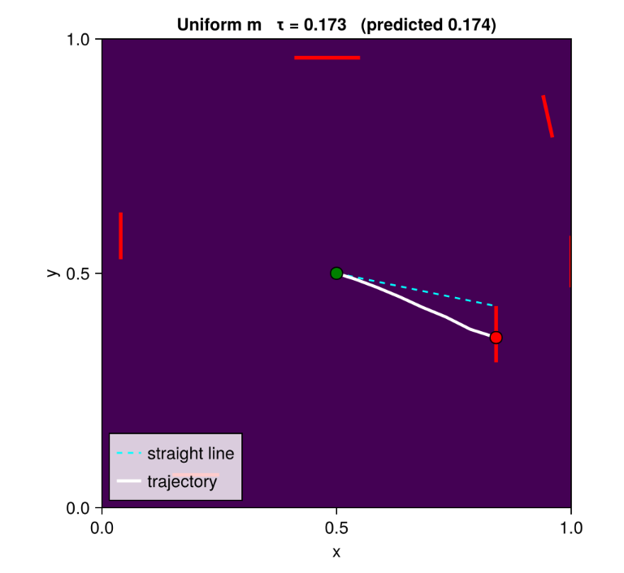
Validation - Uniform-density check
18.337 Final Project | validation

Slide 9
Takeaways and next steps
What we kept
What we gave up
Where it is useful
HJB structure of the original proposal
Finite-element solve on realistic venue geometry
Density-aware optimal feedback control
No self-consistent crowd response
No exit congestion fixed point
Density is fixed snapshot data
Send medics to an attendee
Estimate travel time through crowd
Future extension: replace fixed m(x) with time-dependent m(x,t), then restore the Fokker-Planck equation to recover a true mean-field-game evacuation model.
18.337 Final Project | takeaways

