Slide 1

Sales Analysis – Advanced Excel Project
Name : Yahavarshini E
Date : 12-02-2025
Course : DA & DS
Batch Name : Dec Regular offline – RP33

Slide 2

Project Objective
Identify trends.
Understand sales performance.
Provide actionable business insights.
Goals
Analyze sales trends over time.
Identify high-performing products and sales channels.
Create a dynamic dashboard with key metrics.

Slide 3
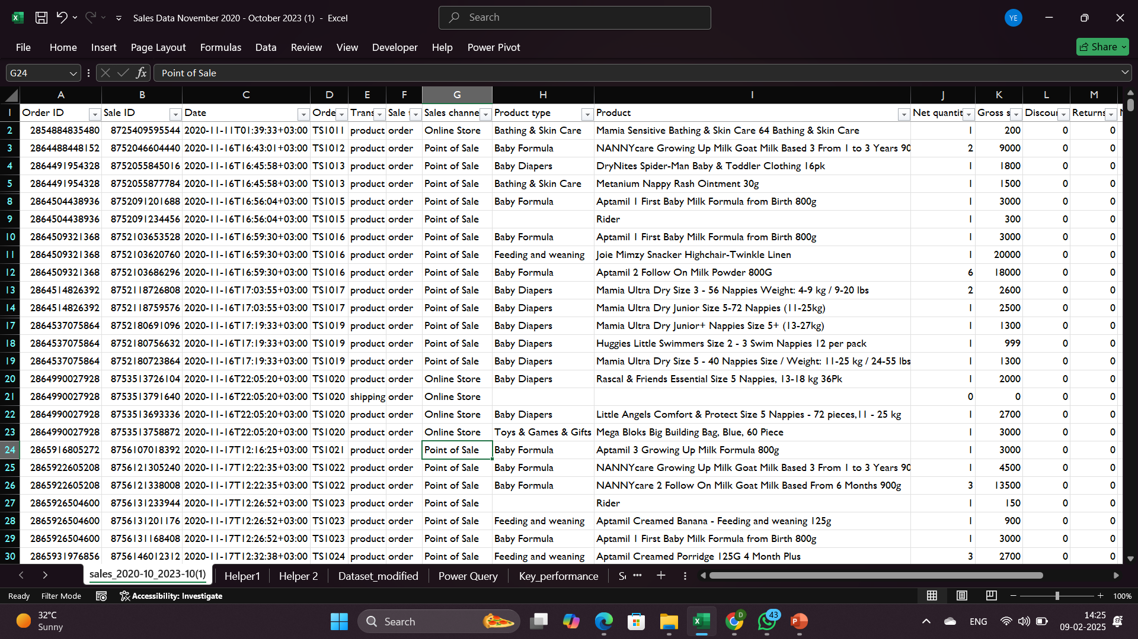
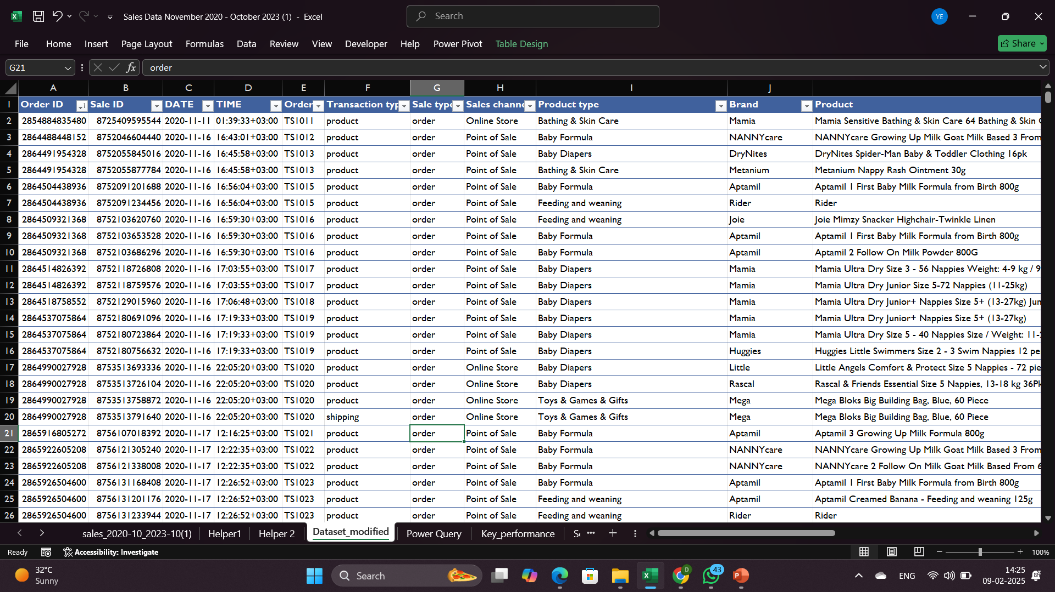
Dataset Overview :
Dataset Cleaning:
Rows: 20,000+
Columns: Order ID, Sale ID, Product Type, Sales, Date, Channel
Time Period: Nov 2020 – Oct 2023
Key Info: Sales across multiple channels (Online, POS, Wholesale)
Removed Duplicates (Order ID, Sale ID).
Handled Missing Values (Filled categories, set 0 for null sales).
Formatted Dates (Standardized YYYY-MM-DD).

Slide 4
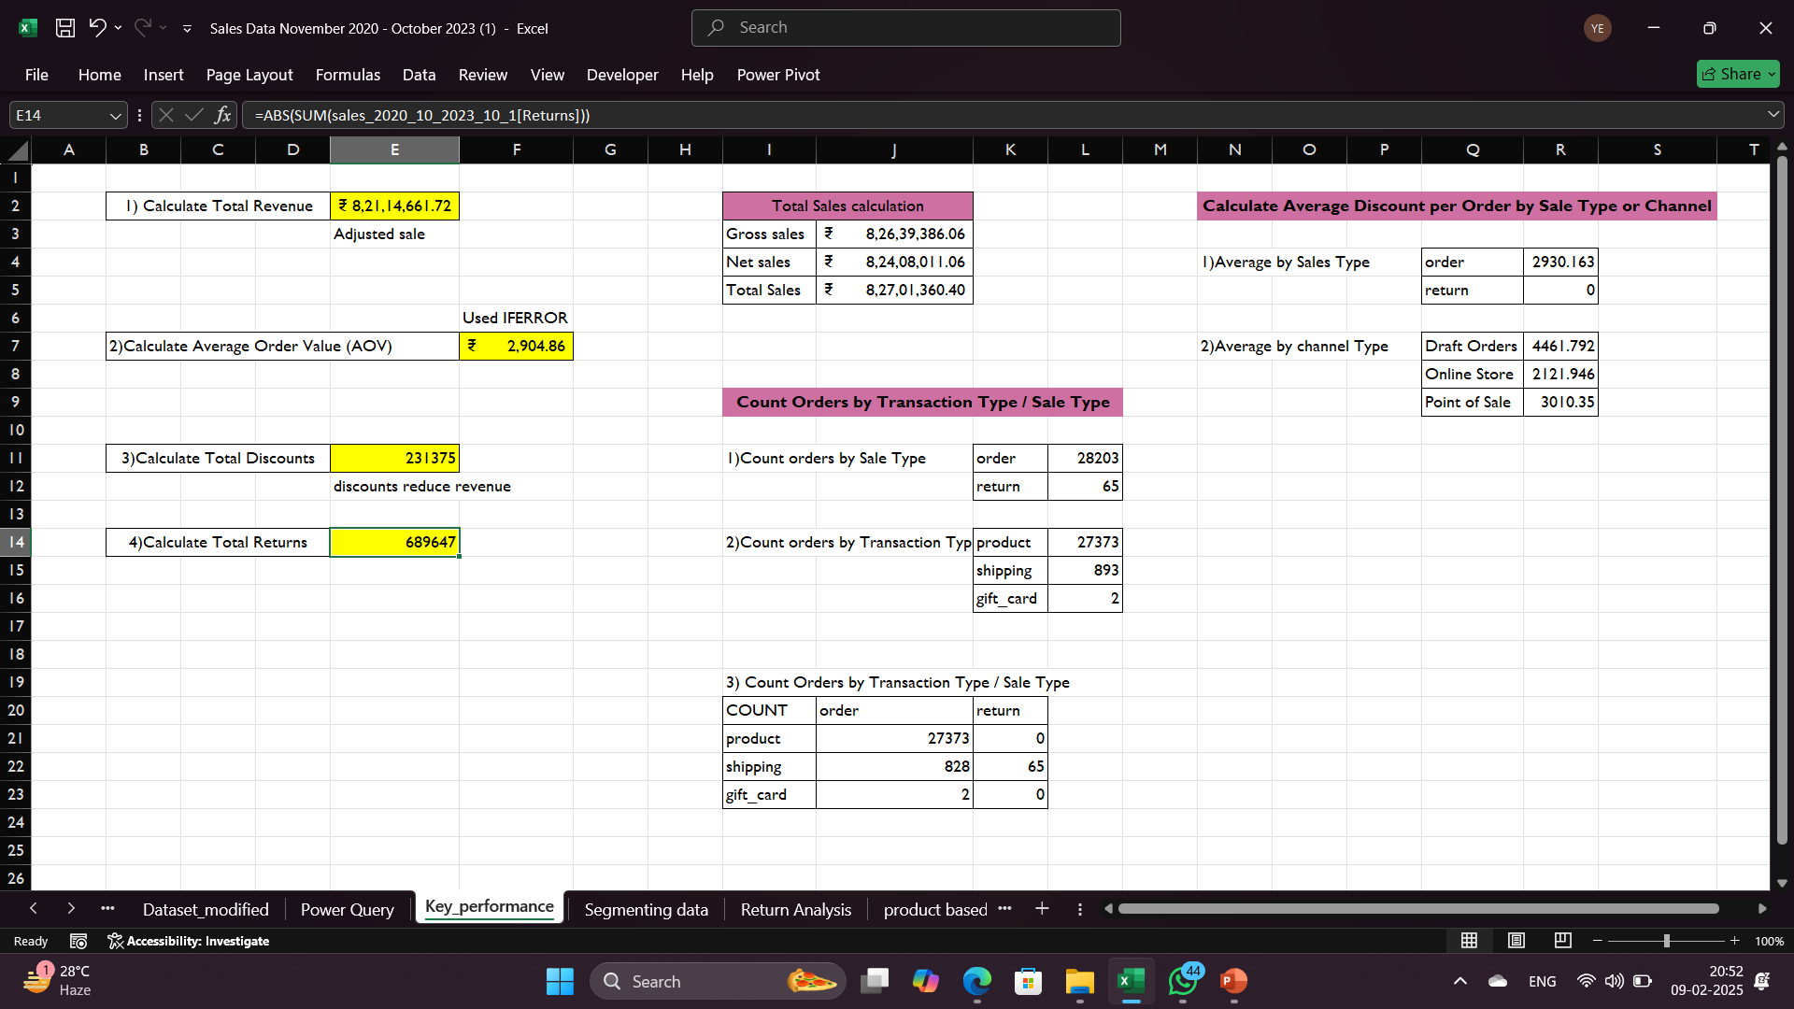
Key Metrics Calculation and Data Analysis
Average Sales Per Order = Sum(Total sales)/Count(Order ID)
Discount Rates = ABS(SUM(Discount))
Return Rates = ABS(SUM(Return))
Sales By Product/Channel = COUNTIFS()
Gross Sales =SUM(Total Sales)
Net Sales =SUM(Total Sales - Discounts)
Adjusted Sales =Gross sale-Discount-shipping-Taxes

Slide 5
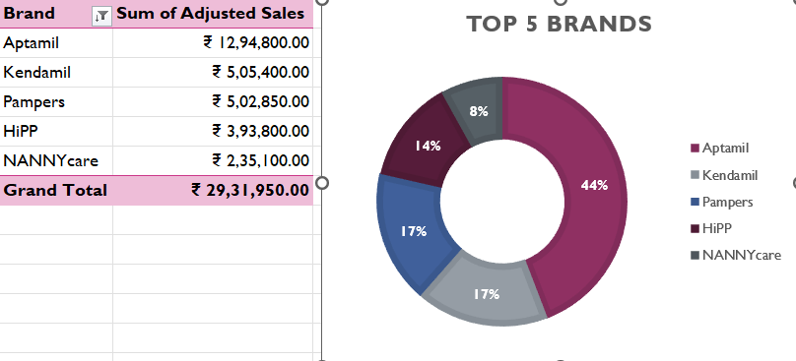
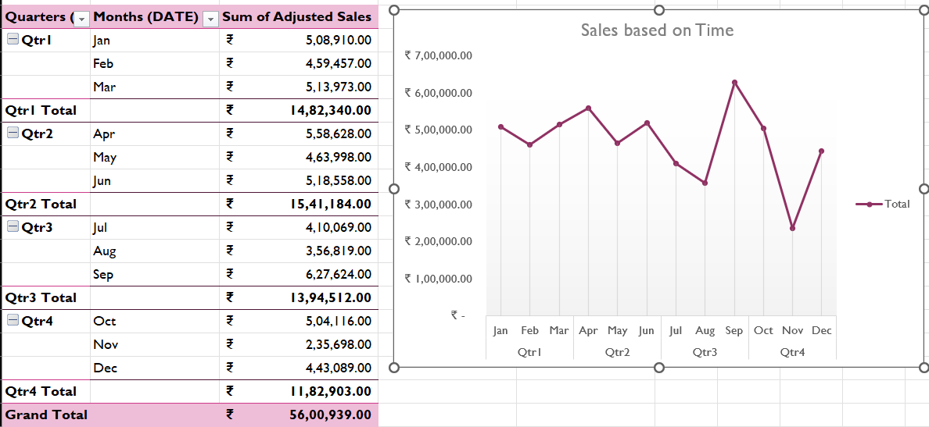
Pivot Tables
Pivot Tables were used to analyze and summarize data dynamically across different dimensions,
Sales by Product Type (Baby Formula, Skin Care etc.).
Sales Over Time (Monthly & Yearly trends).
Top-Selling Products (Based on Sales).
Pivot Charts
Pivot Charts were used to provide clear insights into sales trends:
Line Chart
Pie Chart
Column Chart

Slide 6
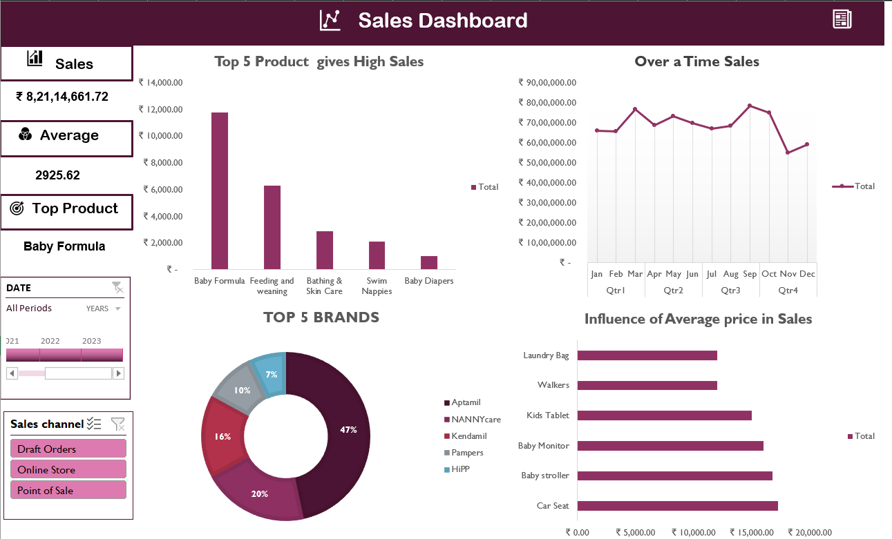
Dashboard Overview
Monitor real-time sales performance
Identify top-selling products & channels
Track Customer Trends
KPI – Key Performance Indicator
Total Sales
Average Sales
Top Product

Slide 7
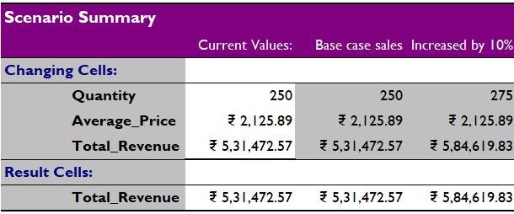
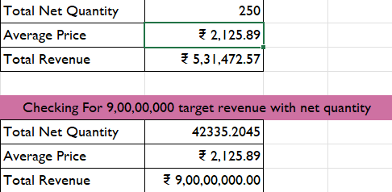
What-If Analysis – Scenario manager
Goal Seek
What-If Analysis was used to simulate sales increased by 10% and return rate decreased by 5% to understand their impact on total revenue.
Goal Seek was used to determine
Quantity required to reach a ₹9 Crore sales target.
Price adjustment needed to achieve a desired profit margin
Scenario 1: Base Case
Scenario 2: Impact of a 10% increase of sales
Excel Tool Used: Data Table & Scenario Manager
Goal Seek

Slide 8
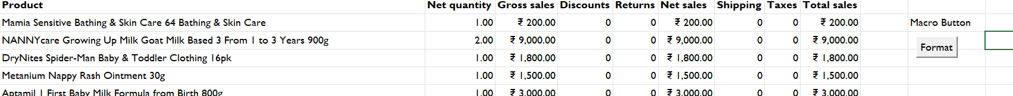
Macros and Automation
Macros were used to automate repetitive tasks in Excel, including:
Formatting worksheets - Automatically applying currency formatting, bolding headers, and freezing panes.
Updating Pivot Tables - Running calculations and refreshing PivotTables whenever new data is added.
Benefits of Automation
Saves Time
Increases Accuracy
Improves Efficiency

Slide 9
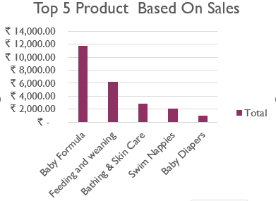
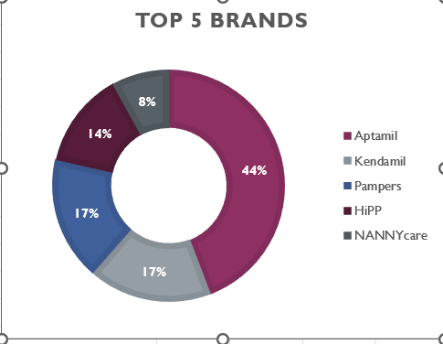
Insights
Highest Revenue-Generating Sales Channel:
The Point of Sale (POS) channel - highest net sales
Draft Orders - less revenue
Most Profitable Product Category:
Baby Formula leads in profitability
It also has the highest sales volume - Point of Sale (POS) and Online Store.
Top-Performing Products & Sales Trends:
Aptamil , kendamil and Pampers
Recommendations
Demand over region analysis
Suggest top brands with discounts to attract new customers.
Use offers and loyalty programs to keep customers coming back.

Slide 10

Conclusion
Summary of Key Findings
Point of Sale (POS) is the highest revenue-generating channel with over ₹7 Crore in net sales.
Baby Formula is the most profitable product category, generating ₹3 Crore in net sales.
Top brands like Aptamil and Kendamil contribute significantly to overall sales.
Sales trends show consistent demand growth in both POS and online stores.
Next Steps for deeper Insights
Regional Demand Analysis
Customer Behaviour Study
Pricing & Discount Strategy
Competitor Benchmarking
THANK YOU

