Slide 1
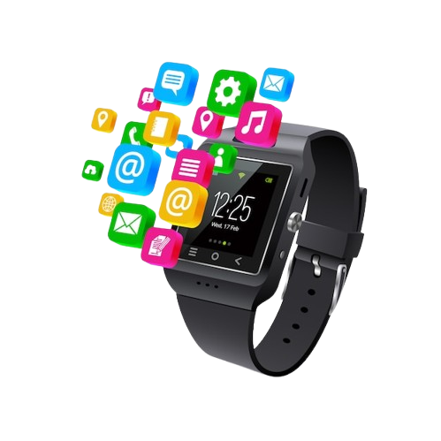
Capstone - Categorizing Watches with NLP and Machine Learning
Yahavarshini E | 21-07-2025

Slide 2
Project Overview
Scrape unlabeled smartwatch data from e-commerce sites.
Clean and preprocess the data using NLP techniques.
Apply PCA and K-Means for clustering and labeling (Smart, Analog, Digital).
Train supervised models (KNN, SVM, XGBoost, etc.) on labeled data.
Classify watch types with high accuracy.

Slide 3
Dataset Description
Data Cleaning
Source: Web-scraped from Amazon using SerpAPI
Total Records: 1000+ smartwatch listings
Scraped Columns:
Title - Full product name
Price - Selling price
Brand - Manufacturer or brand name
Reviews - Total number of reviews
Ratings - Average customer rating
Initial Format: Unlabeled, unstructured text data
Removed duplicates
Checked and handled null values
Dropped brand column (300+ missing values)
Replaced missing values in rating and reviews with median
Removed keywords: "smart", "smartwatch", "analog", "digital“ from title
Extracted them into a new column: watch_type

Slide 4
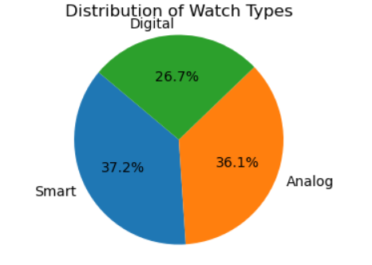
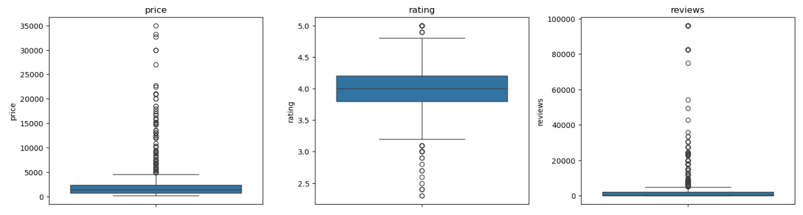
Exploratory Data Analysis
Observed the distribution of price, rating, and reviews using boxplots.
Smartwatches were the most common (37.2%), followed by Analog (36.1%) and Digital (26.7%).
Nearly equal distribution in watch_type ensures balanced classification.

Slide 5
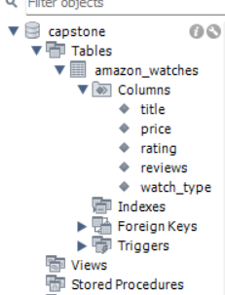
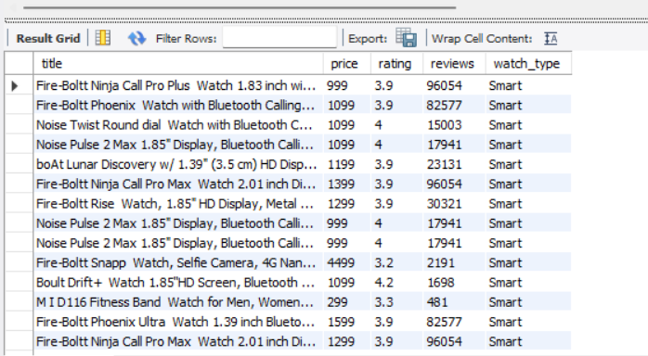
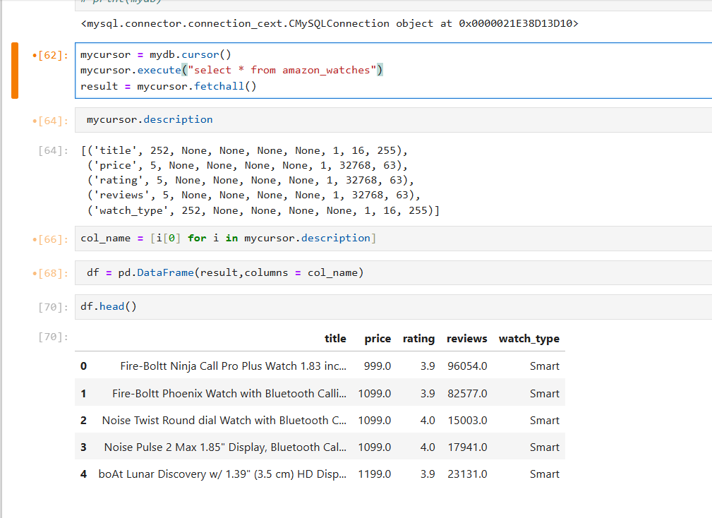
Data Storage and Retrieval
Pushed the cleaned dataset into MySQL database using SQLAlchemy for structured storage.
Retrieved the data using MySQL Connector, ensuring efficient query access.
Loaded the data into a Pandas DataFrame for further analysis and modeling.

Slide 6
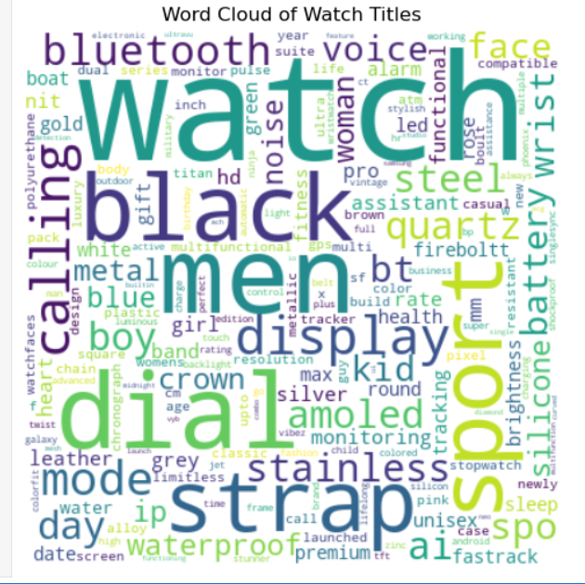
NLP Preprocessing on Title
Applied text preprocessing: lowercasing, punctuation removal, tokenization, stop word removal, and lemmatization.
Filtered words using Part-of-Speech tagging to keep only nouns for meaningful feature extraction.
Generated a WordCloud to visualize the most frequent terms in watch titles.
Converted cleaned text into numerical format using TF-IDF vectorization for modeling.

Slide 7
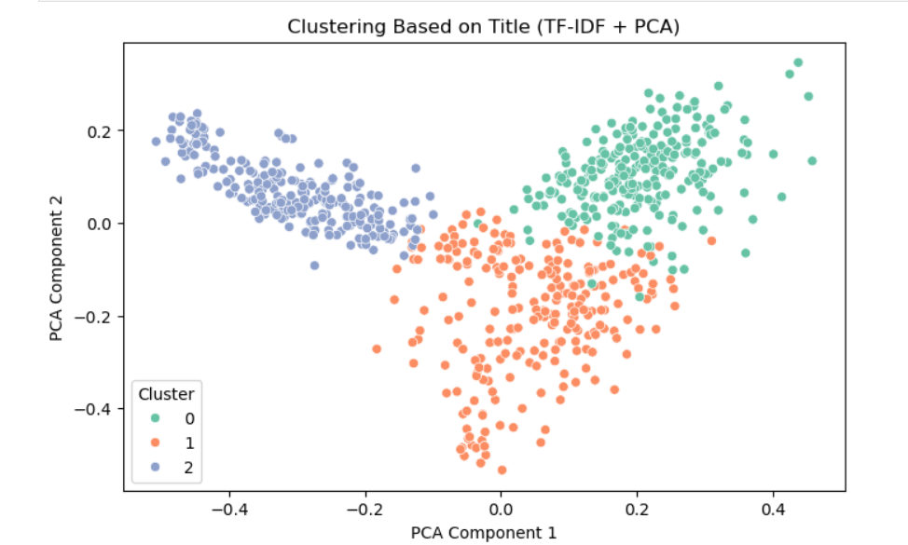
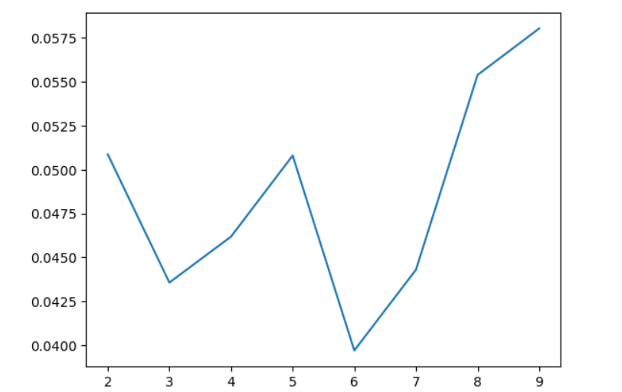
Unsupervised Learning
Used PCA to reduce dimensionality while preserving 98% of variance.
Performed K-Means clustering with n_clusters = 3 to group similar watch types.
Evaluated clustering performance using the Silhouette Score to check how well the data was grouped.
Labeled the clusters as Analog, Digital, and Smart based on frequent keywords in each cluster.

Slide 8
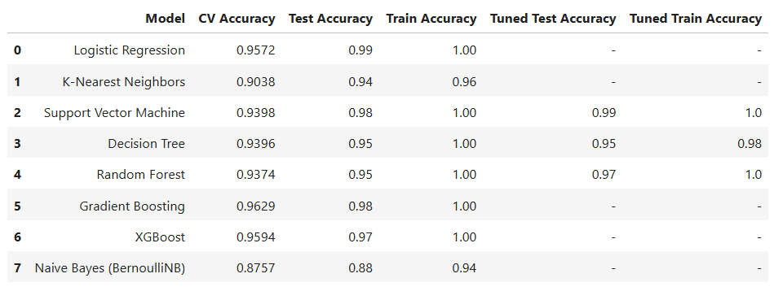
Supervised Learning (Classification)

Slide 9
Conclusion
This end-to-end project from web scraping to supervised modeling demonstrated a complete real-time data science workflow.
Data was cleaned, stored in a database, and transformed using NLP techniques like lemmatization, stop word removal, and TF-IDF to extract meaningful patterns from watch titles.
Dimensionality was reduced using PCA, preserving 98% of the data's variance, which improved training speed and minimized overfitting.
K-Means clustering revealed natural groupings, helping validate class distinctions before classification.
These combined techniques allowed supervised models to learn efficiently from refined features.
As a result, Logistic Regression and SVM achieved the highest accuracy, showing strong generalization, followed by GBoost, XGBoost, and Random Forest.
The pipeline ensured structured preprocessing, meaningful feature engineering, and robust model performance.

Slide 10

Future Scope
Enhance data variety by scraping more e-commerce platforms (like Flipkart, Myntra) to improve model generalization.
Include image analysis using computer vision to extract product features from watch images.
Deploy the model as a web application for real-time watch classification or recommendation.
Improve clustering by experimenting with advanced techniques like hierarchical clustering.
THANK YOU

