Slide 1

Road Signs Classification
using Deep Learning
Name : Yahavarshini E
Date : 28-07-2025

Slide 2
Project Overview
To develop a deep learning model which classifies road sign images using CNN.
To build a user-friendly web interface using Streamlit for testing and predicting road sign classes.

Slide 3
Dataset Description
The project uses the German Traffic Sign Recognition Benchmark (GTSRB) dataset, downloaded from Kaggle.
The dataset is provided in pickle format and consists of training, validation, and test image sets.
A separate signname.csv file is included, containing 43 unique traffic sign labels with their class IDs and names.

Slide 4
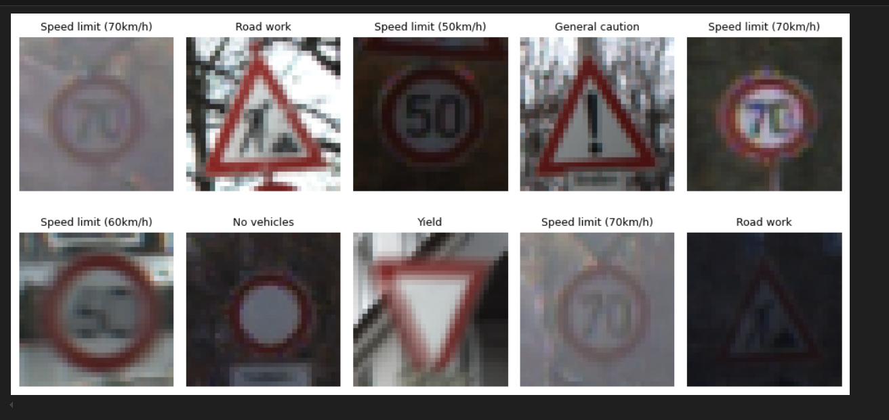
Dataset Preprocessing
Normalized pixel values between 0 and 1.
Shuffling for unbiased training.
Label encoding using sparse_categorical_crossentropy.

Slide 5
Model Creation
Architecture
Training
3 Convolutional layers with ReLU activation.
MaxPooling for two Convolution layer.
Flatten, Dense , Softmax Layers.
10 Epochs, Batch size: 64
Validation data monitored.
Compilation
Accuracy
Optimizer: Adam.
Loss: sparse_categorical_crossentropy.
Metric: Accuracy
Train Accuracy: 99.5%.
Test Accuracy: 92.7%

Slide 6
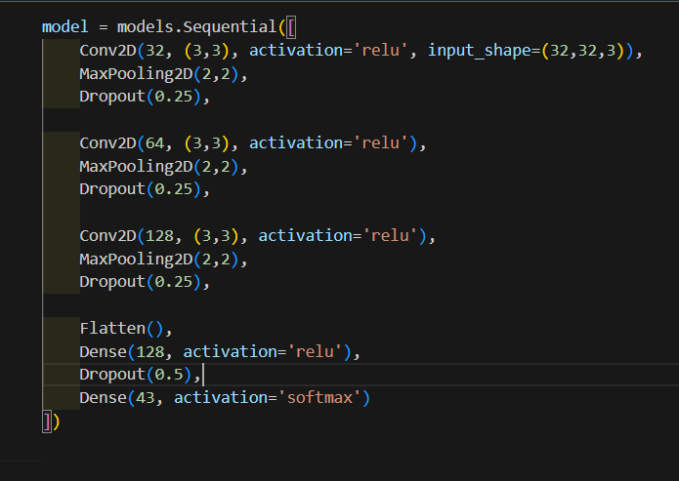
Model Optimization
Added Dropout layers to reduce overfitting.
MaxPooling after each Convolution layer.
Dense layer expanded to 128 neurons.
Early Stopping used to prevent overfitting.
Train Accuracy: 99.8%
Test Accuracy: 96.3%

Slide 7
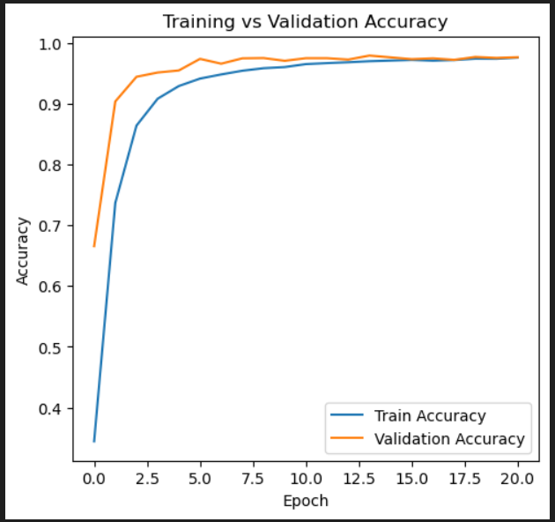
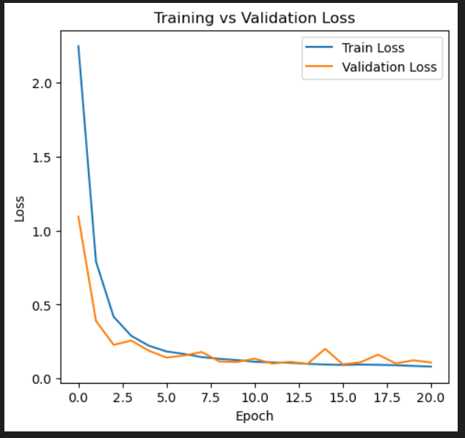
Accuracy & Loss Visualization
Good generalization with minimal overfitting

Slide 8
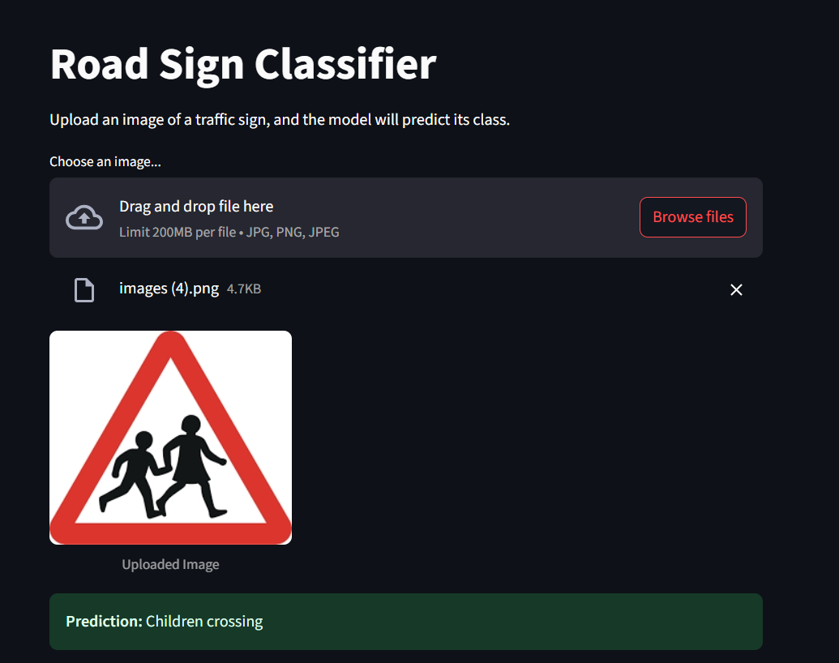
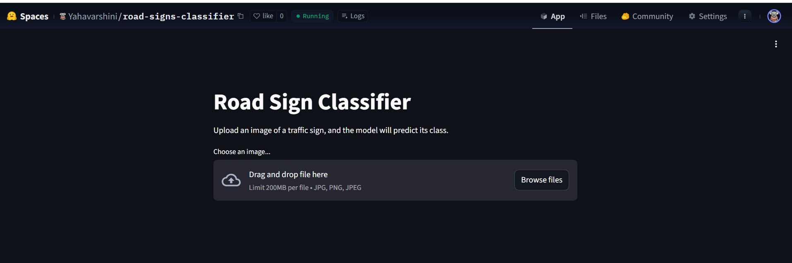
User Interface
Deploy the model using a user-friendly web interface built with Streamlit.
The trained model is saved in Hierarchical Data Format version 5 (.h5) to ensure seamless integration with the UI.
The web app includes simple features such as, uploading an image for prediction and displaying the predicted class label

Slide 9
Conclusion
The CNN model performed well in classifying German traffic signs, achieving high accuracy with minimal overfitting.
Training and validation graphs indicating a well-generalized model.
The classification report revealed strong performance across most classes.
The deployment using Streamlit allowed for easy real-time prediction using new test images, making the model accessible to users.

Slide 10

Future Scope
Expand the dataset with more diverse and real-world images.
Add multilingual support and voice-based output for wider accessibility.
Deploy the app on platforms like Hugging Face Spaces, Heroku, or AWS for global usage.
THANK YOU

