Slide 1

An Analysis of Career Trajectories:
Salary & Experience Across Global Industries
Name : Yahavarshini E
Date : 18-03-2025

Slide 2
Project Overview
Understanding salary trends across industries, job titles, experience levels, and education.
Tools Used: Excel and MySQL
Dataset Description
Rows & Columns : 28,000+ & 13
Attributes of the dataset (Age Range, Industry, Job Title, Salary, Experience, etc.)
The dataset was compiled from global salary surveys and industry reports.
It includes salary information from various countries, ensuring a diverse dataset.

Slide 3
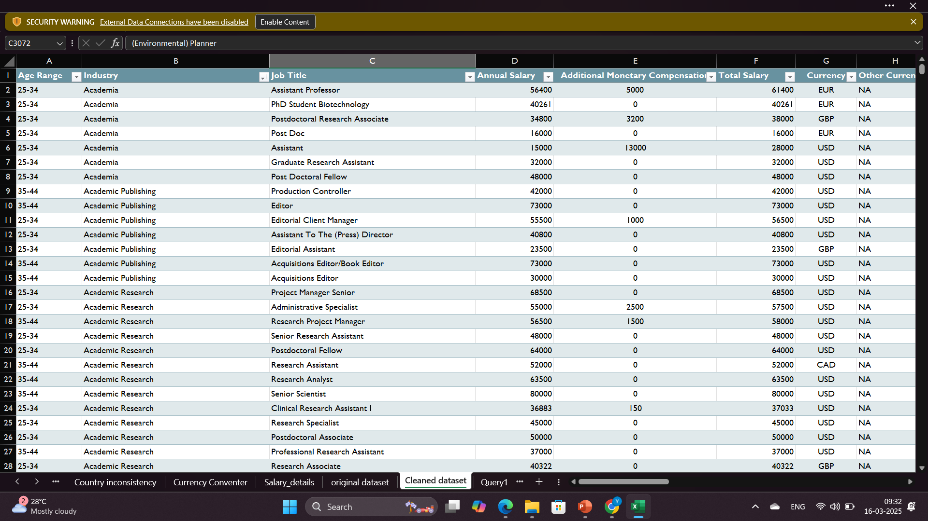
Data Cleaning & Preprocessing
Handled Missing Values – Removed incomplete salary records, filled job titles/industries
Standardized Data – Unified salary currency and text fields.
Fixed Inconsistencies – Corrected spelling errors and country name variations.
Removed Outliers – Eliminated unrealistic salary values for accuracy.

Slide 4
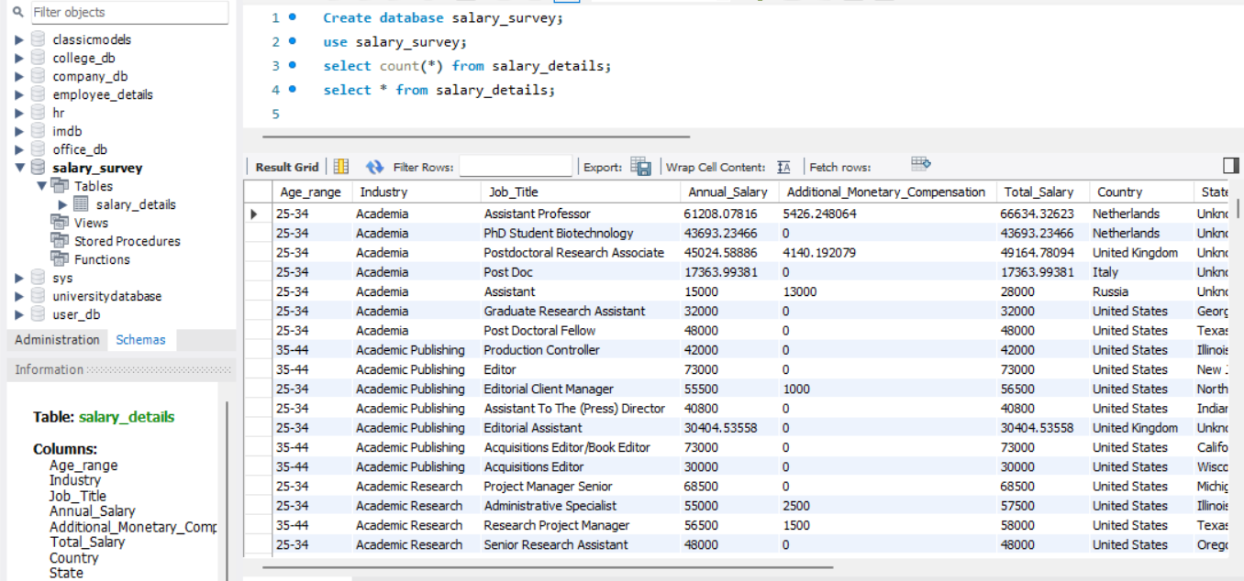
Storing Data in MySQL
Created a Database in MySQL – salary_survey.
Used MySQL Workbench Table Wizard for easy data import.
Ensured correct data mapping and field types.
Executed SQL queries for further analysis and key findings.

Slide 5
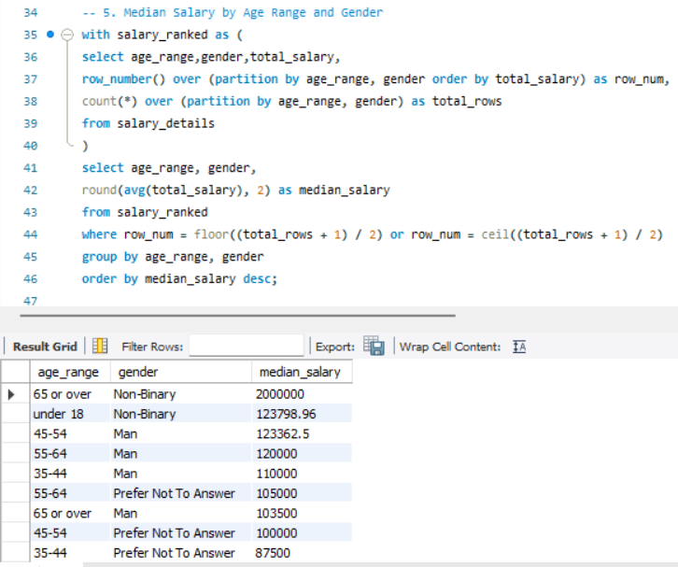
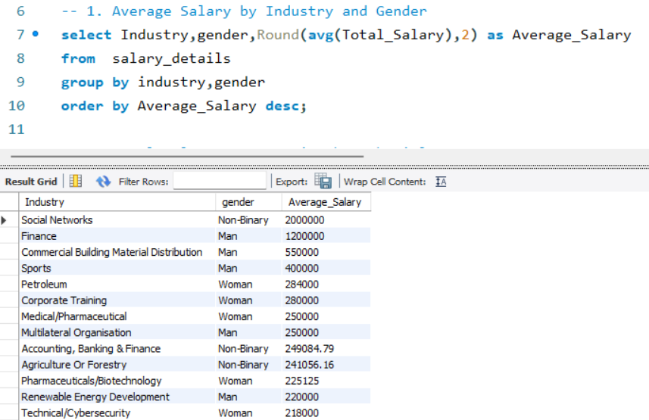
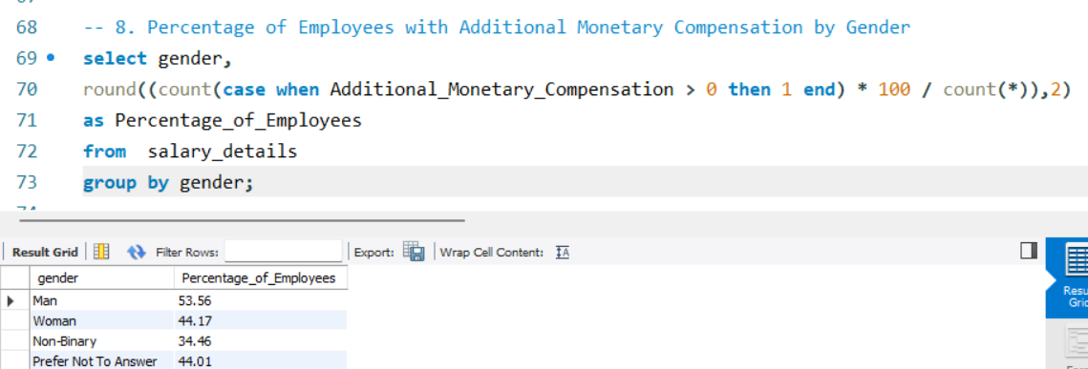
Queries Execution
Lists job titles with the highest average salaries.
Analyzes how education affects salary.
Analyzes how salaries grow with experience.
Summarizes all salary trends based on multiple factors.

Slide 6
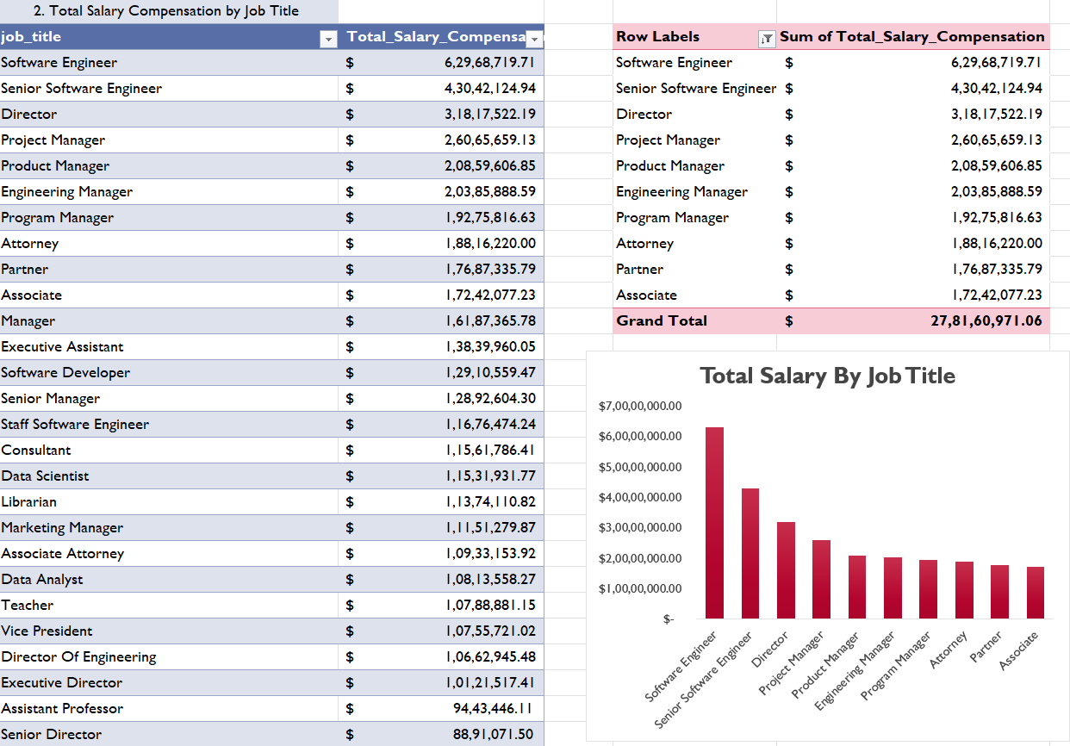
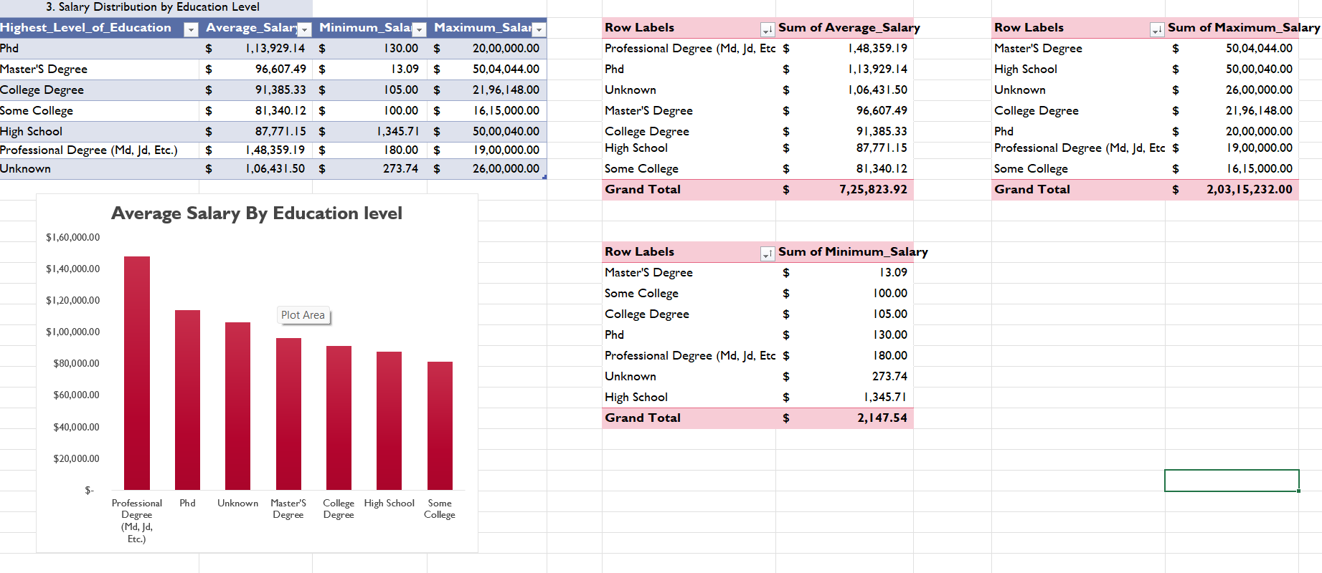
Data Export To Excel
Export Data – Query results are exported from MySQL as a CSV file.
Format in Excel – Data is cleaned, structured, and properly formatted.
Analyze with Pivot Tables & Charts – Key insights are derived using summaries and visualizations.
Extract Key Findings – Trends, patterns, and important insights are identified for decision-making.

Slide 7
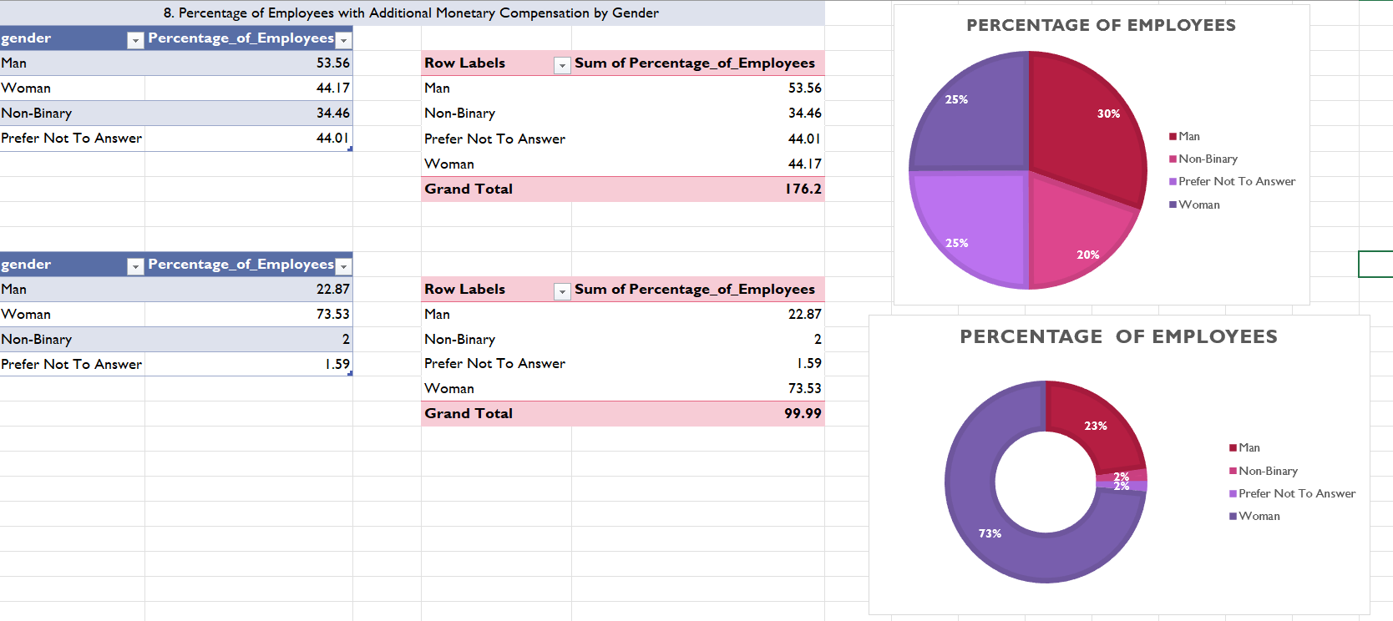
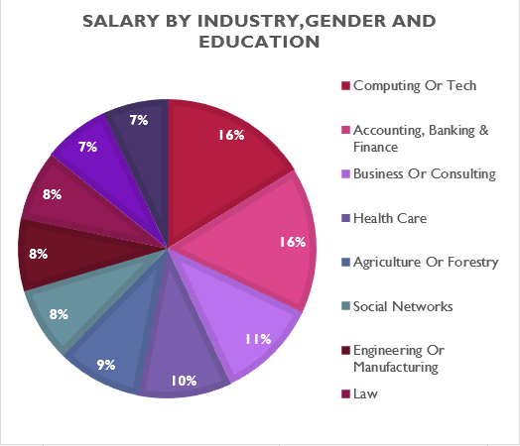
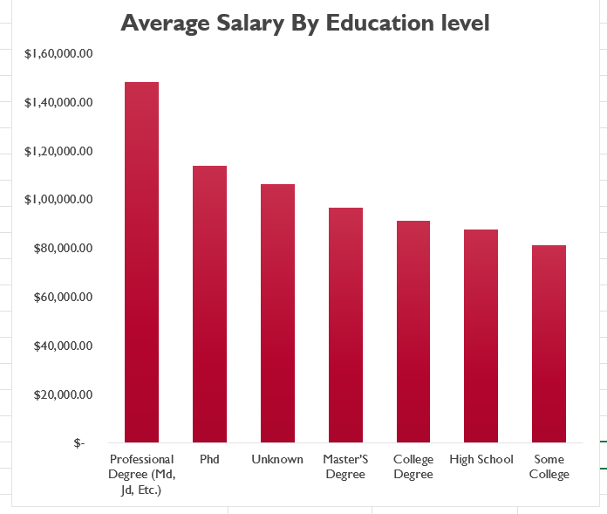
Analysis of SQL Queries
Men dominate high salaries, but women and non-binary earn well in tech.
PhDs earn more, but some industries pay well without higher degrees.
Senior roles or leads earn the most.
Tech, Finance, and Consulting pay the highest salaries.

Slide 8
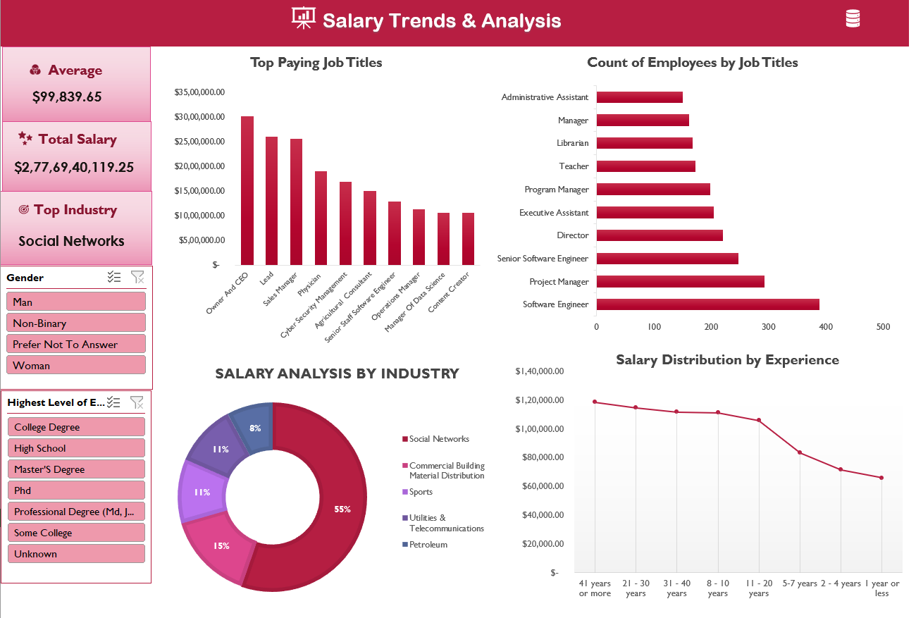
Dashboard Overview

Slide 9
Key Findings
Social Networks, Finance, and IT pay the most. CEO, Sales Manager, and Physicians earn the highest.
Higher degrees lead to better salaries, but some industries pay well without them.
Salary differences exist across genders, especially in Banking & IT.
Earnings rise with experience, peaking at 21–30 years.
Future Job Trends – High demand for AI, Cybersecurity, and Data Science experts.
Conclusion
Tech and leadership roles offer the highest salaries.
On Trend Industry – Social Networks and Commercial Building Materials stand out.
Experience drives salary growth, peaking around 11-20 years.
Higher education correlates with better salaries in many fields.

Slide 10

Future Recommendations
Invest in High-Paying Fields
Upskilling for Better Salaries
Experience-Based Salary Growth
Promoting Gender Diversity and Inclusion
THANK YOU

