Slide 1
Solution 1: A plain deep NN

Slide 2
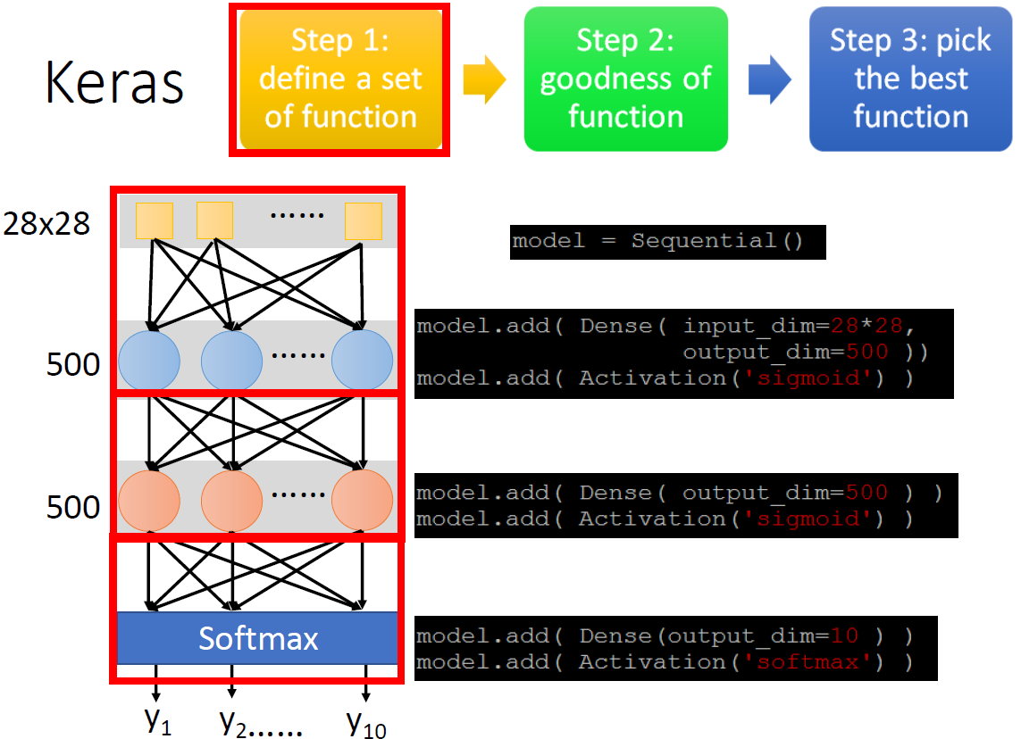

Slide 3
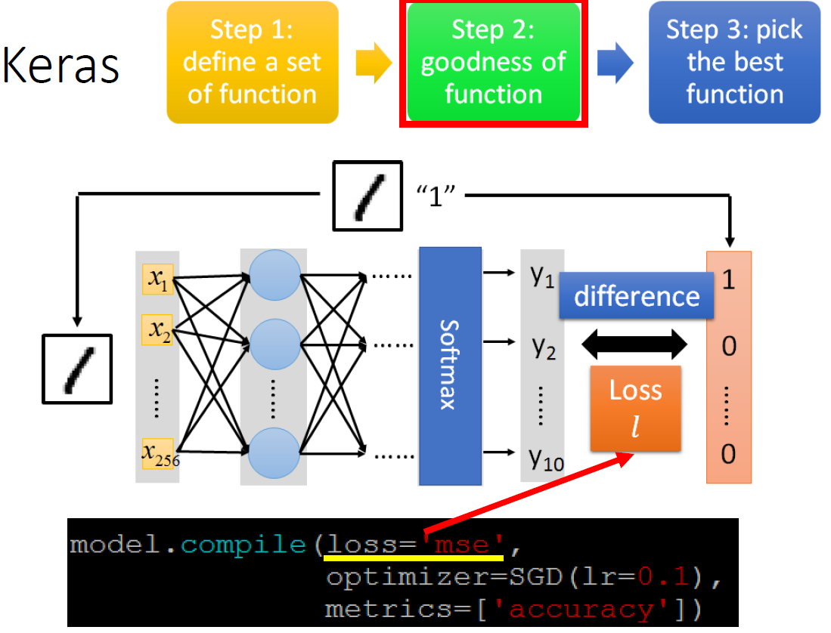

Slide 4
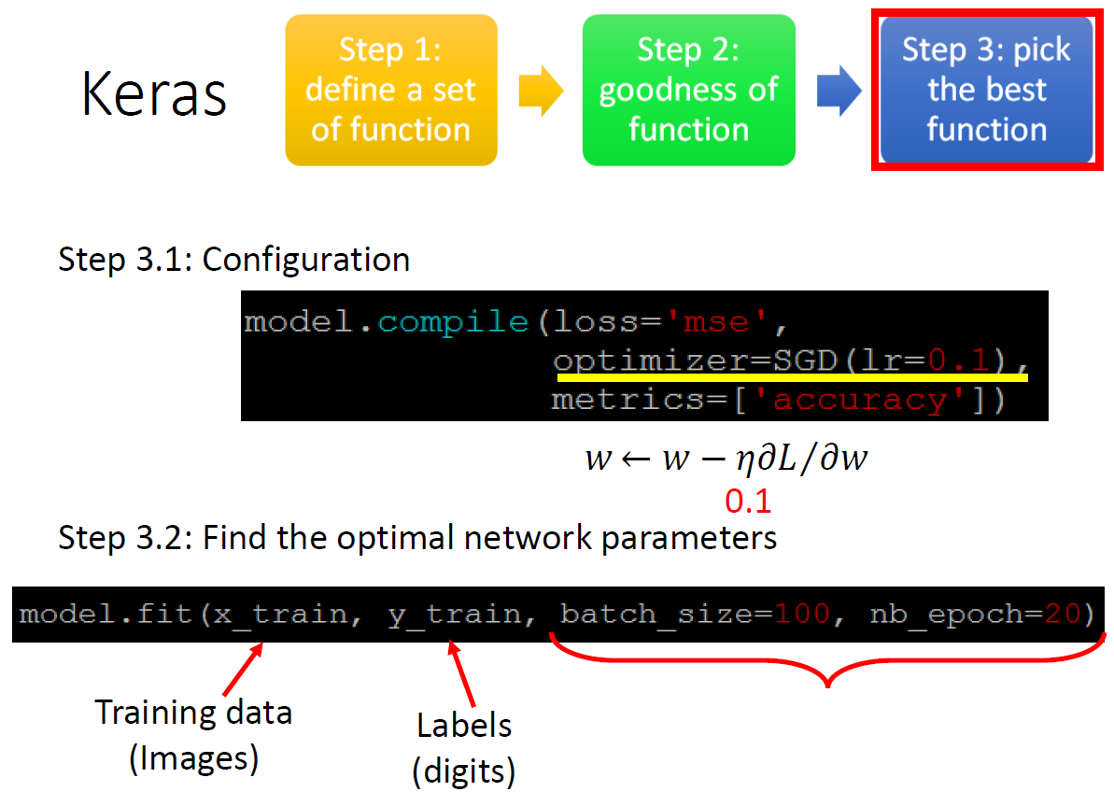
Yet to be explained

Slide 5
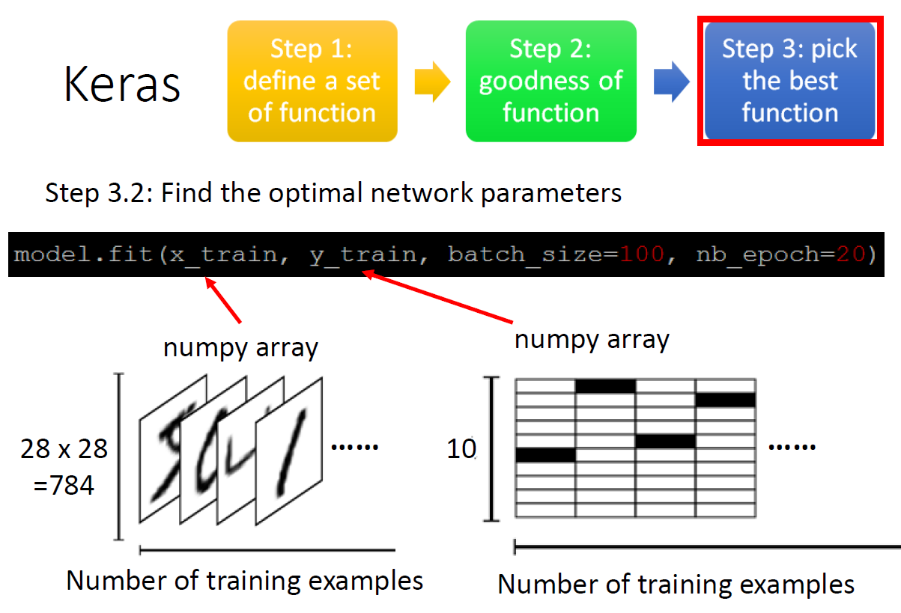

Slide 6
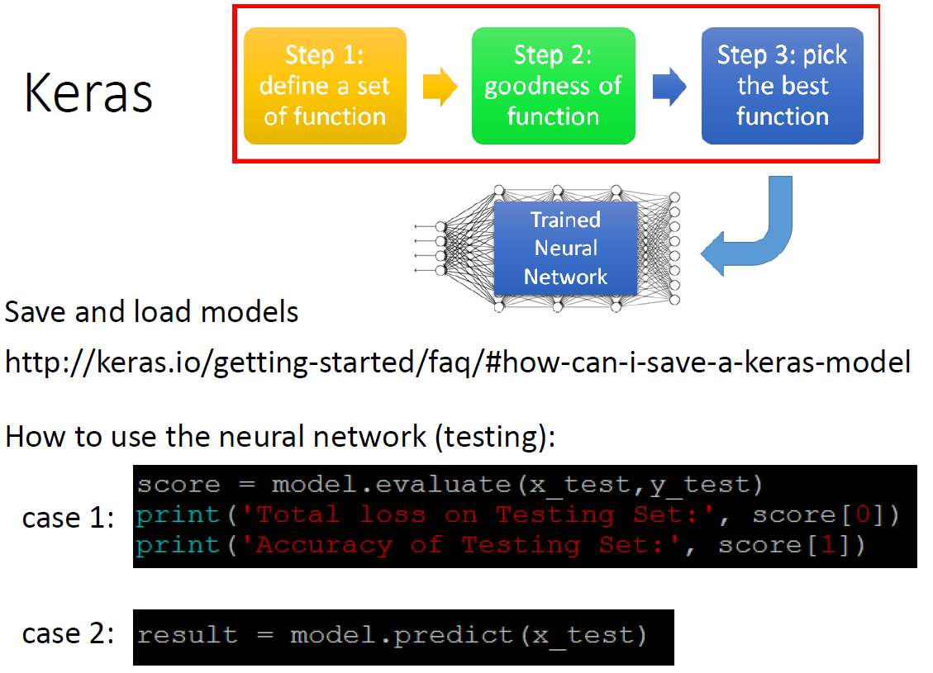

Slide 7
Solution 1: A plaint deep NN on the MNIST dataset can get 98.40% test accuracy after 20 epochs with a lot of tuning

