Slide 1




EGYPFWD Initiative Advanced Embedded Systems Nanodegree, Embedded Software Design Masterclass by SPRINTS Egypt.
Automotive Door Control System Dynamic Design
A Graduation Project submitted in partial Fulfillment of
Embedded Software Design Masterclass.
Prepared by
Yahia Emad Ahmed Derbala
yahderbala@gmail.com
LinkedIn
Github

Slide 2
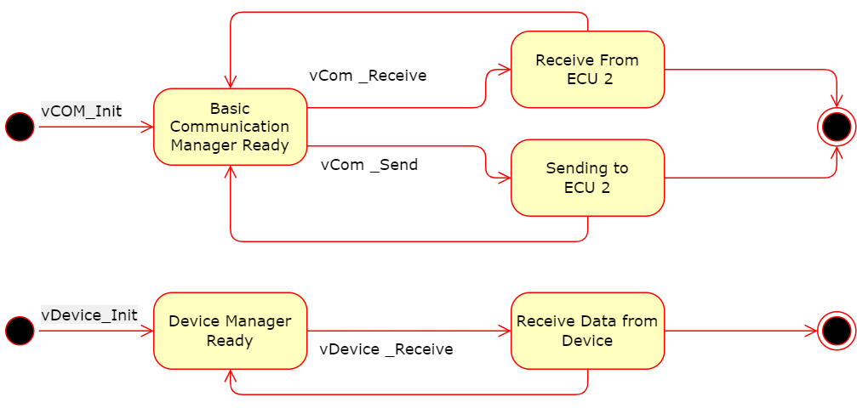
ECU 1 : Manager Modules State Diagrams

Slide 3
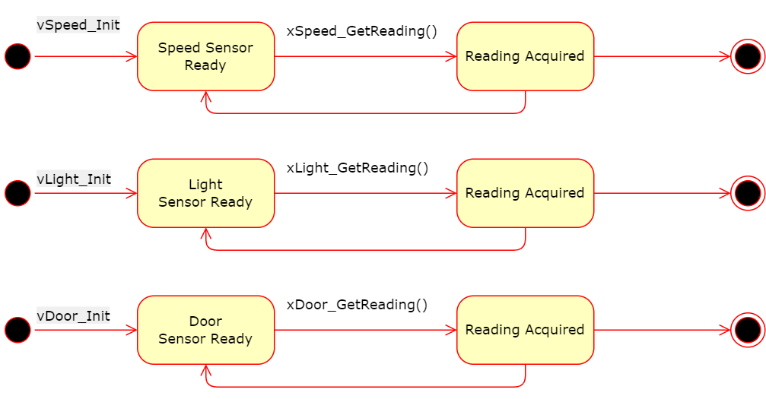
ECU 1 : Sensor Modules State Diagrams

Slide 4
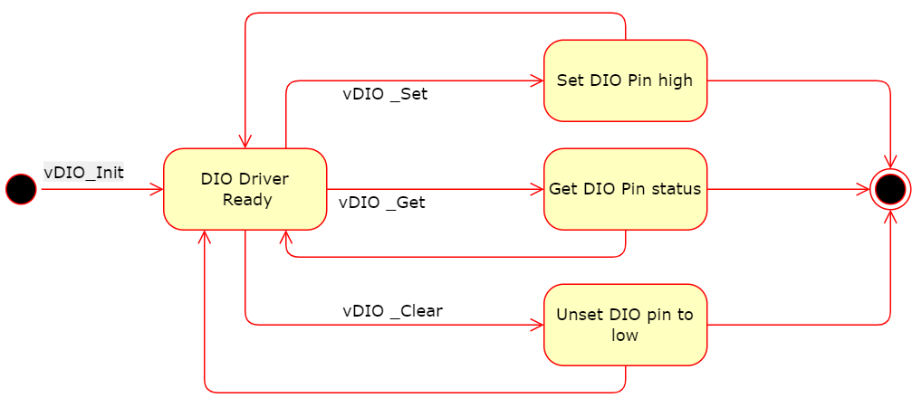
ECU 1 MCAL : DIO State Diagram

Slide 5
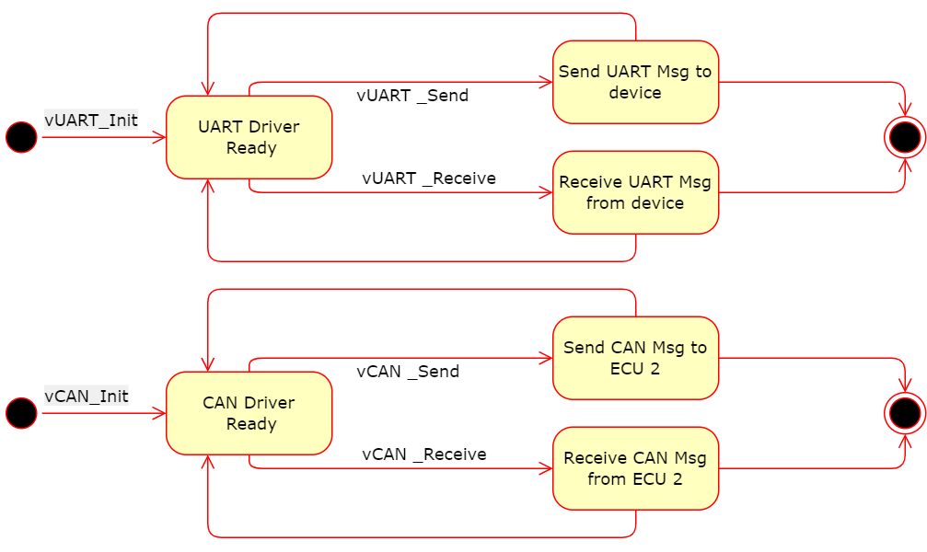
ECU 1 MCAL : COM Drivers State Diagram

Slide 6
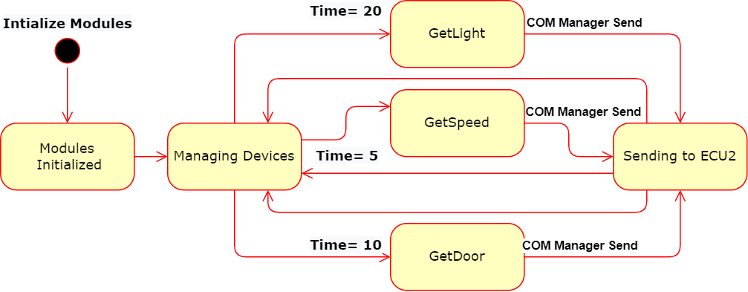
ECU 1 : State Diagram

Slide 7
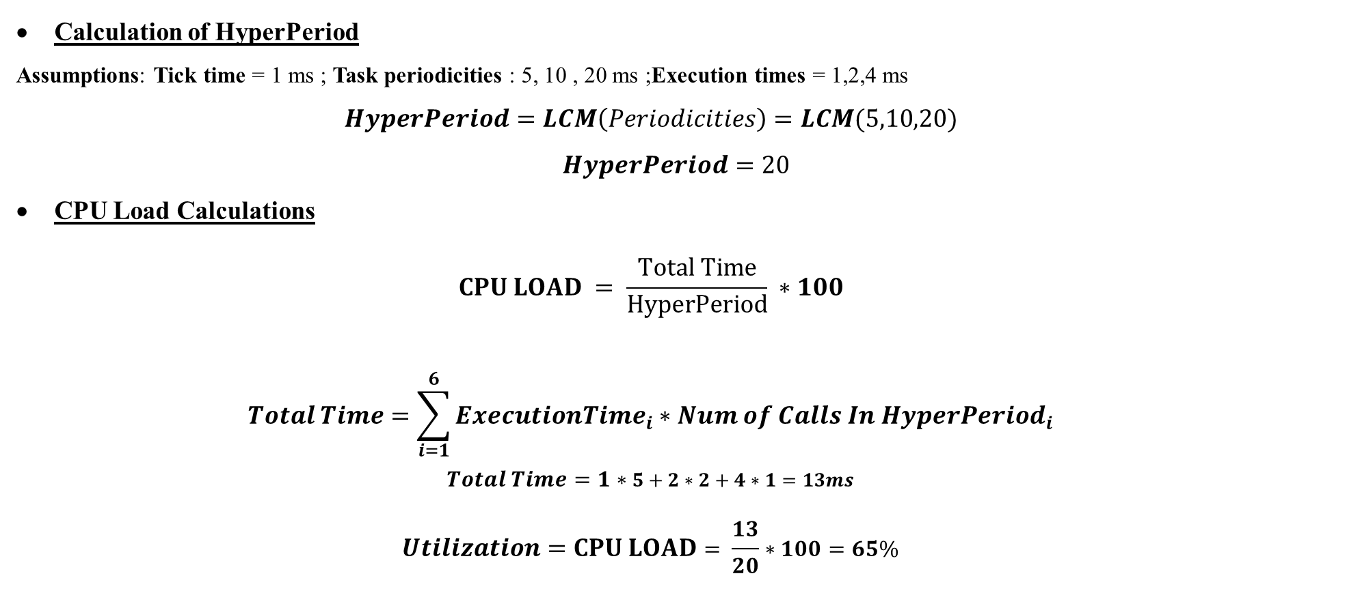
ECU 1 : CPU LOAD
Calculation of HyperPeriod
Assumptions: Tick time = 1 ms ; Task periodicities : 5, 10 , 20 ms ;Execution times = 1,2,4 ms
$$HyperPeriod=LCM\left(Periodicities\right)=LCM(5,10,20)$$
$$HyperPeriod=20$$
CPU Load Calculations
$$CPU LOAD = \frac{Total Time}{HyperPeriod} ∗100$$
$$Total Time=\sum_{i=1}^{6}{{ExecutionTime}_{i}∗{Num of Calls In HyperPeriod}_{i}}$$
$$Total Time=1∗5+2∗2+4∗1=13ms$$
$$Utilization=CPU LOAD= \frac{13}{20}∗100=65\%$$

Slide 8
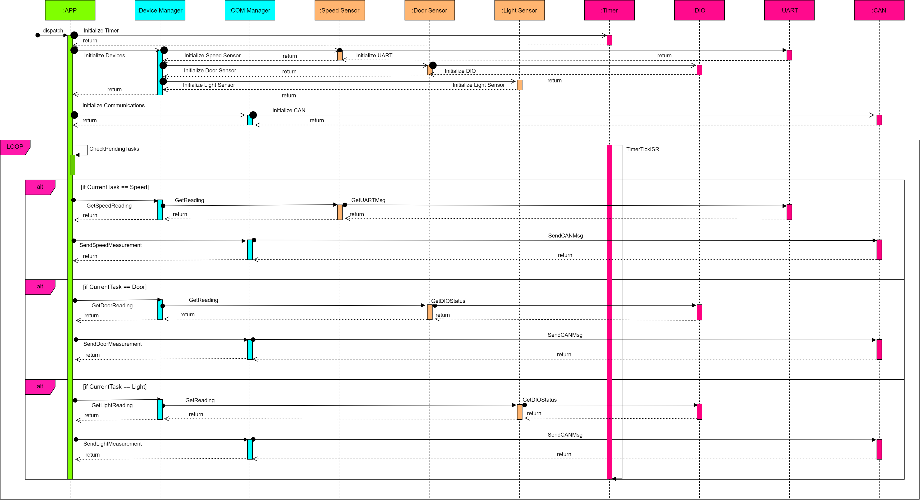
ECU 1 : Sequence Diagram

Slide 9
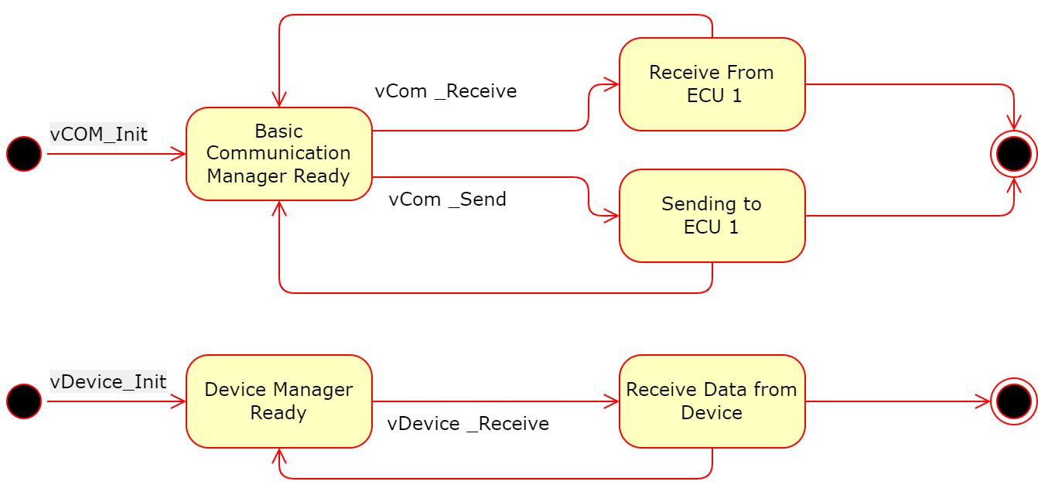
ECU 2 : Manager Modules State Diagrams

Slide 10
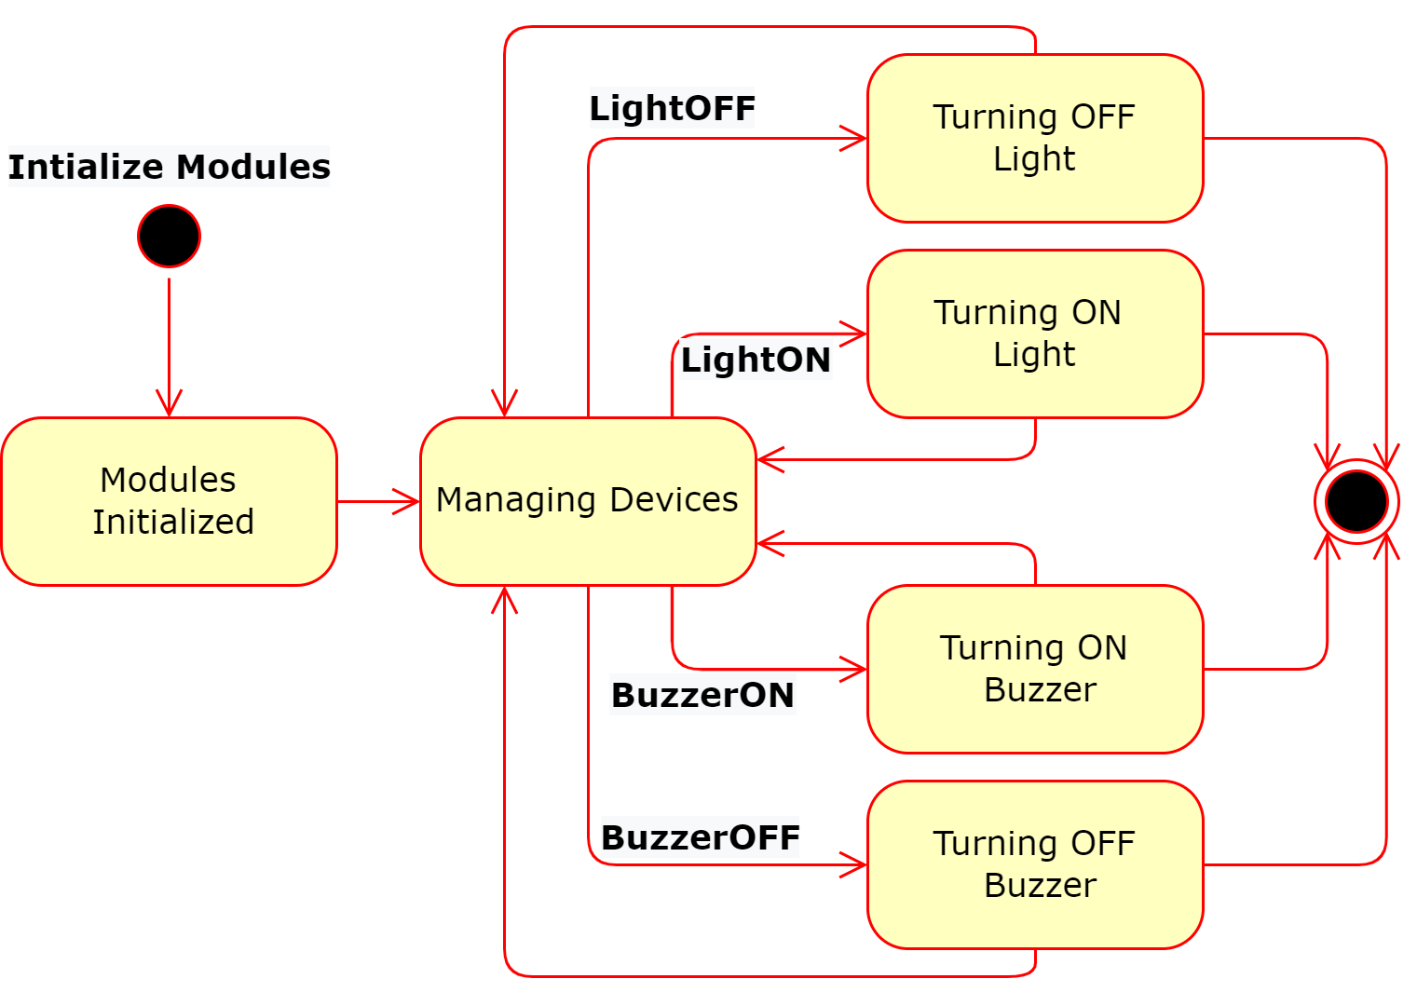
ECU 2 : Actuator Modules State Diagrams

Slide 11
ECU 2 MCAL : DIO State Diagram

Slide 12
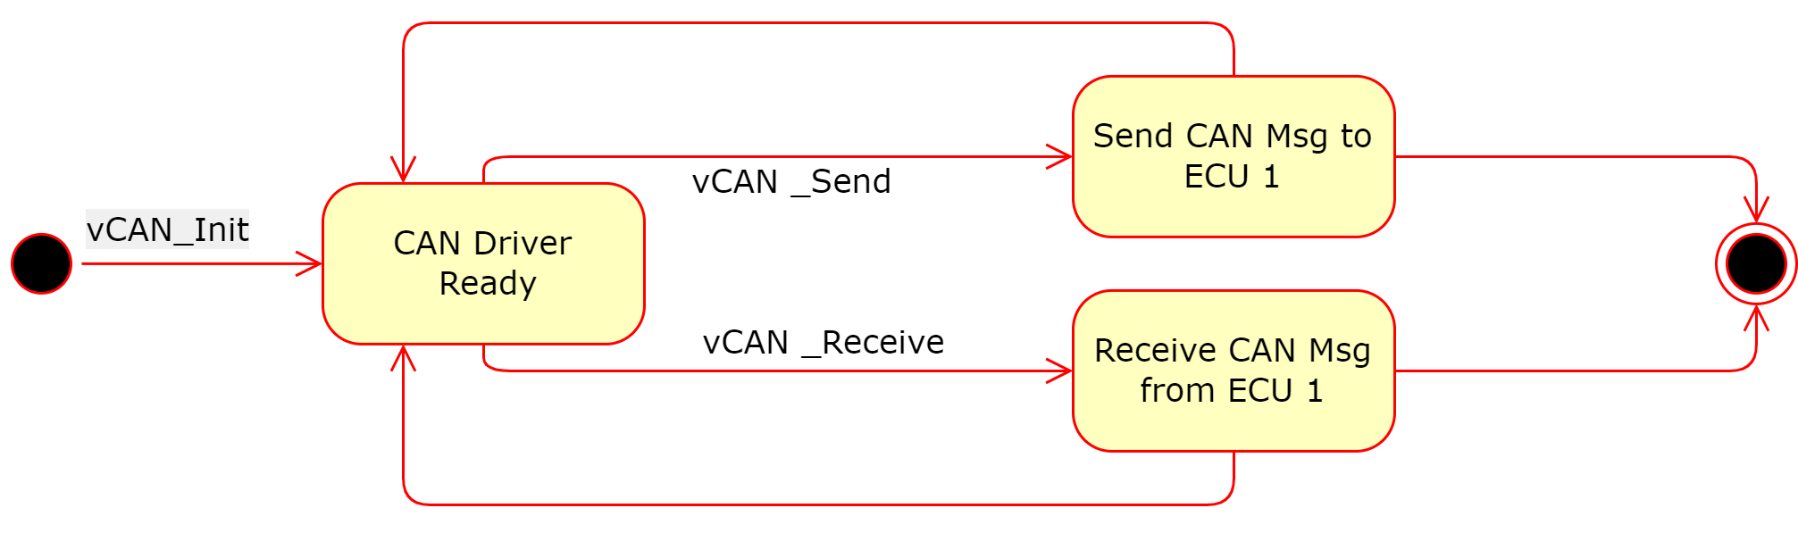
ECU 2 MCAL : COM Drivers State Diagram

Slide 13
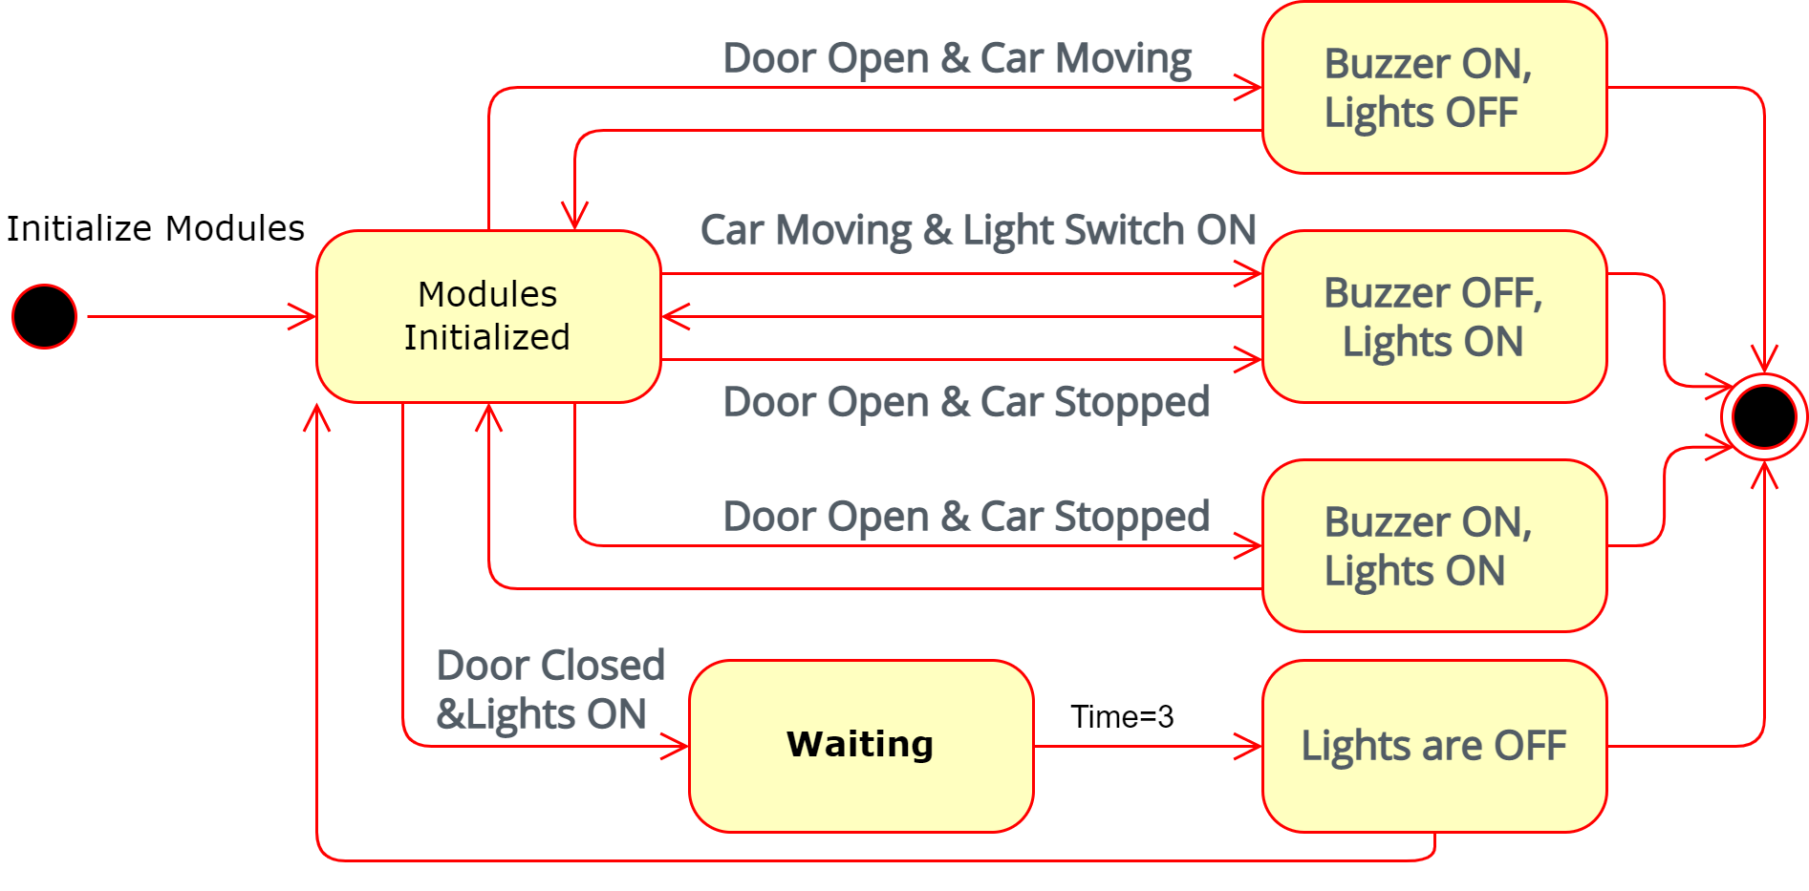
ECU 2 : State Diagram

Slide 14
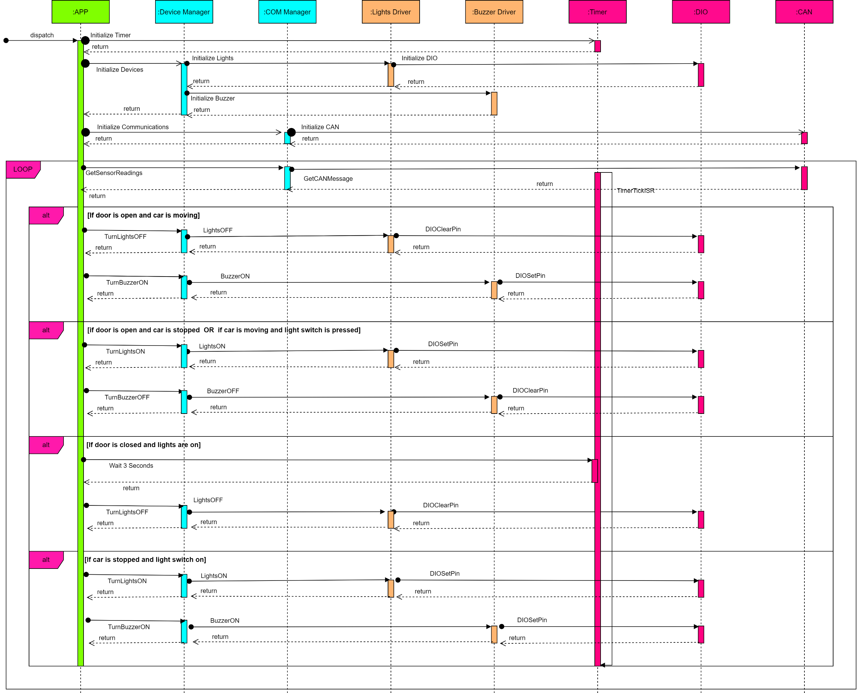
ECU 1 : Sequence Diagram

Slide 15
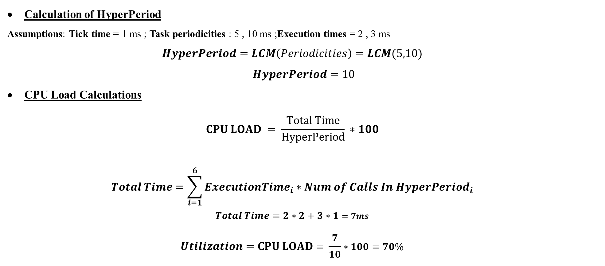
ECU 2 : CPU LOAD
Calculation of HyperPeriod
Assumptions: Tick time = 1 ms ; Task periodicities : 5 , 10 ms ;Execution times = 2 , 3 ms
$$HyperPeriod=LCM\left(Periodicities\right)=LCM(5,10)$$
$$HyperPeriod=10$$
CPU Load Calculations
$$CPU LOAD = \frac{Total Time}{HyperPeriod} ∗100$$
$$Total Time=\sum_{i=1}^{6}{{ExecutionTime}_{i}∗{Num of Calls In HyperPeriod}_{i}}$$
$$Total Time=2∗2+3∗1=7ms$$
$$Utilization=CPU LOAD= \frac{7}{10}∗100=70\%$$

