Slide 1




EGYPFWD Initiative Advanced Embedded Systems Nanodegree, Embedded Software Design Masterclass by SPRINTS Egypt.
Automotive Door Control System Static Design
A Graduation Project submitted in partial Fulfillment of
Embedded Software Design Masterclass.
Prepared by
Yahia Emad Ahmed Derbala
yahderbala@gmail.com
LinkedIn
Github

Slide 2
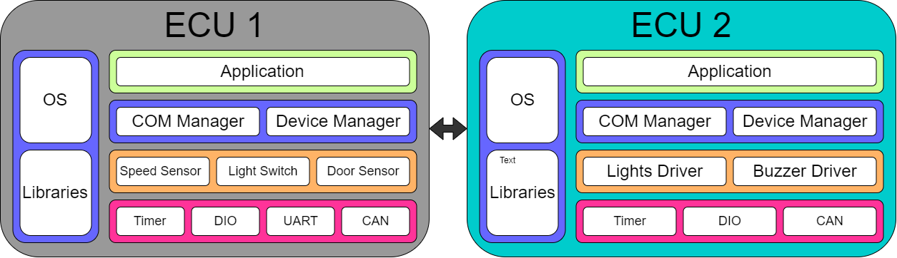
System Schematic Diagram

Slide 3
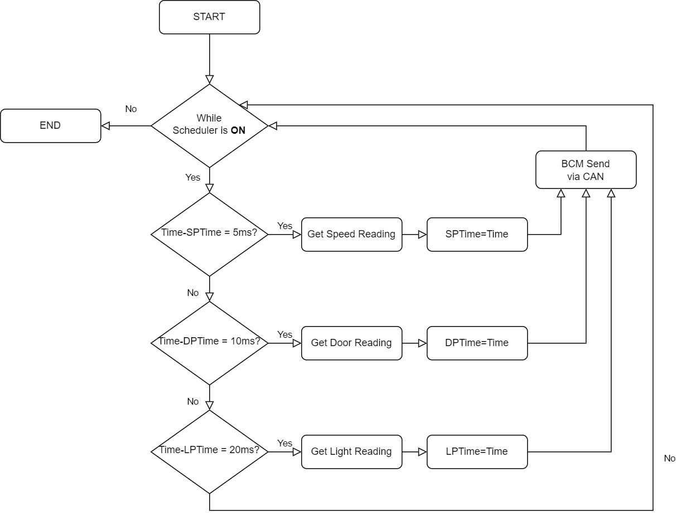
ECU 1 Flowchart

Slide 4
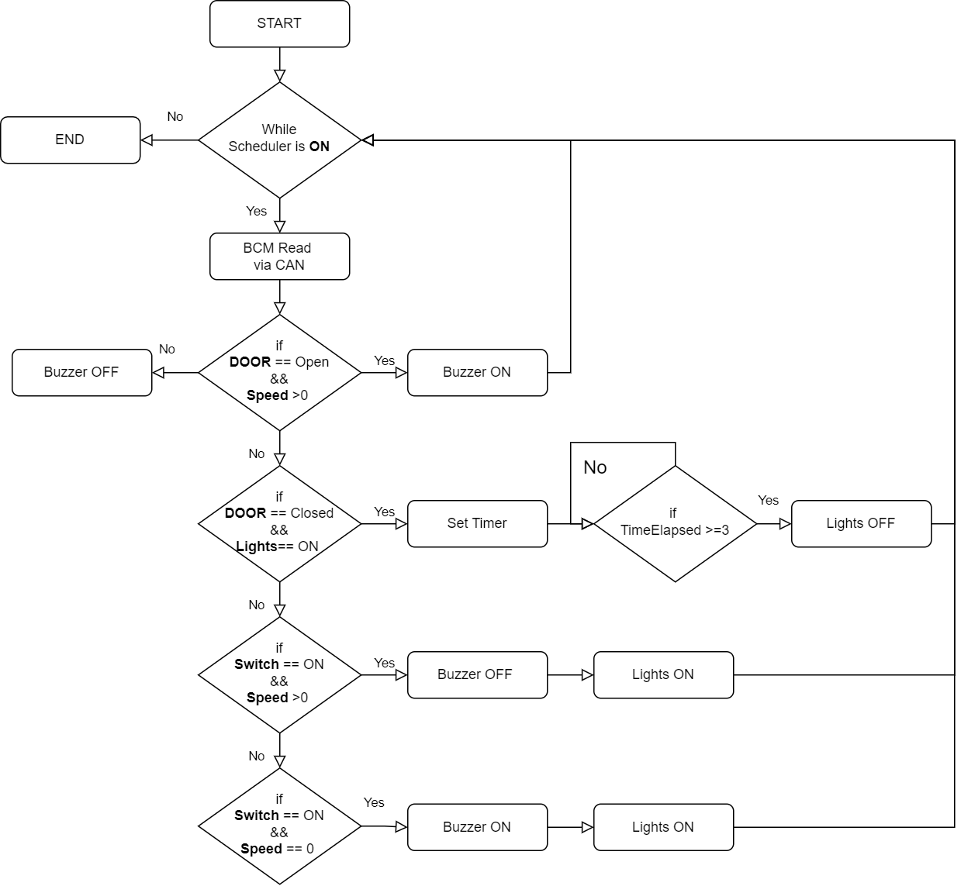
ECU 2 Flowchart

Slide 5
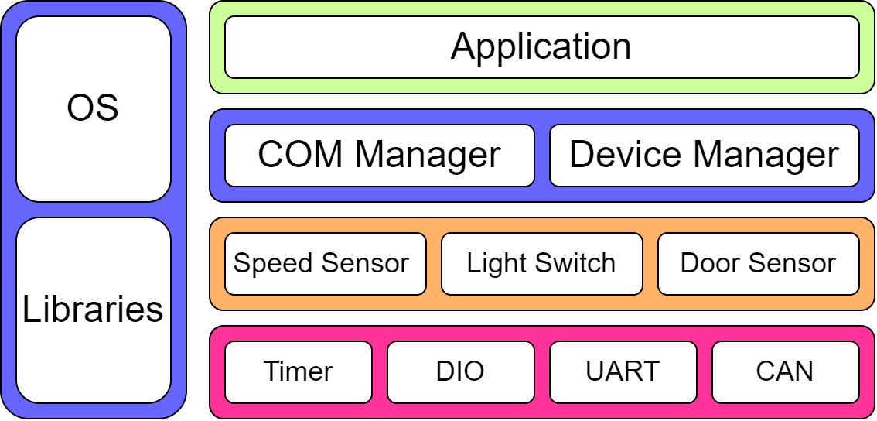
Static Design of ECU 1

Slide 6
ECU 1 APIs : DIO
Typedef | Struct TimerCfg_t
Enum | Timer_Number
Enum | Timer_Mode
Enum | Prescaler
int | Preload

Slide 7
ECU 1 APIs : Timer
API Name | vTimer_Init()
Description | Initialize timer peripheral with provided config
Input Parameters | TimerCfg_t
Output Parameters | None

Slide 8
ECU 1 APIs : Timer
API Name | vTimer_Start()
Description | Start timer
Input Parameters | TimerCfg_t
Output Parameters | None

Slide 9
ECU 1 APIs : Timer
API Name | vTimer_Stop()
Description | Stop timer
Input Parameters | TimerCfg_t
Output Parameters | None

Slide 10
ECU 1 APIs : DIO
Typedef | Struct PinCfg_t
Enum | Pin_Number
Enum | Pin_Direction
Enum | Pin_Mode
Enum | Pin_Special_Function
Typedef | Enum Pin_Status
Description | Pin reading value

Slide 11
ECU 1 APIs : DIO
API Name | vDio_Init()
Description | Initialize dio peripheral with provided configs
Input Parameters | PinCfg_t[“Number of pins”]
Output Parameters | None

Slide 12
ECU 1 APIs : DIO
API Name | vDio_Set()
Description | Set DIO pin high
Input Parameters | PinCfg_t
Output Parameters | None

Slide 13
ECU 1 APIs : DIO
API Name | vDio_Clear()
Description | Un-set DIO pin to low
Input Parameters | PinCfg_t
Output Parameters | None
Reentrancy | Non-Reentrant

Slide 14
ECU 1 APIs : DIO
API Name | vDio_Get()
Description | Get DIO pin status
Input Parameters | PinCfg_t
Output Parameters | Pin_Status

Slide 15
ECU 1 APIs : UART
Typedef | Struct UartCfg_t
Enum | UART_Mode
Enum | Baudrate
Enum | RX_Pin
Enum | TX_Pin
Typedef | Char UART_Msg[]
Description | Message string to be used for sending and receiving

Slide 16
ECU 1 APIs : UART
API Name | vUart_Init()
Description | Initialize UART peripheral with config
Input Parameters | UartCfg_t
Output Parameters | None

Slide 17
ECU 1 APIs : UART
API Name | vUart_Send()
Description | Send from UART peripheral
Input Parameters | UartCfg_t
Output Parameters | None

Slide 18
ECU 1 APIs : UART
API Name | xUart_Receive()
Description | Receive from UART peripheral
Input Parameters | UartCfg_t
Output Parameters | UART_Msg

Slide 19
ECU 1 APIs : CAN
Typedef | Struct CANCfg_t
Enum | CAN_Mode
Enum | Baudrate
Typedef | Char CAN_Msg[]
Description | Message string to be used for sending and receiving

Slide 20
ECU 1 APIs : CAN
API Name | vCAN_Init()
Description | Initialize CAN peripheral with config
Input Parameters | CANCfg_t
Output Parameters | None

Slide 21
ECU 1 APIs : CAN
API Name | vCAN_Send()
Description | Send data over CANBUS
Input Parameters | CANCfg_t
Output Parameters | None

Slide 22
ECU 1 APIs : CAN
API Name | xCAN_Receive()
Description | Receive data over CANBUS
Input Parameters | CANCfg_t
Output Parameters | CAN_Msg

Slide 23
ECU 1 APIs : Speed Sensor
Typedef | Struct SpeedCfg_t
Enum | Sensor_Type
Enum | TX_Pin
Enum | RX_Pin
Typedef | Char Speed_Msg[]
Description | Message string to be used for sending and receiving

Slide 24
ECU 1 APIs : Speed Sensor
API Name | vSpeed_Init()
Description | Initialize a speed sensor with the given config
Input Parameters | SpeedCfg_t
Output Parameters | None

Slide 25
ECU 1 APIs : Speed Sensor
API Name | xSpeed_GetReading()
Description | Get speed reading from sensor
Input Parameters | SpeedCfg_t
Output Parameters | Speed_Msg

Slide 26
ECU 1 APIs : Light Sensor
Typedef | Struct LightCfg_t
Enum | Sensor_Type
Enum | Pin
Typedef | Enum Light_Status
Description | Light sensor reading

Slide 27
ECU 1 APIs : Light Sensor
API Name | vLight_Init()
Description | Initialize a light sensor with the given config
Input Parameters | LightCfg_t
Output Parameters | None

Slide 28
ECU 1 APIs : Light Sensor
API Name | xLight_Read()
Description | Read a light sensor
Input Parameters | LightCfg_t
Output Parameters | Light_Status

Slide 29
ECU 1 APIs : Door Sensor
Typedef | Struct DoorCfg_t
Enum | Sensor_Type
Enum | Pin
Typedef | Enum Door_Status
Description | Door sensor reading

Slide 30
ECU 1 APIs : Door Sensor
API Name | vDoor_Init()
Description | Initialize a Door sensor with the given config
Input Parameters | DoorCfg_t
Output Parameters | None

Slide 31
ECU 1 APIs : Door Sensor
API Name | xDoor_Read()
Description | Read a Door sensor
Input Parameters | DoorCfg_t
Output Parameters | Door_Status

Slide 32
ECU 1 APIs : COM Manager
Typedef | Struct COM_Device_t
Enum | COM_Protocol
Enum | Channel
char | COM_Msg[]

Slide 33
ECU 1 APIs : COM Manager
API Name | vCom_Init()
Description | Initialize a Communication manager
Input Parameters | COM_Device_t
Output Parameters | None

Slide 34
ECU 1 APIs : COM Manager
API Name | vCom_Send()
Description | Send message using communication manager
Input Parameters | COM_Device_t
Output Parameters | None

Slide 35
ECU 1 APIs : COM Manager
API Name | vCom_Receive()
Description | Receive message using communication manager
Input Parameters | COM_Device_t
Output Parameters | COM_Device_t

Slide 36
ECU 1 APIs : Device Manager
Typedef | Struct Device_t
Enum | Device_ID
Enum | Interface_Type
char | Device_Msg[]

Slide 37
ECU 1 APIs : Device Manager
API Name | vDevice_Init()
Description | Initialize device manager
Input Parameters | Device_t
Output Parameters | None

Slide 38
ECU 1 APIs : Device Manager
API Name | vDevice_Receive()
Description | Receive device reading using device manager
Input Parameters | Device_t
Output Parameters | Device_t

Slide 39
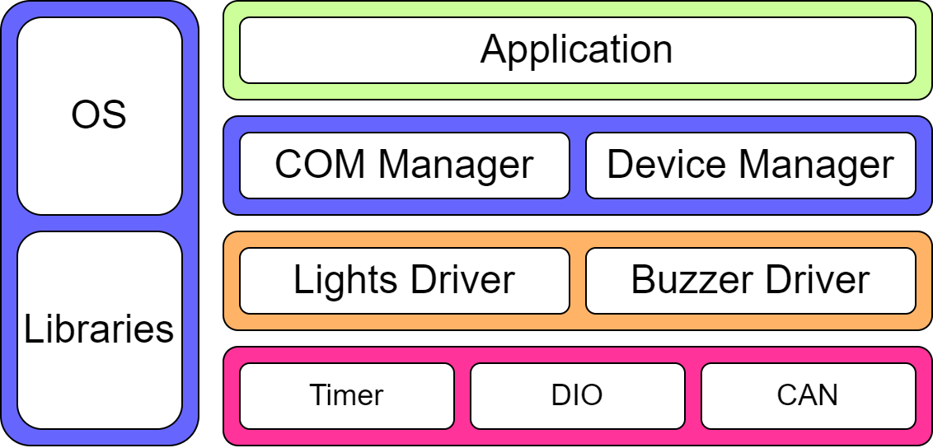
Static Design of ECU 2

Slide 40
ECU 2 APIs : DIO
Typedef | Struct TimerCfg_t
Enum | Timer_Number
Enum | Timer_Mode
Enum | Prescaler
int | Preload

Slide 41
ECU 2 APIs : Timer
API Name | vTimer_Init()
Description | Initialize timer peripheral with provided config
Input Parameters | TimerCfg_t
Output Parameters | None

Slide 42
ECU 2 APIs : Timer
API Name | vTimer_Start()
Description | Start timer
Input Parameters | TimerCfg_t
Output Parameters | None

Slide 43
ECU 2 APIs : Timer
API Name | vTimer_Stop()
Description | Stop timer
Input Parameters | TimerCfg_t
Output Parameters | None

Slide 44
ECU 2 APIs : DIO
Typedef | Struct PinCfg_t
Enum | Pin_Number
Enum | Pin_Direction
Enum | Pin_Mode
Enum | Pin_Special_Function
Typedef | Enum Pin_Status
Description | Pin reading value

Slide 45
ECU 2 APIs : DIO
API Name | vDio_Init()
Description | Initialize dio peripheral with provided configs
Input Parameters | PinCfg_t[“Number of pins”]
Output Parameters | None

Slide 46
ECU 2 APIs : DIO
API Name | vDio_Set()
Description | Set DIO pin high
Input Parameters | PinCfg_t
Output Parameters | None

Slide 47
ECU 2 APIs : DIO
API Name | vDio_Clear()
Description | Un-set DIO pin to low
Input Parameters | PinCfg_t
Output Parameters | None
Reentrancy | Non-Reentrant

Slide 48
ECU 2 APIs : DIO
API Name | vDio_Get()
Description | Get DIO pin status
Input Parameters | PinCfg_t
Output Parameters | Pin_Status

Slide 49
ECU 2 APIs : CAN
Typedef | Struct CANCfg_t
Enum | CAN_Mode
Enum | Baudrate
Typedef | Char CAN_Msg[]
Description | Message string to be used for sending and receiving

Slide 50
ECU 2 APIs : CAN
API Name | vCAN_Init()
Description | Initialize CAN peripheral with config
Input Parameters | CANCfg_t
Output Parameters | None

Slide 51
ECU 2 APIs : CAN
API Name | vCAN_Send()
Description | Send data over CANBUS
Input Parameters | CANCfg_t
Output Parameters | None

Slide 52
ECU 2 APIs : CAN
API Name | xCAN_Receive()
Description | Receive data over CANBUS
Input Parameters | CANCfg_t
Output Parameters | CAN_Msg

Slide 53
ECU 2 APIs : Light Actuator
Typedef | Struct LightCfg_t
Enum | Actuator_Type
Enum | Pin

Slide 54
ECU 2 APIs : Light Sensor
API Name | vLight_Init()
Description | Initialize a Light actuator with the given config
Input Parameters | LightCfg_t
Output Parameters | None

Slide 55
ECU 2 APIs : Light Actuator
API Name | xLight_SetAction()
Description | Set actuator action
Input Parameters | LightCfg_t
Output Parameters | None

Slide 56
ECU 2 APIs : Buzzer Actuator
Typedef | Struct BuzzerCfg_t
Enum | Actuator_Type
Enum | Pin

Slide 57
ECU 2 APIs : Buzzer Sensor
API Name | vBuzzer_Init()
Description | Initialize a Buzzer actuator with the given config
Input Parameters | BuzzerCfg_t
Output Parameters | None

Slide 58
ECU 2 APIs : Buzzer Actuator
API Name | xBuzzer_SetAction()
Description | Set actuator action
Input Parameters | BuzzerCfg_t
Output Parameters | None

Slide 59
ECU 2 APIs : COM Manager
Typedef | Struct COM_Device_t
Enum | COM_Protocol
Enum | Channel
char | COM_Msg[]

Slide 60
ECU 2 APIs : COM Manager
API Name | vCom_Init()
Description | Initialize a Communication manager
Input Parameters | COM_Device_t
Output Parameters | None

Slide 61
ECU 2 APIs : COM Manager
API Name | vCom_Send()
Description | Send message using communication manager
Input Parameters | COM_Device_t
Output Parameters | None

Slide 62
ECU 2 APIs : COM Manager
API Name | vCom_Receive()
Description | Receive message using communication manager
Input Parameters | COM_Device_t
Output Parameters | COM_Device_t

Slide 63
ECU 2 APIs : Device Manager
Typedef | Struct Device_t
Enum | Device_ID
Enum | Interface_Type
Enum | Device_Action

Slide 64
ECU 2 APIs : Device Manager
API Name | vDevice_Init()
Description | Initialize device manager
Input Parameters | Device_t
Output Parameters | None

Slide 65
ECU 2 APIs : Device Manager
API Name | vDevice_Send()
Description | Send device action using device manager
Input Parameters | Device_t
Output Parameters | Device_t

