Slide 1
My Store
What is the subject of the site?
An e-commerce website is one that allows people to buy and sell physical goods, services, and digital products over the internet rather than at a brick-and-mortar location
Where am I?
This is My store : online shopping for the latest clothes and fashion
The project goal ?
Faciliate shopping for people
Anyone can buy online ,,,,

Slide 2
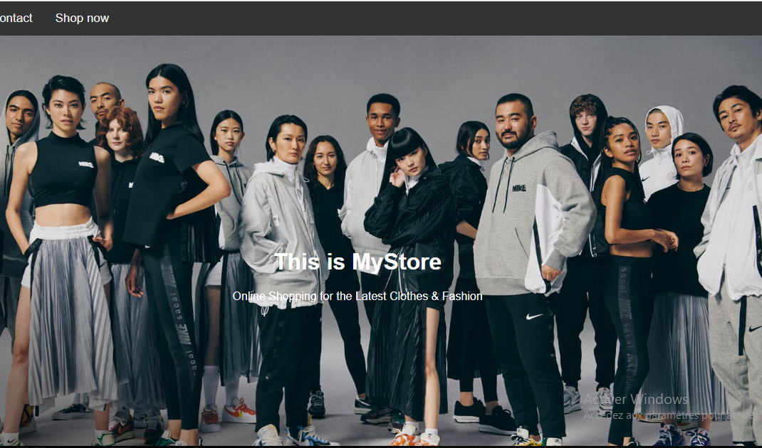
To make a website you shold know how to use HTML CSS and JAVASCRIPT
So this is my project and in this presentation i will explain to you how i make it

Slide 3

First :you need to learn how to programming with :

Slide 4
HTML stands for hyper text markup languge
He is used to create a web pages
CSS stands for cascading style sheets
He describes how HTML éléments are to be displayed on screen and it can control the layout of web pages
Javascript is the programming language of the web
Javascript is the world’s most popular programming languge

Slide 5



Don’t forget that there are many sites can help you ::

Slide 6
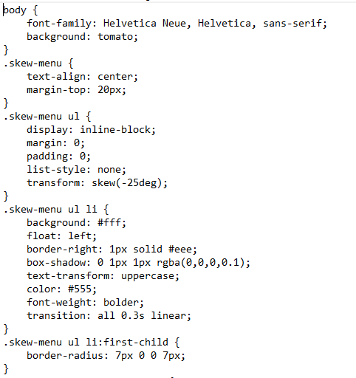
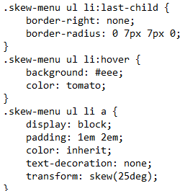
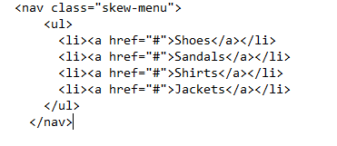
Let’s star with the navbar :
HTML
CSS

Slide 7
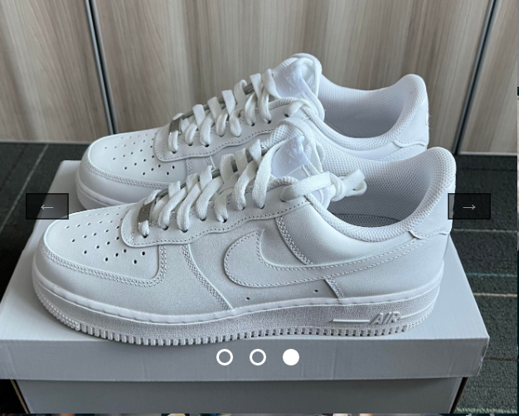
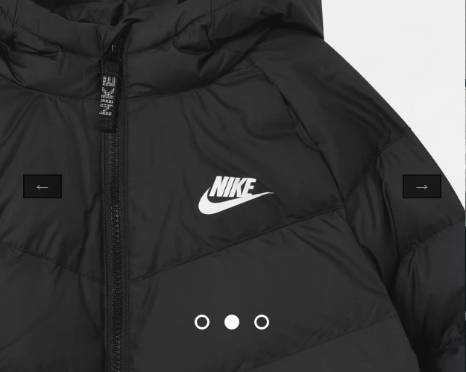
NEWS page : here you can find what is new in the store . you have a slider who show you all the new products

Slide 8
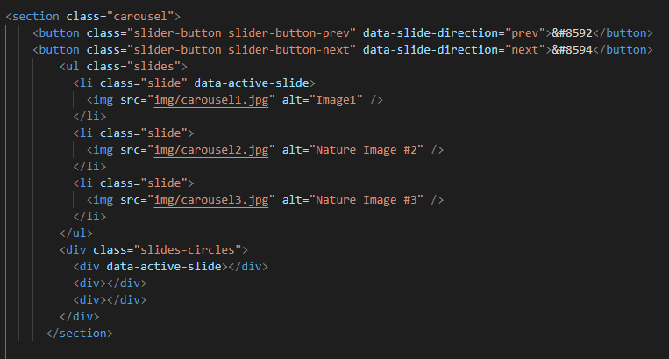
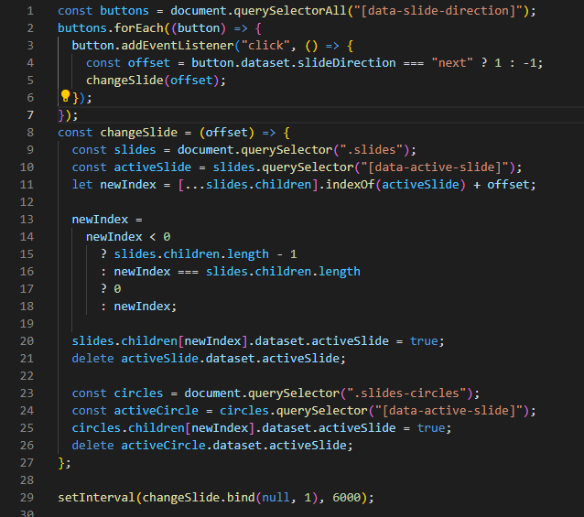
Html and js code

Slide 9
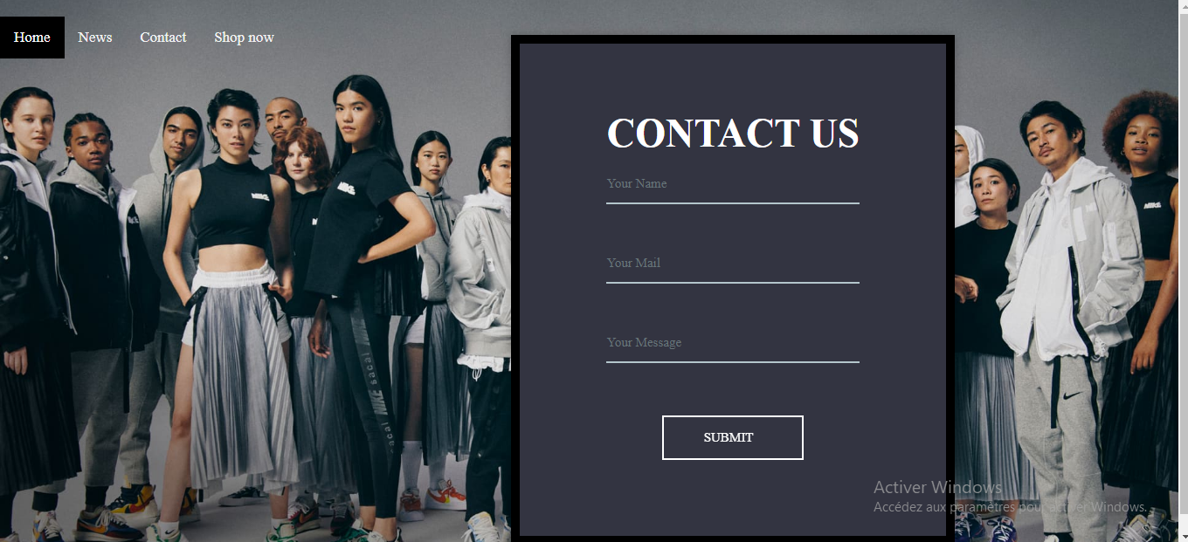
Contact page: here you can contact the store

Slide 10
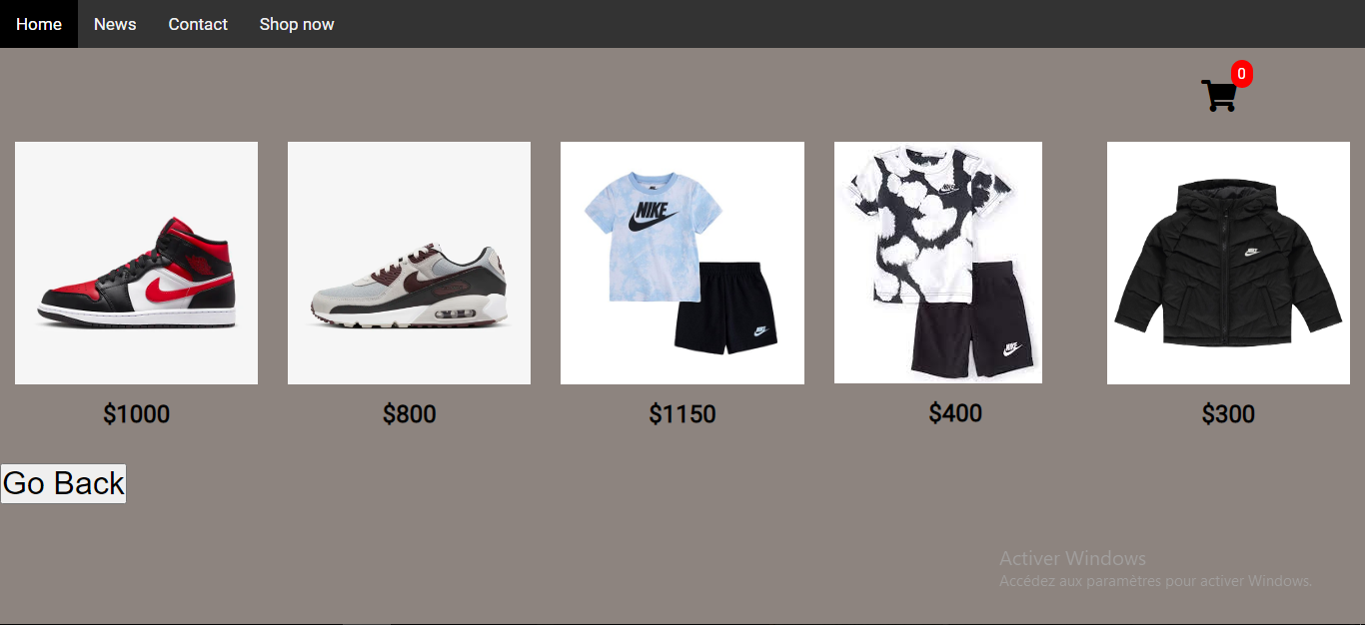
The last page is the shop page : where you can buy any product you want and you paid for it

Slide 11

For example if you want to buy an object :
You just need to click at « add to card »
When you click , the product will be added in the shopping card :
Then you have to choose :
The qunatity
You can also remove the product if you like just when you click at « REMOVE »
The total will be displayed too

Slide 12
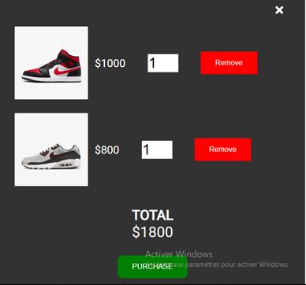

Slide 13
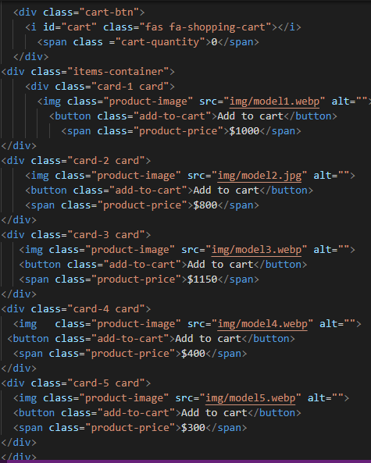
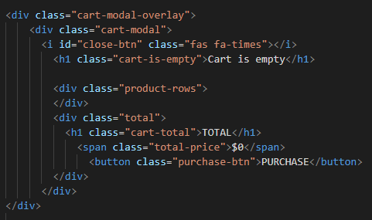
Some html and js code : « shopping card »

Slide 14
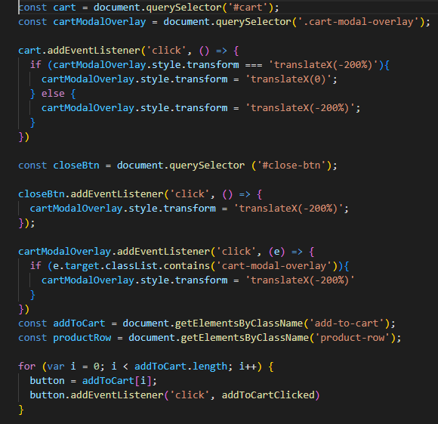
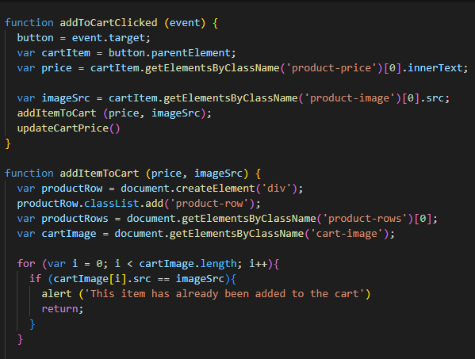
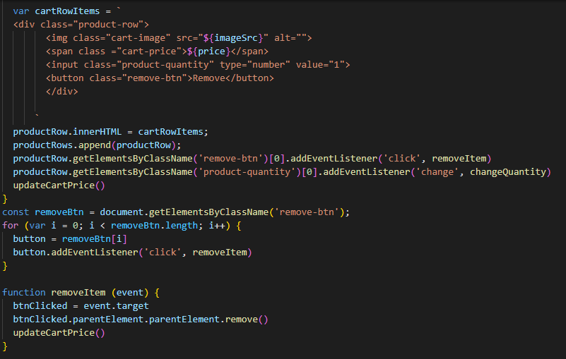

Slide 15
I use : HTML CSS JAVASCRIPT W3SCHOOLS YOUTUBE GOOGLE

