Slide 1





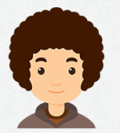

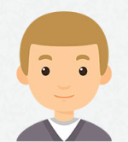

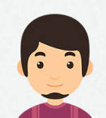
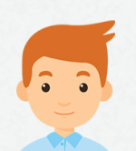

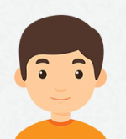

Guess Who
Guess the character with the clues you have
Make questions to get information
Will he (buy a pencil tomorrow)?
Will do…
Will meet…
Will study…
Will travel to…
+ Yes he will.
+ No he won’t.
buy a pencil tomorrow
buy a pencil tomorrow
buy a pencil tomorrow
his friend next week
his friend next week
his friend next week
Mark
English later
Mark
English later
Mark
English later
France next summer
France next summer
France next summer
buy a pencil tomorrow
buy a pencil tomorrow
buy a pencil tomorrow
his friend next week
his friend next week
his friend next week
Mark
English later
Mark
English later
Mark
English later
France next summer
France next summer
France next summer
buy a pencil tomorrow
buy a pencil tomorrow
buy a pencil tomorrow
his friend next week
his friend next week
his friend next week
Mark
English later
Mark
English later
Mark
English later
France next summer
France next summer
France next summer

