Slide 1





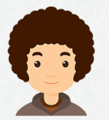
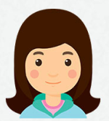
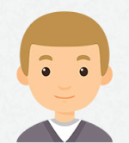
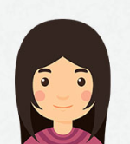
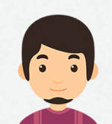
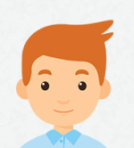
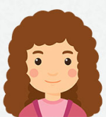
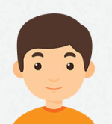
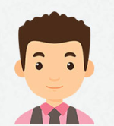
Guess Who
Guess the character with the clues you have
Make questions to get information
Drinks in the morning
Goes to work
Plays sport often
Always eats meat
Does Mia drink coffee in the morning?
Yes, she does.
No, she doesn't.
coffee
tea
juice
by bus
by car
from home
Mark
football
Maria
tennis
Ian
never
never
always
sometimes
milk
milk
water
walks
walks
by bike
Aisha
tennis
Hiro
often
Joshua
often
always
never
sometimes
juice
coffee
tea
from home
by train
from home
Pryia
never
Alex
never
John
football
sometimes
always
sometimes

