Slide 1
EqF for Drones
Yahor Lechanka
05/04/2026
May the 4th be with you

Slide 2
Purpose
Real Time attitude and gyroscope bias estimation using IMU and magnetometer measurements.
3 sensors: gyroscope, accelerometer and magnetometer.
Magnetometer can only estimate yaw reliably.
Accelerometer can estimate only roll and pitch.
Accelerometer experiences forces other than gravity.

Slide 3
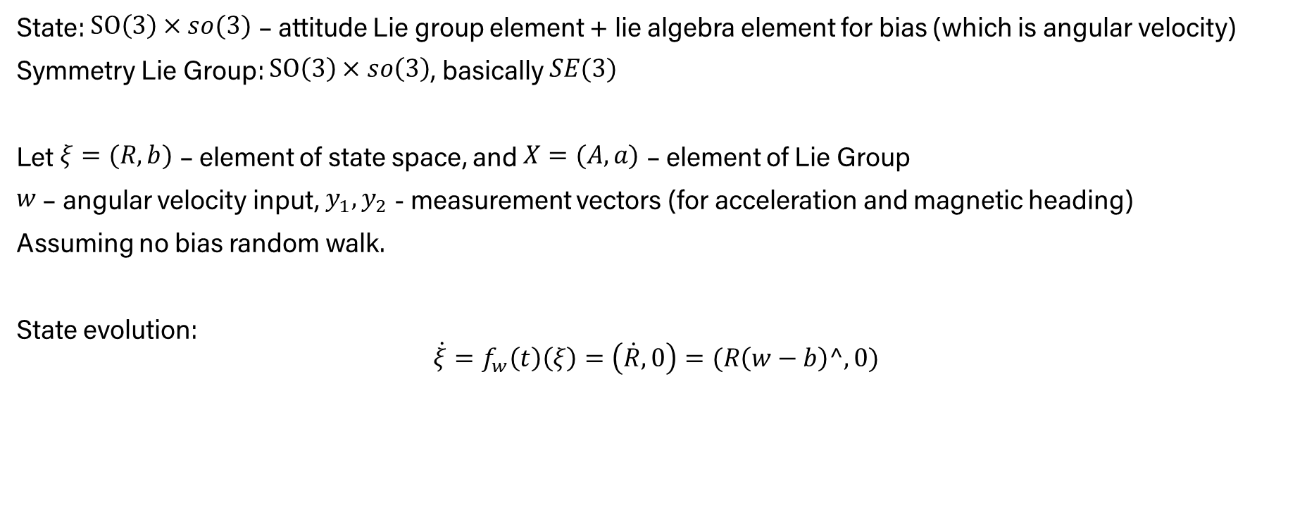
Filter Setup
State: $SO\left(3\right)×so(3)$ – attitude Lie group element + lie algebra element for bias (which is angular velocity)
Symmetry Lie Group: $SO\left(3\right)×so\left(3\right)$, basically $SE(3)$
Let $ξ=(R, b)$ – element of state space, and $X=(A, a)$ – element of Lie Group
$w$– angular velocity input, $y_{1}, y_{2}$ - measurement vectors (for acceleration and magnetic heading)
Assuming no bias random walk.
State evolution:
$$\dot{ξ}=f_{w}\left(t\right)\left(ξ\right)=\left(\dot{R},0\right)=(R\left(w−b\right)^,0)$$

Slide 4

EqF functions
According to EqF paper we need to define a couple functions:
State action
Input symmetry
Equivariant lift
Output map
Output action
Error dynamics
Origin $ξ^{∘}$, local coordinates $θ$

Slide 5

State Action
$φ:G×M→M$
$φ\left(X,ξ\right)=φ\left(\left(A,a\right),\left(R,b\right)\right)=(RA,A^{T}\left(b+a\right))$
$D_{φ_{X}}\left(ξ\right)=\left(\dot{R}A,0\right)$

Slide 6
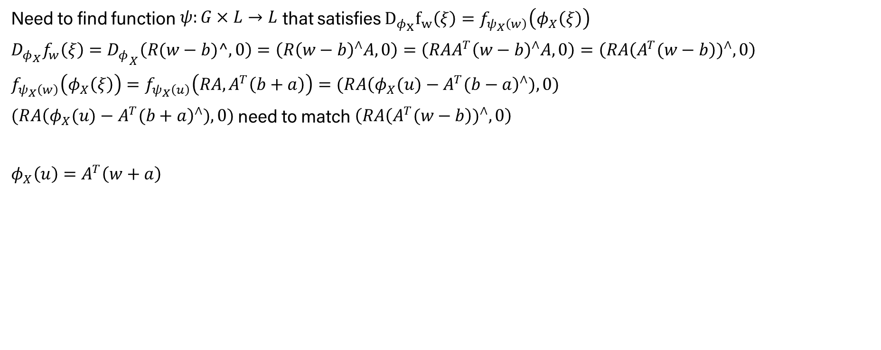
Input symmetry
Need to find function $ψ:G×L→L$ that satisfies $D_{φ_{X}}f_{w}\left(ξ\right)=f_{ψ_{X}\left(w\right)}\left(φ_{X}\left(ξ\right)\right)$
$D_{φ_{X}}f_{w}\left(ξ\right)={D_{φ}}_{X}\left(R(w−b)^,0\right)=\left(R{\left(w−b\right)}^{∧}A,0\right)=\left(RAA^{T}{\left(w−b\right)}^{∧}A,0\right)=\left(RA{\left(A^{T}(w−b\right))}^{∧},0\right)$
$f_{ψ_{X}\left(w\right)}\left(φ_{X}\left(ξ\right)\right)=f_{ψ_{X}\left(u\right)}\left(RA,A^{T}\left(b+a\right)\right)=(R{A\left(φ_{X}(u)−A^{T}(b−a\right)}^{∧}),0)$
$(R{A\left(φ_{X}(u)−A^{T}(b+a\right)}^{∧}),0)$need to match $\left(RA{\left(A^{T}(w−b\right))}^{∧},0\right)$
$φ_{X}\left(u\right)=A^{T}\left(w+a\right)$

Slide 7
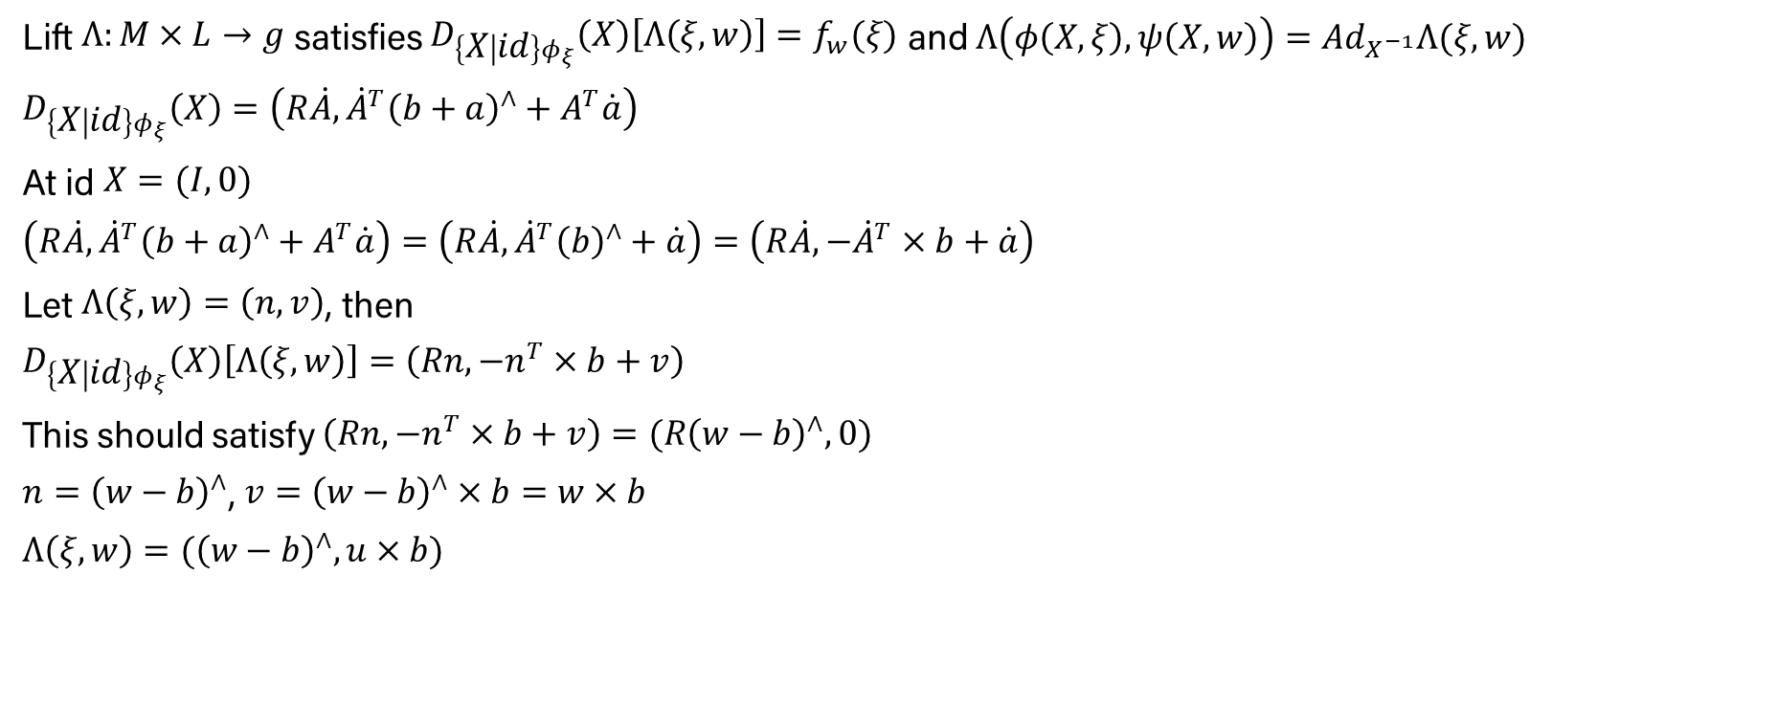
Equivariant Lift
Lift $Λ:M×L→g$ satisfies $D_{\left\{X | id\right\}φ_{ξ}}\left(X\right)\left[Λ\left(ξ, w\right)\right]=f_{w}(ξ)$ and $Λ\left(φ\left(X,ξ\right),ψ\left(X,w\right)\right)=Ad_{X^{−1}}Λ(ξ, w)$
$D_{\left\{X | id\right\}φ_{ξ}}\left(X\right)=\left(R\dot{A}, {\dot{A}}^{T}{\left(b+a\right)}^{∧}+A^{T}\dot{a}\right)$
At id $X=(I,0)$
$\left(R\dot{A}, {\dot{A}}^{T}{\left(b+a\right)}^{∧}+A^{T}\dot{a}\right)=\left(R\dot{A}, {\dot{A}}^{T}{\left(b\right)}^{∧}+\dot{a}\right)=\left(R\dot{A}, {−\dot{A}}^{T}×b+\dot{a}\right)$
Let $Λ\left(ξ,w\right)=\left(n,v\right)$, then
$D_{\left\{X | id\right\}φ_{ξ}}\left(X\right)\left[Λ\left(ξ, w\right)\right]=\left(Rn, {−n}^{T}×b+v\right)$
This should satisfy $\left(Rn, {−n}^{T}×b+v\right)=(R{\left(w−b\right)}^{∧},0)$
$n={\left(w−b\right)}^{∧}$, $v={\left(w−b\right)}^{∧}×b=w×b$
$Λ\left(ξ,w\right)=({\left(w−b\right)}^{∧},u×b)$

Slide 8
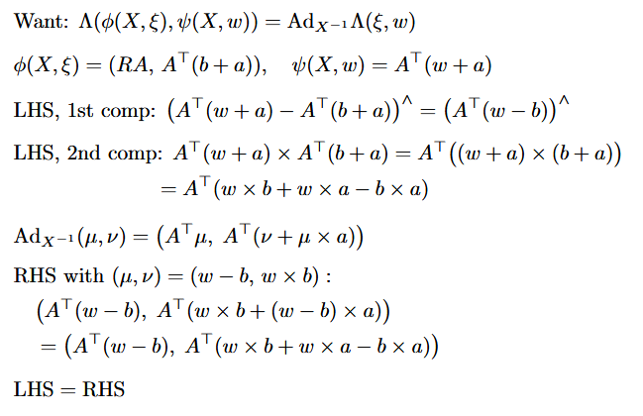
Equivariant Lift

Slide 9
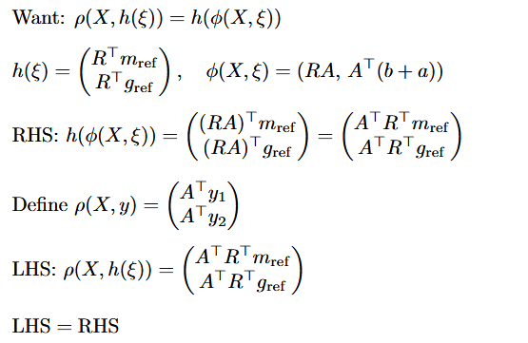
Output Map and Action

Slide 10









Error State and Output coordinates
EqF error:
Inverse of the state:
So
Origin:
Now convert the error to local vector coordinates

Slide 11

Output coordinates
Inverse

Slide 12



EqF matrices
Now we have everything to get matrices for EqF using these equations:

Slide 13
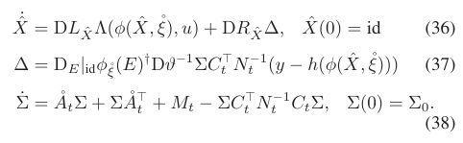
Kalman Filter Equations

Slide 14
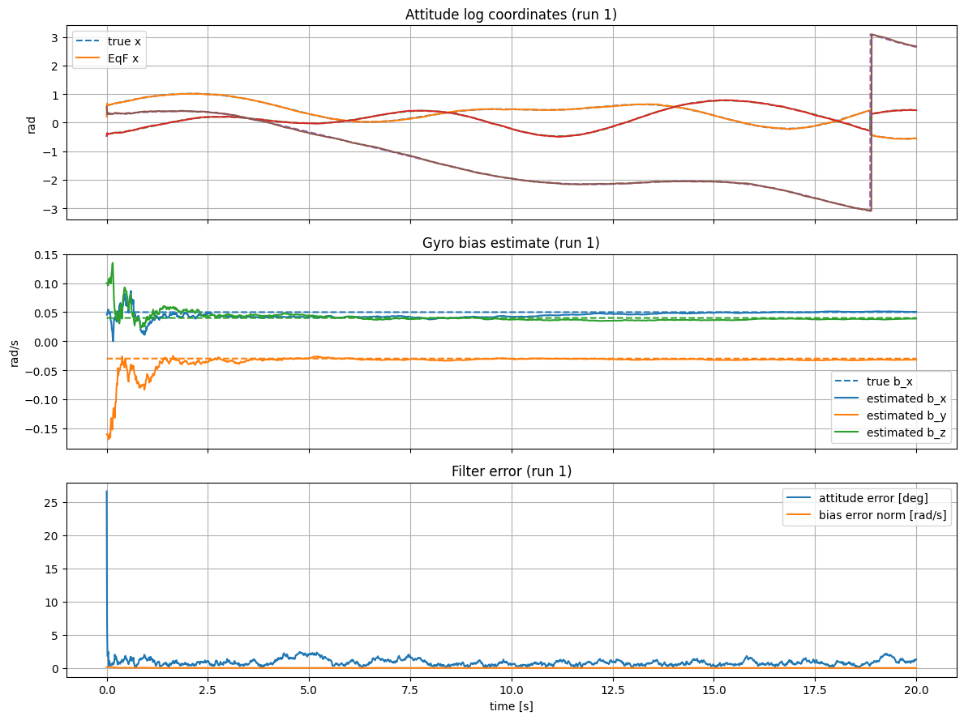
Simulation Results

Slide 15
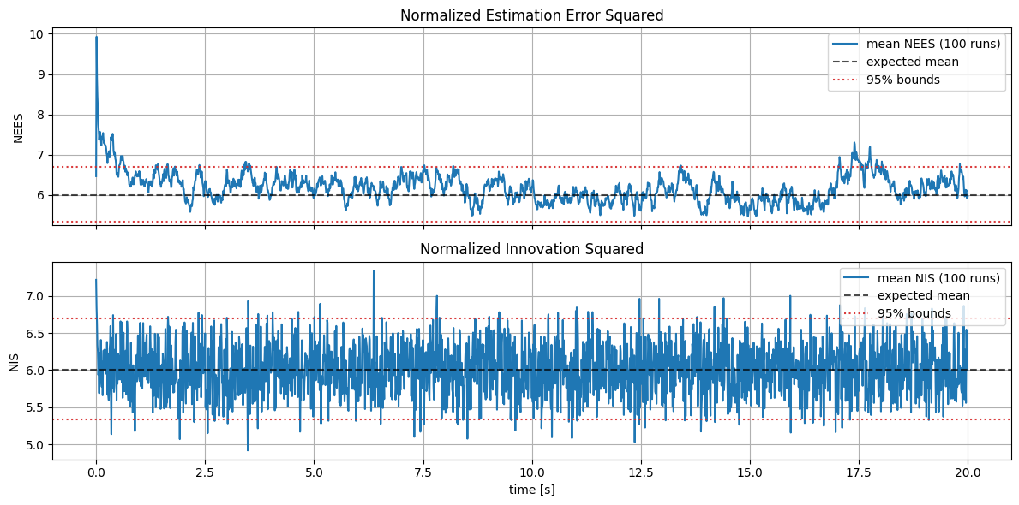
NEES and NIS

Slide 16
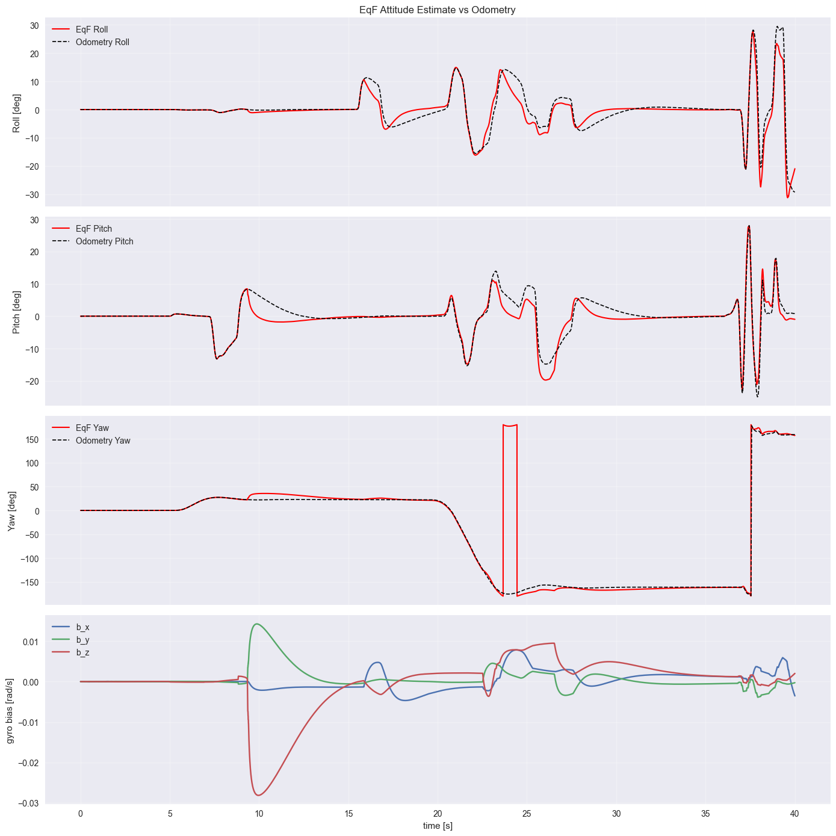
Drone data

Slide 17
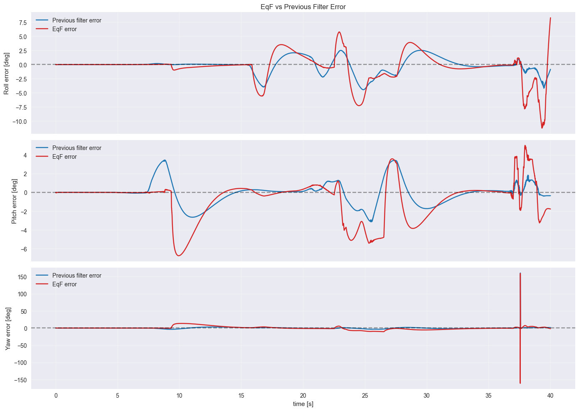
Drone data

Slide 18

Drone Data

Slide 19
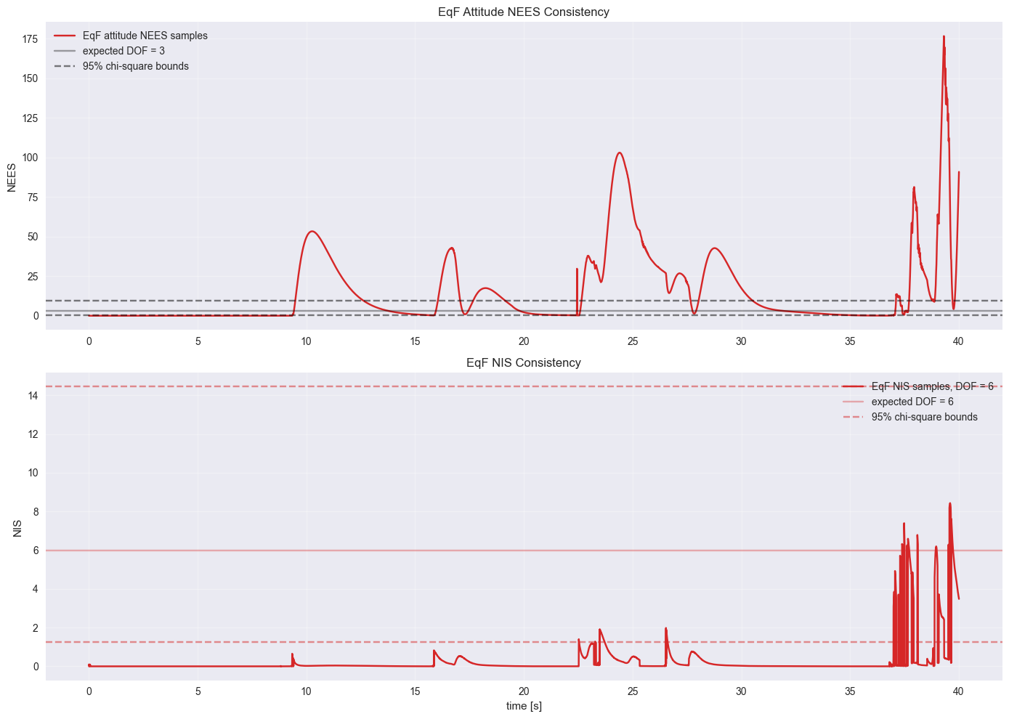
NEES and NIS for drone data

Slide 20
Next Steps
Make the code cleaner.
Figure out how to calculate derivatives
Tune the filter
Work on introducing position with GPS and optical flow measurements
Derive filter with bias random walk

Slide 21
References
Course materials
van Goor, P., Hamel, T., & Mahony, R. (2023). Equivariant Filter (EQF). IEEE Transactions on Automatic Control, 68(6), 3501–3512. https://doi.org/10.1109/tac.2022.3194094
Fornasier, A., Ng, Y., Brommer, C., Bohm, C., Mahony, R., & Weiss, S. (2022). Overcoming bias: Equivariant filter design for biased attitude estimation with online calibration. IEEE Robotics and Automation Letters, 7(4), 12118–12125. https://doi.org/10.1109/lra.2022.3210867

