Slide 1
Train Dispatch System
By Yash Sheth, Frank Savino, Ran Bi

Slide 2
Introduction
This Train Dispatch project is to design a quick, efficient system, which can route trains from a location to another one.
The main motivation behind the Train Dispatch System is to replace some of the inappropriate dispatch system, which may waste our time. Also, a more efficient and appropriate dispatch system will make our life easier.

Slide 3
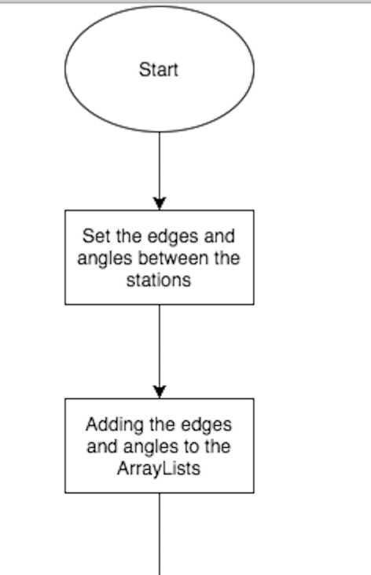
Description

Slide 4
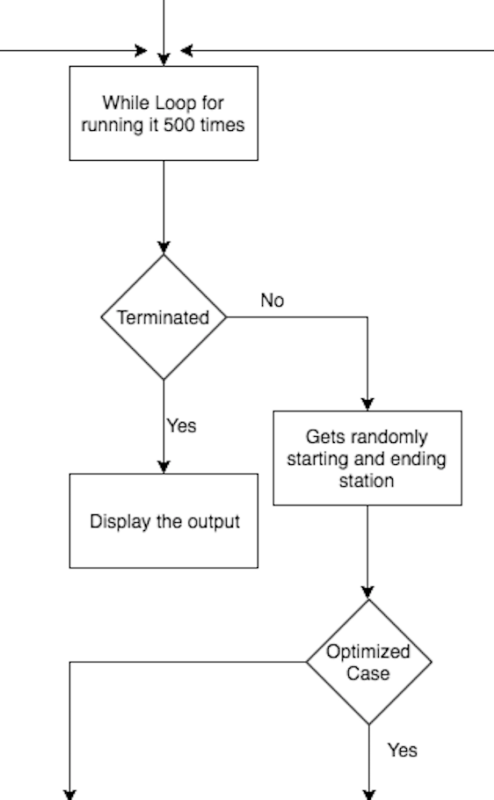
Description

Slide 5
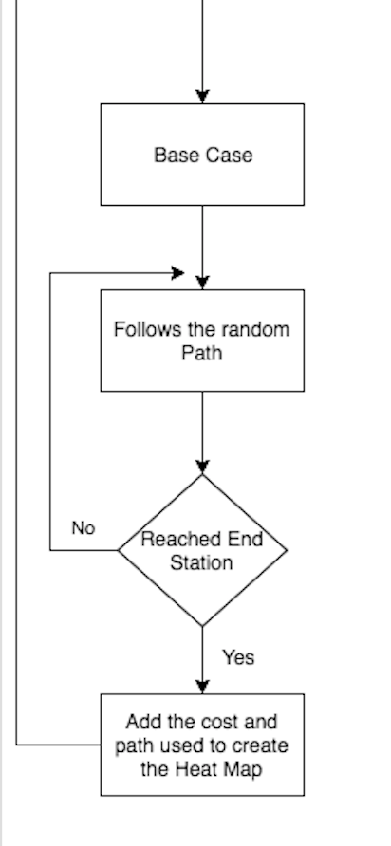
Description

Slide 6
Description

Slide 7
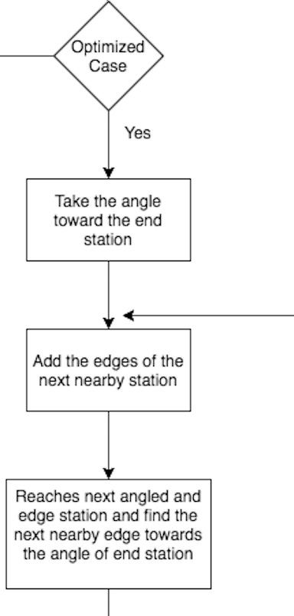
Description

Slide 8
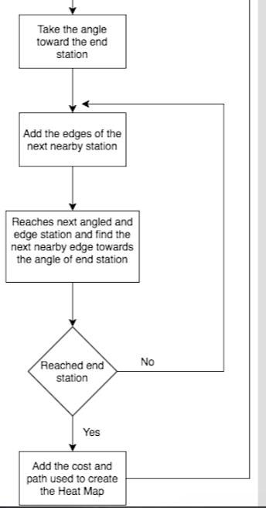
Description

Slide 9
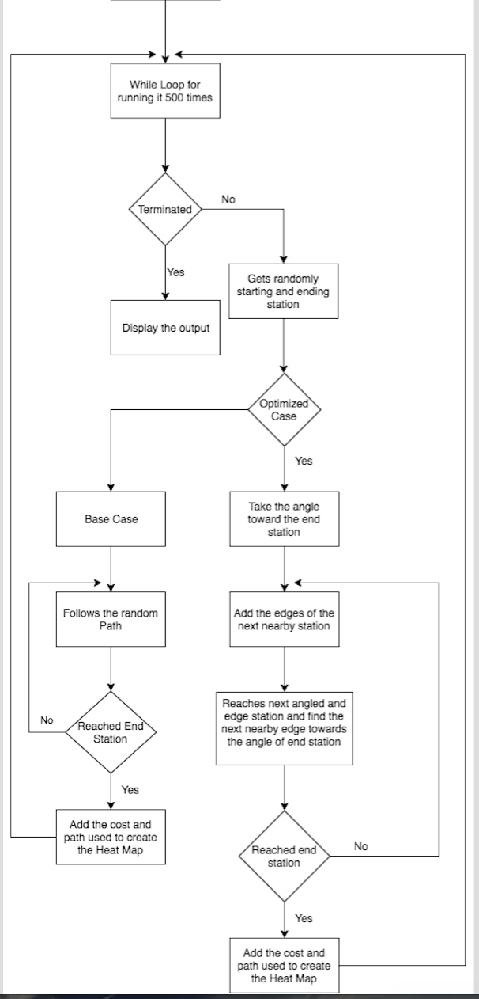
Description

Slide 10
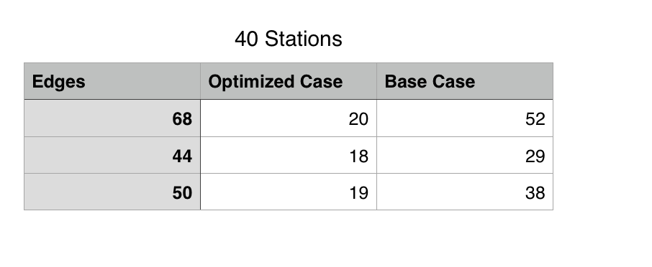
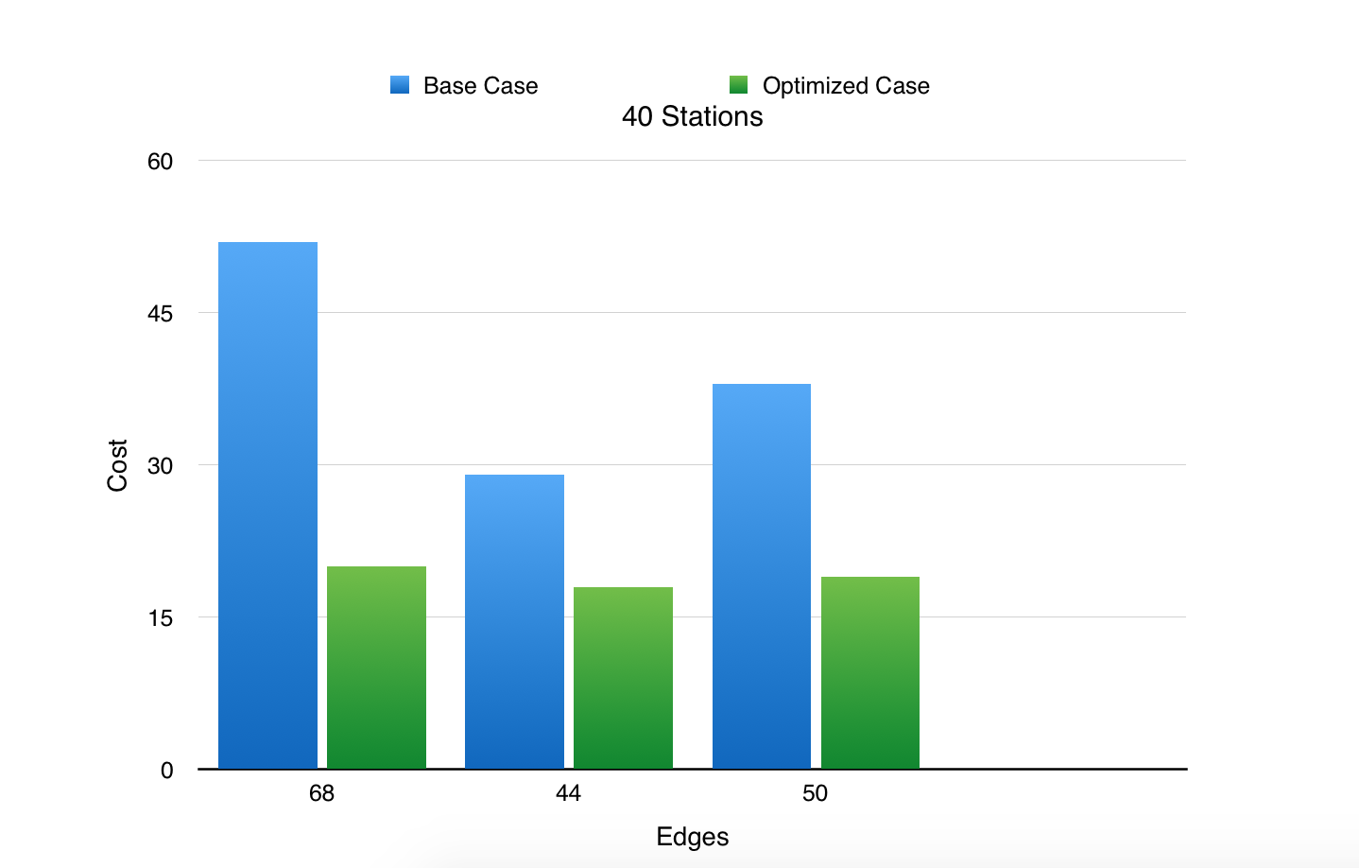
Statistics

Slide 11
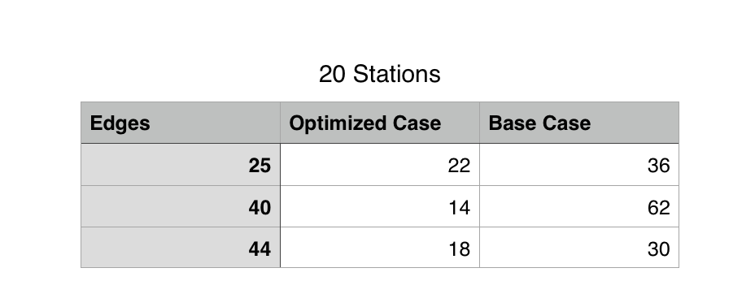
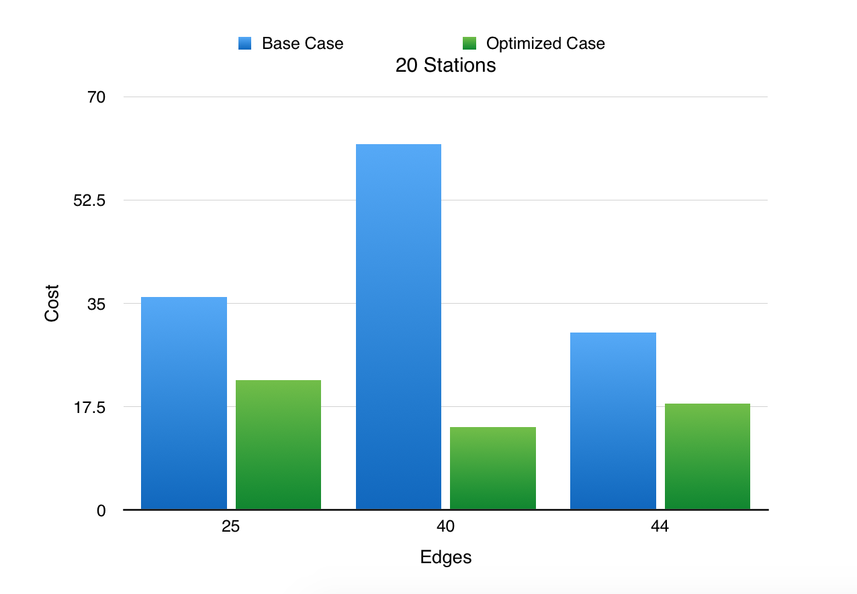
Statistics

Slide 12
QUESTIONS?

