Slide 1

Global Perspectives on AI Integration: Usage, Acceptance, and the Imperative for Regulation
By: Yahya Salama

Slide 2
The Objectives
Primary objective: to determine the true extent of AI reliance in everyday life globally.
Secondary objective: is investigating strategies to maintain self-autonomy in an AI age

Slide 3

The data challenge
Consolidating 16 separate survey data files

Slide 4
DATA
Standardization: A custom function then processed 16 files, standardized columns, generated unique Respondent_IDs, and renaming all data columns with wave IDs to prevent merge conflicts.
Horizontal Merging: map2 from the purrr library was used to automate the standardization, and full_join from the dplyr library merged all 16 files into one master data frame based on the unique Respondent_IDs.
Final Selection: From the new master file, only columns of interest were selected. The Respondent_ID was removed to produce the final, clean data set for analysis.

Slide 5
The Result
264 x 44
Final Data Frame
From 16 Files to One Focused Dataset
The process successfully consolidated 16 separate files from 1,624 rows x 16 columns into a manageable 264 row by 44 column wide format data frame.

Slide 6

Data: Visualized
Analyzing Trends in AI usage and Sentiment

Slide 7
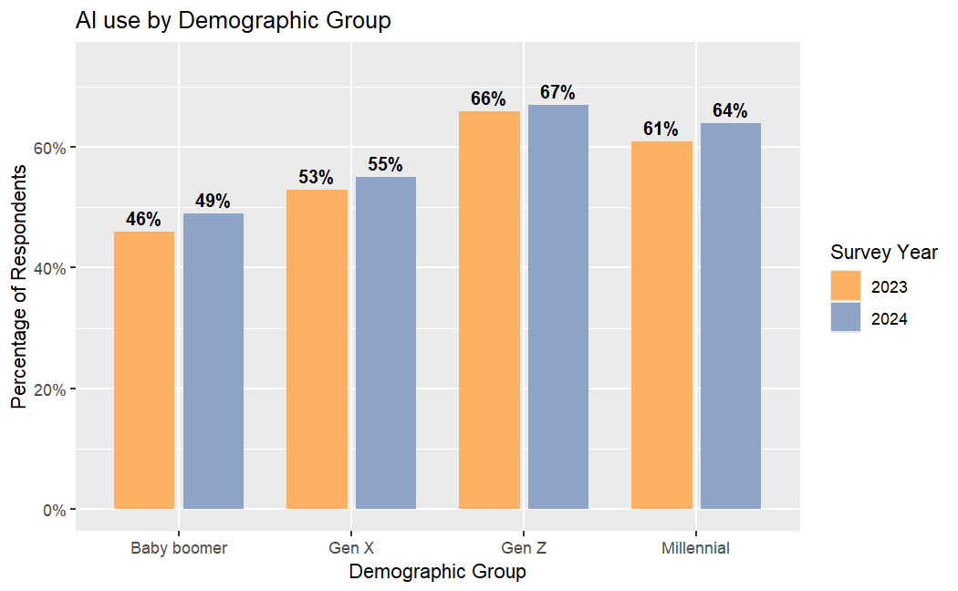
AI use by demographic
Unanimous Growth: AI usage increased across all four major demographic groups
Highest Adoption: Generation Z
Largest Adoption Shifts: Millennials and Baby Boomers
confirms AI's quick transition from a niche tool to a mainstream medium

Slide 8
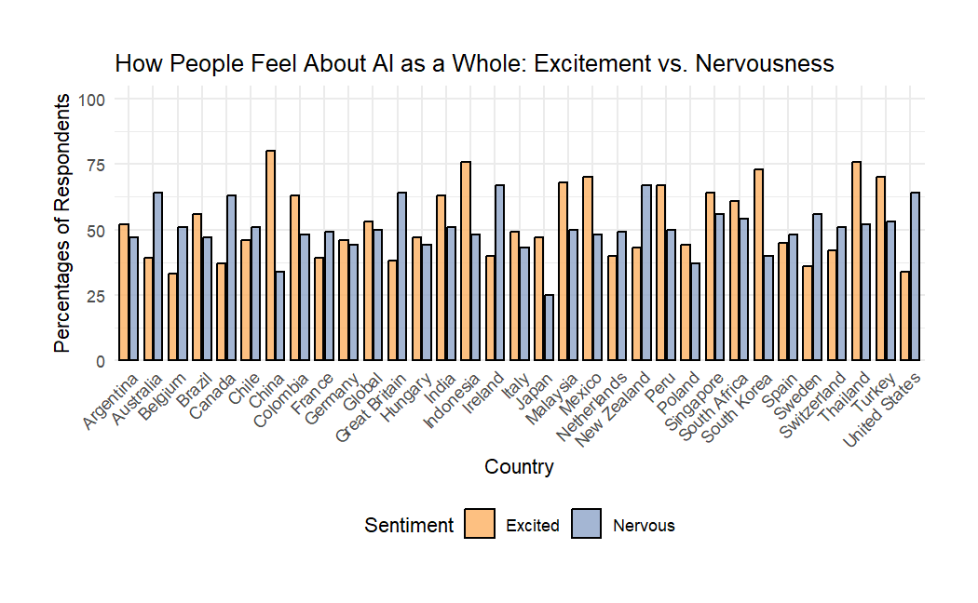

Global AI Sentiment: Excitement vs. Nervousness
Varying Global Response Policy driven excitement Hesitation among the west potentially due to misinformation Regulatory Clarity is essential

Slide 9
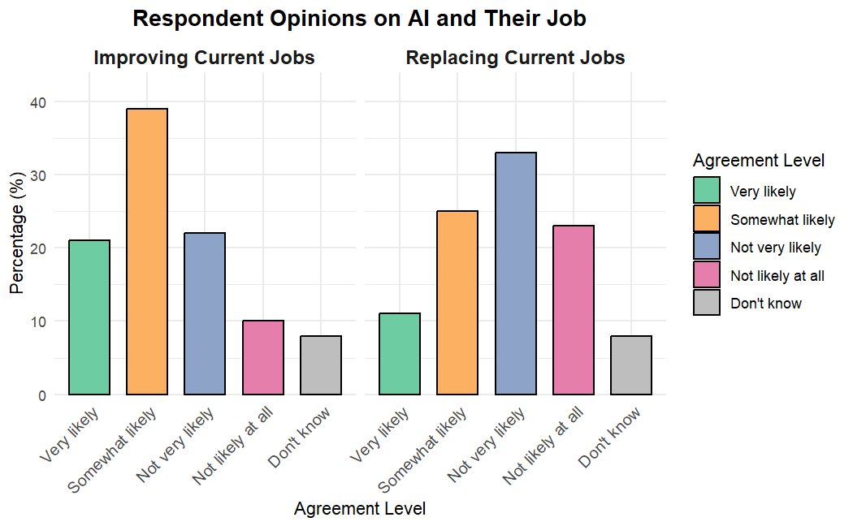
Respondent Opinions on AI and Their Job
60 % of the workforce has a strong optimism for improvement
Job security remains high at 58%
Pattern suggests that most respondents view AI as a valuable tool for job improvement, not job elimination

Slide 10
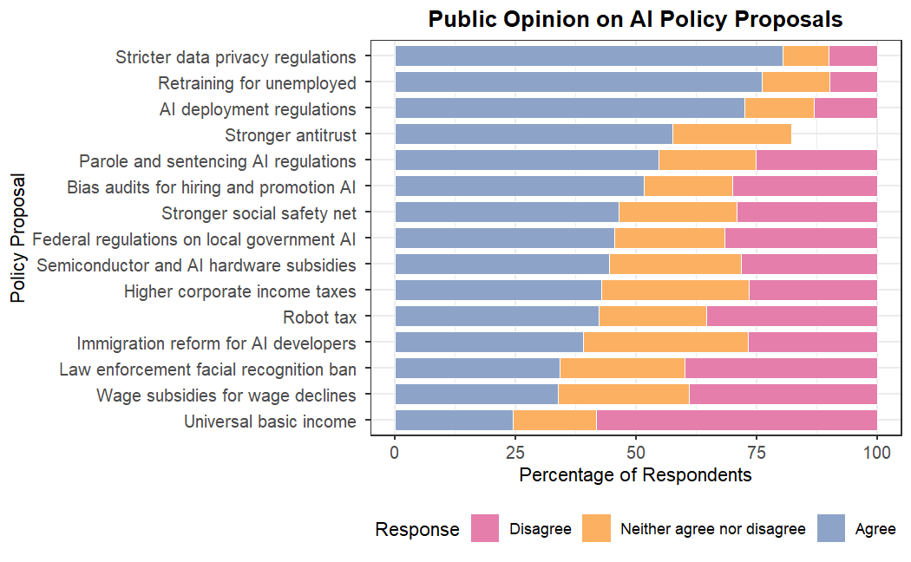
Policy Proposal Approval in the us

Slide 11

Results of the investigation

Slide 12
Key Conclusions
Public perception of AI's daily impact varies significantly across different countries.
The data reveals a strong public desire for establishing regulatory frameworks. This supports the conclusion that AI integration is widely accepted, provided clear regulations are set in place.

Slide 13
Potential solutions & Future Work
Solution 1: Use long-term models to correlate public perception data with policy proposals and ethical rulings, guiding the development of new regulations that ensure user protection and human control.
Solution 2: Propose systemic policy changes to foster critical thinking, such as a mandatory digital literacy curriculum and creating societal structures that incentivize human-only decision-making in critical fields like healthcare and law.

Slide 14

Questions?

Slide 15

Thank you for your time!

