Slide 1
QUACI-ACV
Dealing with uncertainties in comparative building life cycle assessment

Slide 2

Introduction

Slide 3
Context
.
The building and construction sectors account for 40% of global energy consumption anad greenhouse gas emissions.
These sectors also contribute to resource depletion, waste production , and pollution.

Slide 4
Objective
.
To propose a methodology for addressing uncertainties in Comparative Life Cycle Assessment (CompLCA) of building design alternatives.
To strengthen in LCA can significantly affect results, especially in early design phases and comparative studies.

Slide 5
CompLCA
.
To ensure robustness and reliability when comparing building design alternatives.
To highlight trade-offs between alternatives and support decision-making.

Slide 6

Uncertainties in LCA

Slide 7
Definition
Uncertainty: Lack of knowledge about the true value of a quantity.
Variability: Natural stochastic variation of quantity.

Slide 8
Sources
Model Uncertainty: Inaccuracies in the LCA model.
Variability: Variability in input data (e.g., material properties, energy use).
Scenario Uncertainty: Assumptions made during the study (e.g., allocation rules, functional unit).

Slide 9
Impact
LCA results can vary significantly based on assumptions and input data.
Less than 20% of LCA studies quantify uncertainties, leading to potential misinterpretation of results.

Slide 10

Uncertainty and Sensitivity Analysis

Slide 11
UA&SA
<UA>Uncertainty Analysis:
Quantifies the propagation of uncertainties from input to output.
Common method: Monte Carlo (MC) simulation
<SA> Sentivity Analysis:
Identifies the most influential uncertain factors.
Helps prioritize which parameters need refinement.

Slide 12
CompLCA
LCA results can vary significantly based on assumptions and input data.
Less than 20% of LCA studies quantify uncertainties, leading to potential misinterpretation of results.

Slide 13

Perform LCA with UA&SA

Slide 14
Selection of Alternatives and LCA Model
Define the building design alternatives to compare.
Establish the LCA model with a consistent functional unit.
{GWP:Global Warming Potential , …}
Integrate dynamic building energy simulation (DBES) to account for temporal variations in energy use and impacts

Slide 15
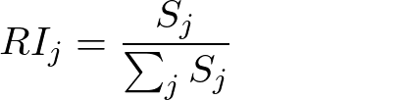
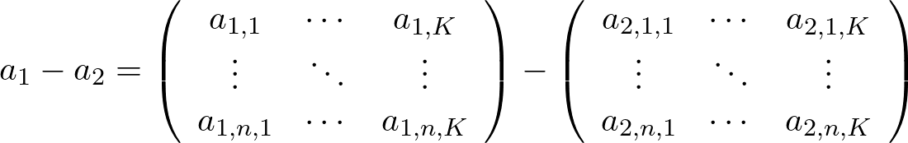
Sensitivity Analysis(SA)
MA-Morris method.
Dependent sampling.
Sensitivity indices.

Slide 16
Uncertainty Analysis (UA)
Perform UA using dependant sampling and Monte Carlo simulations.
Use metrics {DA/ RP/ MQ/ SMD/ DRD/ SMD/ DRD/ HSM} for Comparison.
Visualize using probability density functions(PDFs), boxplots, violin plots, Heatmaps.

Slide 17
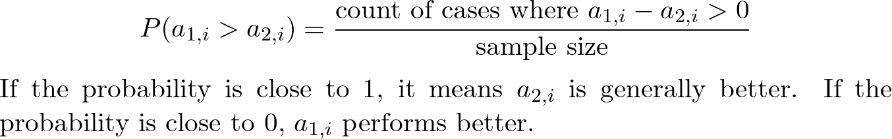
Uncertainty Analysis (UA)
DA:Discernibility analysis
RP: Probability of occurrence of rankings
MQ: Computation of means and quantiles
<means | Medians | Quantiles>

Slide 18
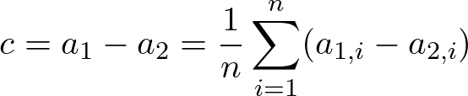

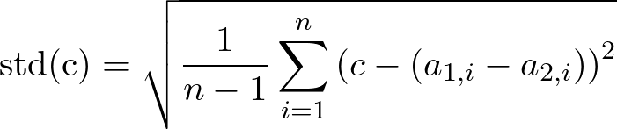
Uncertainty Analysis (UA)
SMD:Standardised mean difference: {small d -> similar products}

Slide 19

Uncertainty Analysis (UA)
DRD:The distribution of the relative differences
Dimensionless Series of Values.
Boxplot.
How often one alternative performs better.

Slide 20
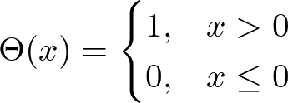
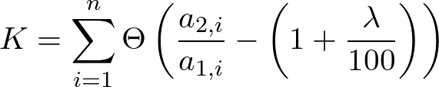
Uncertainty Analysis (UA)
HSM:Heijungs significance metric K4

