Slide 1
FEATURE EXTRACTION FROM SKETCH BASED IMAGES
Bachelor Thesis 2023
Presented by : Yahya Ramzy Akel

Slide 2




Motivation
Helps artists and designers find related sketches or images based on their own sketches.
Enables designers to explore different variations and interpretations of their design.
Allows students to learn about different design styles and techniques by searching for related sketches and images.
Sketch-based images are important in the design process, but extracting features from them is challenging. WHY?

Slide 3
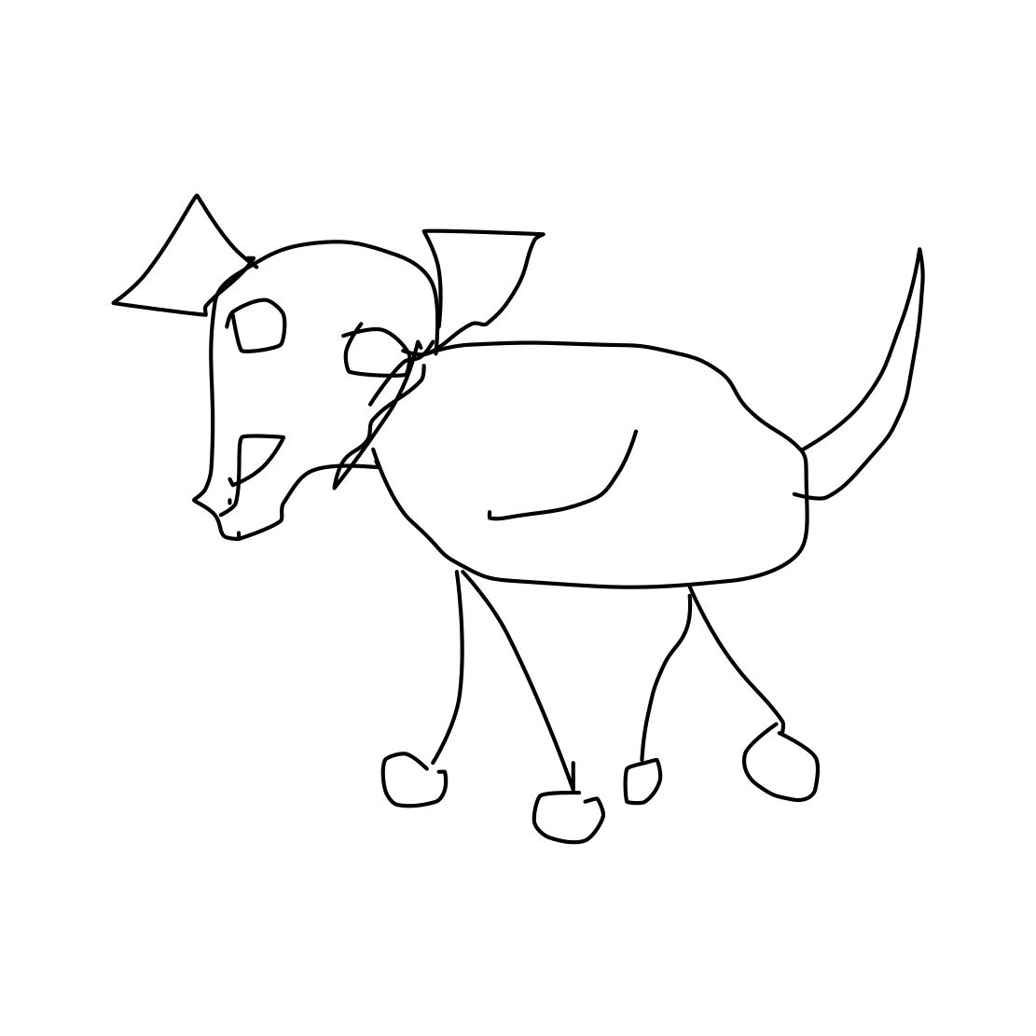
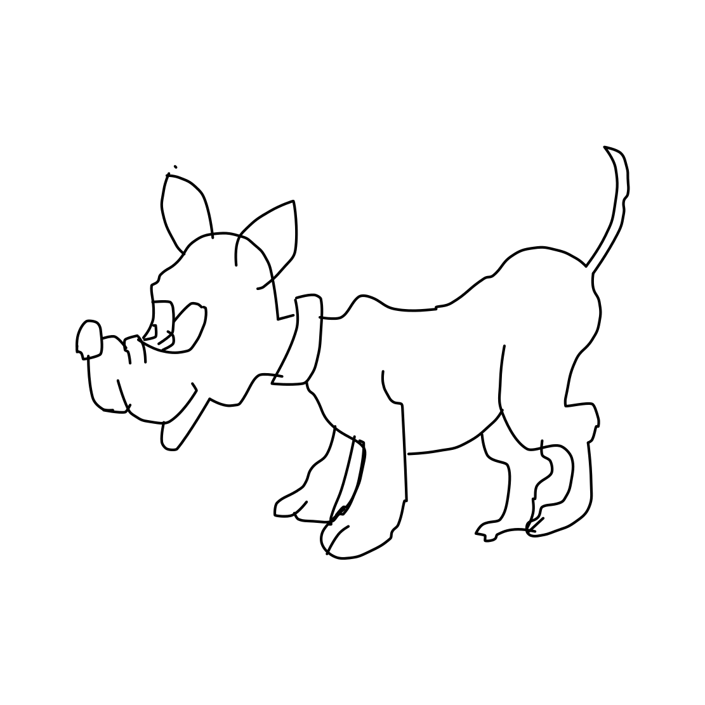
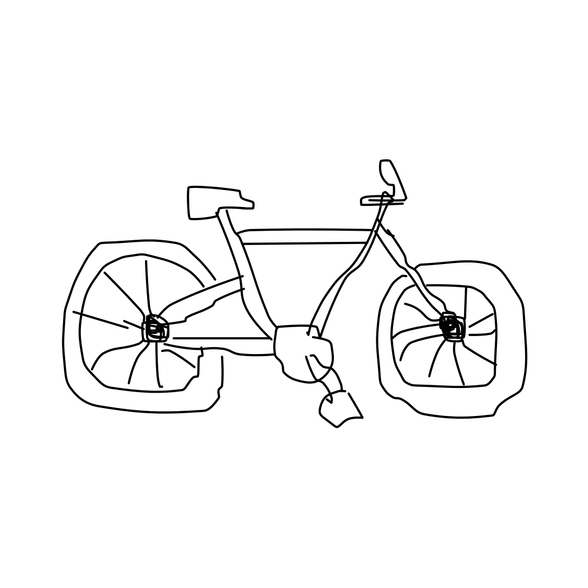
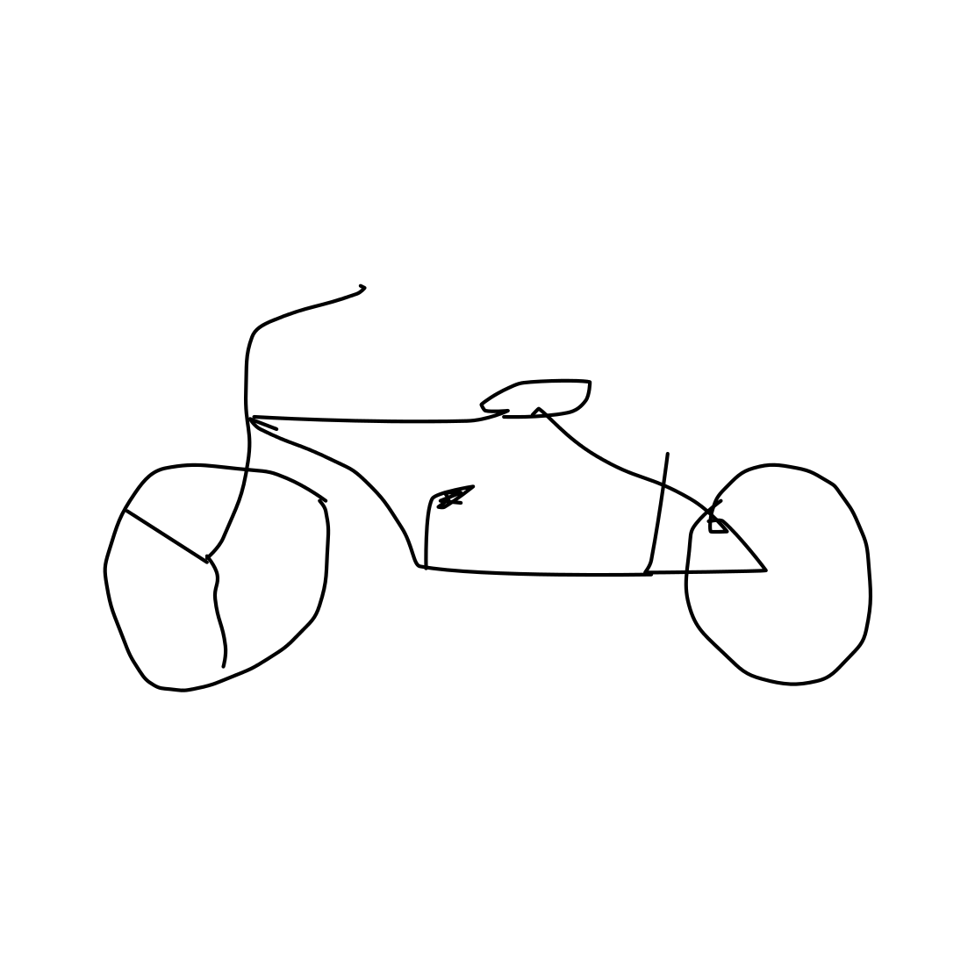
Why is it Challenging?
They don't have clear lines and textures.
They can be complex and different from one another.
Dog Sketches
Bicycle Sketches

Slide 4
Objectives

Slide 5
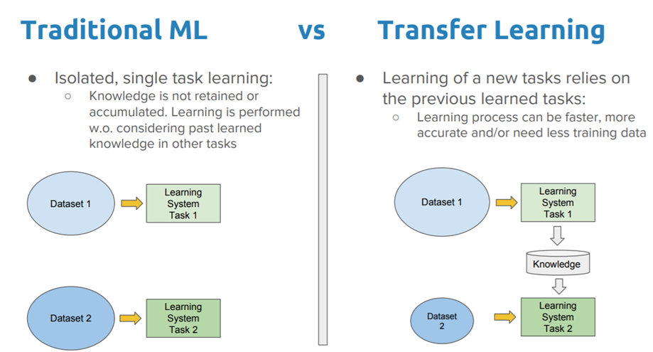
Traditional ML vs Transfer Learning
a

Slide 6
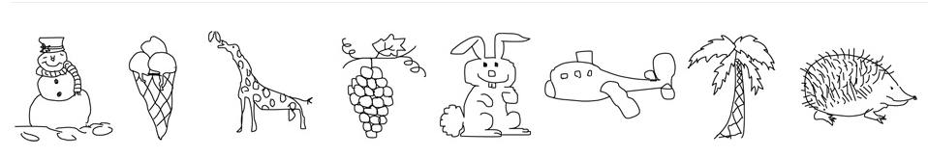
TU-Berlin Sketch Dataset
Tu Berlin Sketch Dataset

Slide 7
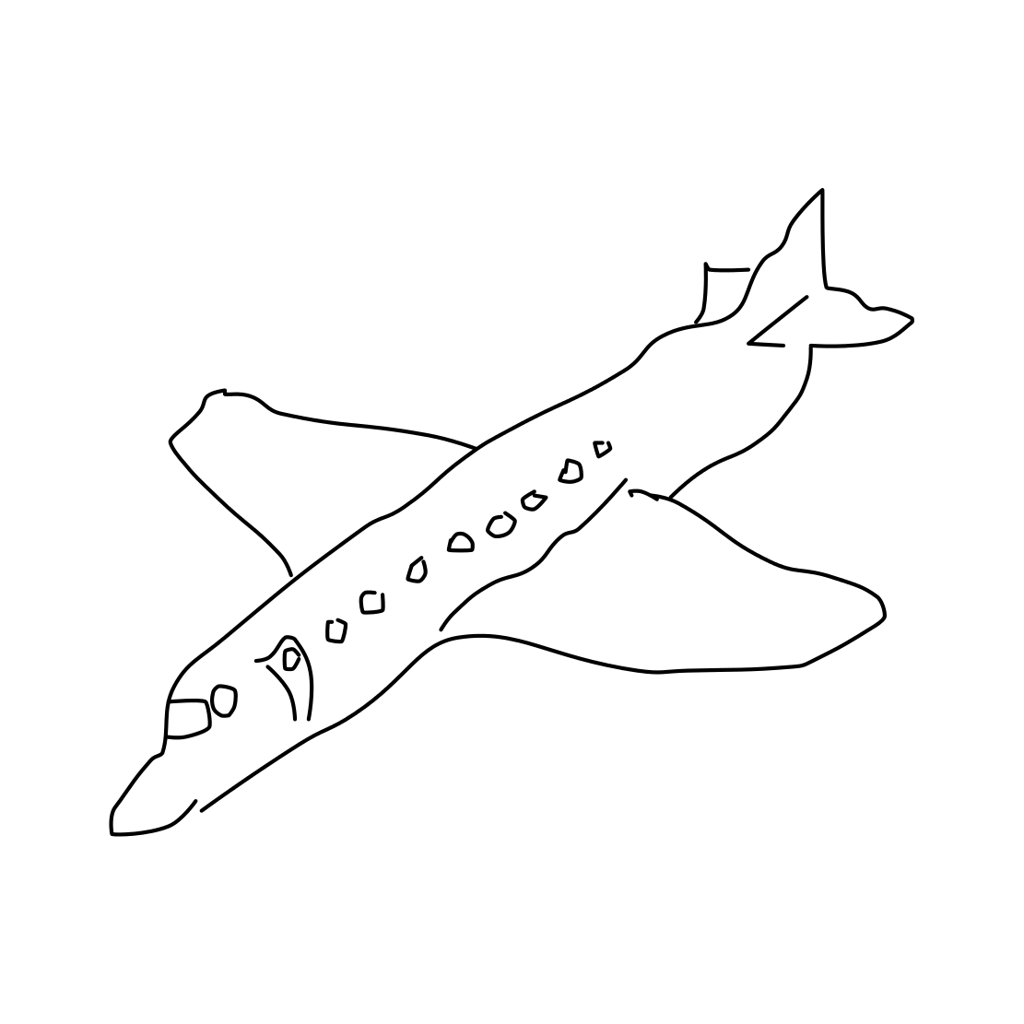
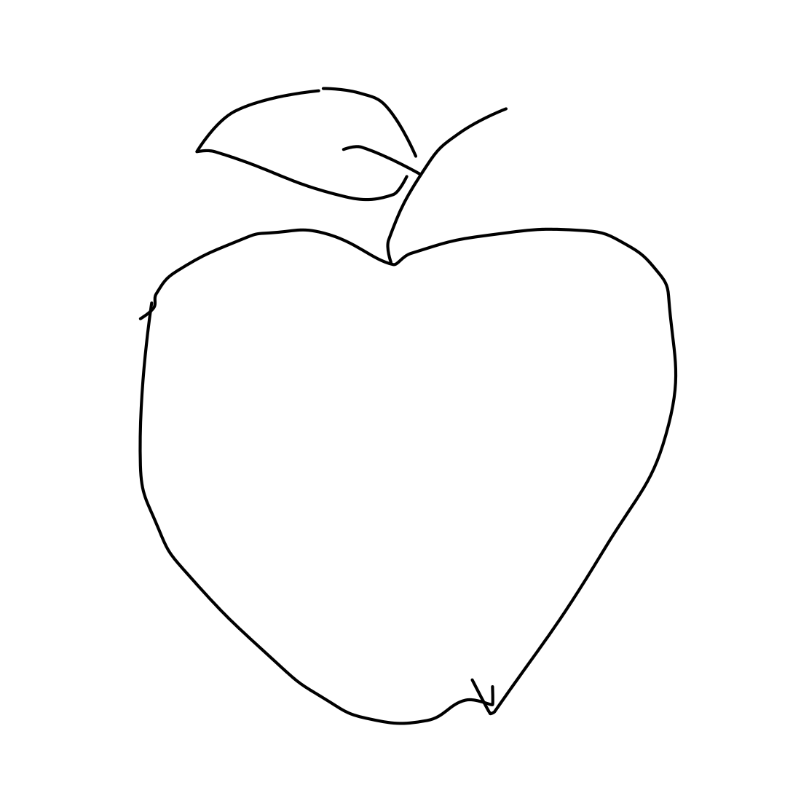
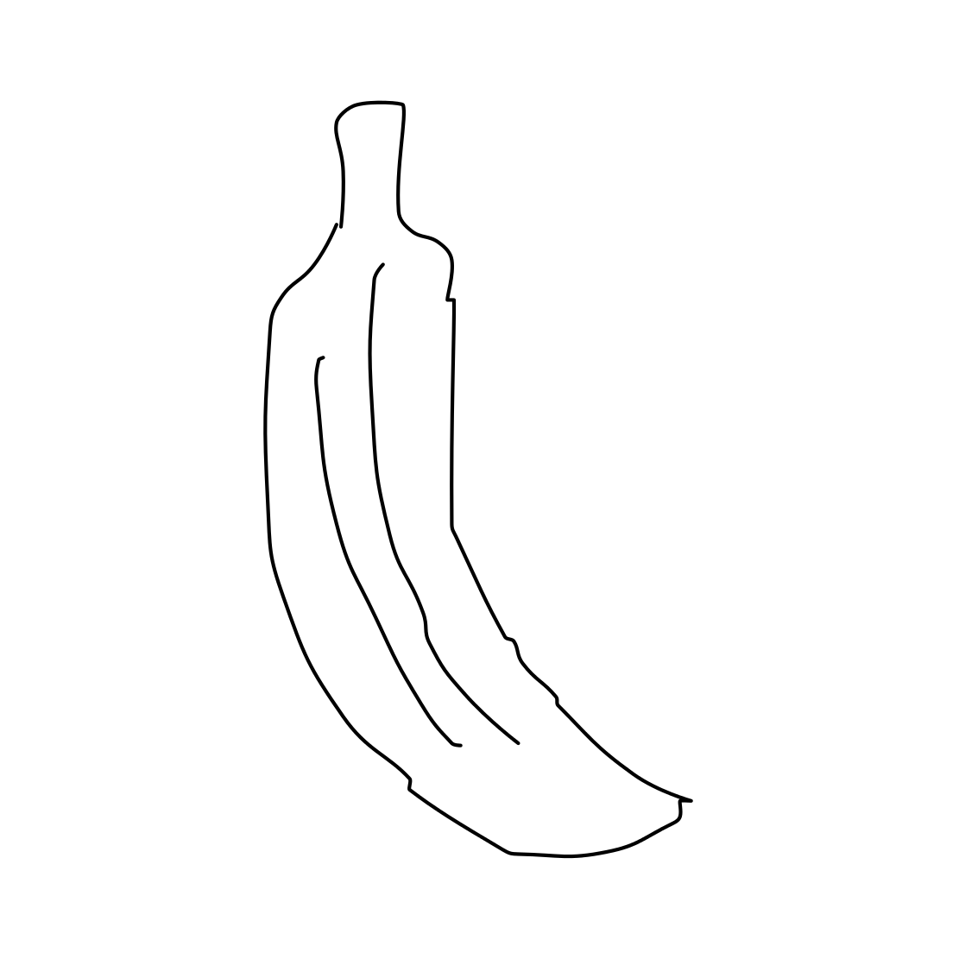
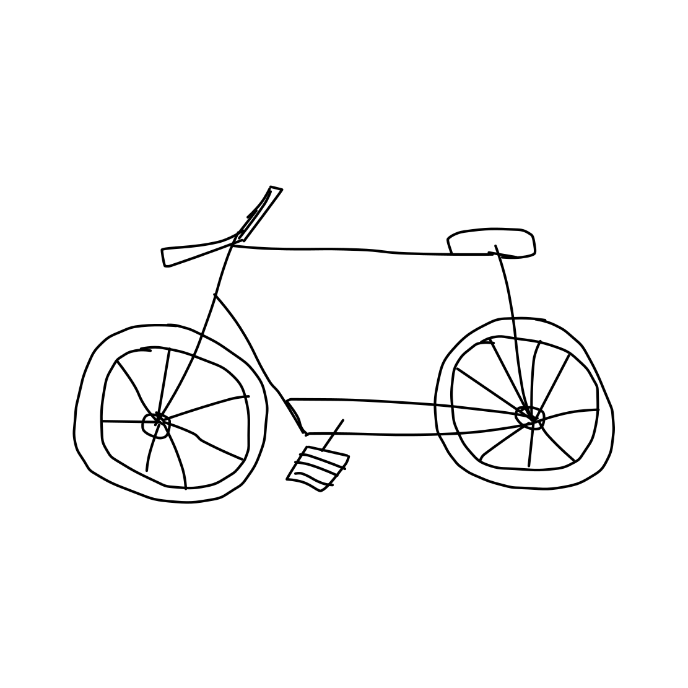
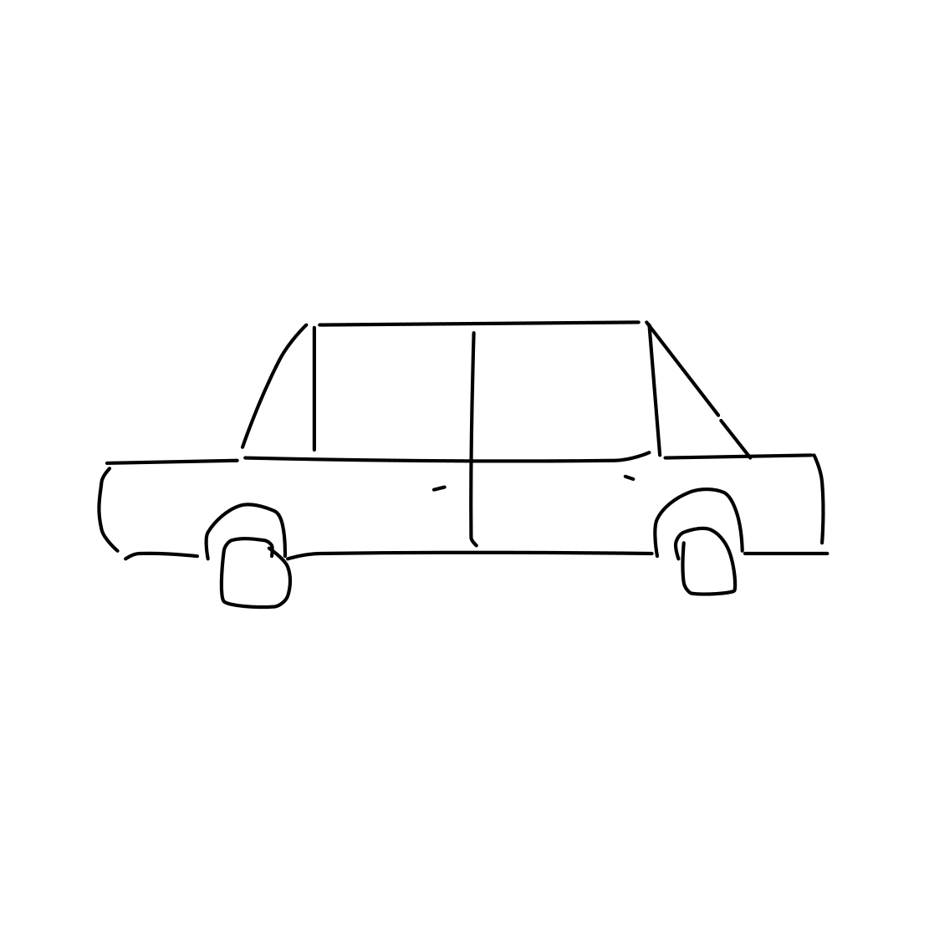
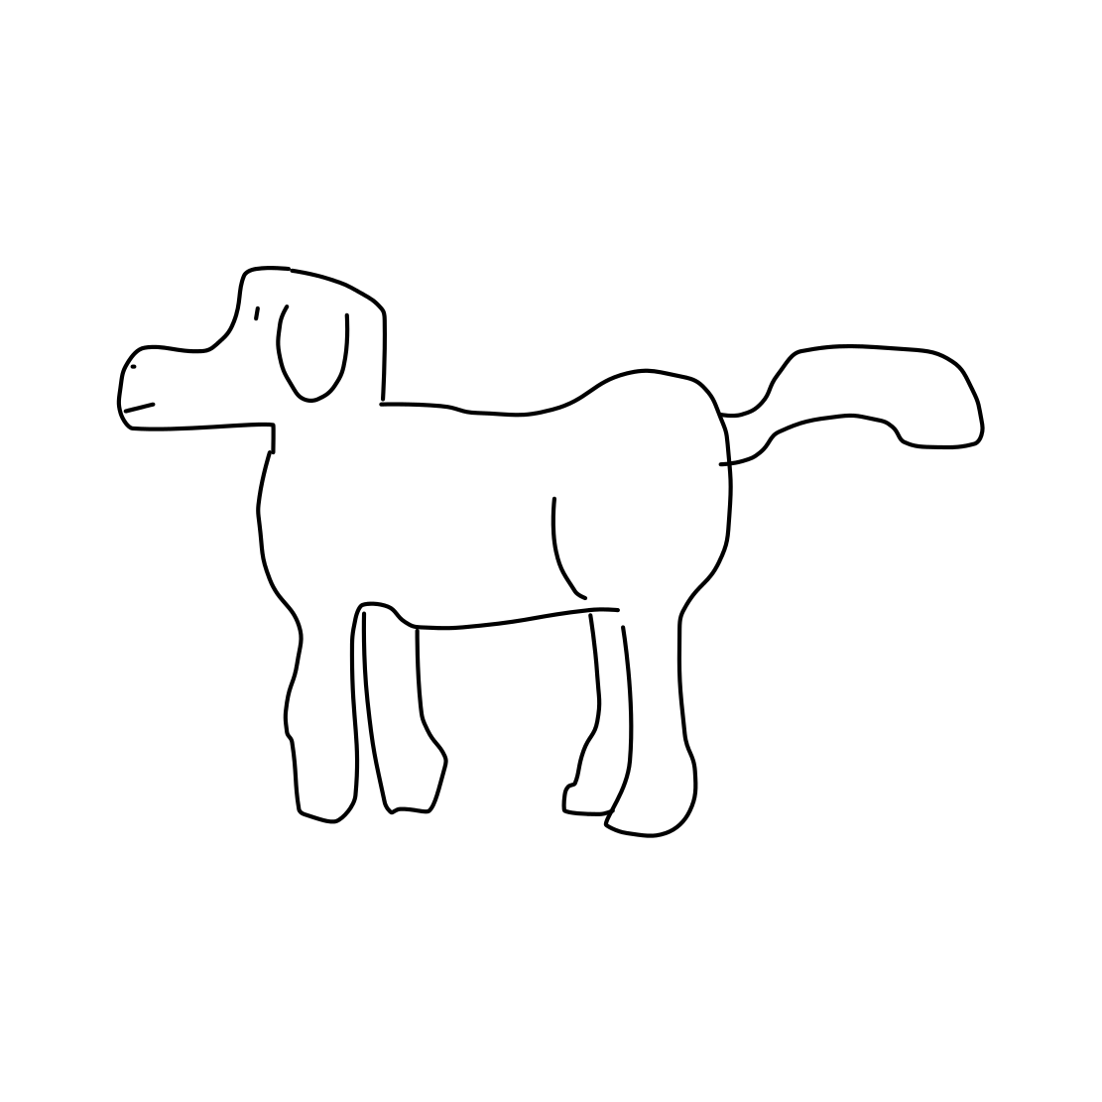
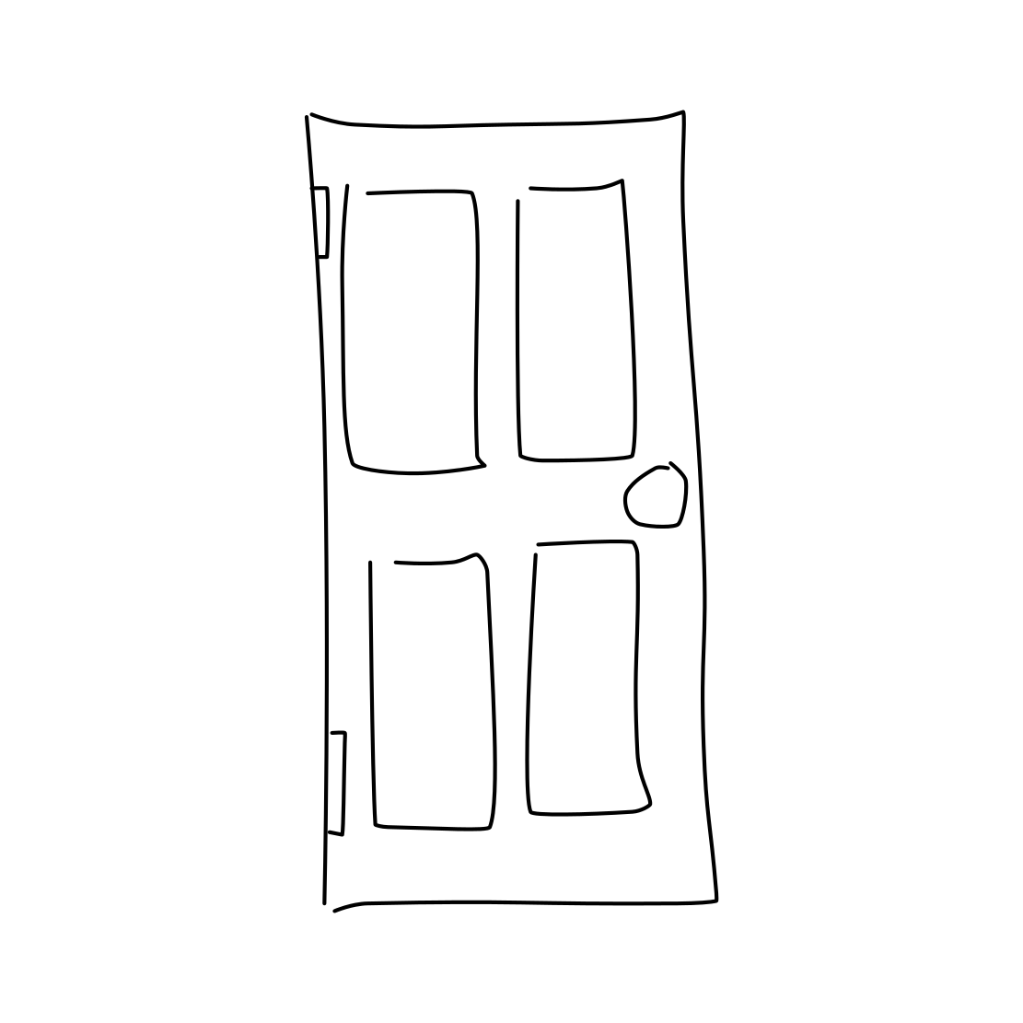
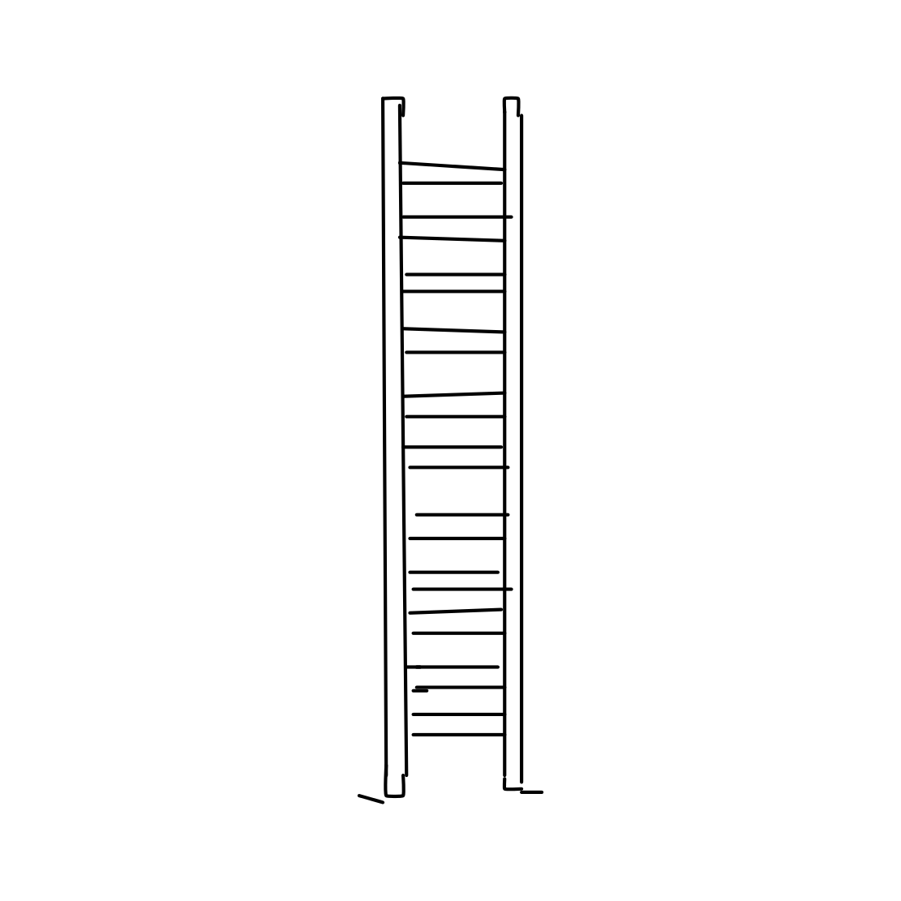
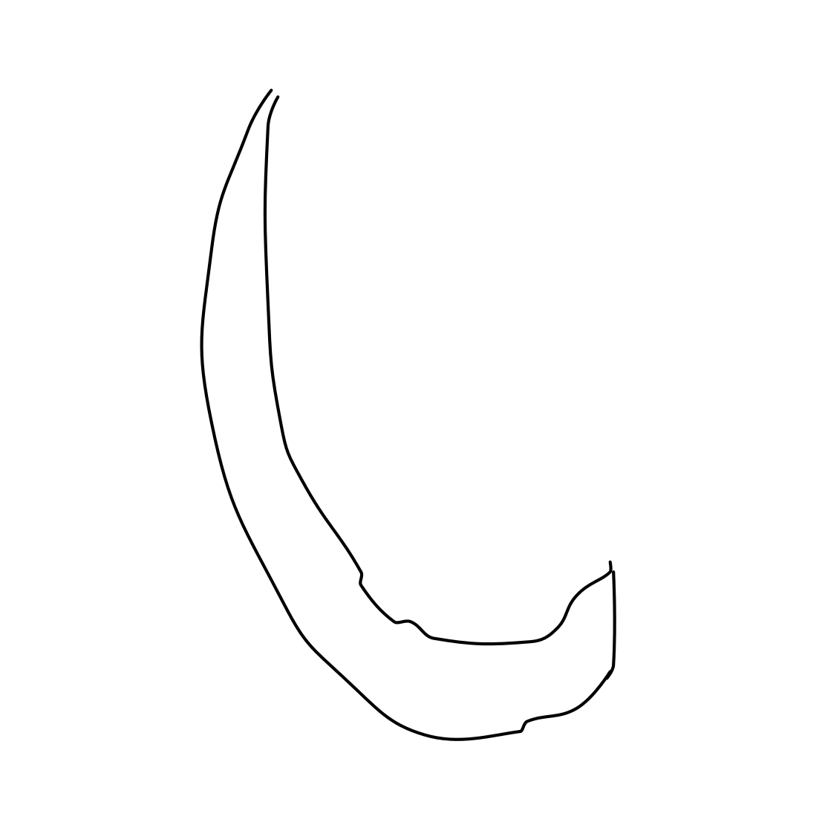
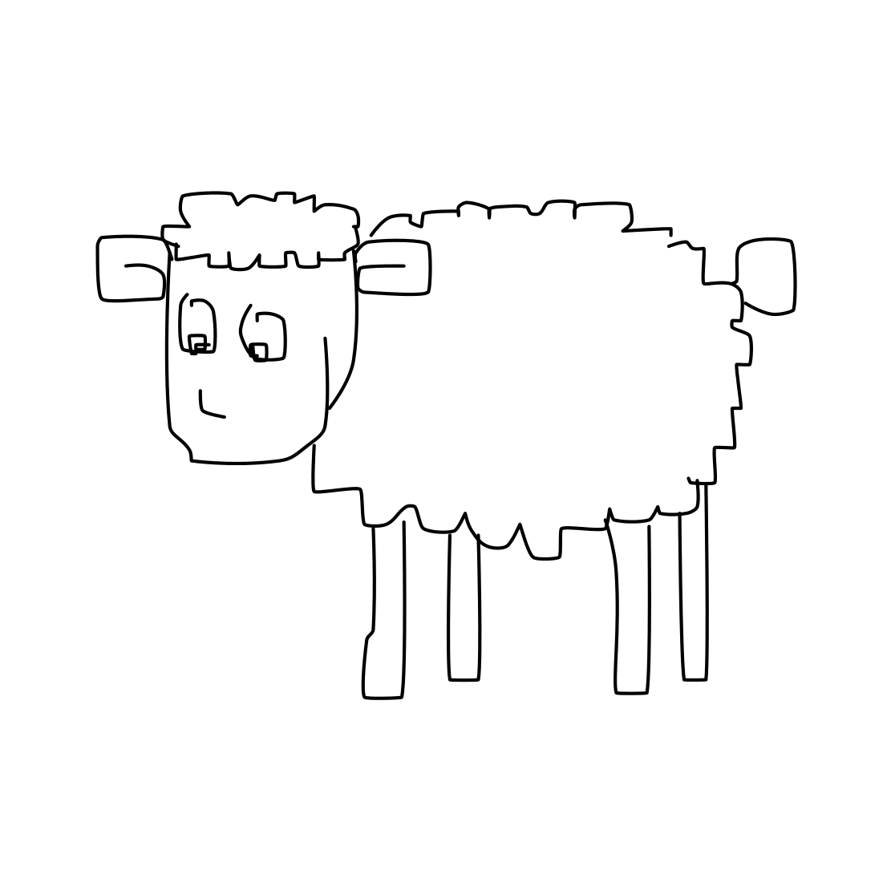
Categories
Airplane
Apple
Banana
Bicycle
Car
Dog
Door
Ladder
Moon
Sheep

Slide 8
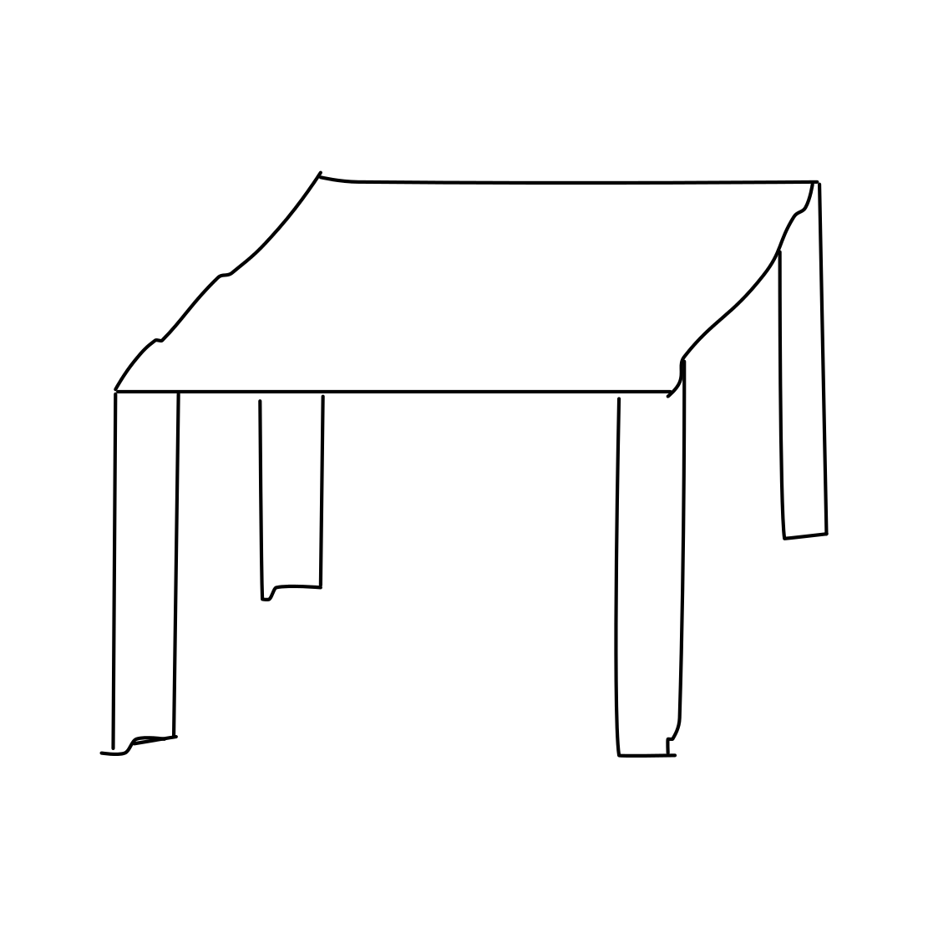
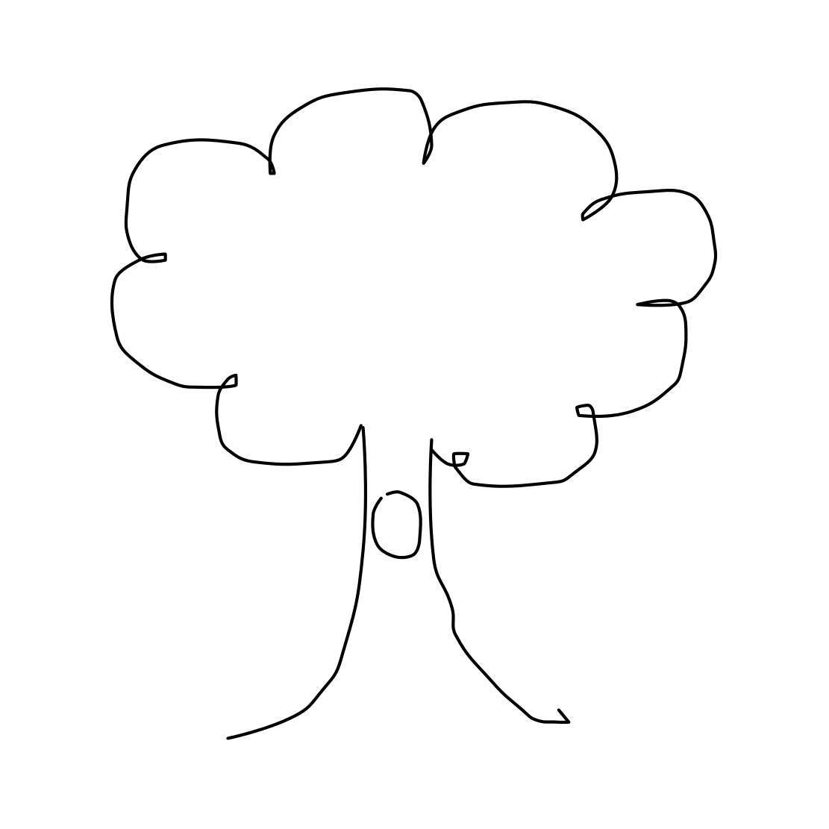
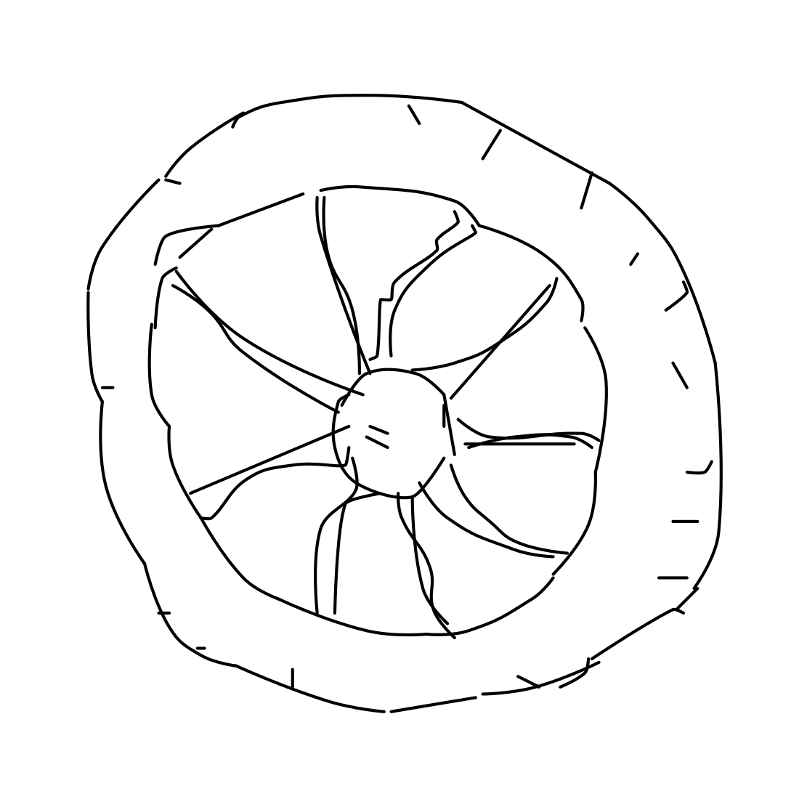
Categories Cont.
Table
Tree
Wheel

Slide 9
Transfer Learning Approach

Slide 10
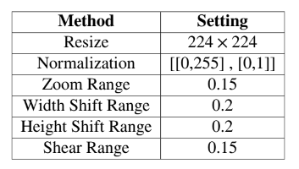
VGG-16 : Data Preprocessing

Slide 11
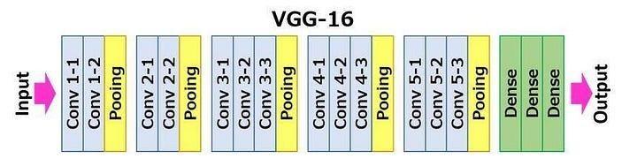
VGG-16 : Architecture

Slide 12


VGG-16 : Transfer Learning
Before applying Transfer Learning
After applying Transfer Learning

Slide 13
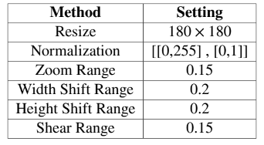
ResNet-50 : Data Preprocessing

Slide 14
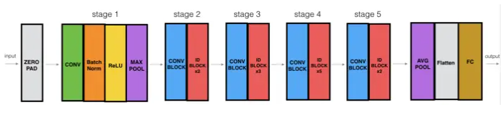
ResNet-50 : Architecture

Slide 15
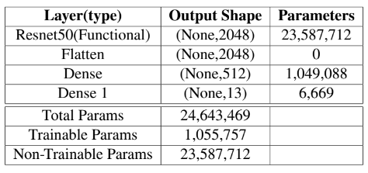
ResNet-50 : Transfer Learning
After applying transfer learning to resnet50

Slide 16
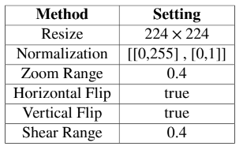
InceptionV3 : Data Preprocessing

Slide 17
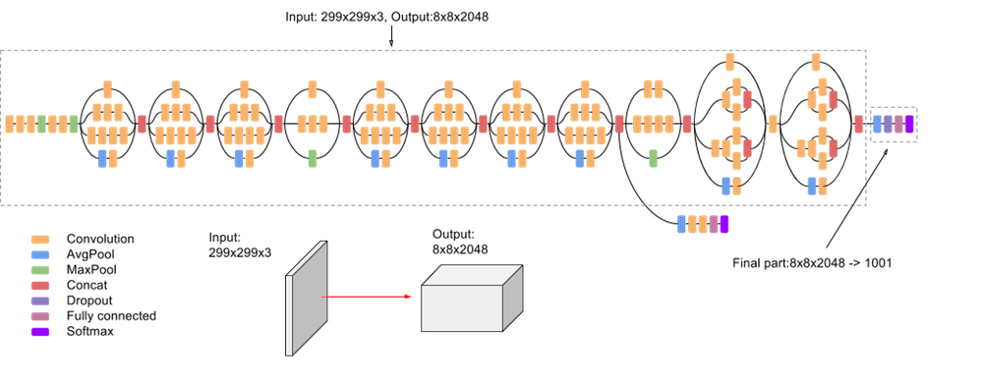
InceptionV3 : Architecture

Slide 18
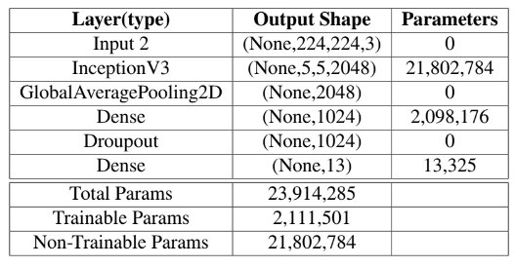
InceptionV3 : Transfer Learning
After applying transfer learning

Slide 19
Traditional Machine Learning
Approach

Slide 20
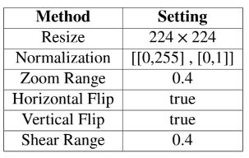
CNN : Data Preprocessing

Slide 21
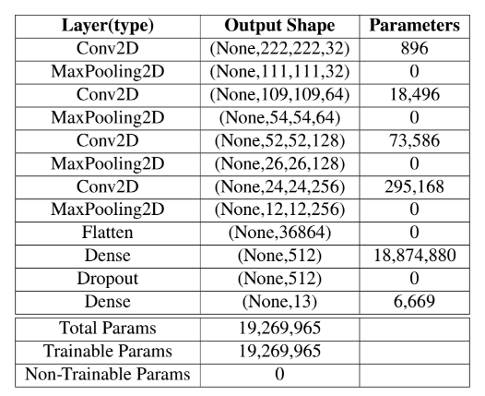
CNN : Architecture

Slide 22
Results

Slide 23
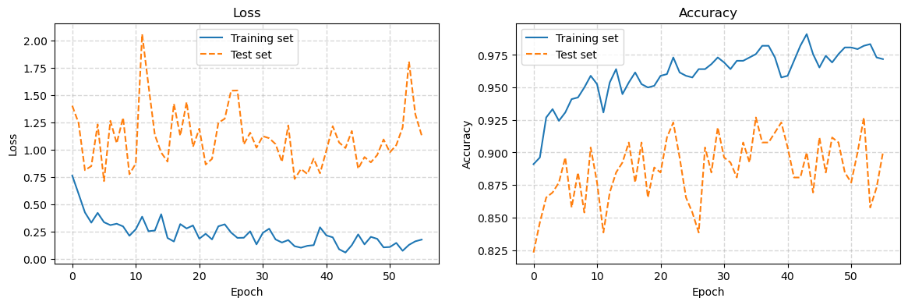
VGG-16 Results
Accuracy and Loss Graphs for VGG-16

Slide 24
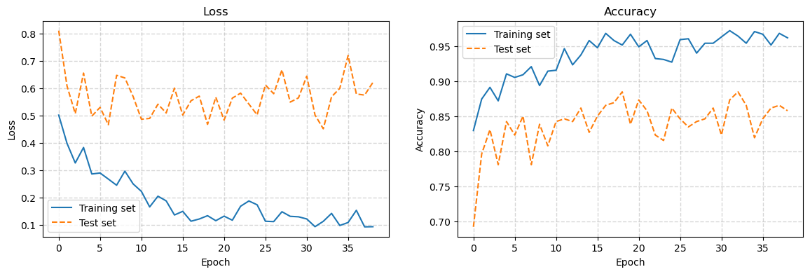
ResNet-50 : Results
Accuracy and Loss graphs for ResNet-50

Slide 25
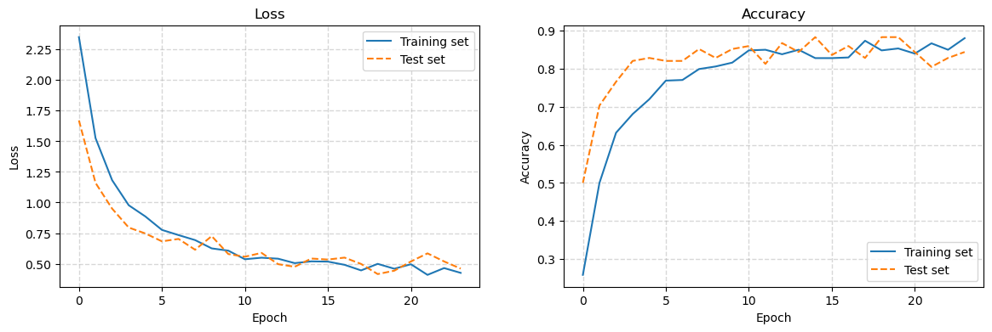
InceptionV3 : Results
Accuracy and Loss graphs for InceptionV3

Slide 26
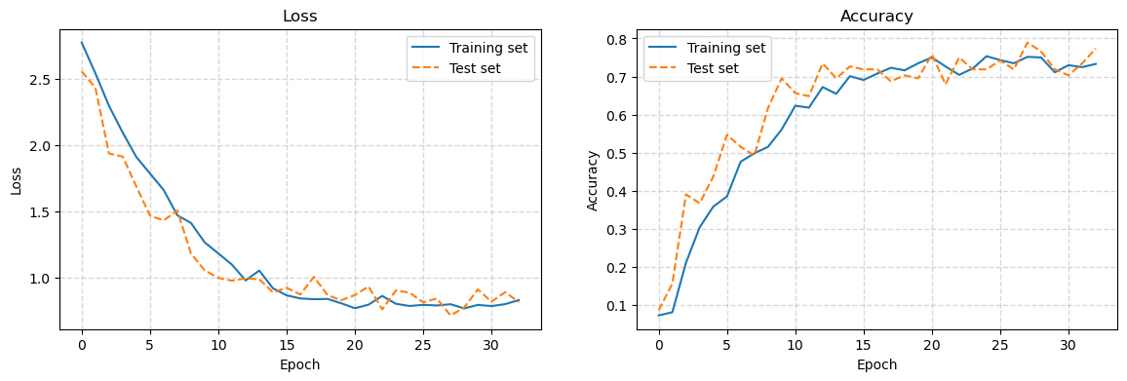
CNN : Results
Accuracy and Loss graphs for CNN

Slide 27
Testing

Slide 28

Demo for Ladder Sketch (InceptionV3 Model)

Slide 29
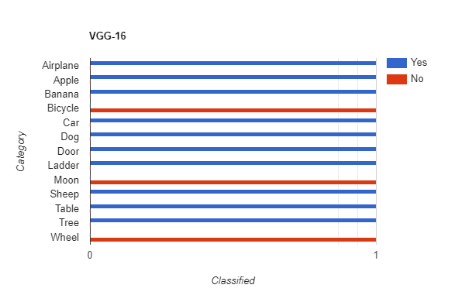
VGG-16 Testing Results

Slide 30
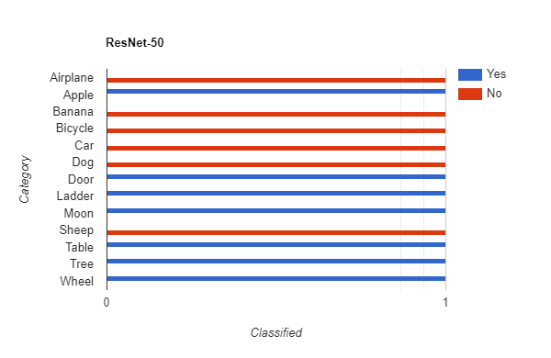
ResNet-50 Testing Results

Slide 31
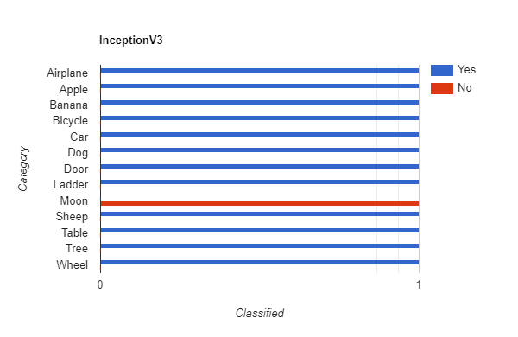
InceptionV3 Testing Results

Slide 32
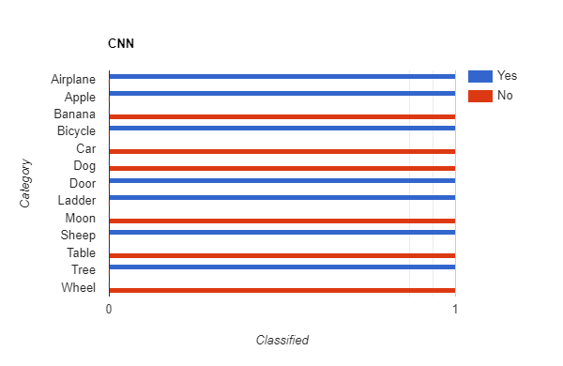
CNN Testing Results

Slide 33
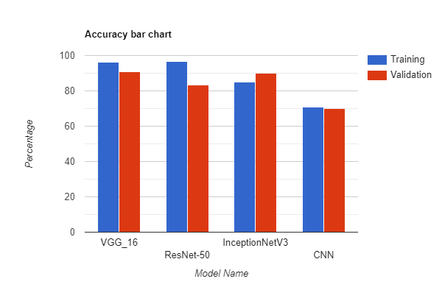

Slide 34
Transfer Learning
Traditional Machine Learning
VGG-16
ResNet-50
InceptionV3
CNN

Slide 35
Remaining Work
Abstract
Conclusion
Future Work
Graphical Abstract

