Slide 1

FEATURE EXTRACTION FOR SKETCH BASED IMAGE RETRIEVAL
Faculty Of MET
Bachelor Thesis 2023
By : Yahya Ramzy Akel
Supervised By : Ahmed Abdelfatah

Slide 2




MOTIVATION
Helps artists and designers find related sketches or images based on their own sketches.
Enables designers to explore different variations and interpretations of their design.
Allows students to learn about different design styles and techniques by searching for related sketches and images.
Sketch-based images are important in the design process, but extracting features from them is challenging. WHY?

Slide 3
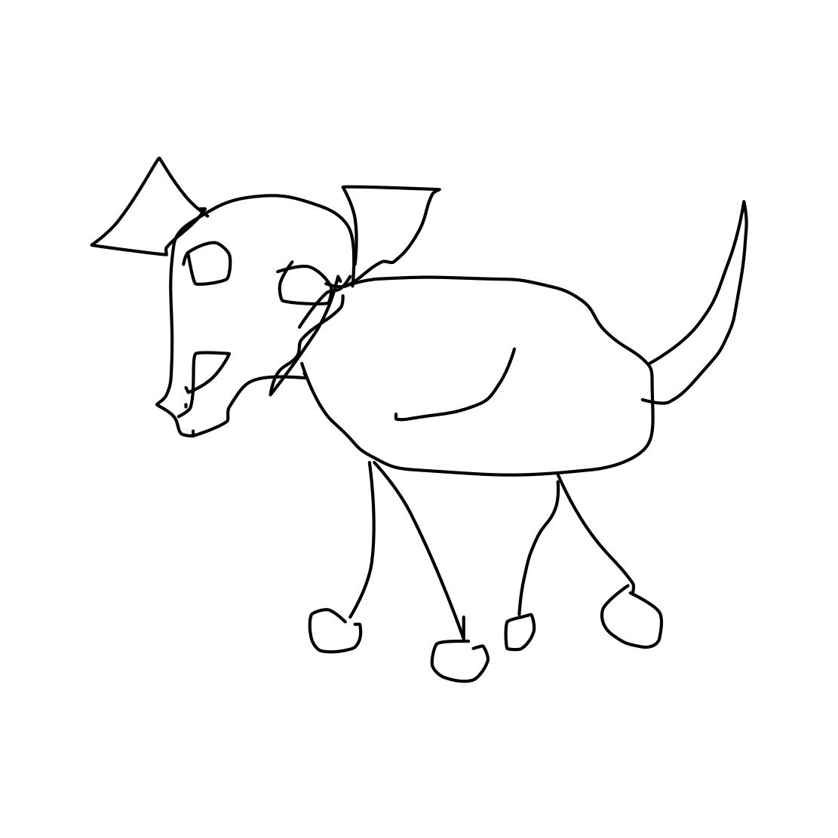
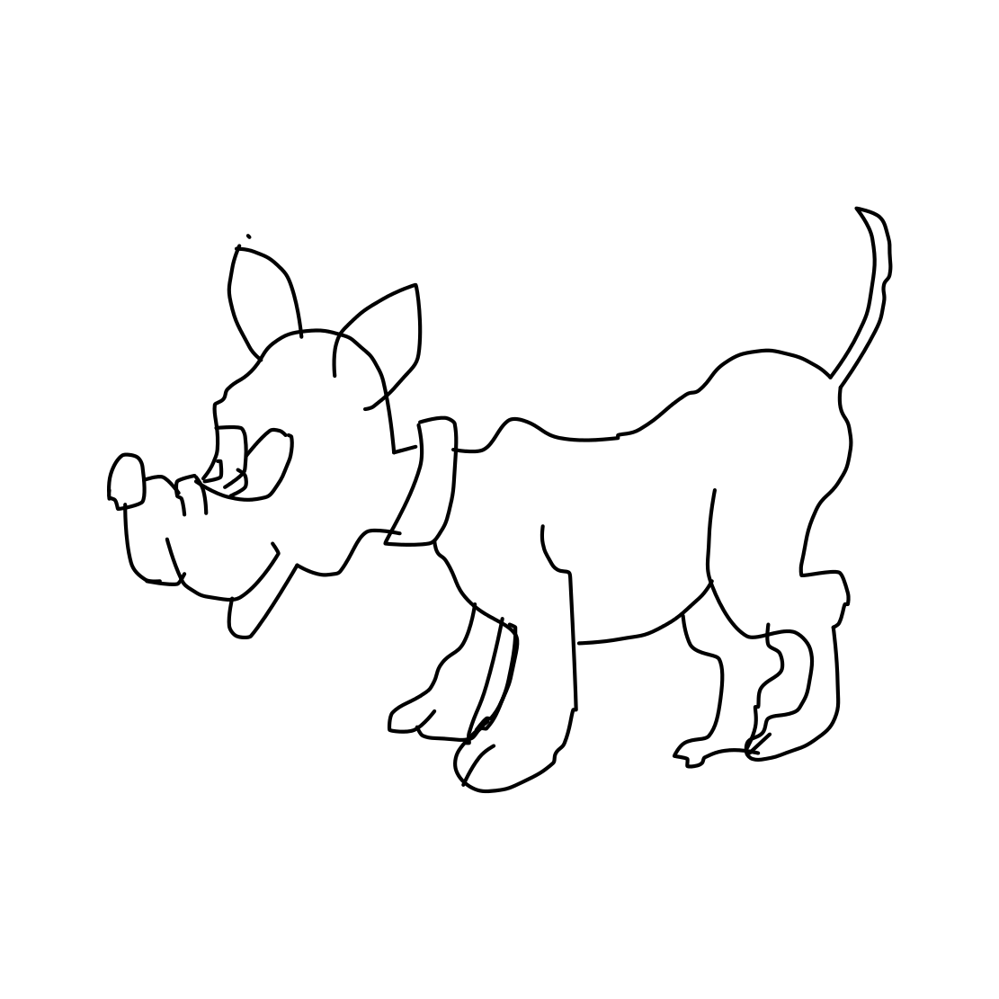
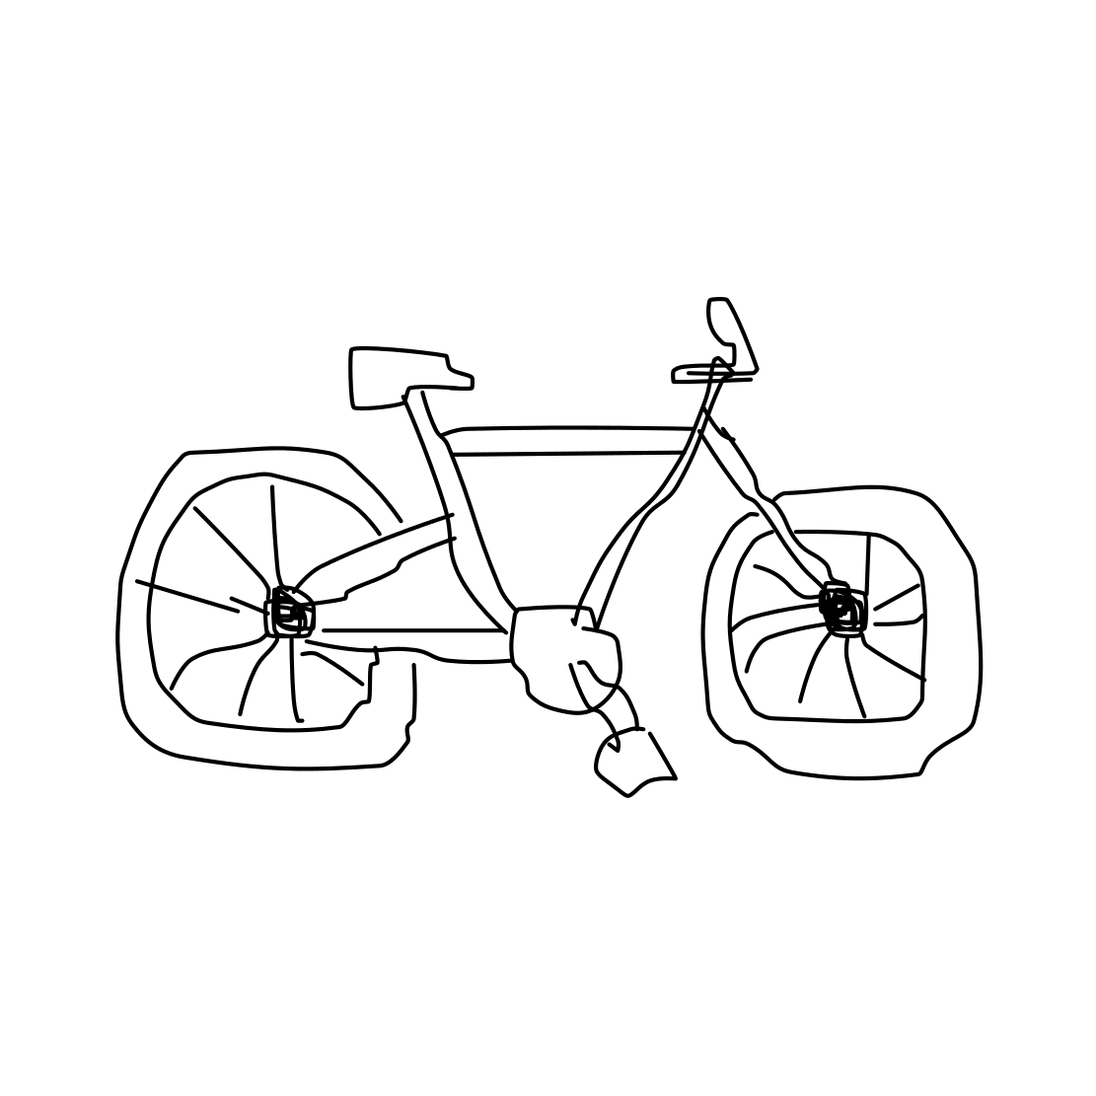
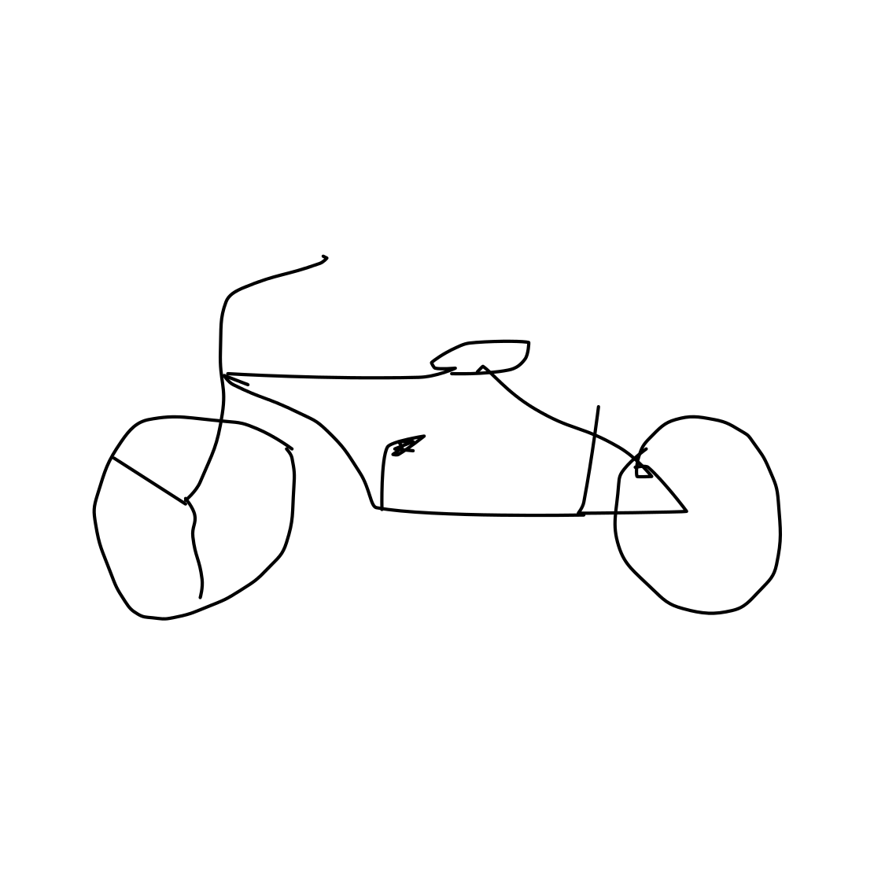
Why is it Challenging?
They don't have clear lines and textures.
They can be complex and different from one another.
Dog Sketches
Bicycle Sketches

Slide 4
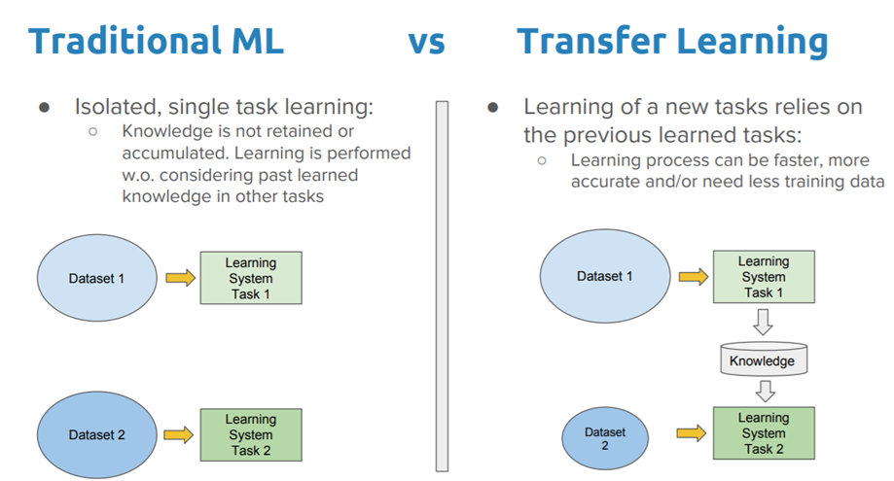
Traditional ML vs Transfer Learning
a

Slide 5
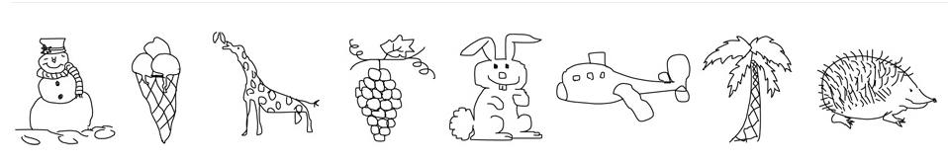
TU-Berlin Sketch Dataset
Tu Berlin Sketch Dataset

Slide 6

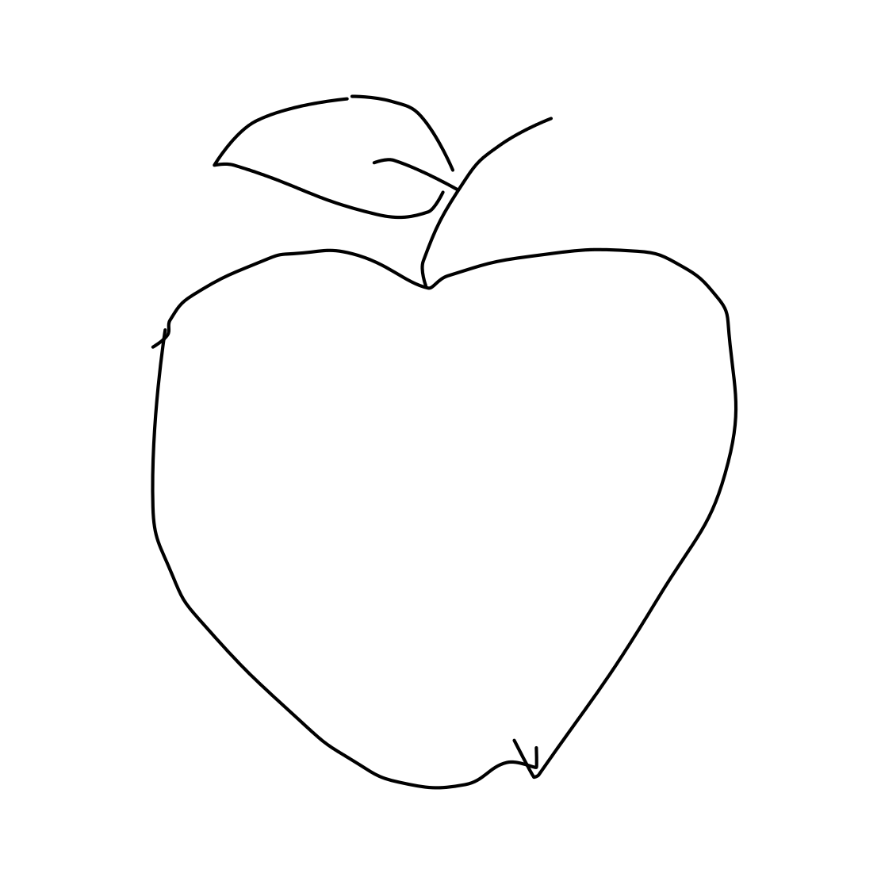
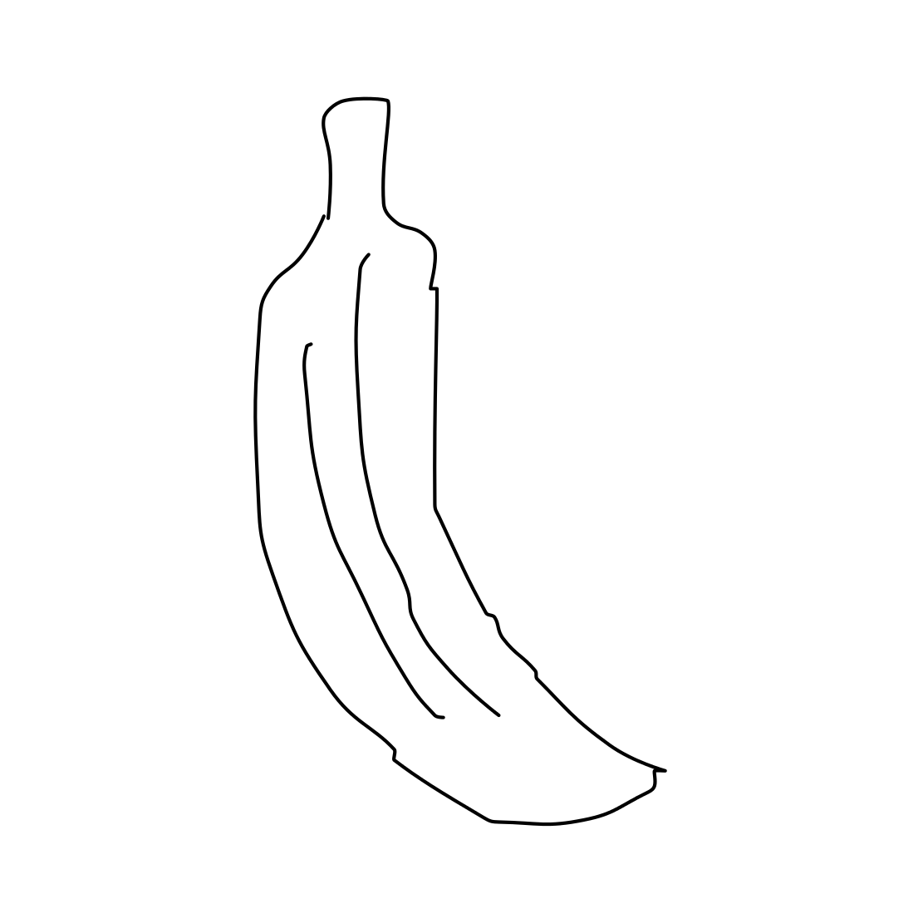
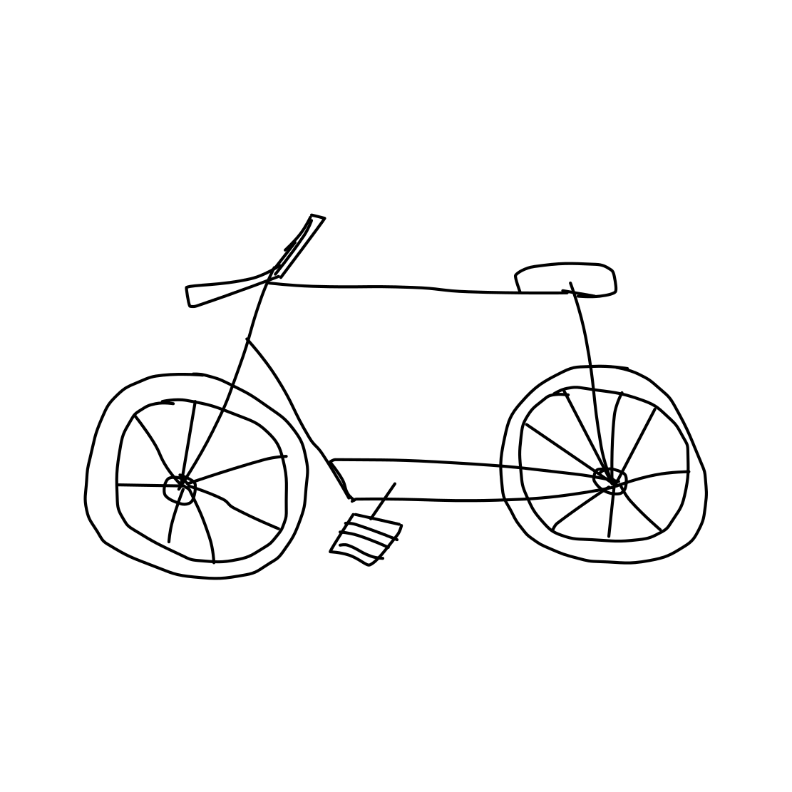
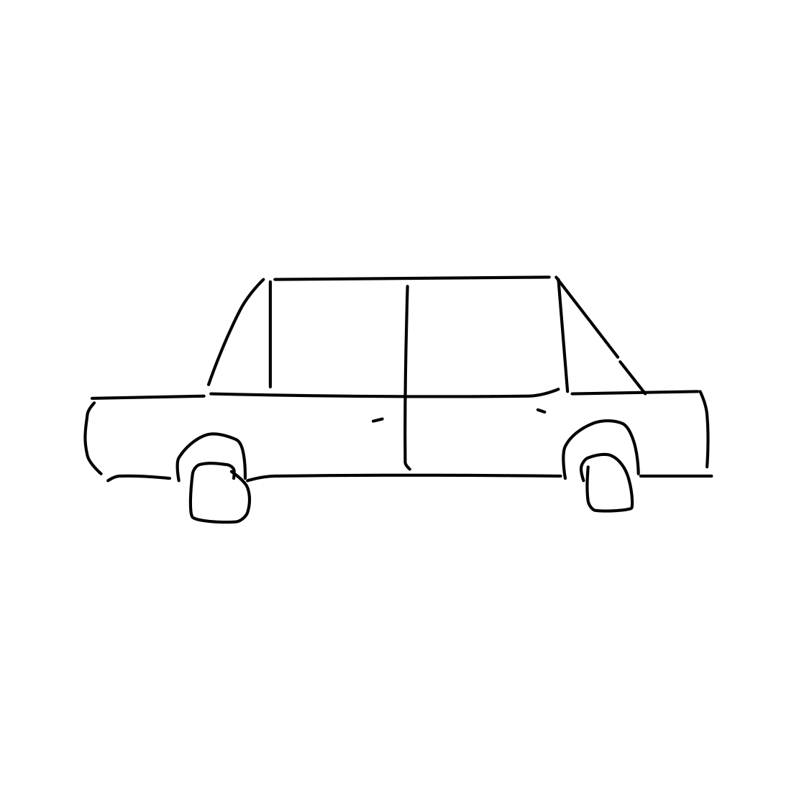
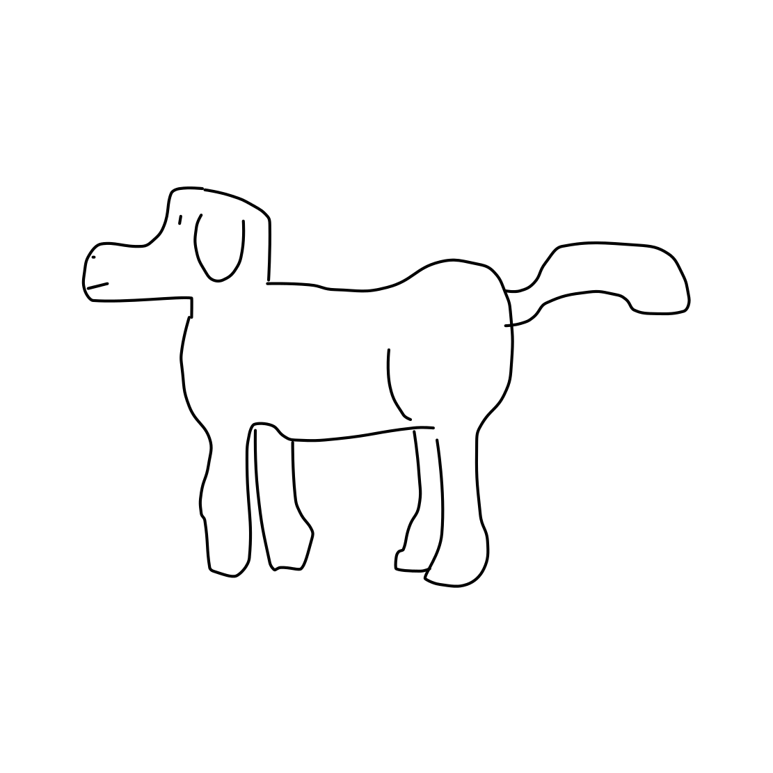
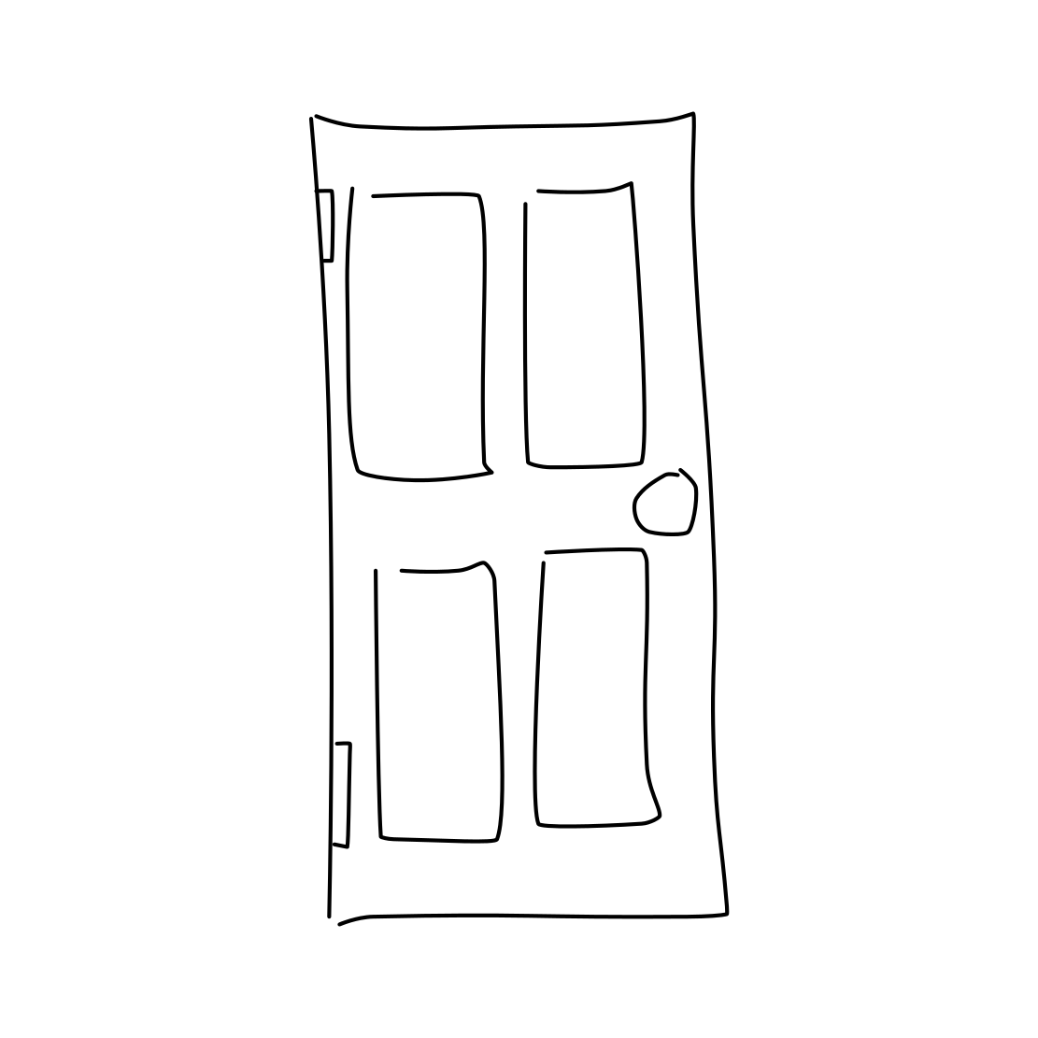
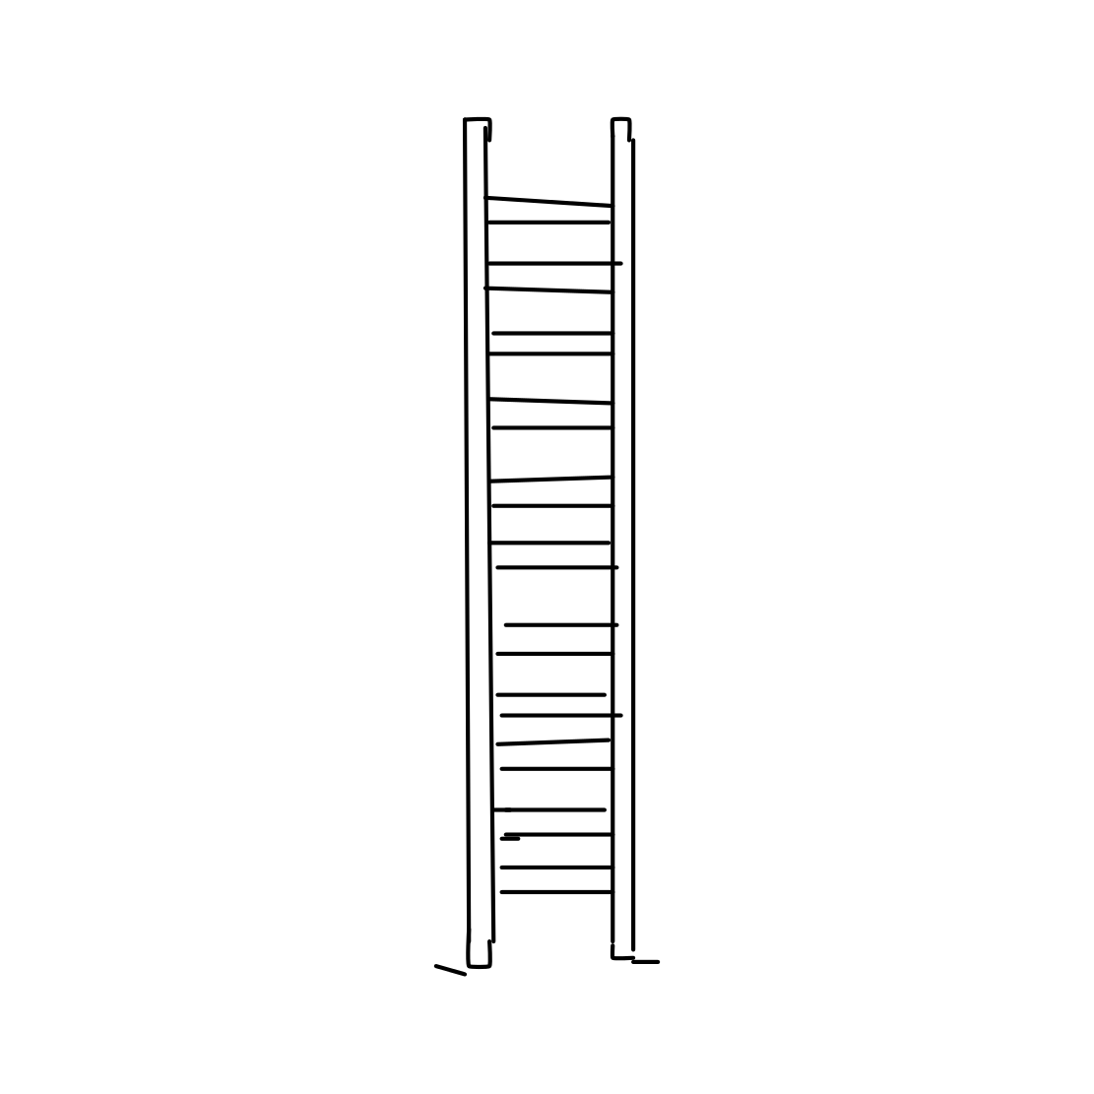
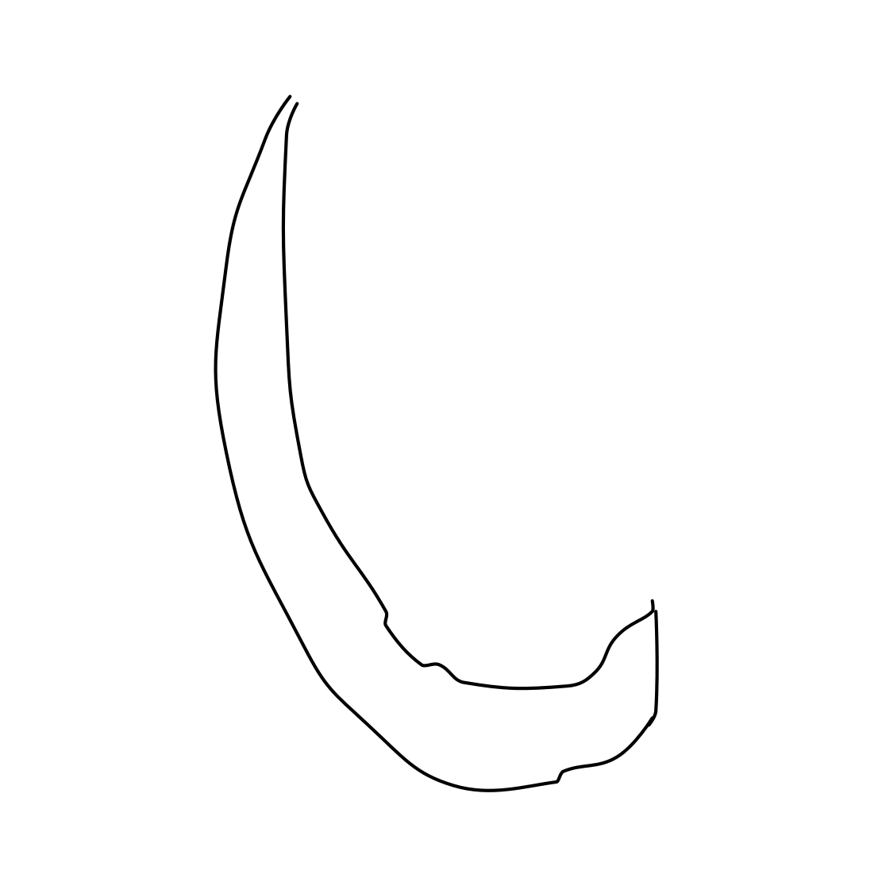
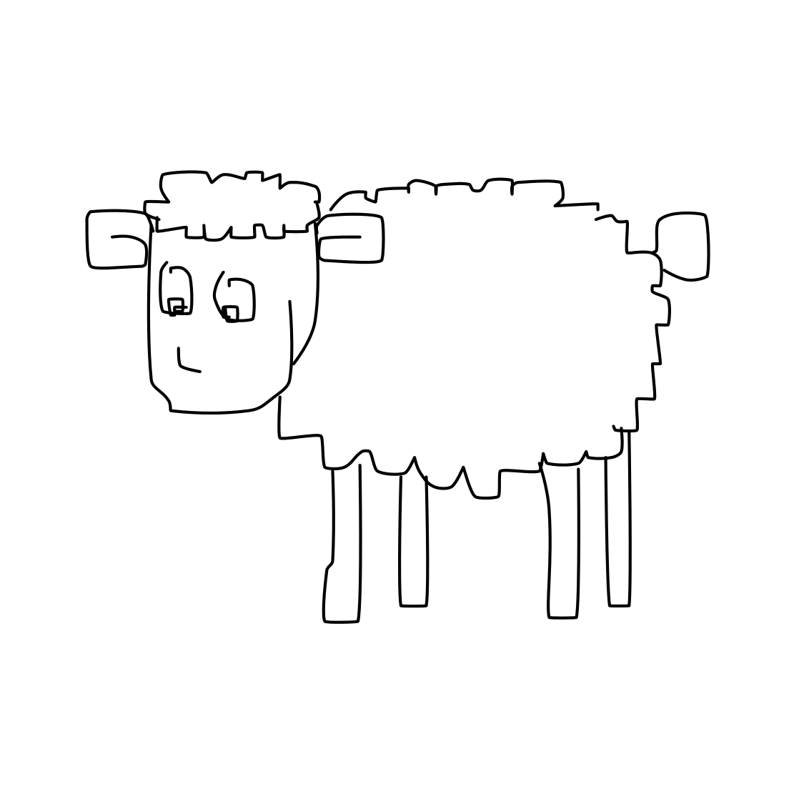
Categories
Airplane
Apple
Banana
Bicycle
Car
Dog
Door
Ladder
Moon
Sheep

Slide 7
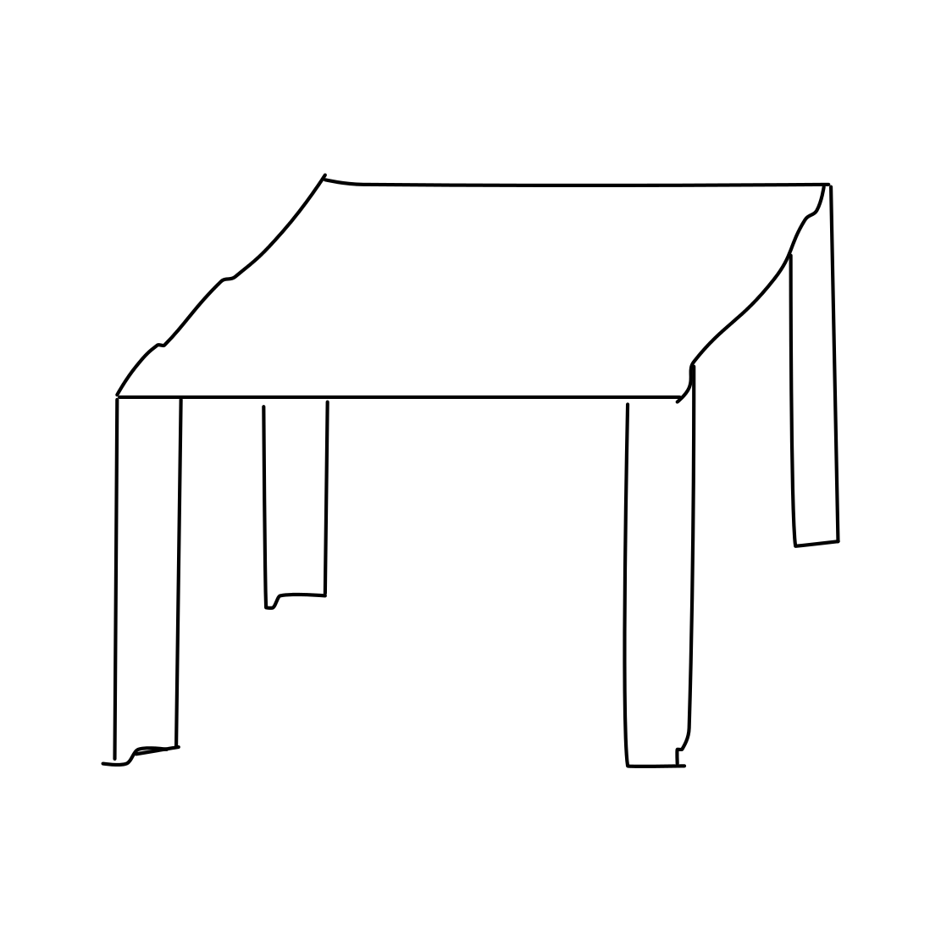
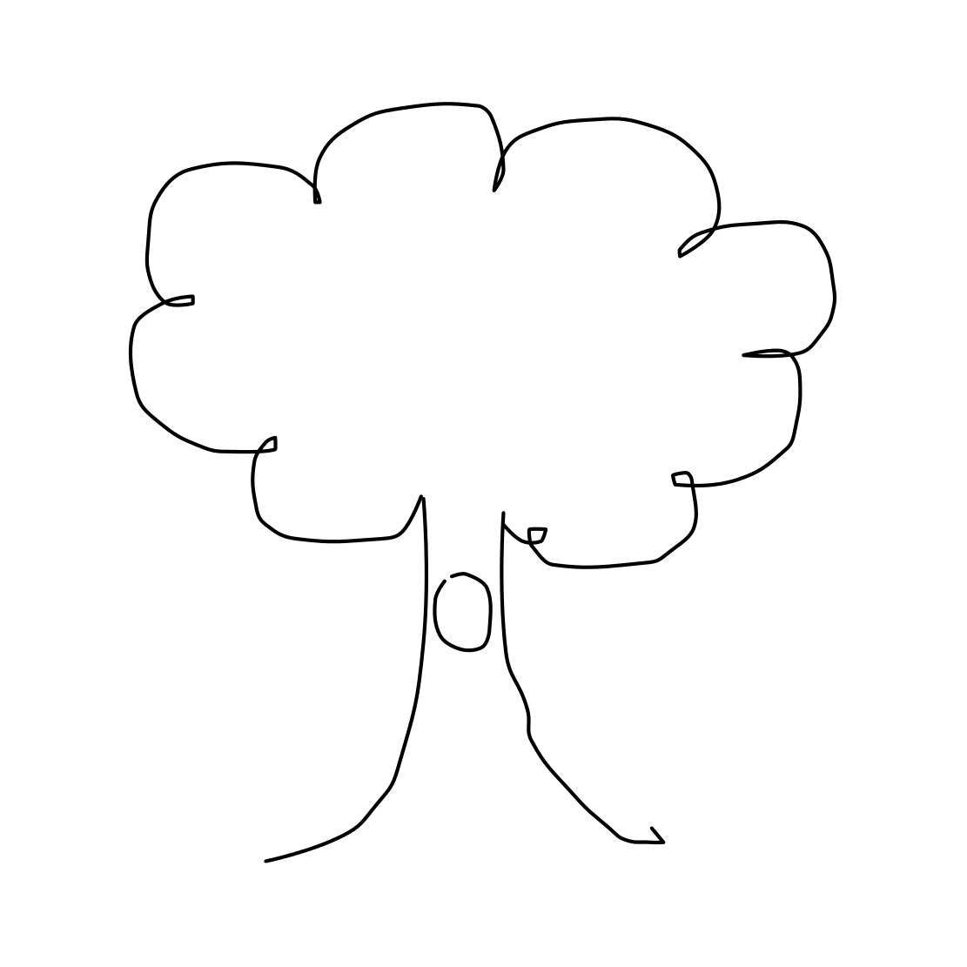
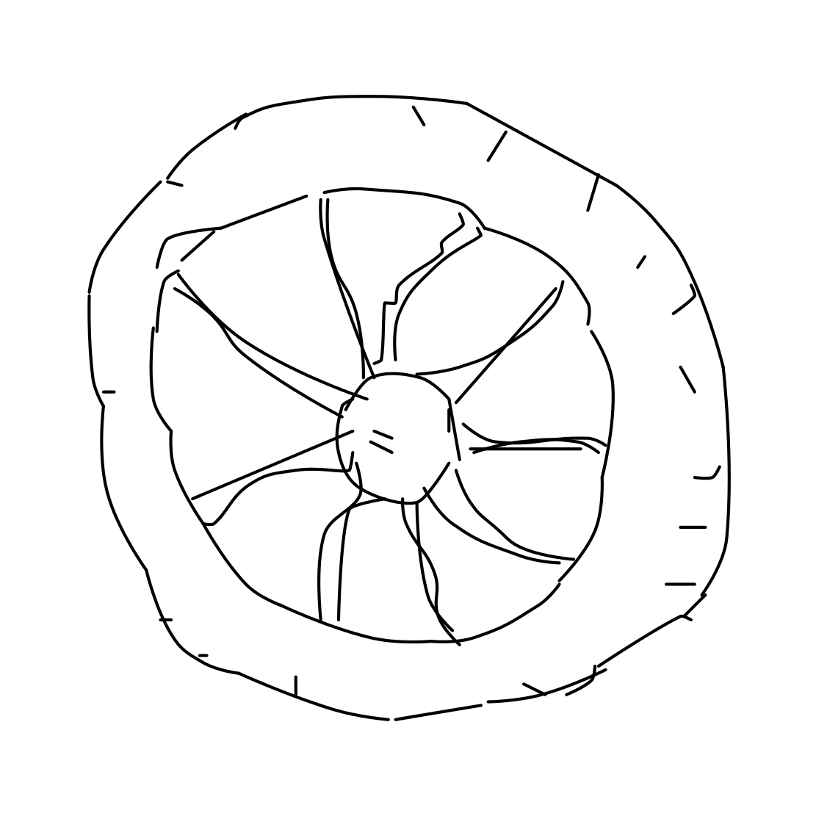
Categories Cont.
Table
Table
Tree
Wheel

Slide 8
Transfer Learning Approach

Slide 9
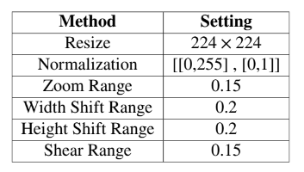
VGG-16 : Data Preprocessing

Slide 10
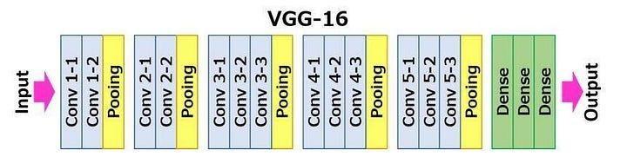
VGG-16 : Architecture

Slide 11


VGG-16 : Transfer Learning
Before applying Transfer Learning
After applying Transfer Learning

Slide 12
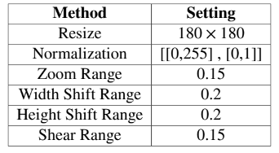
ResNet-50 : Data Preprocessing

Slide 13
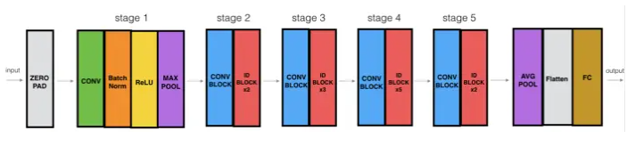
ResNet-50 : Architecture

Slide 14
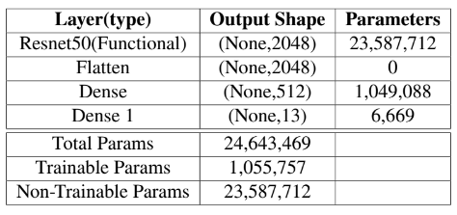
ResNet-50 : Transfer Learning
After applying transfer learning to resnet50

Slide 15
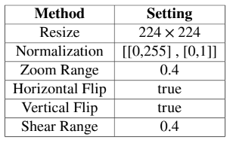
InceptionV3 : Data Preprocessing

Slide 16
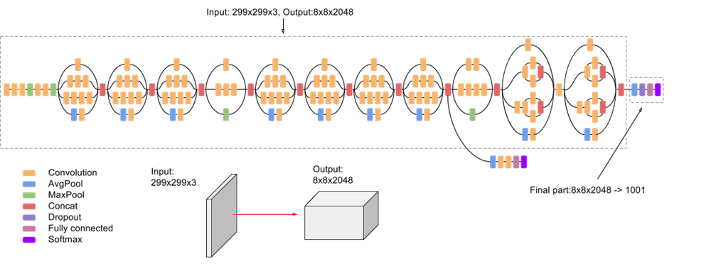
InceptionV3 : Architecture

Slide 17
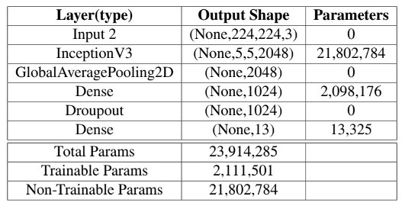
InceptionV3 : Transfer Learning
After applying transfer learning

Slide 18
Traditional Machine Learning
Approach

Slide 19
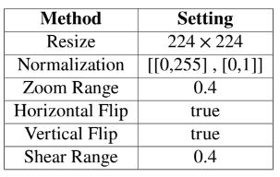
CNN : Data Preprocessing

Slide 20
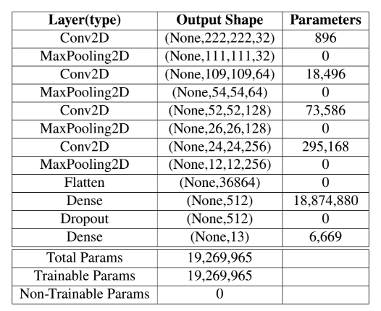
CNN : Architecture

Slide 21
Results

Slide 22
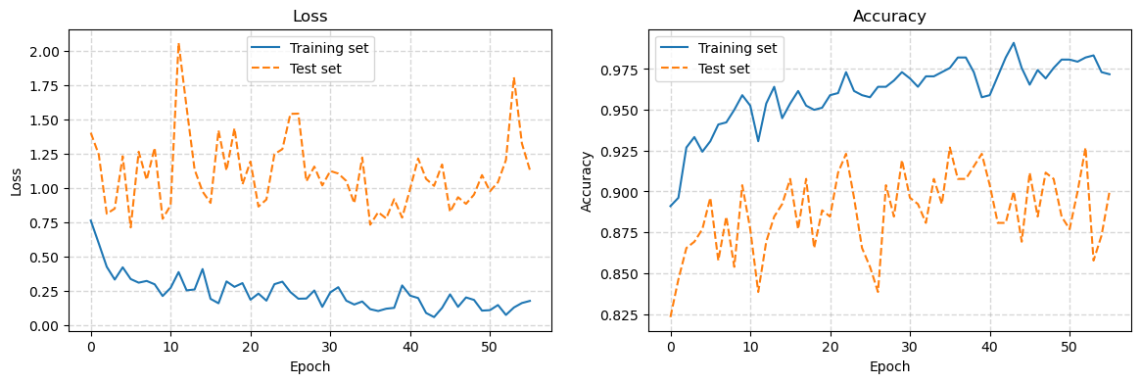
VGG-16 Results
Accuracy and Loss Graphs for VGG-16

Slide 23
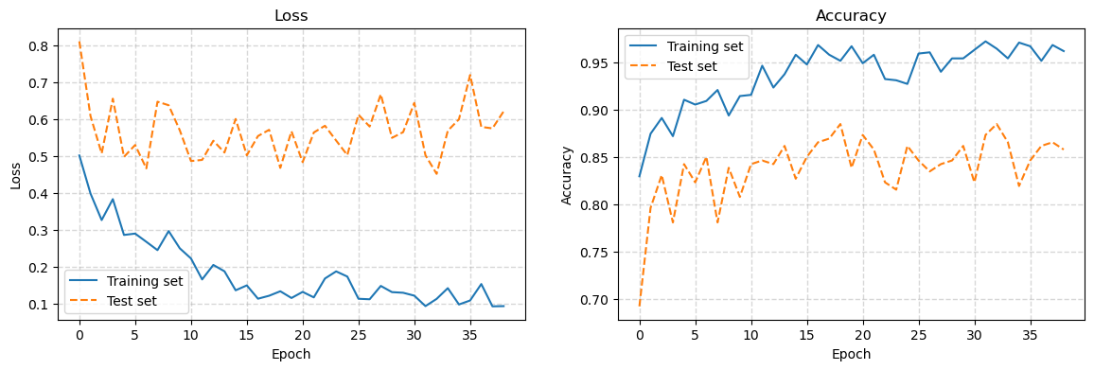
ResNet-50 : Results
Accuracy and Loss graphs for ResNet-50
Accuracy and Loss Graphs for ResNet-50

Slide 24
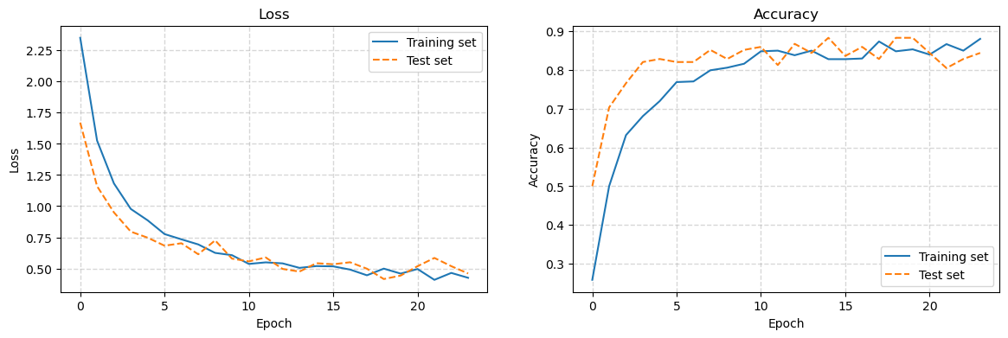
InceptionV3 : Results
Accuracy and Loss graphs for InceptionV3
Accuracy and Loss Graphs for InceptionV3

Slide 25
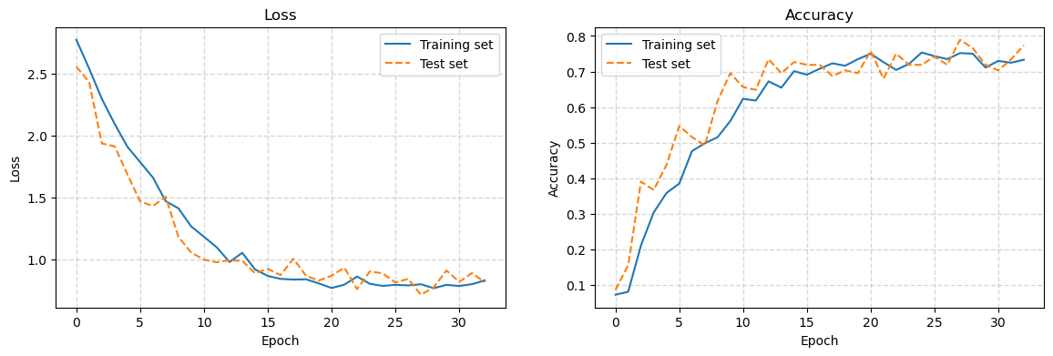
CNN : Results
Accuracy and Loss graphs for CNN
Accuracy and Loss Graphs for CNN

Slide 26
Testing

Slide 27
Demo for Airplane Sketch (InceptionV3 Model)

Slide 28
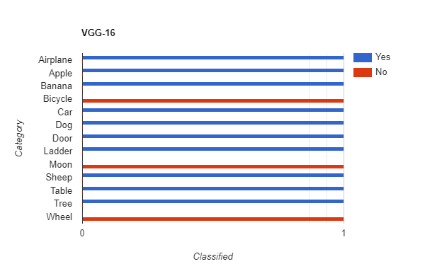
VGG-16 Testing Results

Slide 29
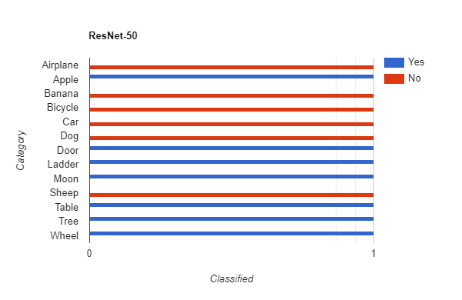
ResNet-50 Testing Results

Slide 30
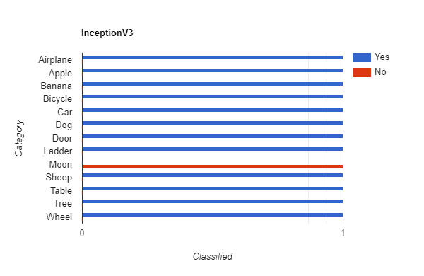
InceptionV3 Testing Results

Slide 31
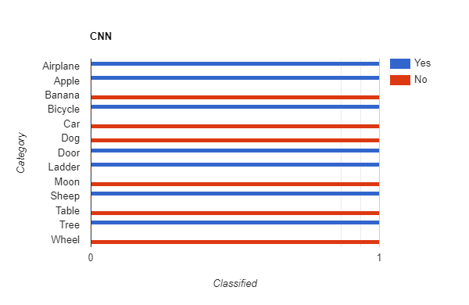
CNN Testing Results

Slide 33
Transfer Learning
Traditional Machine Learning

Slide 34
Future Work
Data Set Expansion
Model Fine-Tuning
Hybrid Approaches
Ensemble Methods

Slide 35
Thank you
Questions?

