Slide 1
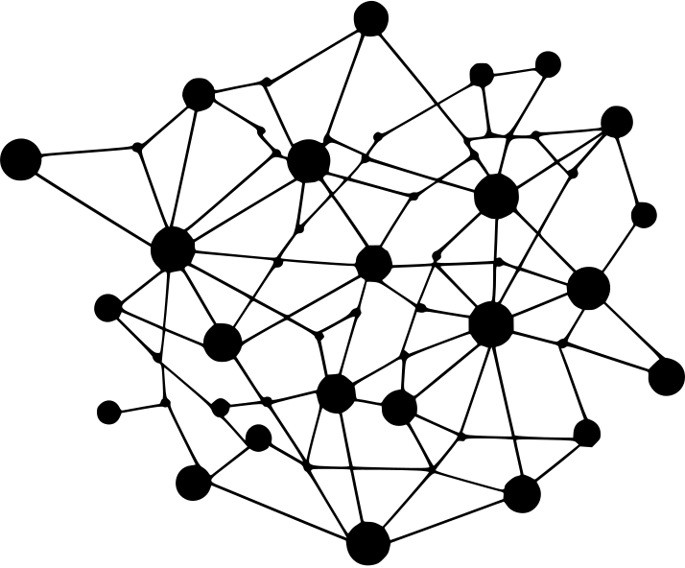
Undercomplete Autoencoders: Learning Efficient Representations
Team Presentation
VADAPALLI JASWANTH SAI (RA2311047010006)
ADVIKA AWASTHI (RA2311047010007)
NIRANJAN GOBE S (RA2311047010008)
R V ADVAITH (RA2311047010009)
RAAHIL HASSAN (RA2311047010010)
Notes:
1

Slide 2
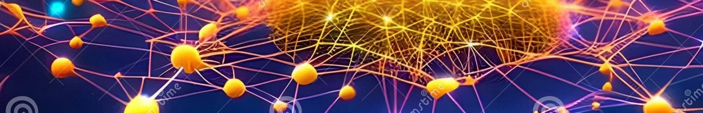
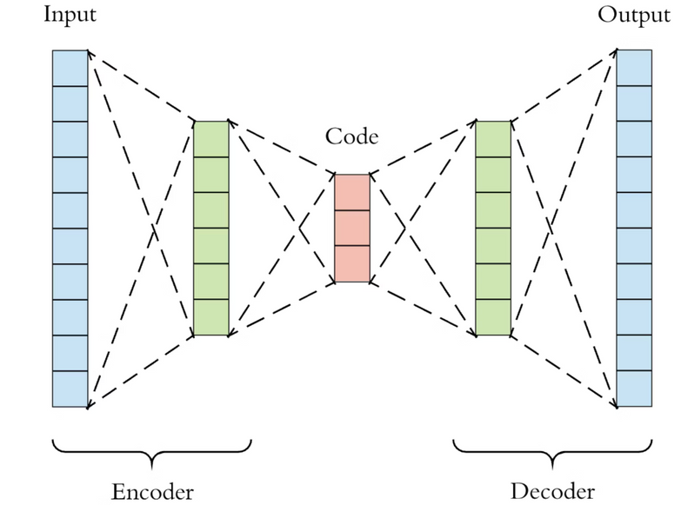
Introduction to Autoencoders
An autoencoder is a type of Artificial Neural Network (ANN) used for unsupervised learning. Its primary goal is to learn an efficient representation of data without explicit labels.
The structure consists of two main parts:
Encoder: Compresses the input into a smaller feature space, often called the latent code or bottleneck.
Decoder: Reconstructs the original data from this compressed latent code, aiming to produce an output as close to the input as possible.
Notes:
3

Slide 3
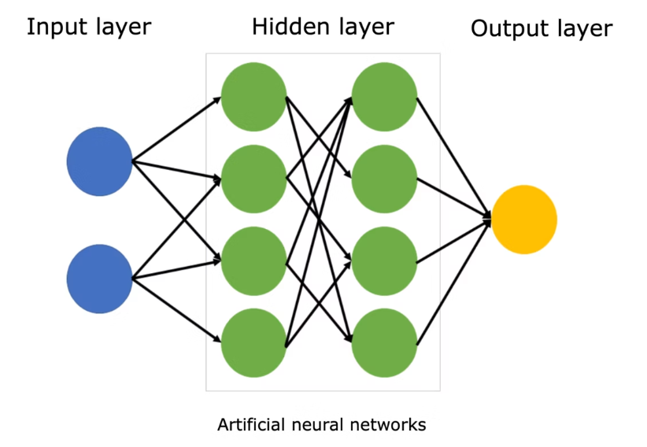
What is an Undercomplete Autoencoder?
The term “undercomplete” comes from the fact that the capacity of the hidden layer is smaller than the input dimension.
This means that the model is intentionally restricted by having fewer neurons in the bottleneck layer than in the input layer.
This bottleneck forces the network to focus on the most important features of the data, instead of just memorizing pixel-by-pixel or feature-by-feature.
In other words, the network cannot simply copy the input to the output; it must learn the underlying patterns, correlations, and structure present in the data.
As a result, the model learns a compressed and meaningful representation of the input.
This representation, also called the latent code, captures only the essential information while discarding redundancy or noise.
Such representations are highly valuable because they make downstream tasks like classification, clustering, or anomaly detection more efficient and effective.
Notes:
4

Slide 4
Why Undercomplete Autoencoders?
Dimensionality Reduction
Meaningful Features
Image Compression
Reduces data complexity, similar to PCA but with non-linear capabilities.
Learns compact, highly relevant features from raw data.
Efficiently compresses images while retaining essential information.
Noise Reduction
Anomaly Detection
Effective in denoising tasks, reconstructing clean data from noisy inputs.
Identifies unusual data points by their high reconstruction error.
Notes:
5

Slide 5
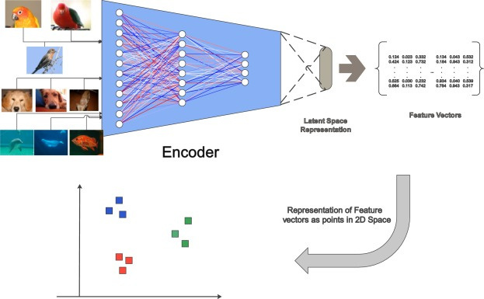
Architecture
The architecture of an undercomplete autoencoder is fundamentally divided into three key components:
Encoder: This part of the network takes the input data x and transforms it into a lower-dimensional latent representation z. It learns to extract the most salient features.
Latent Space (Bottleneck): This is the compressed, undercomplete representation of the input. It acts as an information bottleneck, forcing the encoder to prioritize information.
Decoder: The decoder's role is to take the latent representation z and map it back to a reconstructed version of the original data, denoted as \hat{x}.
The mathematical representation of this process is:
Where f_\theta is the encoder function with parameters \theta, and g_\phi is the decoder function with parameters \phi.
Notes:
6

Slide 6
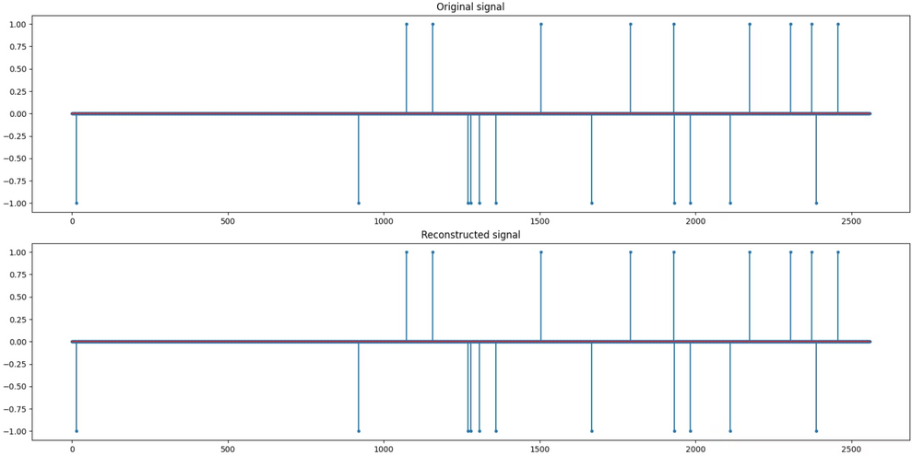
Loss Function: Minimizing Reconstruction Error
The primary objective during the training of an autoencoder is to minimize the reconstruction error. This error quantifies how much the reconstructed output deviates from the original input.
A commonly used loss function for this purpose is the Mean Squared Error (MSE), which calculates the average of the squared differences between the original input and its reconstruction:
Minimizing this loss ensures that the autoencoder learns to produce an output \hat{x} that is as close as possible to the original input x, thereby capturing its essential features in the latent space.
Notes:
7

Slide 7
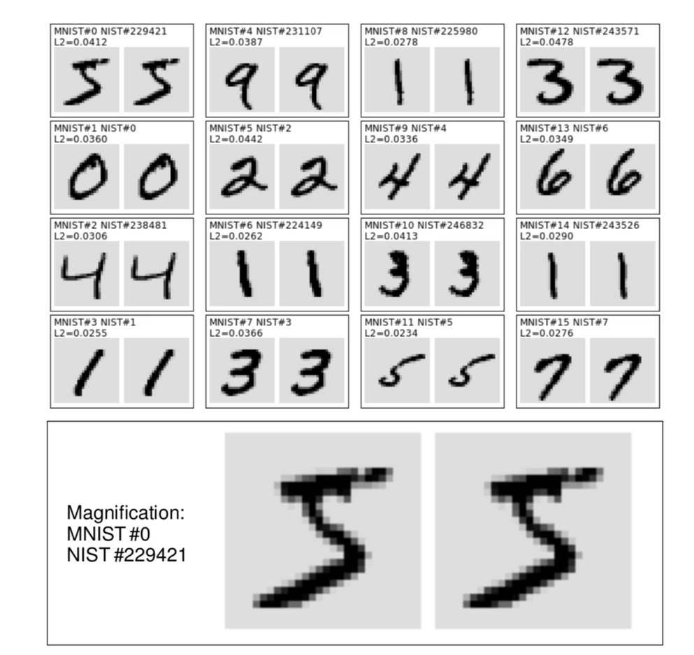
Example with MNIST Digits
Let's consider an example using the popular MNIST dataset, which consists of handwritten digits (0-9).
Input: Each digit is a 28x28 grayscale image.
Encoder: The encoder compresses this 784-pixel input into a much smaller latent space, for instance, 32 features.
Decoder: The decoder then attempts to reconstruct the original 28x28 digit from these 32 features.
While the reconstruction may not be pixel-perfect, the undercomplete autoencoder successfully captures the important features and structural characteristics of the digits, demonstrating its ability to learn efficient representations.
Notes:
8

Slide 8





Advantages & Applications
Dimensionality Reduction
Simplifies complex datasets for easier analysis and visualization.
Noise Removal
Effectively cleans noisy data, enhancing data quality.
Feature Extraction
Extracts salient features crucial for classification and other tasks.
Anomaly Detection
Identifies outliers in data, useful in fraud or medical diagnostics.
Notes:
9

Slide 9

Undercomplete vs. Overcomplete Autoencoders
The choice between undercomplete and overcomplete autoencoders hinges on the desired outcome and the nature of the data.
Undercomplete
Smaller than input
Efficient representation
Undercomplete Autoencoders: With a latent space smaller than the input, they are forced to learn highly efficient and generalized features, preventing simple memorization.
Overcomplete
Larger/same as input
Risk of memorization
Overcomplete Autoencoders: When the latent space is larger than or equal to the input dimension, there's a higher risk of memorization. The model might simply learn to copy the input without extracting meaningful representations, unless regularization techniques are applied.
Notes:
10

