Slide 1
Assignment 2

Slide 2
Overview
Implement a basic ray tracer
Shoot a ray through each pixel in the image
Calculate ray intersection with all surfaces in the scene
Compute color according to the material of the surface and the lighting conditions
We will use Python (version 3.8)
Only basic python packages, except numpy

Slide 3
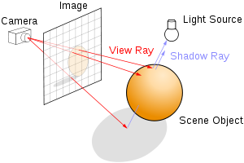
Ray Tracing
For each pixel in output image, shoot a ray (line segment)
From observer’s eye, through the screen (viewport) into the scene
Calculate intersections with geometry

Slide 4
Surfaces
Sphere
Defined by the position of its center and its radius
Infinite plane
Defined by its normal and an offset along the normal
Cube
Defined by the position of its center and its edge length
Notes:
Infinite plane - $\left\{P | P⋅N=C\right\}$
Cube – no rotations (to make computations of intersetcion easier)

Slide 5
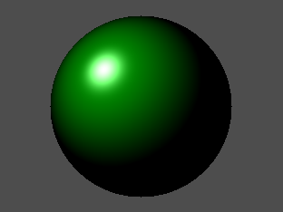
Materials
Diffuse color (RGB)
“Regular” color
The base color is a multiplication of this value and the light received
Specular color (RGB)
The reflection of a light source
Phong specularity coefficient (floating point)
Controls the type of specularity of a surface
Reflection color (RGB)
Reflections from the surface are multiplied by this value
If surface is reflective, you need to shoot reflection rays to find objects which would be reflected
Transparency (floating point)
If object is transparent, you should shoot rays through the surface to find the surfaces that are behind it
The reflections are independent of the object's transparency
Notes:
The specular color of a surface defines the intensity and color of that reflection. Materials in real life often have different specular color than diffuse color. For example, a polished wooden desk would have a brown diffuse color but white
specular color.
Phong - high value (around 100) renders small and sharp specular reflections, for shiny surfaces such as metal, and a low value (around 1 or so) renders wide and soft specular reflections, for materials such as clay or stone
Reflection - For example a red metal pipe might reflect its surrounding but the reflection will have a red tint.

Slide 6

Additive colors
$output color = (background color) ∗ transparency + (diffuse + specular) ∗ (1 − transparency) + (reflection color)$

Slide 7
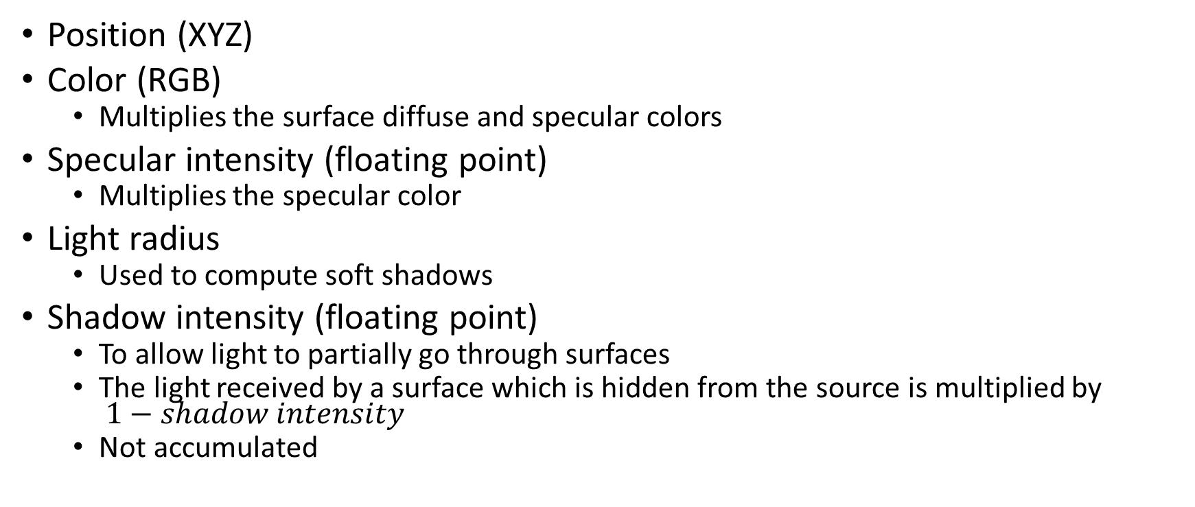
Lights
Position (XYZ)
Color (RGB)
Multiplies the surface diffuse and specular colors
Specular intensity (floating point)
Multiplies the specular color
Light radius
Used to compute soft shadows
Shadow intensity (floating point)
To allow light to partially go through surfaces
The light received by a surface which is hidden from the source is multiplied by $1−shadow intensity$
Not accumulated
Notes:
We use point lights with the following attributes
Specular intensity – want only partial specular lighting..
If this number is 1, the light intensity will be the same for the diffuse component and the specular component computation. Otherwise, the light color will be multiplied by the specular intensity for the specular component computation.
To compute the color of the surface, you go over each light in the scene and add the value it induces on the surface. To find out whether the light hits the surface or not, you shoot rays from the light towards the surface and find whether the ray intersects any other surfaces before the required surface - if so, the surface is occluded from the light and the light does not affect it (or partially affects it because of the shadow intensity parameter).

Slide 8
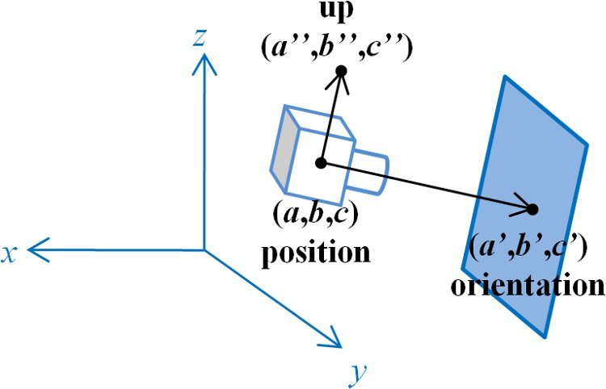
Camera
Position (XYZ)
Look-at-point (XYZ)
Specifying the position which the camera is looking at
Used to compute the direction of the camera
Up vector (XYZ)
Screen distance
Defines the focal point of the camera
Controls the direction of the rays
Screen width
Controls the viewing angle
Used to compute the screen height (with the requested aspect ratio)

Slide 9
General settings
Background color (RGB)
Number of shadow rays (integer)
Number of rays which are used for each light point, to compute soft shadows
Maximum recursion level
Limits the recursion level when computing reflection
Notes:
Max - o after this amount of recursion the returned color would be the background color (as if the tenth reflected surface does not exist).

Slide 10
Questions?
roieliyaub@mail.tau.ac.il

