Slide 1
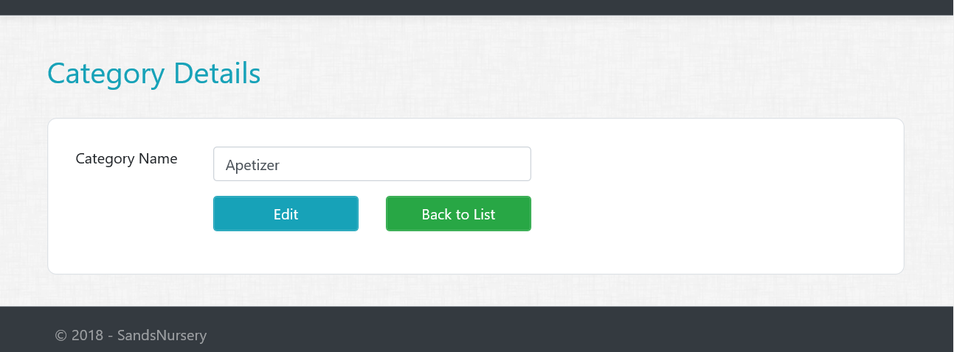
Assignment 1
Category Details Views/Actions
Create Details GET action method in Category controller.
Create Category Details View.
All fields should be disabled or read only
Create a Partial view for buttons (_DetailsAndBackToListButton
HINT : Partial View will take ID as model to pass to edit page.

Slide 2
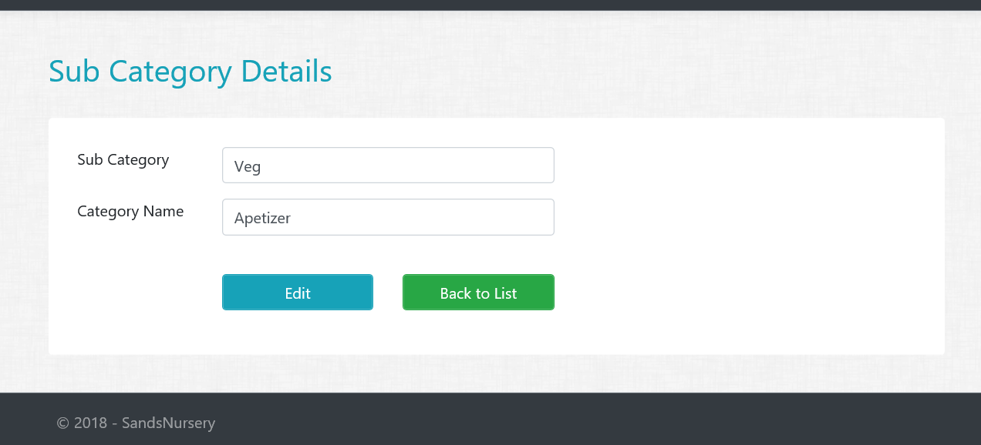
Assignment 2 – Part 1
SubCategory Details Views/Actions
Create Details GET action method in SubCategory controller.
Create SubCategory Details View.
All fields should be disabled or read only
HINT : Consume Partial View for Buttons

Slide 3
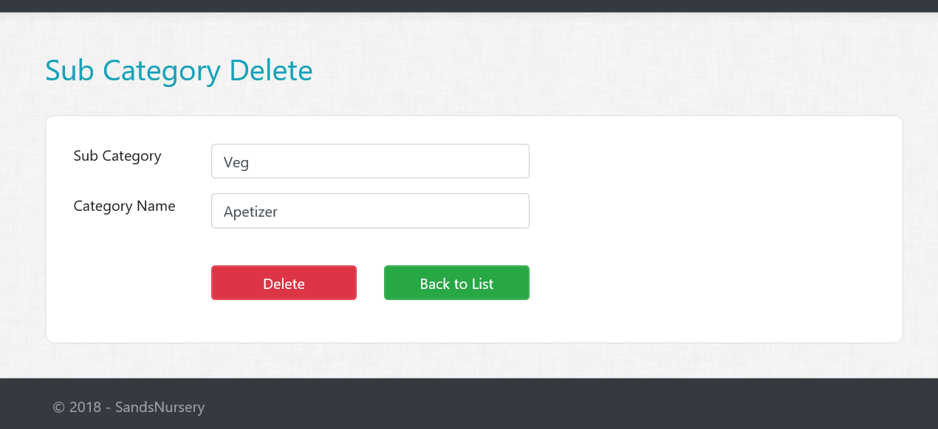
Assignment 2 – Part 2
SubCategory Delete Views/Actions
Create Delete GET action method in SubCategory controller.
Create SubCategory Delete View.
All fields should be disabled or read only
HINT : Consume Partial View for Buttons
Create Delete POST action method in SubCategory controller.

Slide 4
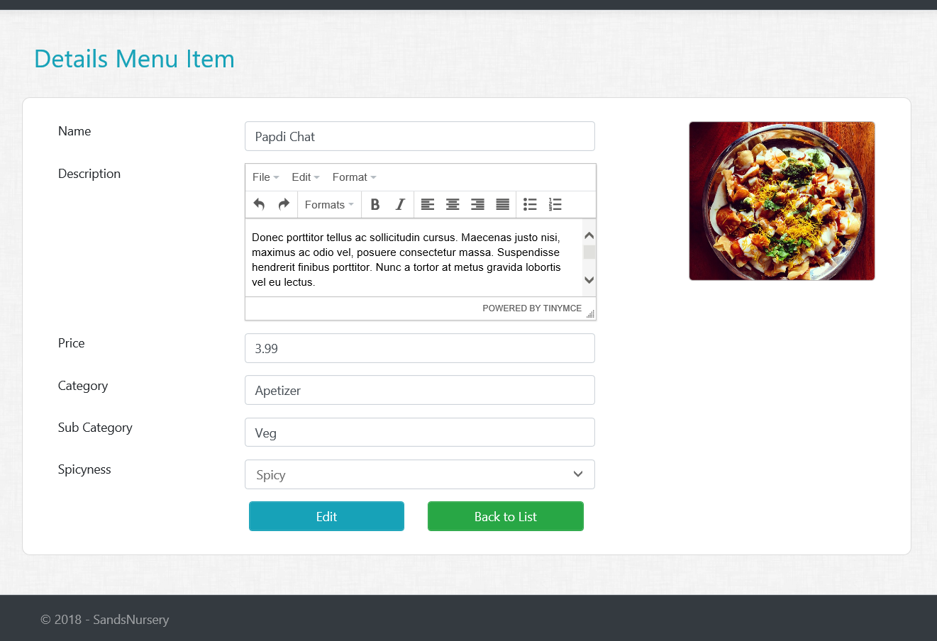
Assignment 3 – Part 1
MenuItem Details Views/Actions
Create Details GET action method in MenuItem controller.
Create MenuItem Details View.
All fields should be disabled or read only
HINT : TinyMce has property (readonly: 1) to make textarea read only

Slide 5
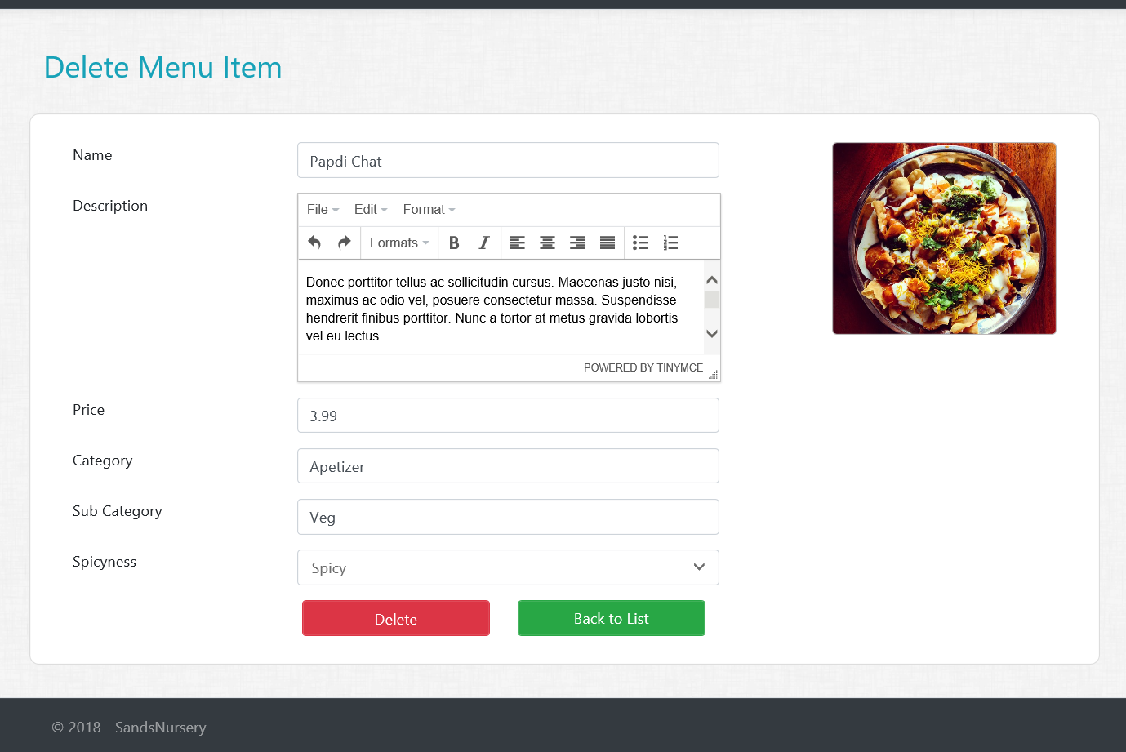
Assignment 3 – Part 2
MenuItem Delete Views/Actions
Create Delete GET action method in MenuItem controller.
Create MenuItem Delete View.
All fields should be disabled or read only
HINT : Consume Partial View for Buttons
Create Delete POST action method in MenuItem controller.
HINT : Make sure to delete the MenuItem Image from the server!

Slide 6
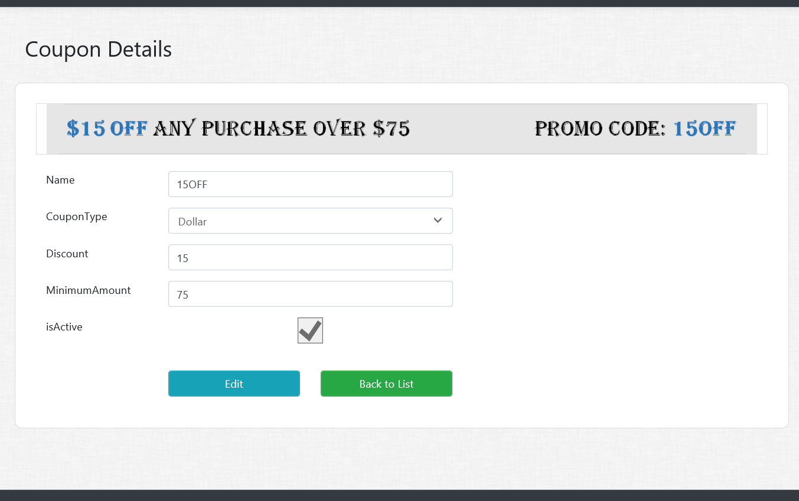
Assignment 4 – Part 1
Coupons Details Views/Actions
Create Details GET action method in Coupon controller.
Create Coupon Details View.
All fields should be disabled or read only

Slide 7
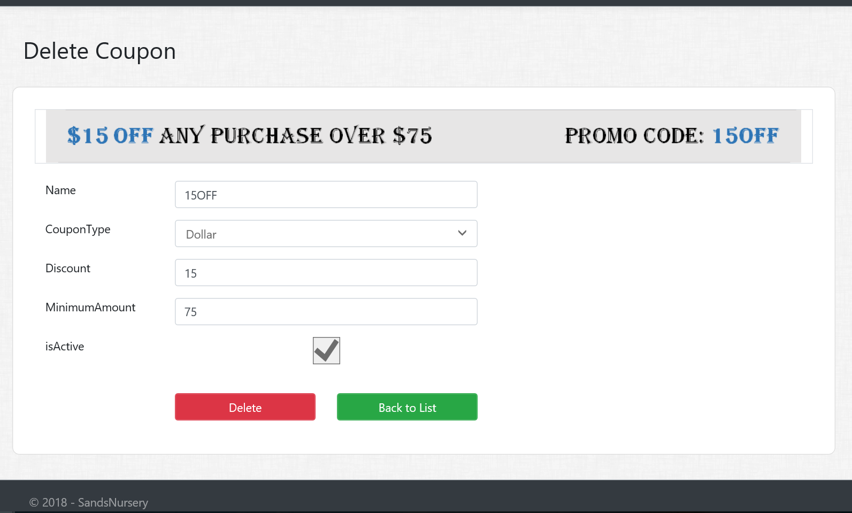
Assignment 4 – Part 2
Coupons Delete Views/Actions
Create Delete GET action method in Coupon controller.
Create Coupon Delete View.
All fields should be disabled or read only
HINT : Consume Partial View for Buttons
Create Delete POST action method in Coupon controller.

Slide 8
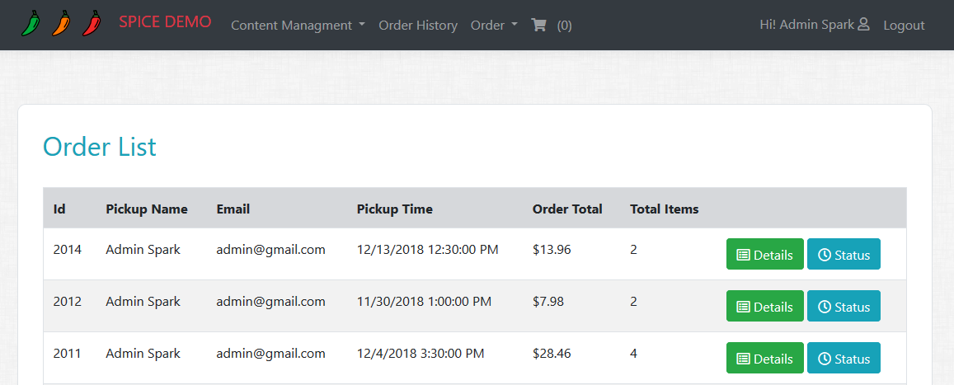
Assignment 5 – Step 1
Order Status Tracking on Order History Page
Create a “Status” button next to Details button in Order history view
Status button should not be visible if order status is Cancelled.

Slide 9
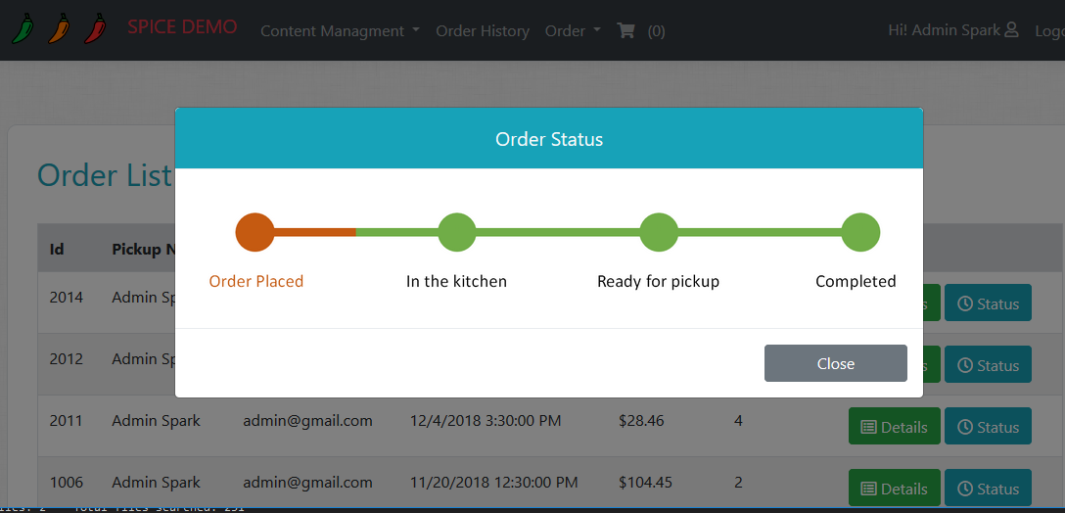
Assignment 5 – Step 2
Order Status Tracking on Order History Page
Create partial View for displaying Order Status Image (_OrderStatus).
Based on the order status display its corresponding Images.
Images Attached
OrderPlaced.png
InKitchen.png
ReadyForPickup.png
Completed.png
HINT : Add constants in SD class for all images and use them over magic string.
Create an action in OrderController that will return the new PartialView (_OrderStatus).
Add a new Modal to display
‘Order Status’ in PopUp like we did
for Order Details.

