Slide 1
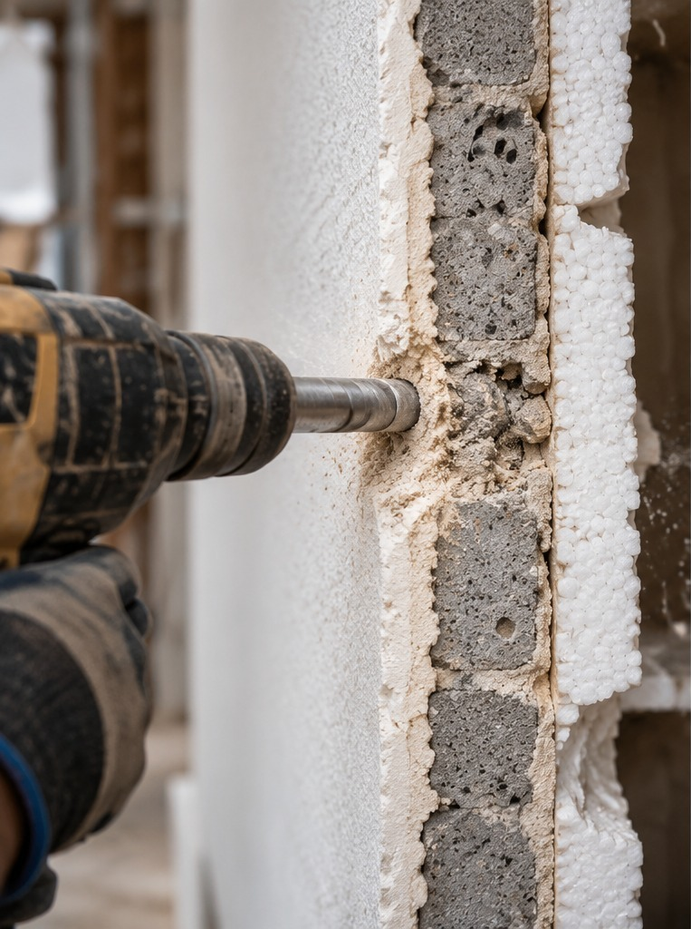
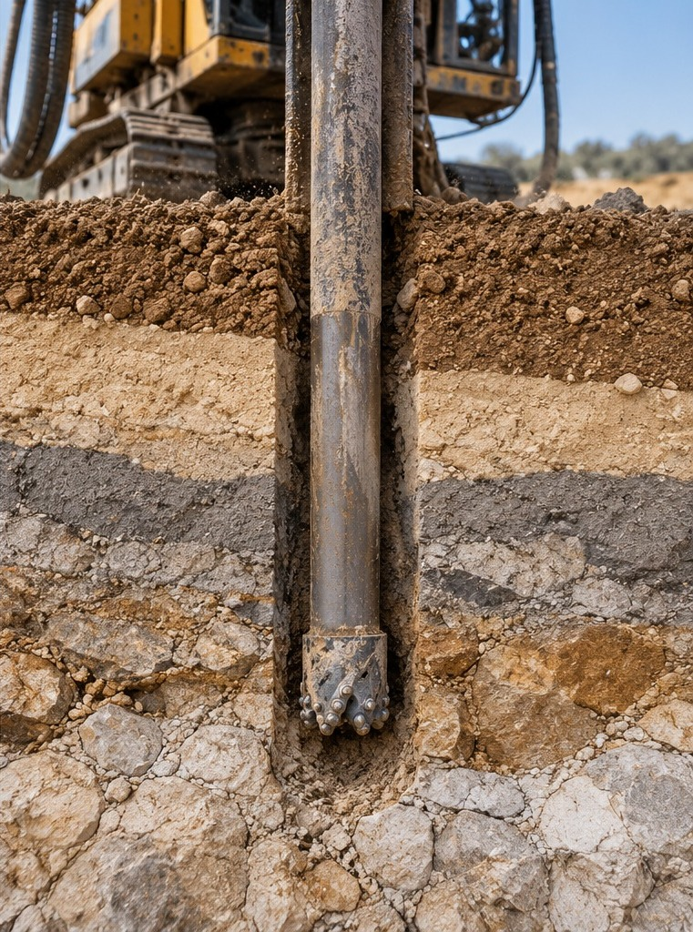
A QUICK QUESTION
The drill already knows what’s inside
A WALL
100 m OF ROCK
A mine drills 100 m of rock. How long until it knows what it hit?
1
2
3
A
A few hours
soft
B
A few days
hard · slow
C
Weeks to months
Think of your answer…
new rock, new cuttings
1 easy · white dust
2 hard · grey dust
3 sudden jump
Notes:
Everyone here has drilled into a wall. First it's easy: plaster, white dust. Then it gets hard and slow, and the dust turns grey: concrete. And then, suddenly, the drill jumps forward: you're through. Without seeing anything, you know exactly what's inside.
[CLICK: the ground appears]
Now imagine that wall is a hundred meters of rock. A drilling rig feels every layer: hard, soft, a new color in the cuttings. Every hole, all day long.
So, a quick question. In the wall, you knew what was inside in one second. When a mine drills a hundred meters of rock, how long until it knows what it hit? A few hours? A few days? Weeks to months? Think of your answer.
TRANSITION (before click): "Let's see."

Slide 2
A QUICK QUESTION
The drill already knows what’s inside
A WALL
100 m OF ROCK
A mine drills 100 m of rock. How long until it knows what it hit?
1
2
3
A
A few hours
soft
B
A few days
hard · slow
C
Weeks to months
4–10¹
16 yrs²
new rock, new cuttings
1 easy · white dust
weeks, typical wait for lab results
from discovery to a working mine
2 hard · grey dust
3 sudden jump
Meanwhile, the rig felt every meter in real time.
1. Typical commercial lab assay turnaround; industry and company reports, 2021–2026. 2. S&P Global Market Intelligence, 2026: average discovery-to-production lead time (232 mines, 1990–2025).
Notes:
Weeks to months. The samples go to a lab, and the results typically come back four to ten weeks later, sometimes longer.
By then, the rig has moved on, and the decisions have already been made.
Zoom out, and the whole journey from discovery to a working mine takes about sixteen years on average.
Meanwhile, the drill felt every meter, in real time. And almost nobody was listening.
TRANSITION (before click): "So, who are we, and how do we change that?"

Slide 3
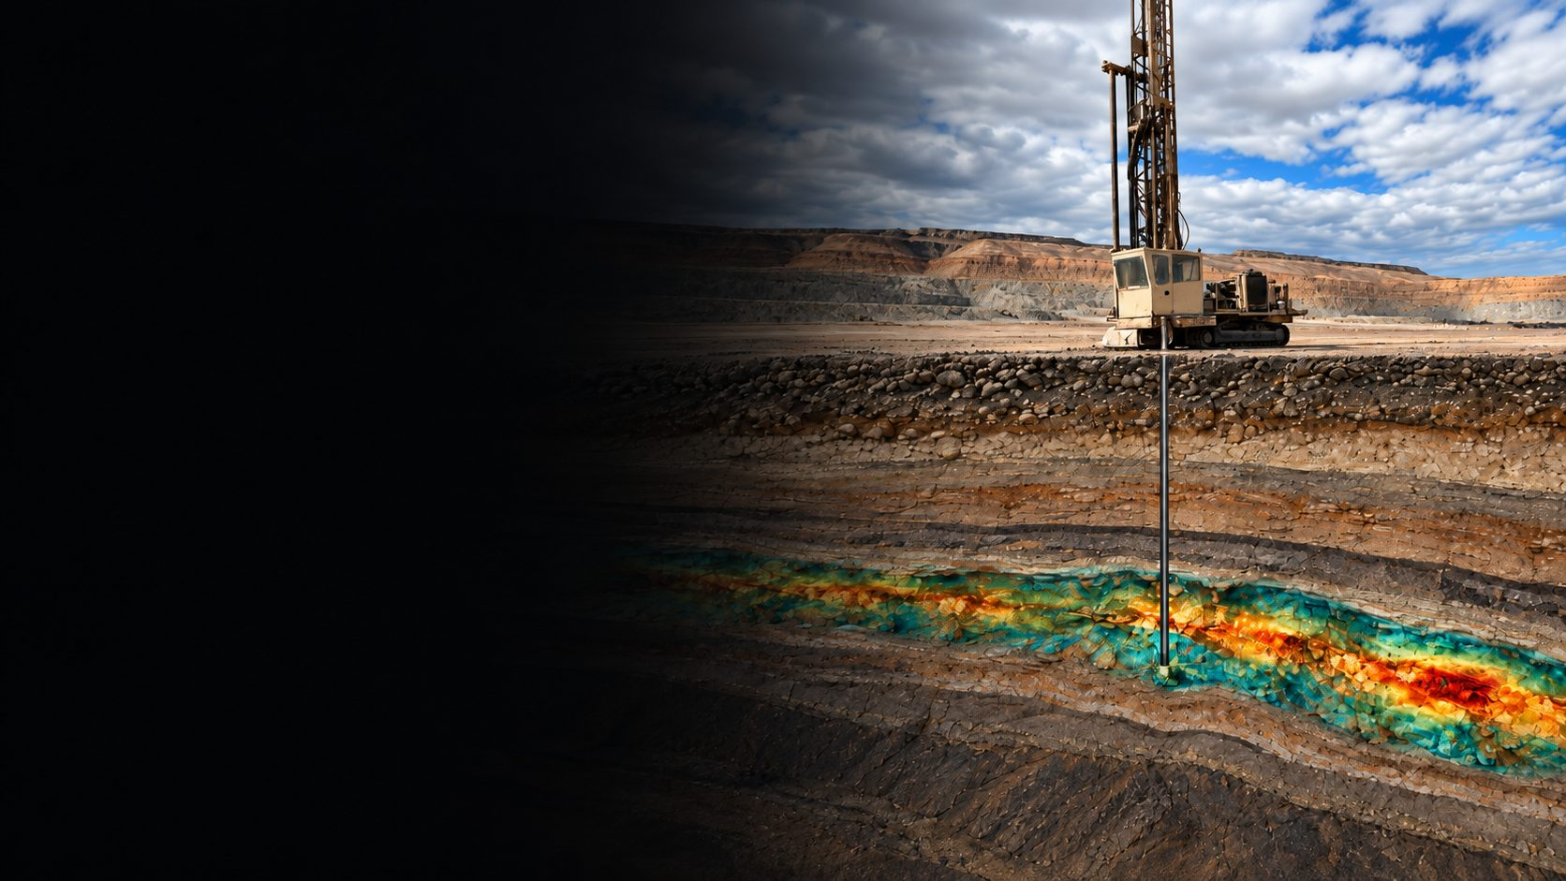
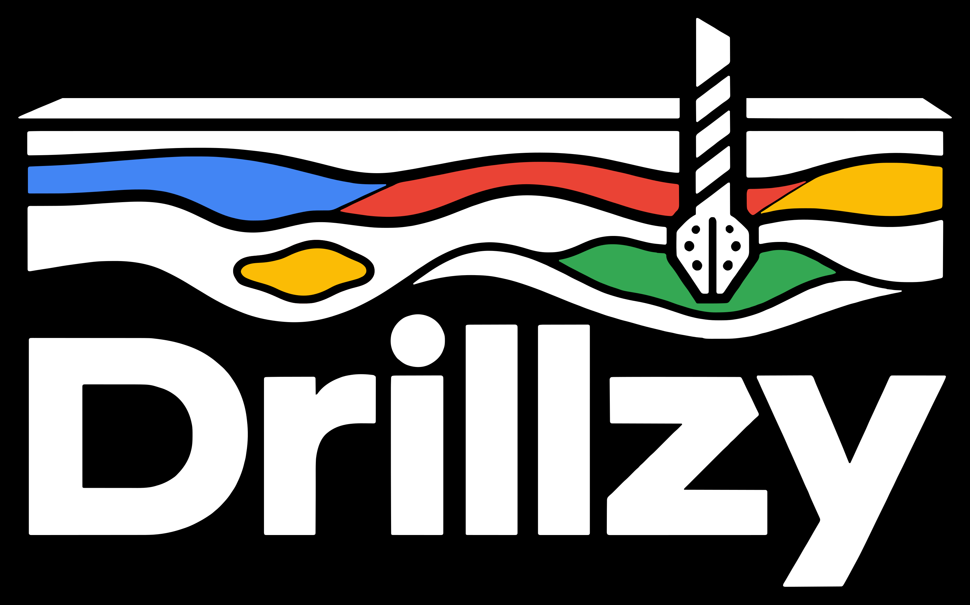
THE INTELLIGENCE LAYER FOR CRITICAL MINERALS RESILIENCE
Turn every drilling rig into a
real‑time source of drilling &
subsurface intelligence.
Every meter drilled becomes data, operational and geological.
1st place · Israel's Critical Minerals competition
Israel Innovation Authority & Ministry of Energy · 2026
1
Yair Gordin, Ph.D. · Founder & CEO
Notes:
I'm Yair Gordin, founder and CEO of Drillzy.
We turn every drilling rig into a real-time source of drilling and subsurface intelligence.
In the next three minutes, I'll show you how.
TRANSITION (before click): "Let's start with what happens at the rig today."

Slide 4
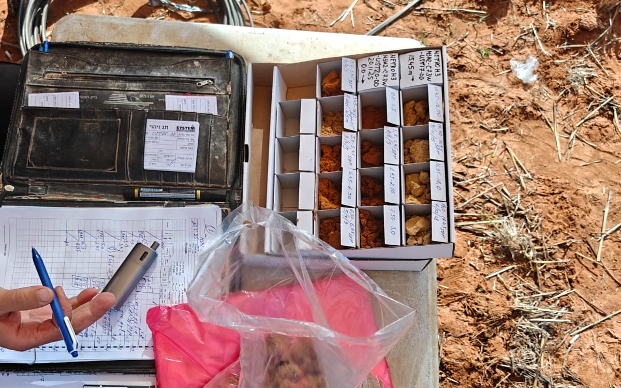
THE PROBLEM
Drilling is the first and only time we touch the rock
And that’s exactly where data stops.
1
Best case: logged by hand
Subjective, and different with every person.
2
Often: no record at all
On many rigs, almost nothing the drill feels is ever captured.
3
Always: late, no standard
No common standard, and by the time it is a report, the decision on site has already been made.
A real drilling site: the record of the ground is a notebook and sample trays.
Notes:
Drilling is the first and only time we actually touch the rock. And that's exactly where data stops.
On a good day, a geologist logs it by hand: a notebook, a pen and sample trays. Subjective, and different with every person.
And that's the good case. On many rigs, nothing is recorded at all.
And there is no common standard, so data from one rig, one site or one contractor can't be compared with the next.
And by the time it becomes a report, it's too late: the decision on site has already been made.
TRANSITION (before click): "That's the gap we close: data in time for the decisions that can make or break a project."

Slide 5
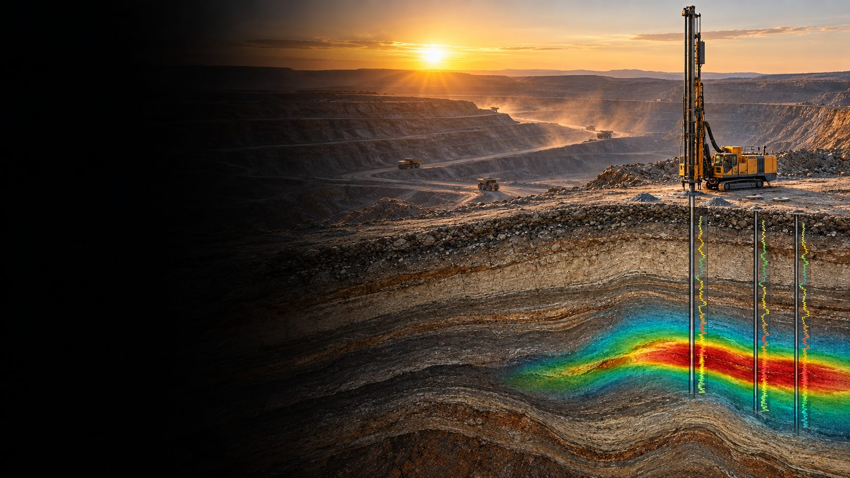
THE SOLUTION
Make every meter drilled work twice.
Capture → Process → Deliver a vendor-agnostic sensing layer for any rig, old or new; physics + AI, tied to depth.
1
Here and now: at the rig
Real-time drilling decisions on site: when to stop, when to sample, where the ore starts and ends.
2
Over time: the subsurface model
Every hole updates one shared model, for operations, geology and engineering.
THE VALUE · FROM DRILL TO MILL
Shorter drilling cycles
Cleaner feed to the plant
Reliable, consistent data
Gut feeling → evidence & data
Proprietary technology · sensing + AI, built in-house
Notes:
Our answer: make every meter drilled work twice.
We add a vendor-agnostic sensing layer to rigs already in the field, old or new, and turn many signals, tied to depth, into a picture of the rock, with physics and AI.
Once, at the rig: the driller knows when to stop, when to sample, and where the ore starts and ends.
And twice, over time: every hole updates one shared model for operations, geology and engineering.
The value runs from drill to mill: shorter drilling cycles and cleaner feed to the plant.
And the technology is proprietary: it is our own.
TRANSITION (before click): "And this is already working in the field."

Slide 6
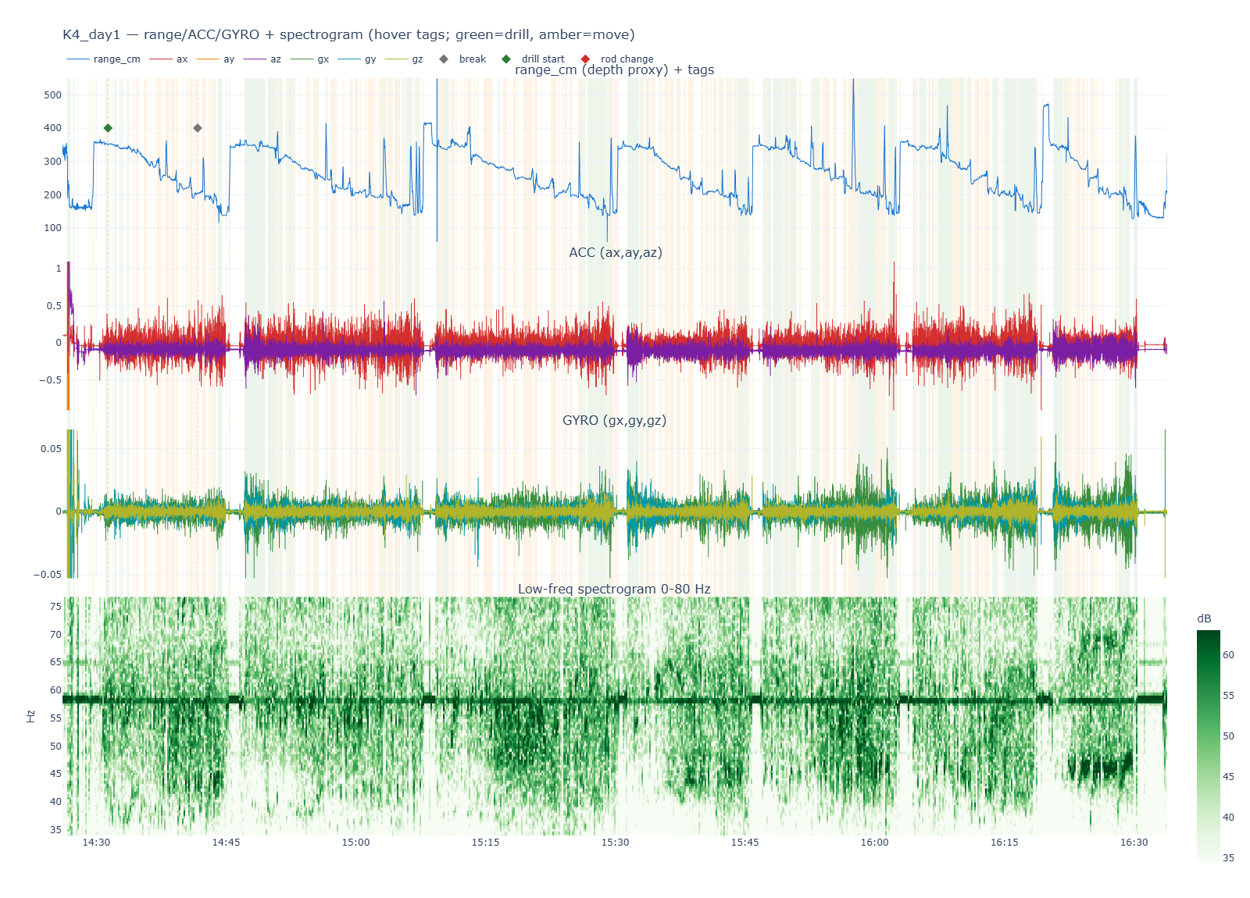
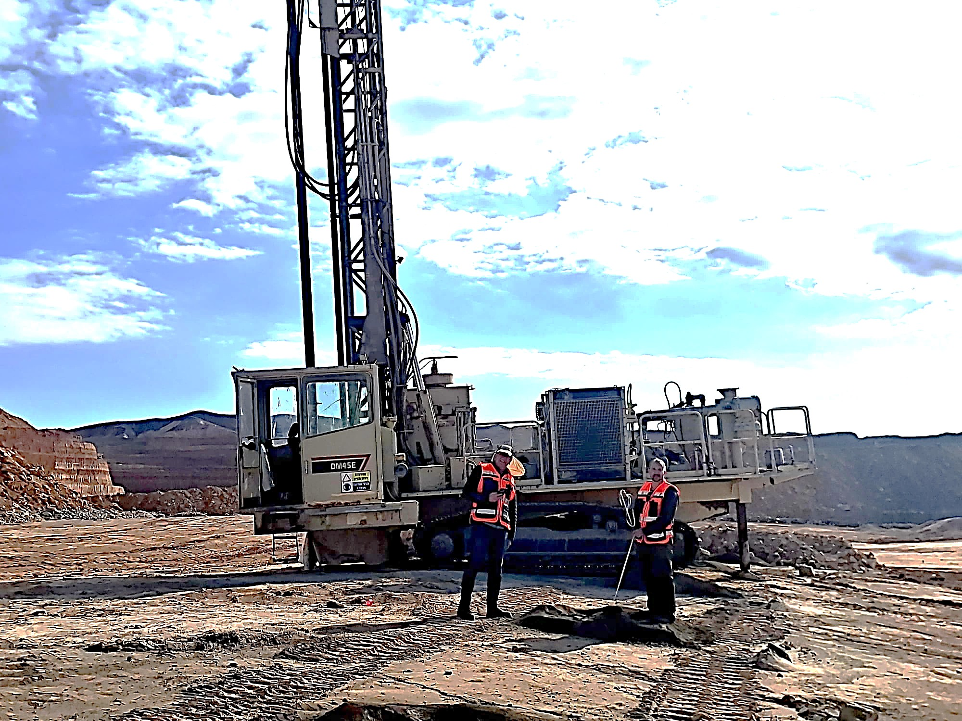
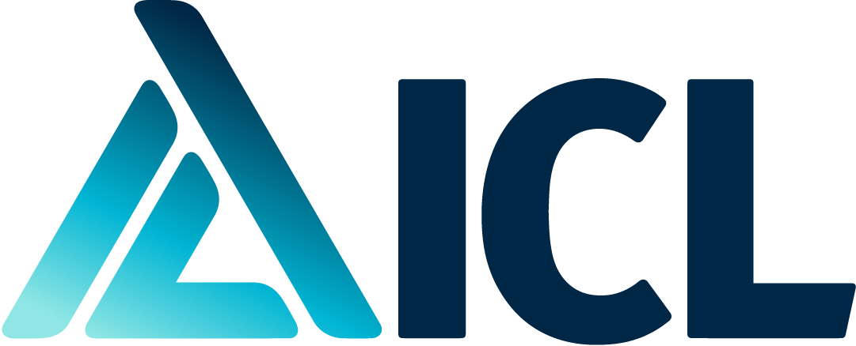


IN THE FIELD
Real rigs. Real drilling. Real data.
Dozens
boreholes, many deeper than 100 m
Dry & wet
drilling conditions, both measured
3
geologies that represent critical minerals
The Drillzy team on a working rig · open-pit mine
Any rig · vendor-agnostic
Real sensor data · time and depth · partial view
OUR DESIGN PARTNERS
Mining
Open-pit · sedimentary
Government body
Intrusive ore body · hard rock
Water utility
Aquifer drilling · brines
Notes:
This is our team on a working rig in an open-pit mine, with real sensor data, aligned to time and depth.
We have recorded dozens of boreholes, many deeper than a hundred meters, in both dry and wet drilling conditions, across three geologies that represent critical minerals.
Our design partners: an open-pit mine, a government body working in hard rock, and a water utility drilling aquifers and brines.
TRANSITION (before click): "So how does this compare with what exists today?"

Slide 7
COMPETITIVE LANDSCAPE
Today you choose: rich data or scalable economics.
Richness of subsurface data →
Instruments & scans
Rich data, high cost per hole
THE WHITE SPACE
Drillzy
Rich data, on every hole, any rig
Manual logging
Slow, subjective, inconsistent
Software on existing data
Scales, but only reads what was already collected
Cost-effectiveness per meter →
Notes:
Today, you have to choose: rich data from expensive instruments, slow manual logging, or software that only reads data someone already collected.
Drillzy breaks that trade-off: rich data, read from the drilling itself, on every hole and any rig.
TRANSITION (before click): "Doing this takes a rare combination of people."

Slide 8
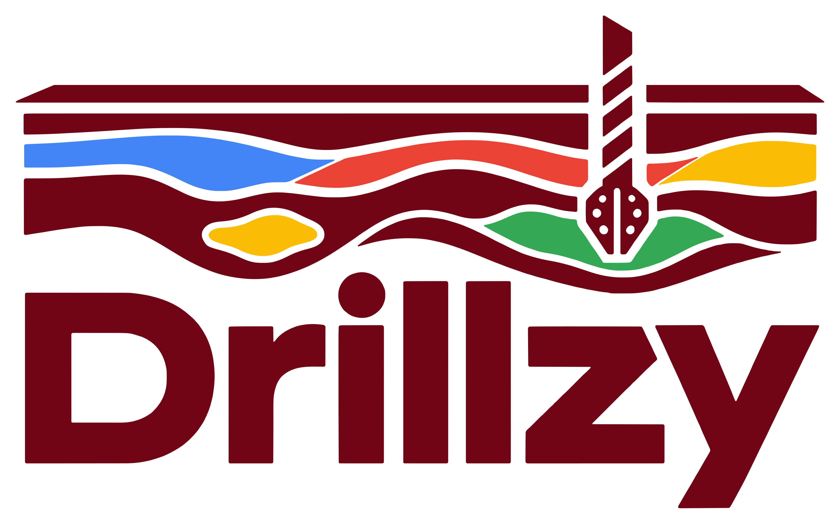
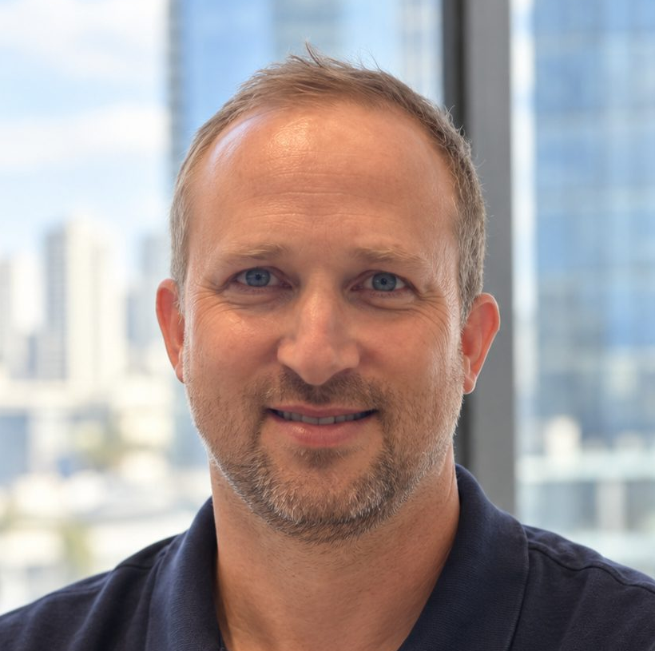
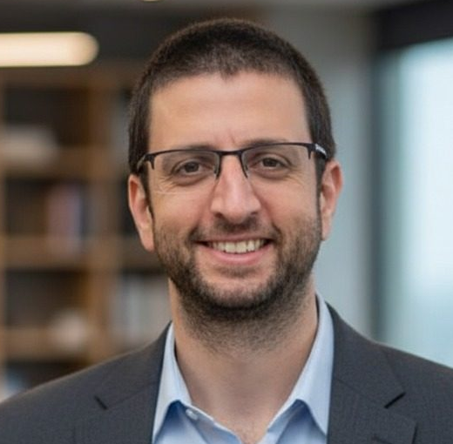
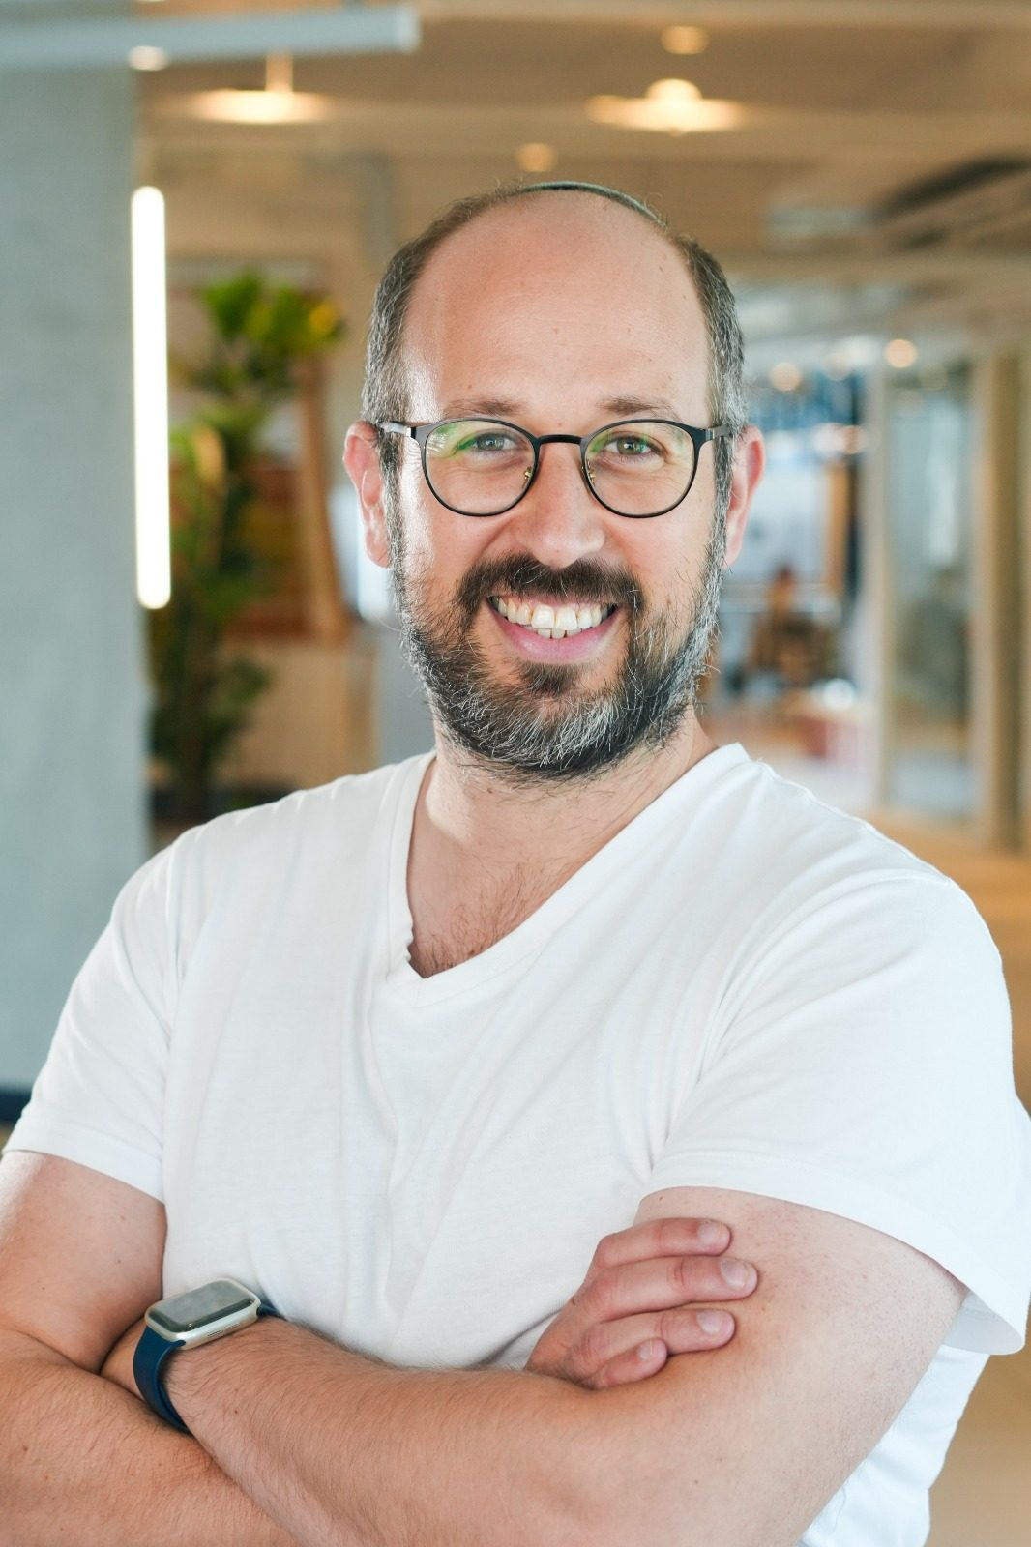
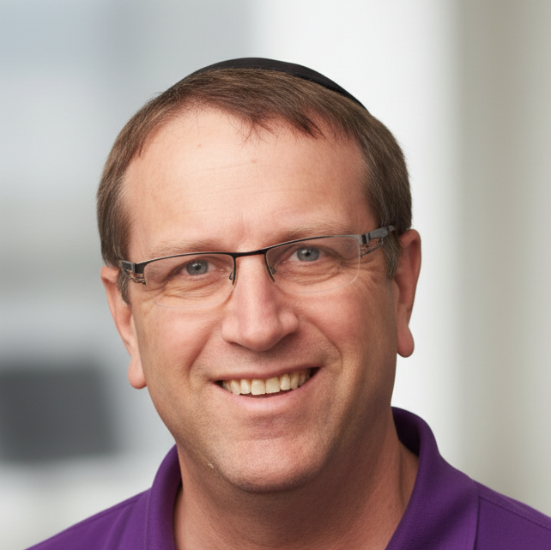
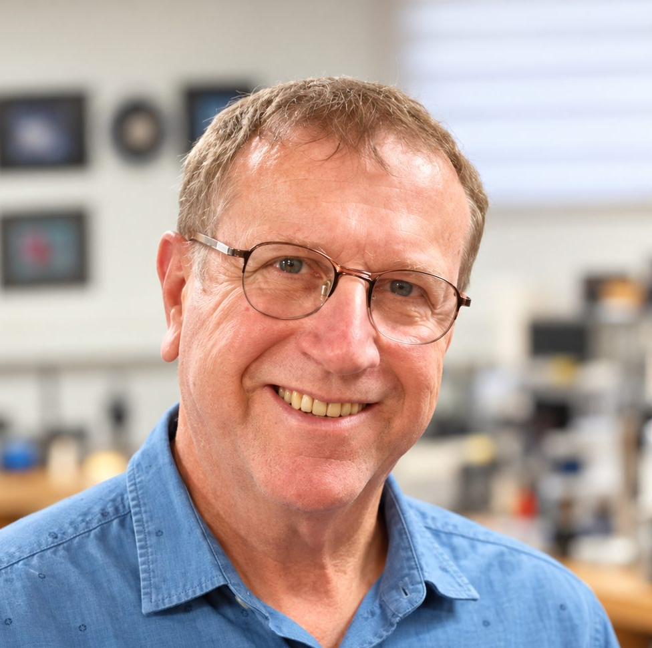
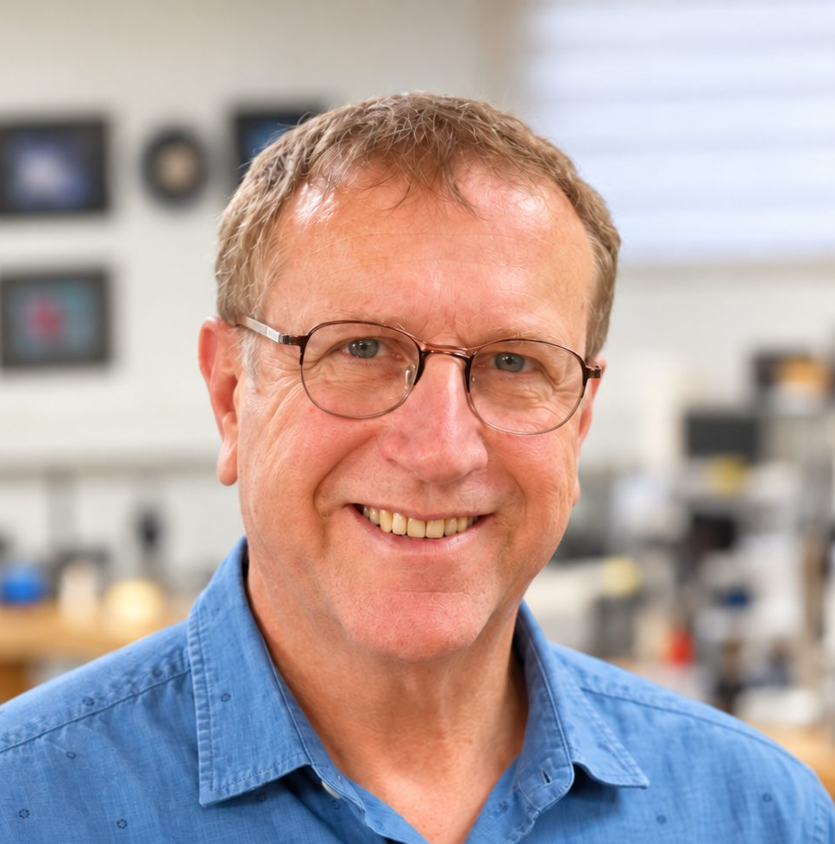











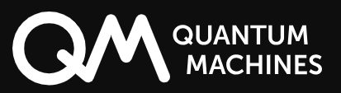


TEAM
A rare combination: four disciplines, one team.
Geoscience & Data
AI & Algorithms
Hardware & Sensors
Field Experience & Biz Dev
Yair Gordin, Ph.D.
Asaf Nebenzal, Ph.D.
Achikam Dadon
Efi Holzman
Founder & CEO
CTO
Senior Engineer
VP Growth & Partnerships
8200
Drillzy.AI · 2026
8
Notes:
Building this takes four disciplines that rarely sit in one room.
I lead geoscience and data. Asaf, our CTO, leads AI and algorithms.
Achikam leads hardware and sensors, and Efi leads field experience and business development.
Together, we cover the whole path: from the sensor on the rig to the decision on site.
TRANSITION (before click): "So where do we go from here?"

Slide 9
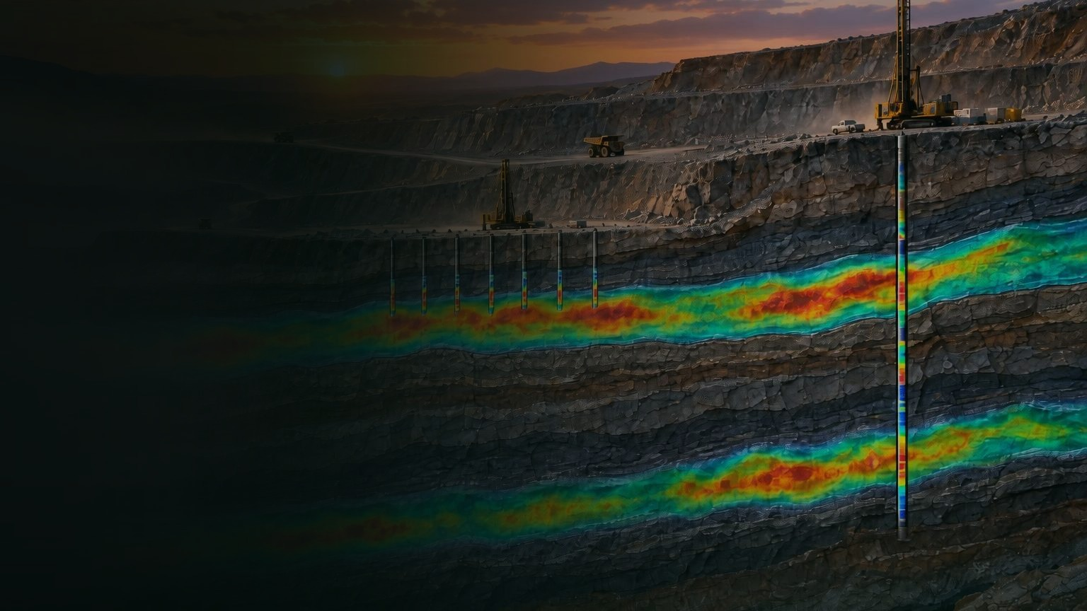
Certainty underground.
Every meter drilled improves the next decision.
WHERE WE GO
TODAY
Open-pit mines
Exploration & blast-hole drilling
NEXT
Underground mining & tunneling
where ground risk costs most
THEN
Construction, foundations & underground infrastructure
~$10T / yr construction industry¹
WE ARE LOOKING FOR
Pilot sites
Strategic partners
Investors
Yair Gordin, Ph.D. · Founder & CEO · info@drillzy.ai · drillzy.ai
1. Oxford Economics, Global Construction Futures (US$9.7T in 2022).
Notes:
Our vision: certainty underground, where every meter drilled improves the next decision.
We start with open-pit mines, in exploration and blast-hole drilling, where we already work. Next come underground mining and tunneling.
And then construction, foundations and underground infrastructure, an industry worth nearly ten trillion dollars a year.
Wherever there is a drill, there is data we can read.
We are looking for pilot sites, strategic partners, and investors who want to build this with us.
I'm Yair, this is Drillzy. Come and talk to us. Thank you.

Slide 10
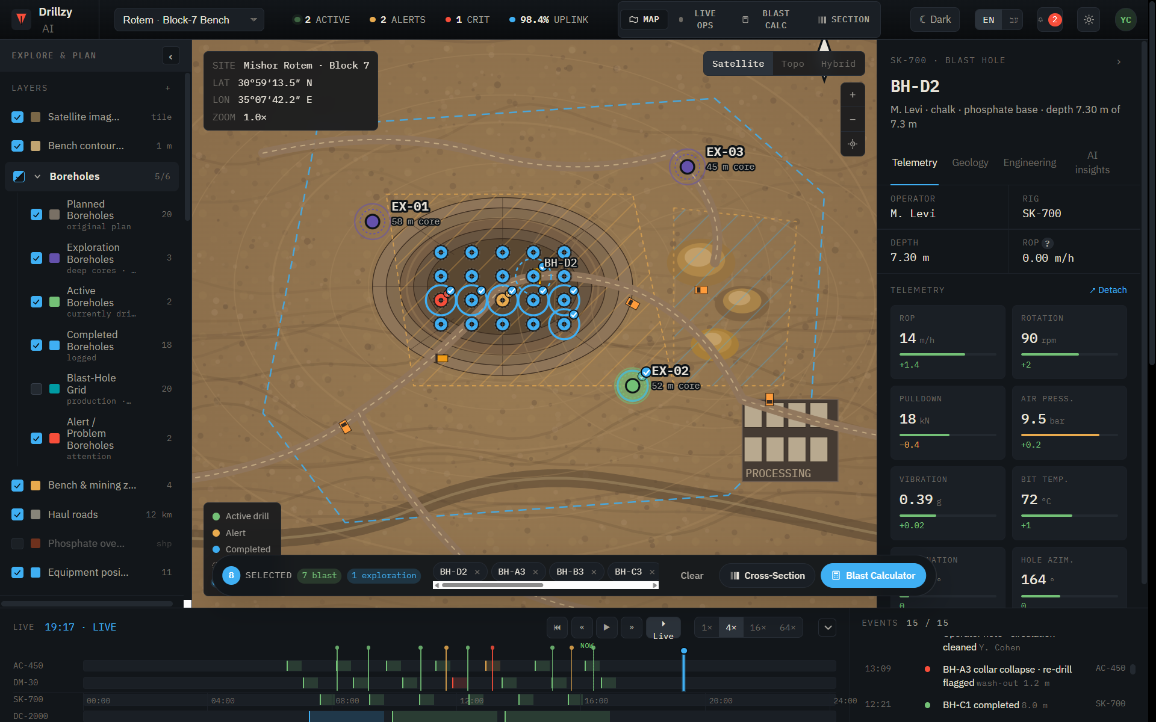
THE PLATFORM
One shared picture. Three decisions.
Product preview
Driller
Sees the ground change as it happens. Knows when to stop, and when to sample.
Operations
Every rig and every hole, against the plan.
Geology & engineering
A model that updates with every hole, and shows where to drill next.
Notes:
So what does this give the people on site? One shared picture, and three decisions. The driller sees the ground change as it happens, and knows when to stop and when to sample. The operations manager sees every rig and every hole against the plan. And the geologist and the engineer get a subsurface model that updates with every hole, showing where we are confident, and where to drill next.

Slide 11
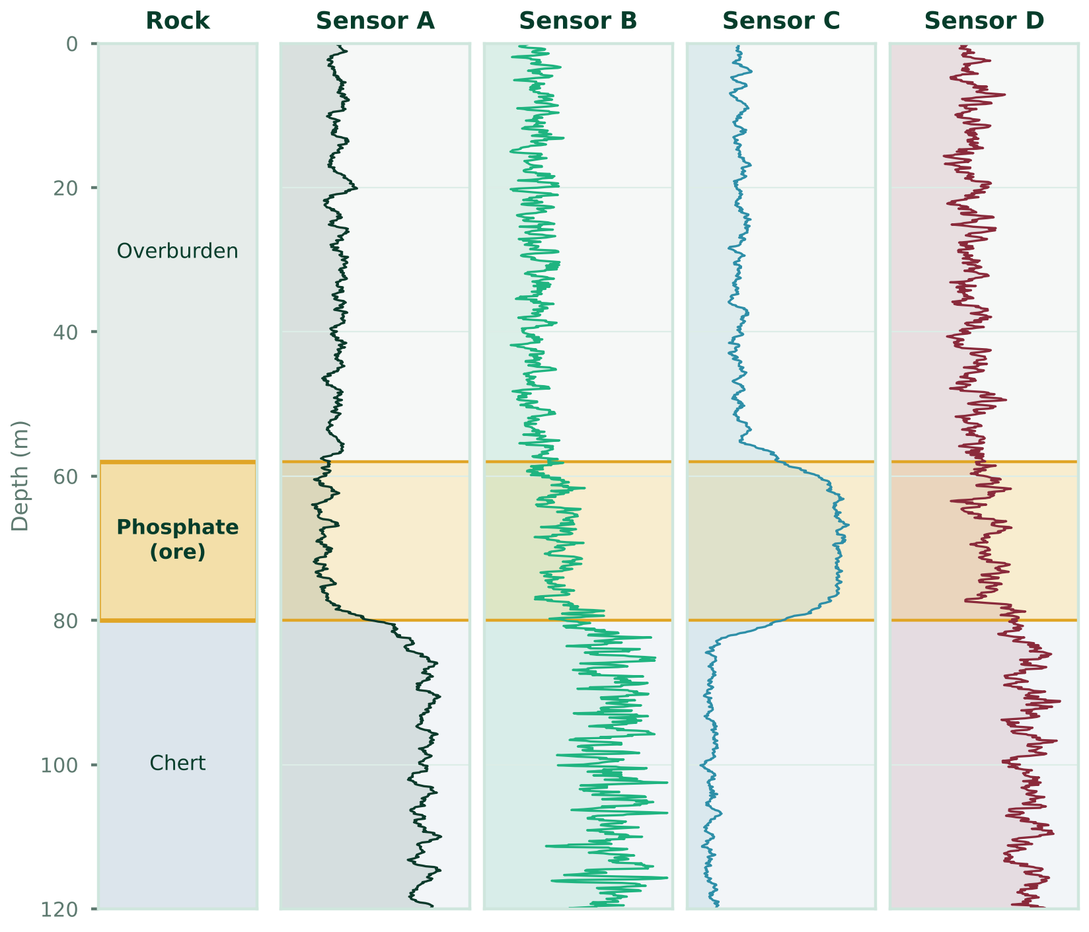

IN THE FIELD
Real rigs. Real drilling. Real data.
Dozens
boreholes, many deeper than 100 m
3
projects in representative geologies
#1
Israel's Critical Minerals competition, 2026
The Drillzy team on a working rig · open-pit mine
Illustrative example · simulated phosphate section
Any rig · vendor-agnostic
OUR DESIGN PARTNERS
Mining
Phosphate mine
Government body
Hard rock
Water utility
Aquifer
Notes:
And this is not a concept. This is our team on a working rig. Next to it, an illustrative borehole through a phosphate section, with four sensors aligned to depth. At every change in the rock, from the overburden, into the phosphate ore, and down into hard chert, the sensors shift together. That is exactly what our models learn to read. We have recorded dozens of boreholes, many deeper than a hundred meters, on three different rigs and three very different geologies. We work with our design partners: a phosphate mine, a government body working in hard rock, and a water utility. Next, we are extending to reverse-circulation and core drilling. And this year, Drillzy won first place in Israel's national Critical Minerals competition.

