Slide 1

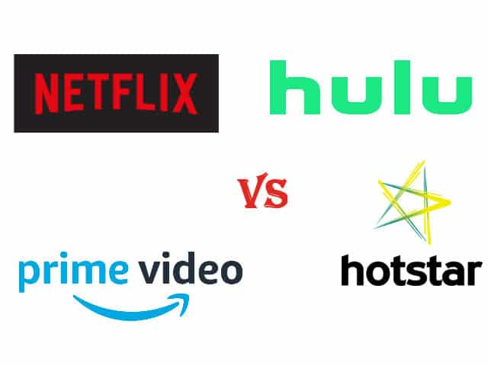
Course Title: Exploratory Data Analysis
Course Code: 21ECSC210
Project Title: EXPLORATORY DATA ANALYSIS ON OTT PLATFORMS
Group no: 9
ANIKET AMBEKAR (144)
YAJAS MENON (148)
Karthik Hiremath (154)
Sangamesh mainale (159)

Slide 2
Problem Statement:
How did COVID-19 had an impact on the growth and popularity of OTT platforms in the lockdown period.

Slide 3
Dataset Understanding:
Our data consists of 6 datasets namely:
Netflix Dataset: This dataset consists of 8807 rows x 13 columns of movie and tv shows, directors, cast, country, release year, duration, rating, listed in and description.
Amazon Prime Dataset: This dataset consists of 9668 rows x 13 columns of movie and tv shows, directors, cast, country, release year, duration, rating, listed in and description.
Disney+ Hotstar Dataset: This dataset consists of 1450 rows x 13 columns of movie and tv shows, directors, cast, country, release year, duration, rating, listed in and description.
Hulu Dataset: This dataset consists of 3073 rows x 13 columns of movie and tv shows, directors, cast, country, release year, duration, rating, listed in and description.
Movie Dataset: This dataset consists of 9515 rows x 11 columns of movies , year, age, rotten tomatoes, type and OTT platforms.
Tv show Dataset: This dataset consists of 5368 rows x 11 columns of movies , year, age, rotten tomatoes, type and OTT platforms
Revenue Dataset: This datasets consists of 40 rows X 3 columns of area, years, revenue of Netflix platform.

Slide 4
Data Preprocessing :
Netflix Dataset: This dataset consists of total 4307 null values, we dropped few unwanted columns in order to remove the null values.
Amazon Prime Dataset: This dataset consists of total 22161 null values, we dropped few unwanted columns in order to remove the null values.
Disney+ Hotstar Dataset: This dataset consists of total 888 null values, we dropped few unwanted columns in order to remove the null values.
Hulu Dataset: This dataset consists of total 8627 null values, we dropped few unwanted columns in order to remove the null values.
Movies Dataset: This dataset consists of total 4184 null values, replaced the null values by mode of the attribute in order to remove the null values.
Tv shows Dataset: This dataset consists of total 3089 null values, replaced the null values by mode of the attribute in order to remove the null values.
Revenue Dataset: This dataset consists of zero null values.

Slide 5
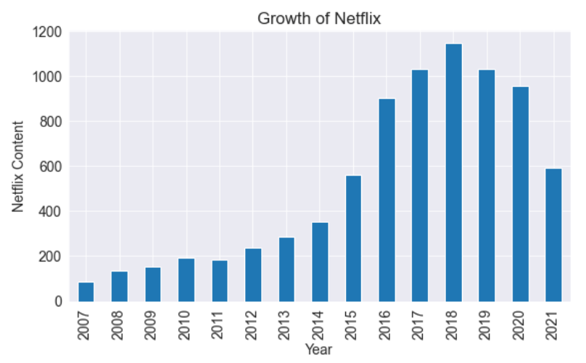
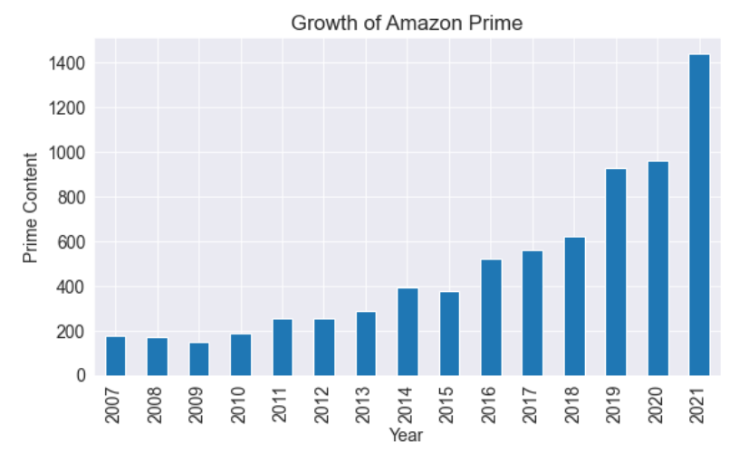
Q1. Growth of OTT Platforms year wise
Figure 1a Total no. of content present in Netflix over the years.
Figure 1b Total no. of content present in Amazon Prime over the years.

Slide 6
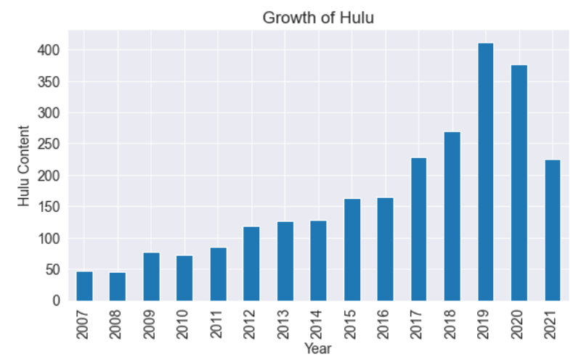
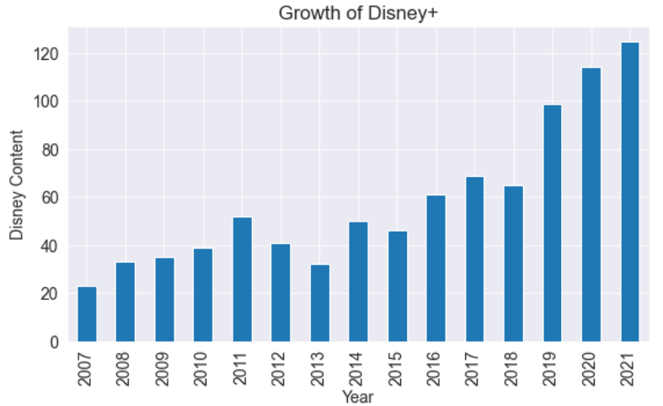
Figure 1c Total no. of content present in Hulu over the years.
Figure 1d Total no. of content present in Disney+ hotstar over the years.

Slide 7
Inference:
Figure 1a says that Netflix in the year 2020 content decreased because of lack of new movies and tv shows.
Figure 1b says Amazon prime in the year 2020 content got increased as they added existing movies and tv shows.
Figure 1c says that Hulu content in the year 2020 decreased because of lack of movies and tv shows.
Figure 1d says Disney + Hotstar in the year 2020 content got increased as they added existing movies and tv shows.

Slide 8
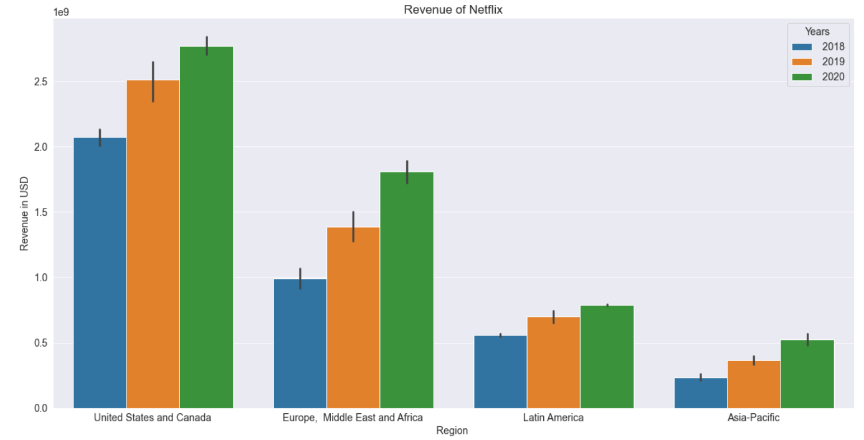
2. Revenue of Netflix over the years.
Inference:
From figure 2 revenue of Netflix has increased in all regions, comparing the revenue of the year 2018 and 2019.
Figure 2 Revenue of Netflix in 2018, 2019 and 2020

Slide 9
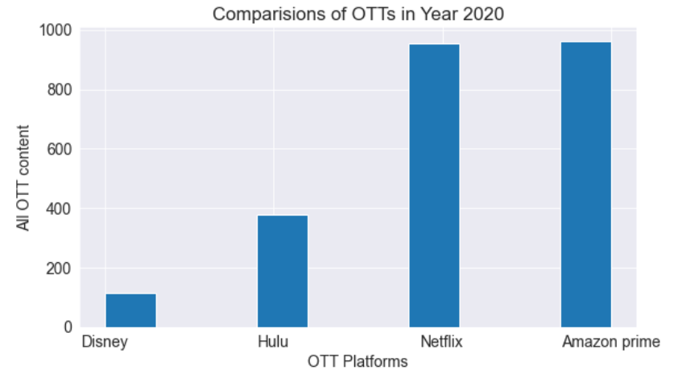
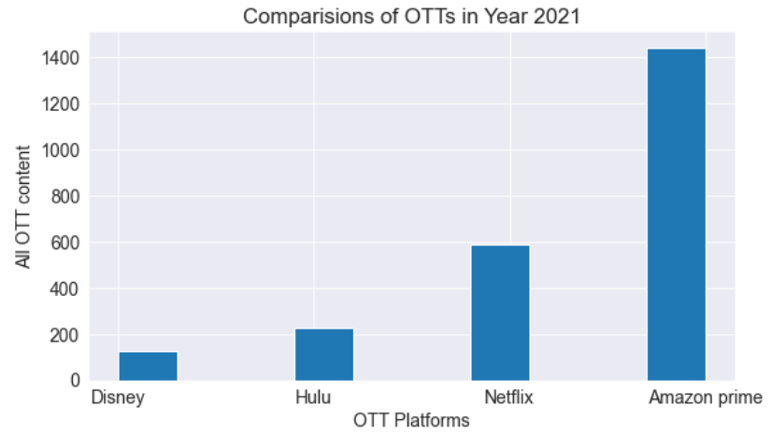
3. No. of Content produced by OTT platforms in the year 2020 and 2021
Figure 3.1 No. of content in different OTT platforms in year 2020.
Figure 3.2 No. of content in different OTT platforms in year 2021.

Slide 10
Inference:
Figure 3.1 shows the number of movies and tv shows present in each OTT platform in the year 2020.
Figure 3.2 shows the number of movies and tv shows present in each OTT platform in the year 2021.

Slide 11
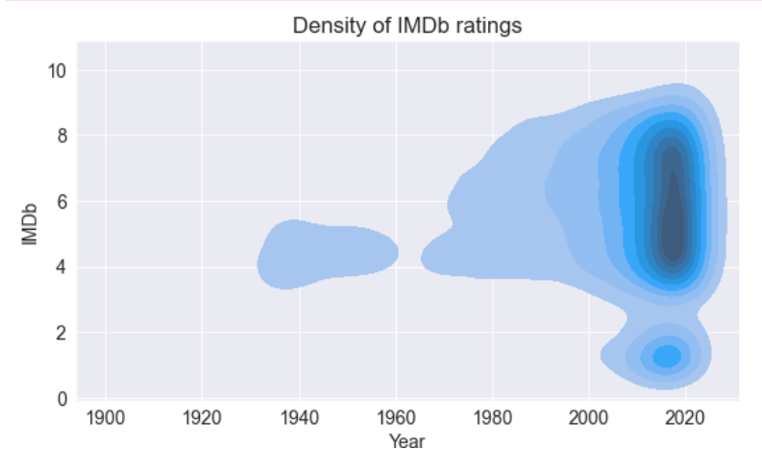
4. Impact of COVID-19 on IMDb ratings
Inference:
Figure 4 shows that how density of IMDb ratings is high near the year of 2020.
It also says that people watched more number of movies and tv shows and rated them in the year 2020.
Figure 4 Density of IMDb ratings over the years.

Slide 12
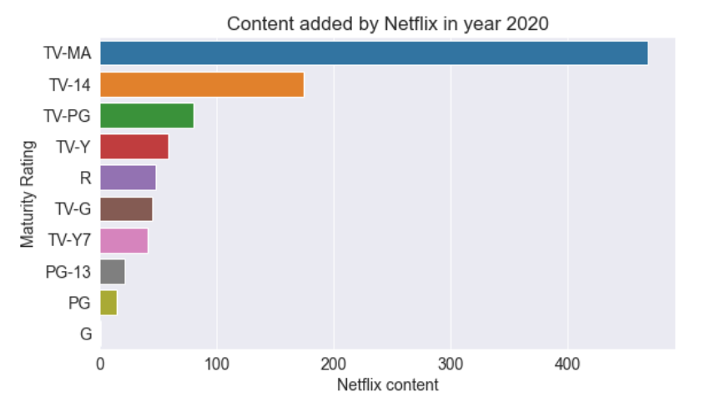
5. Type of Content that are added by Netflix in the year 2020
Inference:
Figure 5 says that what are movies and content added by Netflix based on the maturity ratings. TV-MA content is added the highest amongst all.
Figure 5 Type content released by Netflix in the year 2020.

Slide 13
Conclusions:
By this data analysis we can conclude that the growth of OTT platforms as been increased during the COVID-19 lockdown phase.
All age groups have watched movies and tv shows on OTT platforms.
Netflix and Amazon Prime has grown more among all the OTT platforms in terms of content added.
As people had free time, people started to watch movies and tv shows and also give them ratings, resulting in the increase of IMDb ratings count.
The number of content added by each OTT platforms in the year 2020 and 2021, in which Amazon Prime has added more content compared to all other platform.
As Netflix is more popular among the OTT platforms, so the content added by Netflix in year 2020 is of TV-MA maturity rating.

Slide 14
Thank You

