Slide 1

COURSE TITLE: EXPLORATORY DATA ANALYSIS
COURSE CODE: 21ECSC210
PROJECT TITLE: ANALYSIS ON OTT PLATFORMS
Group no: 9
ANIKET AMBEKAR 01fe20bcs044 144
YAJAS MENON 01fe20bcs048 148
Karthik Hiremath 01fe20bcs055 154
Sangamesh Mainale 01fe20bcs060 159

Slide 2
Contents
Problem Statement
Domain Understanding
Dataset Details
Data Pre-processing
Questions and Analysis
Conclusions

Slide 3
Problem Statement:
Analysis of the Covid 19 Pandemic on the OTT Platform

Slide 4
Domain Understanding:
Over-the-Top (OTT) video platforms, once considered a luxury is today a commodity. In India, there is an increasingly growing number of consumers adapting to it. While Indian streaming services like Hotstar and Jio Cinema has gained a stronger foothold, global players like Netflix and Amazon Prime have steadily grown their market share in India. This paper explores the emergence, advantage, and future of streaming service in India through analytical research. We also present the various OTT services, their growth factors, technology background, audience characteristics, content, censorship and future developments expected in the industry.

Slide 5
Dataset Details:
Our data consists of 6 datasets namely:
Netflix Dataset: This dataset consists of 8807 rows x 13 columns of movie and tv shows, directors, cast, country, release year, duration, rating, listed in, and description.
Amazon Prime Dataset: This dataset consists of 9668 rows x 13 columns of movie and tv shows, directors, cast, country, release year, duration, rating, listed in, and description.
Disney+ Hotstar Dataset: This dataset consists of 1450 rows x 13 columns of movie and tv shows, directors, cast, country, release year, duration, rating, listed in and description.
Hulu Dataset: This dataset consists of 3073 rows x 13 columns of movie and tv shows, directors, cast, country, release year, duration, rating, listed in, and description.
Movie Dataset: This dataset consists of 9515 rows x 11 columns of movies, year, age, rotten tomatoes, type, and OTT platforms.
Tv show Dataset: This dataset consists of 5368 rows x 11 columns of TVs, year, age, rotten tomatoes, type, and OTT platforms
Revenue Dataset: This dataset consists of 40 rows X 3 columns of area, years, and revenue of the Netflix platform.

Slide 6
Attributes:
Attribute Name | Description | Type of Data
Type | Movie or Tv show | Categorical Data
Title | Title of the content | Nominal Data
Release year, Year | Year in which the content was released | Ordinal Data
Listed in | Genre of the content | Nominal Data
Ott | Name of the Ott platform | Categorical Data
Age | Age group | Categorical Data
IMDb | IMDb ratings of content | Discrete Data
Rotten Tomatoes | Rotten Tomatoes ratings of content | Discrete Data
Area | Area /Region | Categorical Data
Years | Year in which revenue is collected | Ordinal Data
Revenue | Revenue of Netflix | Discrete Data

Slide 7
Data Preprocessing:
Netflix Dataset: This dataset consists of a total of 4307 null values, we dropped a few unwanted columns in order to remove the null values.
Amazon Prime Dataset: This dataset consists of a total of 22161 null values, we dropped a few unwanted columns in order to remove the null values.
Disney+ Hotstar Dataset: This dataset consists of a total of 888 null values, we dropped a few unwanted columns in order to remove the null values.
Hulu Dataset: This dataset consists of a total of 8627 null values, we dropped a few unwanted columns in order to remove the null values.
Movies Dataset: This dataset consists of a total of 4184 null values, and replaced the null values by mode of the attribute in order to remove the null values.
Tv shows Dataset: This dataset consists of a total of 3089 null values, and replaced the null values by mode of the attribute in order to remove the null values.
Revenue Dataset: This dataset consists of zero null values.

Slide 8
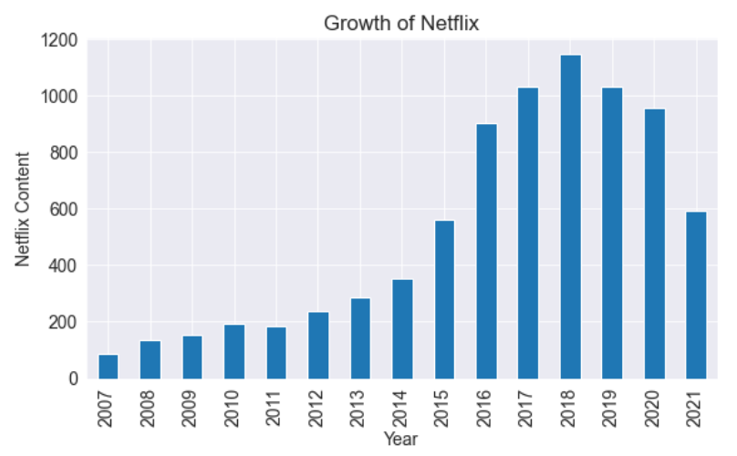
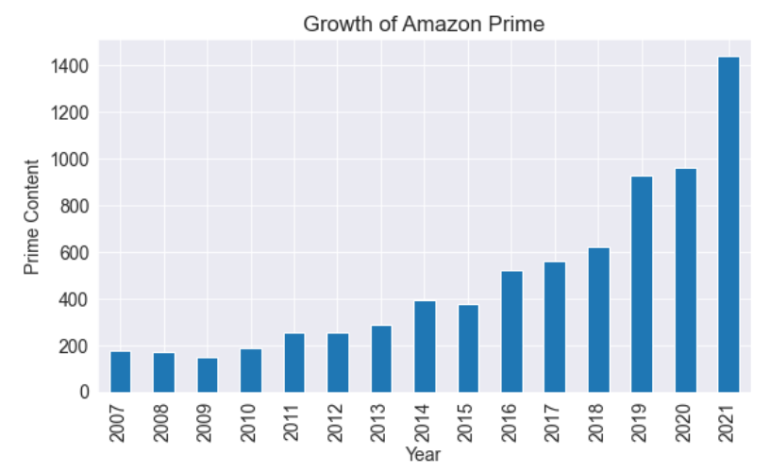
Questions and Analysis:
1. Growth of OTT Platforms year wise
Figure 1.a:Total no. of content present in Netflix over the years.
Figure 1.b: Total no. of content present in Amazon Prime over the years.

Slide 9
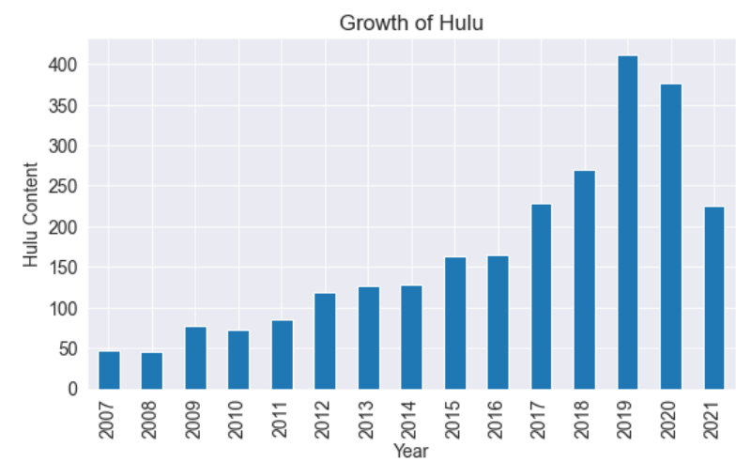
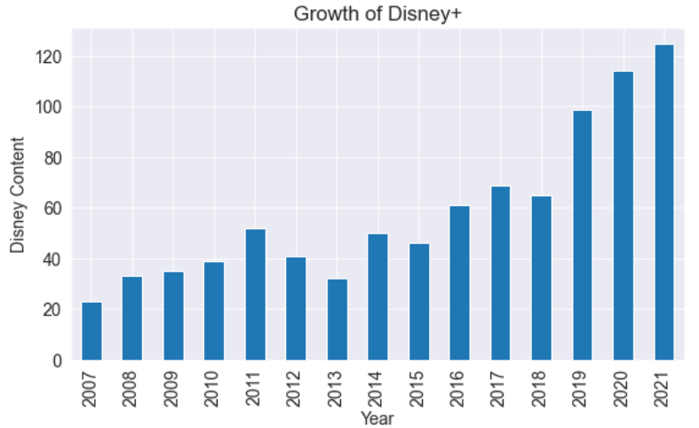
Figure 1.c: Total no. of content present in Hulu over the years.
Figure 1.d: Total no. of content present in Disney+ Hotstar over the years.

Slide 10
Inference:
Figure 1a says that Netflix in the year 2020 content decreased because of lack of new movies and tv shows.
Figure 1b says Amazon prime in the year 2020 content got increased as they added existing movies and tv shows.
Figure 1c says that Hulu content in the year 2020 decreased because of lack of movies and tv shows.
Figure 1d says Disney + Hotstar in the year 2020 content got increased as they added existing movies and tv shows.

Slide 11
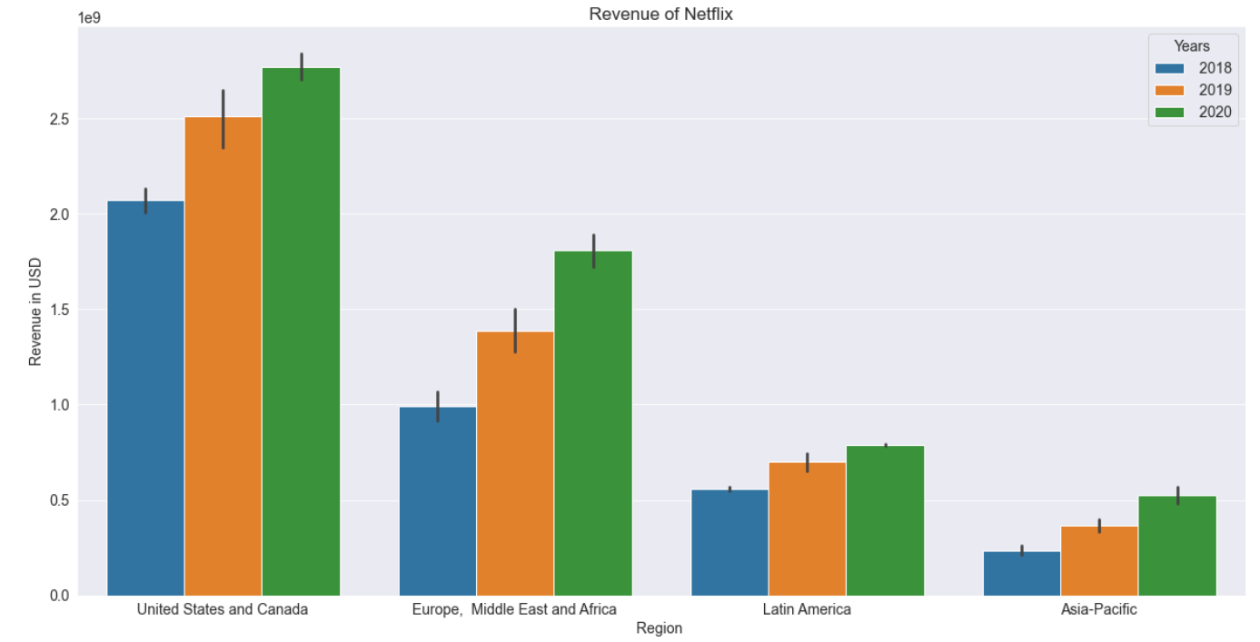
2. Revenue of Netflix over the years.
Inference:
From figure 2 revenue of Netflix has increased in all regions, comparing the revenue of the year 2018 and 2019.
Figure 2: Revenue of Netflix in 2018, 2019 and 2020

Slide 12
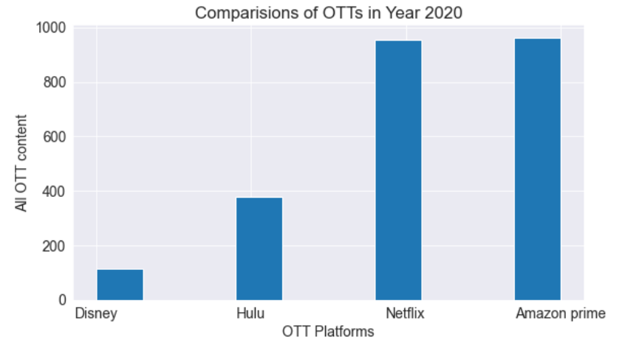
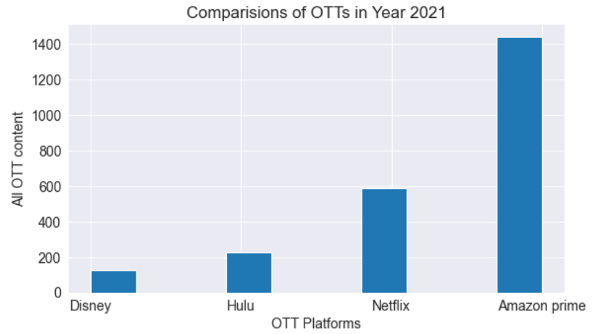
3. No. of Content produced by OTT platforms in the years 2020 and 2021
Figure 3.a: No. of content in different OTT platforms in the year 2020.
Figure 3.b: No. of content in different OTT platforms in the year 2021.

Slide 13
Inference:
Figure 3.a shows the number of movies and tv shows present on each OTT platform in the year 2020.
Figure 3.b shows the number of movies and tv shows present on each OTT platform in the year 2021.

Slide 14
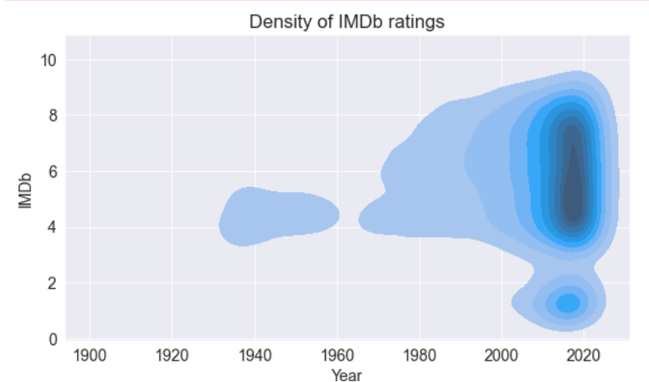
4. Impact of COVID-19 on IMDb ratings
Inference:
Figure 4 shows how the density of IMDb ratings is high near the year 2020.
It also says that people watched more number of movies and tv shows and rated them in the year 2020.
Figure 4 Density of IMDb ratings over the years.

Slide 15
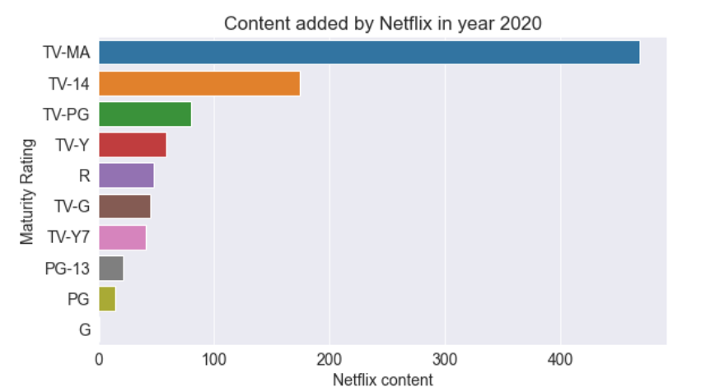
5. Type of Content that are added by Netflix in the year 2020
Inference:
Figure 5 says that what are movies and content added by Netflix based on the maturity ratings. TV-MA content is added the highest amongst all.
Figure 5 Type content released by Netflix in the year 2020.

Slide 16
Conclusions:
By this data analysis we can conclude that the growth of OTT platforms as been increased during the COVID-19 lockdown phase.
All age groups have watched movies and tv shows on OTT platforms.
Netflix and Amazon Prime has grown more among all the OTT platforms in terms of content added.
As people had free time, people started to watch movies and tv shows and also give them ratings, resulting in the increase of IMDb ratings count.
The number of content added by each OTT platforms in the year 2020 and 2021, in which Amazon Prime has added more content compared to all other platform.
As Netflix is more popular among the OTT platforms, so the content added by Netflix in year 2020 is of TV-MA maturity rating.

Slide 17
Thank You

