Slide 1
GraphModi
Updating graph language models in multi-turn dialogue
Team Hansraj: Prasoon Dev, Yajat Lakhanpal, Hrishiraj Mitra, Arihant Rastogi
ANLP project, IIIT Hyderabad
Notes:
GraphModi asks: what happens to a graph language model when the graph changes mid-conversation?

Slide 2
Motivation: the graph is always static
Prior work answers questions about a graph that is handed over once and never changes
Graphs as text
Soft graph tokens
Evaluations
Talk-like-a-graph and the NLGraph benchmark serialise a fixed graph into the prompt. Accuracy depends on the encoding and is brittle to spurious correlations, but the graph itself never changes.
GraphToken, TEA-GLM, G-Retriever and Graph Language Models pass a GNN encoding of one graph to a frozen or lightly tuned LLM. Each query gets a graph supplied once, and the tokens are computed once.
CLEGR and soft-prompt studies ask whether the model really uses the graph, yet still on a fixed graph. Dynamic-graph QA and knowledge-editing work (DyGraphQA, MQuAKE) describe changes in text or in model weights, not in graph tokens.
No benchmark exists for this setting: none defines how a natural-language revision should change the graph a GLM encodes, or scores answers turn by turn as the graph evolves. Our main contribution is that multi-turn benchmark, with GraphModi as the first system evaluated on it.
2
Notes:
Every one of the surveyed works evaluates QA against a graph supplied once per query. Our controls borrow from them: text-serialised history, soft prompt, and shuffled graph from CLEGR.

Slide 3
The problem: graph tokens go stale
GLMs encode the graph once; users keep revising it
1 Static GLM
2 User revises
3 Stale answer
A GNN encodes the graph G0 into soft tokens that a frozen LLM attends to. This works well as long as the graph never changes during the conversation.
A transit user says "Station X is closed now" or corrects an earlier connection. The tokens computed before the message still describe the old network.
Any question whose answer depends on the revision, such as whether two stations are still reachable, gets the pre-revision answer.
Task: keep the graph state correct across turns and answer about the current graph, with the LLM never reading the revision text.
Two skills to test separately: WRITE (revision -> graph change) and READ (answer from re-encoded tokens).
3
Notes:
Writing and reading are scored separately, which is what existing GLM evaluations do not do.

Slide 4
Research questions and contributions
1
RQ1 Write
Contributions
Can a frozen LLM emit executable edit programs from a few-shot prompt? What do its errors cost?
Main: a multi-turn benchmark for graph language models. Sessions of revision plus question, 4,455 turns per split, crossing graph size, density, session length and task, with 41% of test turns changing the answer.
A formulation with an edit language and executor that separates write accuracy from read accuracy, plus paired conditions isolating stale tokens, text history and graph-blind controls.
GraphModi, a first system on the benchmark, and evidence on where stale tokens hurt: turns where the edit changes the answer.
2
RQ2 Read
Does re-encoding beat stale G0 tokens and text-history controls as turns accumulate?
3
RQ3 Graph use
Do graph tokens carry information beyond graph-blind baselines?
4

Slide 5
Method: edit, execute, re-encode, answer
Explicit graph state; the QA call never sees the revision
Revision r_t
Edit program
Executor
GNN encoder
Projector
Frozen Llama-3.1-8B
natural language
>
few-shot frozen Llama
SET NODE / ADD / DEL EDGE / NOOP
>
G_t = Apply(G_t-1, P_t)
invalid ops skipped
>
BERT-768 features
GraphSAGE 3 layers
>
task-conditional readout
10 x 4096 tokens
>
tokens + question
-> answer
WRITE PATH (navy)
READ PATH (teal)
The write path turns each revision into at most three typed operations; an invalid operation is skipped, so an edit error persists into every later turn. The read path re-encodes the updated graph at each turn.
Training uses static QA and before/after counterfactual pairs only (5 epochs, AdamW lr 1e-3, batch 24, seed 42) with Llama frozen. As in CLEGR, the queried node text is appended to the question, but station status is withheld from it.
5
Notes:
Edit accuracy is the fraction of turns where applying the predicted program yields the same graph as the gold program. An edit error persists into later turns.

Slide 6
Our benchmark: multi-turn metro sessions
The graph changes between questions; seed 42, balanced, leak-audited
4,455
41%
11 / 9
12-22
turns per split
(1,188 sessions)
test turns where the
edit changes the answer
static / multi-turn
task families
stations per graph,
3 densities
The grid crosses 11 graph sizes x session lengths {1, 2, 4, 8} x 3 densities (mean degree 2.8 / 3.8 / 5.0) x 9 tasks, so every session length and density is covered evenly.
Yes/no answers 50/50 within every prompt-visible stratum; 37% of test turns are NOOP.
Tasks: reachability, constrained reachability, edge existence, cycle membership, degree, neighbour counts, shortest path, within-hops count, most-common attribute.
6

Slide 7
Paired conditions isolate what helps
Every condition runs on the same sessions, so differences come from the inputs alone
Re-encoded graph
Stale graph
Wrong graph
oracle_updated_graph encodes the gold graph G_t afresh every turn. It is the upper bound for re-encoding because no edit error enters.
structure_only and frozen_graph_history keep the tokens of the initial graph G0; the second also adds the revision history as text.
shuffled_graph gives tokens of another session's graph: the right format with the wrong content. It tests whether tokens encode this session.
Graph-blind text
Soft prompt
References
question_only and token_matched_history use no graph tokens; graph_once_then_text gives G0 tokens only on the first turn, then text.
A learned prompt with no GNN that reads the accumulated revision history. It can answer many questions directly from the edits.
The stale answer (59.3%) ignores edits and is not a competitor. The per-task majority answer scores 29.4%.
7
Notes:
Shuffled graph tests that tokens encode this session graph. Stale answer is the pre-edit answer, returned with no model.

Slide 8
GraphModi matches the oracle graph
TEA-style, multi-turn test accuracy (%), single seed
Tokens encode this graph
GraphModi and the oracle graph beat a shuffled graph by about 5 points.
Not beyond soft prompt
GraphModi is +0.7 pts above it (oracle +0.9, CI [-0.8, +2.6]). The soft prompt reads the revision text.
8
Notes:
Reference lines: stale-answer baseline 59.3% (ignores edits), per-task majority 29.4%. Static QA test: TEA 36.3, soft prompt 32.8, majority 28.9.

Slide 9
Stale tokens hurt where the edit matters
GraphModi with its own edits matches the oracle graph and beats stale tokens by about 4.5 points on answer-changing turns; on unchanged turns they match. The session-length decline appears on test only, not validation.
9
Notes:
Re-encoded accuracy is the same on changed and unchanged turns, which is what a model reading the current graph should show.

Slide 10
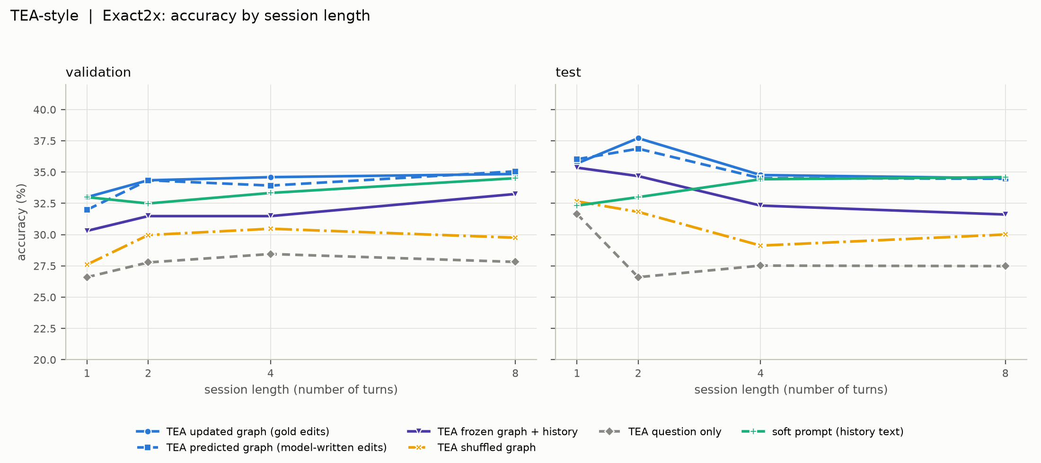
Write path: predicted edits cost little
RQ1: frozen Llama, few-shot prompt, greedy decoding
88.6%
test turns where predicted edits
reproduce the gold graph state
95.2%
turns with an
execution-equivalent edit
34.9 vs 35.1
Accuracy by session length (report figure 1). Revisions are templated, so edit accuracy overstates free-form performance.
TEA accuracy, predicted
vs gold edits (test)
10
Notes:
Run on the benchmark after the mid-project report. The second model reports 37.6 with predicted edits vs 37.9 with oracle edits.

Slide 11
Scope of the evidence
What the results do and do not show
Single seed
Templated revisions
All results use seed 42. An identical recipe varies by about 3-4 points between runs, so small gaps between models or conditions are not interpretable on their own.
Node edits use one template and edge edits are the edit command itself, so write-path accuracy likely overstates performance on free-form revisions.
The soft prompt reads the revision text, so we do not claim graph tokens beat a text channel. The evidence for graph use comes from the shuffled-graph and stale-token controls.
11
Notes:
Scope of the claims.

Slide 12
Takeaways
What we can claim
What we cannot claim yet
Stale tokens are worse exactly on answer-changing turns, and re-encoding recovers about 5 points there.
The tokens encode the specific graph: the correct graph beats a shuffled one by about 5 points.
The write path is not the bottleneck: model-written edits cost almost nothing.
The read path is: absolute accuracy is about 35% and count tasks stay below 20%.
That graph tokens beat a text channel that sees the revision history (+0.9 points, not significant).
Any model-vs-model ranking, since single-seed gaps of 3-4 points are within run variance.
That edit accuracy carries over to free-form revisions, because ours are templated.
Notes:
Read path is the bottleneck: about 35% absolute accuracy, count tasks under 20%.

